Slide 1
PDCWG Report to ROS
Chair: Chad Mulholland, NRG
Vice Chair: Jimmy Jackson, CPS
ROS
January 9th, 2020

Slide 2
Report Overview & Notes
Report Overview
  Meeting Minutes
  BAL-001-TRE-1 FMEs & IMFR
    1 FMEs in the month of November
  Frequency Control Report

Slide 3
Meeting Minutes
PDCWG Meeting 12/11/19
  Southern Cross DC Tie – Directive 3, DC Tie Ramping Limits
    Conceptual summary: If Real-Time conditions show insufficient ramp capability, taking into account the full ramping capability of all available Resources and preserving sufficient PRC to avoid EEA, ERCOT may request one or more e-Tags be modified
    PDCWG to review ERCOT white paper with Protocol language proposal in January 2020
  ERCOT Interconnection Inertia Analysis
    Interconnection Inertia trends are best described as “roughly consistent and flat” from 2013 through the end of 2019 (graph on next slide)
  PDCWG 2020 Leadership Nominations
    2019 Leaders Re-nominated: Chair – Chad Mulholland, NRG; Vice Chair – Jimmy Jackson, CPS
  Regulation & Frequency Control Reports

Slide 4
ERCOT Inertia 2013-2019
Date and Time | 2013 3/10/13 3:00 AM | 2014 3/30/14 3:00 AM | 2015 11/25/15 2:00 AM | 2016 4/10/16 2:00 AM | 2017 10/27/17 4:00 AM | 2018 11/03/18 3:30 AM | 2019(Jan-Dec) 3/27/2019 1:00 AM
Min synch. Inertia (GW*s) | 132 | 135 | 152 | 143 | 130 | 128.8 | 134.5
System load at minimum synch. Inertia (MW) | 24,726 | 24,540 | 27,190 | 27,831 | 28,425 | 28,397 | 29,883
Non-synch. Gen. in % of System Load | 31 | 34 | 42 | 47 | 54 | 53 | 50
Notes:
For each box, the central mark (red line) is the median, the edges of the box (in blue) are the 25th and 75th percentiles, the whiskers correspond to +/- 2.7 sigma (i.e., represent 99.3% coverage, assuming the data are normally distributed. The corresponding lowest inertia in each year is given in the table.
The circle on each boxplot is showing inertia during time when highest portion of load was served by wind generation in that year. In 2019 it was on November 26 3:52 am, 57.87%.

Slide 5
Frequency Measurable Events Performance

Slide 6
Frequency Measurable Events
There was 1 FME in November
  11/18/2019 16:20:36
    Loss of 466 MW
    Interconnection Frequency Response: 728.5 MW/0.1 Hz
    8 of 36 Evaluated Generation Resources had less than 75% of their expected Initial Primary Frequency Response.
    8 of 36 Evaluated Generation Resources had less than 75% of their expected Sustained Primary Frequency Response.

Slide 7
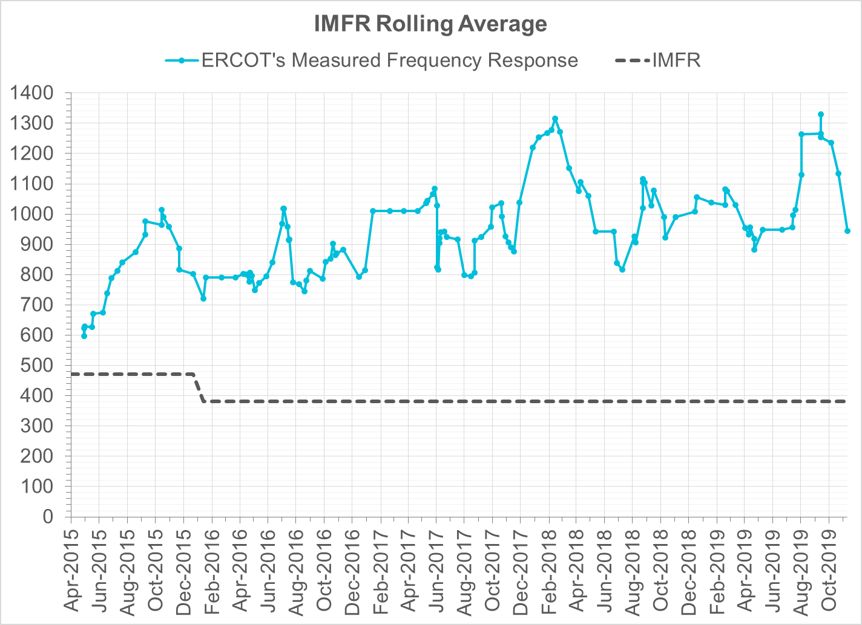
Interconnection Minimum Frequency Response (IMFR) Performance
IMFR Performance currently 944.69 MW/0.1Hz
Frequency Response Obligation (FRO): 381 MW/0.1 Hz

Slide 8
Frequency Control Report
November 2019

Slide 9

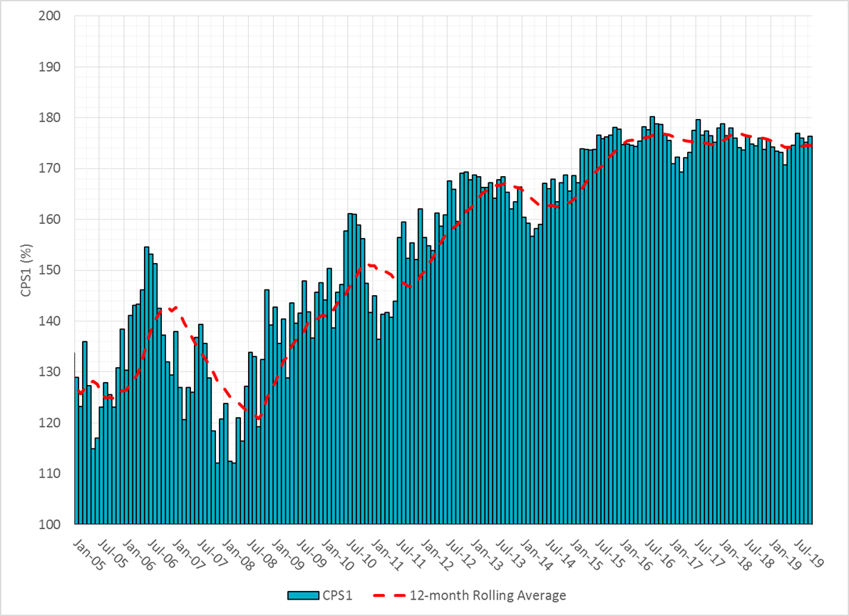
CPS1 Performance

Slide 10
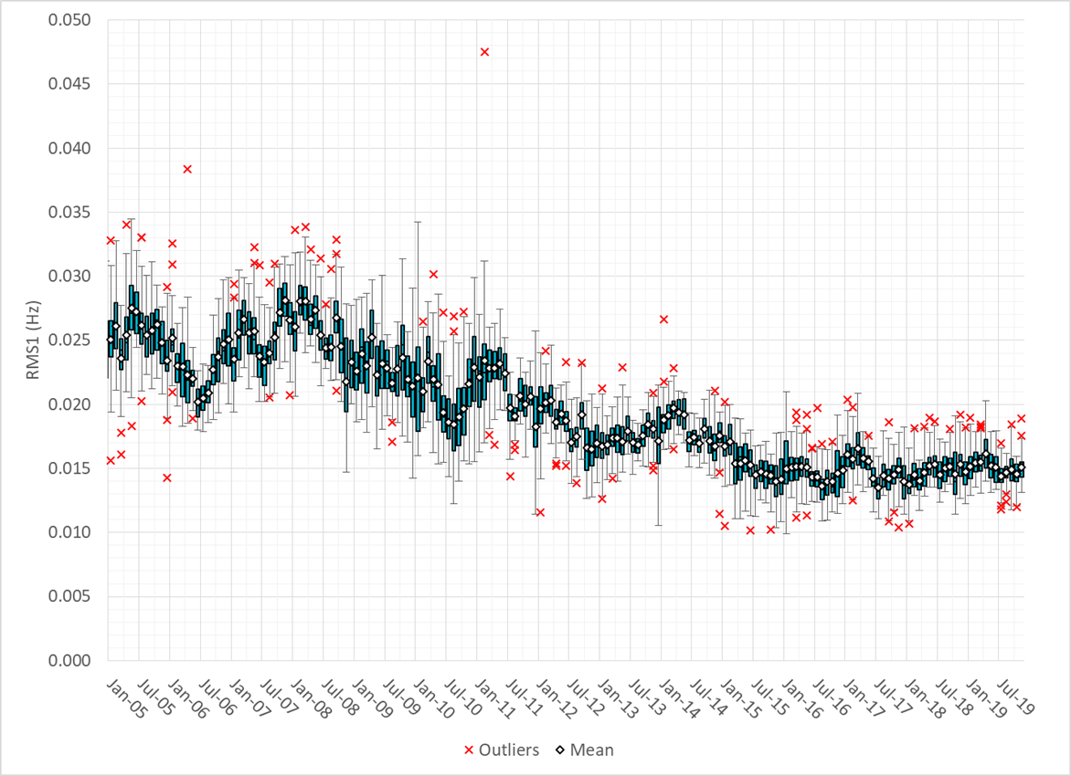
RMS1 Performance of ERCOT Frequency

Slide 11
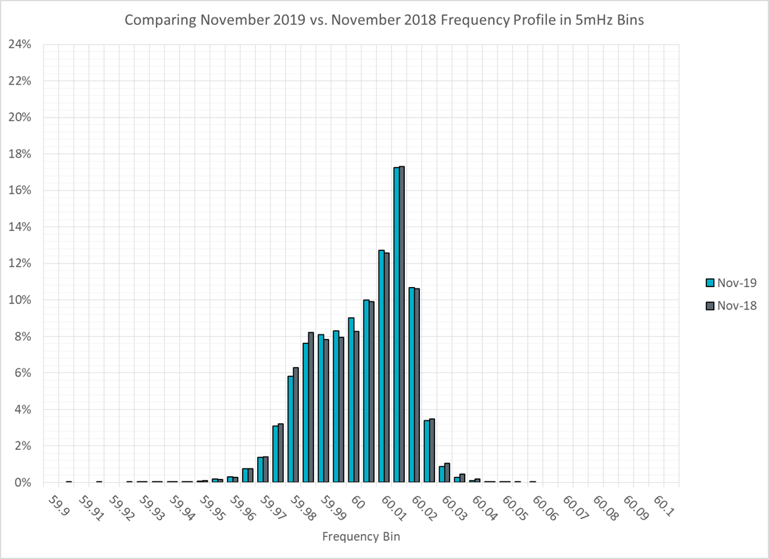
Frequency Profile Analysis

Slide 12
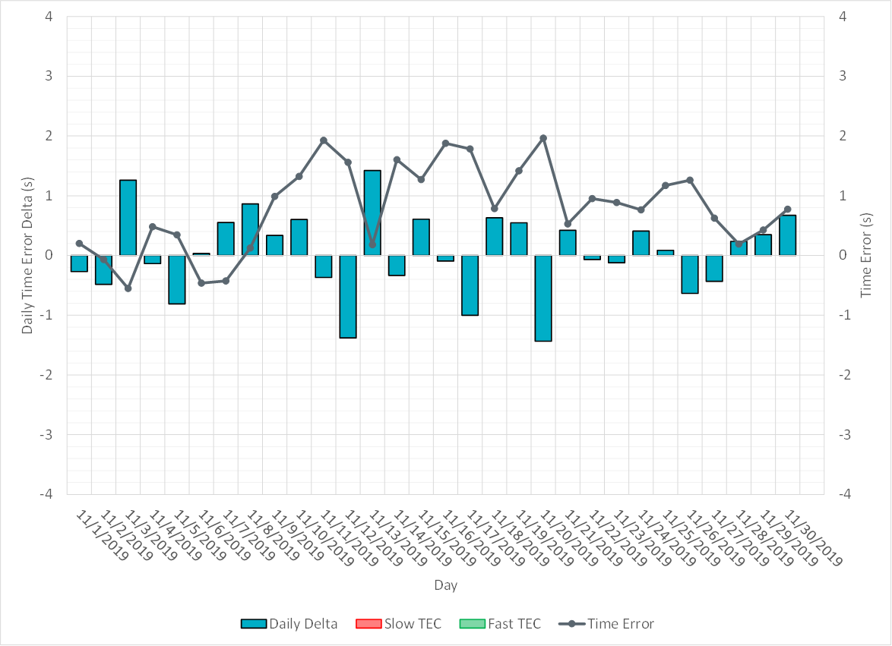
Time Error Corrections

Slide 13
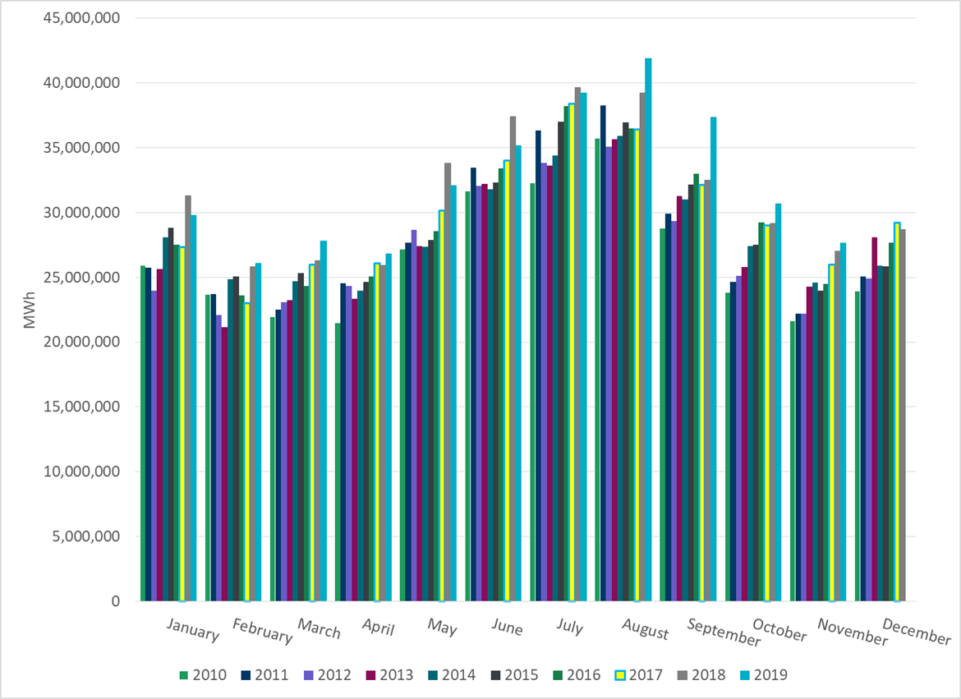
ERCOT Total Energy

Slide 14
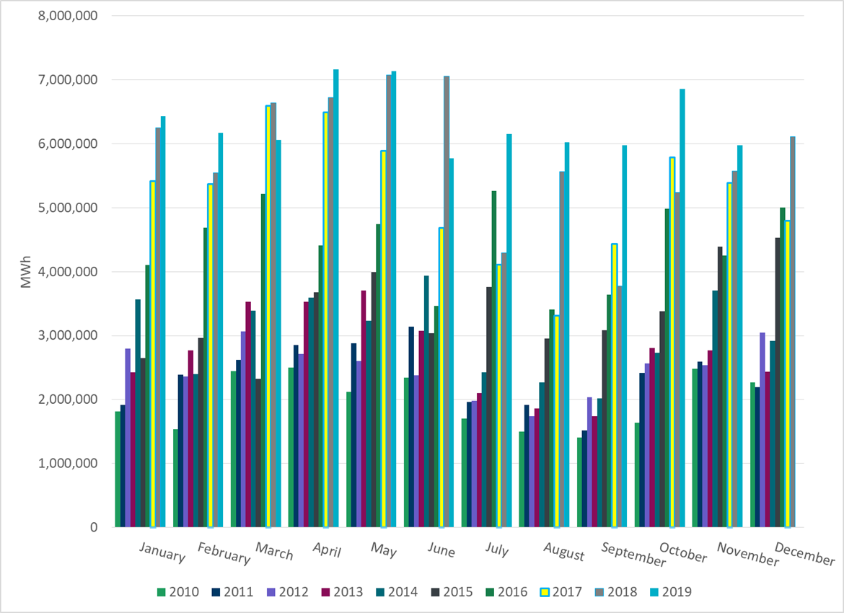
ERCOT Total Energy from Wind Generation

Slide 15
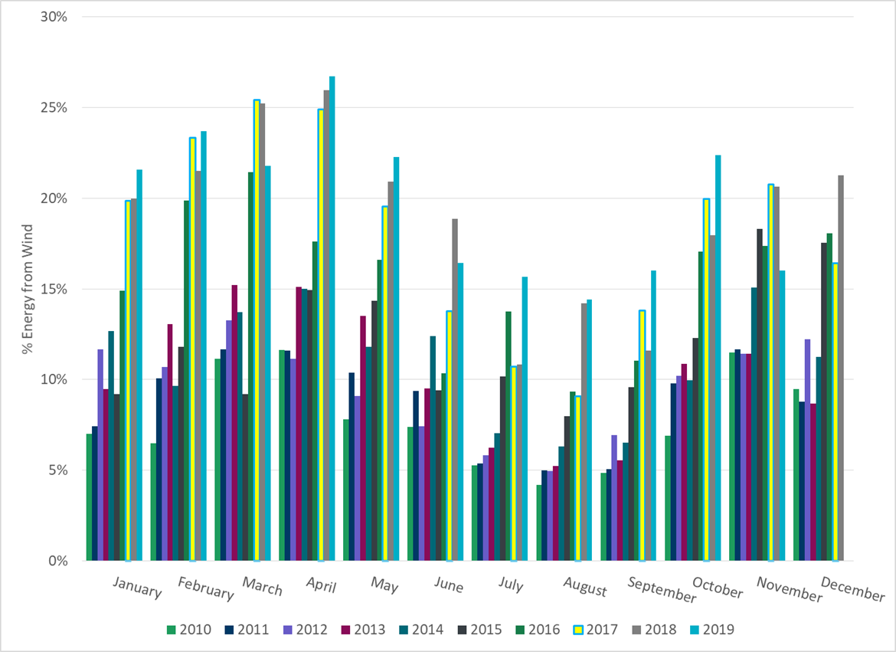
ERCOT % Energy from Wind Generation

Slide 16
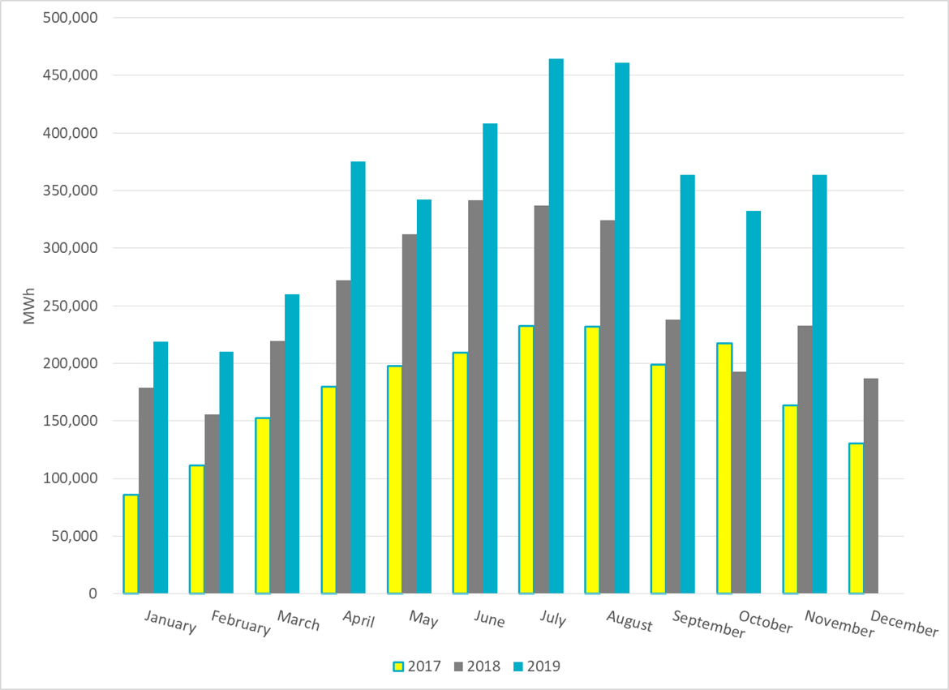
ERCOT Total Energy from Solar Generation

Slide 17
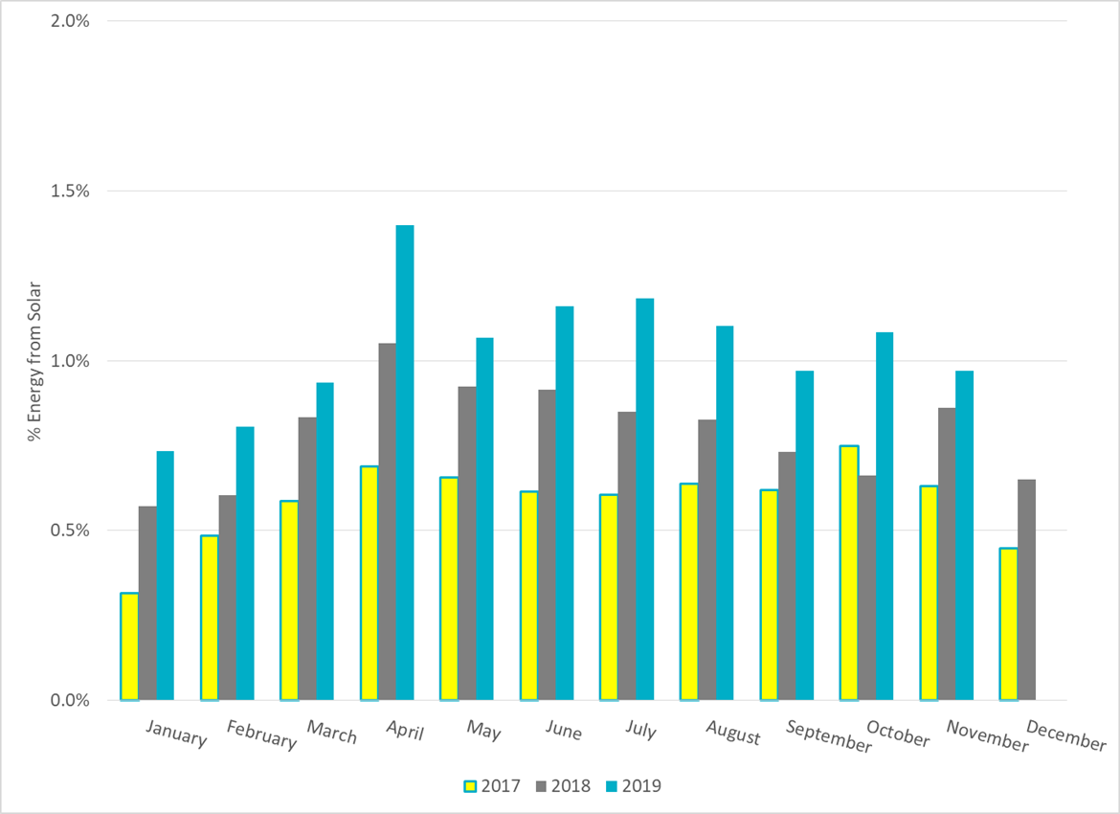
ERCOT % Energy from Solar Generation

Slide 18
Questions?

