Slide 1
NPRR953 – Relay Loadability Rating Workshop
Joel Koepke
Manager - Grid Coordination, Application and Development
1/6/2020

Slide 2
Topics
Overview of NERC Changes and NPRR953
Uses of Relay Loadability Rating in RTA and OPA Studies
System Change Implementation Timing and Roadmap
Initial Rating Collection Process
Ongoing Rating Maintenance Process
NMMS Changes
Open Discussion

Slide 3
Topics
Overview of NERC Changes and NPRR953
Uses of Relay Loadability Rating in RTA and OPA Studies
System Change Implementation Timing and Roadmap
Initial Rating Collection Process
Ongoing Rating Maintenance Process
NMMS Changes
Open Discussion

Slide 4
Overview of NERC Changes and NPRR953
NERC Project 2007-6.2: System Protection Coordination changes the definition of a Real-Time Assessment (RTA) and Operational Planning Analysis (OPA)
“An evaluation of system conditions using Real-time data to assess existing (pre-Contingency) and potential (post-Contingency) operating conditions. The assessment shall reflect applicable inputs including, but not limited to: load, generation output levels,…
Before:
  …known Protection System and Special Protection System status or degradation,…
After:
  …known Protection System and Remedial Action Scheme status or degradation, functions, and limitations;…
…Transmission outages, generator outages, Interchange, Facility Ratings, and identified phase angle and equipment limitations.”
Enforcement effective date is October 1st, 2020

Slide 5
Overview of NERC Changes and NPRR953
Currently ERCOT is solely responsible for the Reliability Coordinator and Transmission Operator requirements related to conducting the OPA and RTA per the Coordinated Functional Registrations (CFRs) with other ERCOT TOs.
The Relay Loadability Rating will be required per IRO-010-2 and TOP-003-3 as “data necessary for” ERCOT “to perform” its OPA and RTA.
https://www.nerc.com/pa/Stand/Project200706_2SystemProtectionCoordinationDL/Project_2007_06_2_OPA_RTA_Evaluation_Final_Draft_2016_05_17_Clean.pdf
All other IRO-010-2 and TOP-003-3 required data is identified in the ERCOT Protocols and Operating Guides.

Slide 6
SPWG/ERCOT-Proposed Definition
Relay Loadability Rating
The MVA rating below which no load-responsive phase-protection relay tripping is expected. The Relay Loadability Rating is calculated based on the trip points of protective devices at the equipment terminals of the affected Transmission Element under a set of operating criteria defined by the Transmission Element owner.

Slide 7
NPRR Overview
NPRR953, and subsequent comments, made the following changes:
  2.1, Definitions
    Adds the new Relay Loadability Rating definition
  3.10.7.1.1, Transmission Lines
    Adds Relay Loadability Rating as a required attribute
  3.10.7.1.4, GSU Transformers
    Adds Relay Loadability Rating as a required attribute
  3.10.3 CRR Network Model
    Excludes the need for this rating in the CRR model

Slide 8
Topics
Overview of NERC Changes and NPRR953
Uses of Relay Loadability Rating in RTA and OPA Studies
System Change Implementation Timing and Roadmap
Initial Rating Collection Process
Ongoing Rating Maintenance Process
NMMS Changes
Open Discussion

Slide 9
Real-Time Assessment
Current Flow
Post-Contingency Flow
✓
✓
ERCOT performs a daily Operational Planning Analysis (OPA) for the next day and a Real-Time Assessment (RTA) every 5 minutes to determine if:
Any basecase or pre-contingency flows exceed a Transmission Element’s Normal/Continuous rating (i.e. pre-contingency SOL exceedance).
Any post-contingency flows exceed a Transmission Element’s 2-hour rating (i.e. post contingency SOL exceedance).

Slide 10
Real-Time Assessment
A basecase violation occurs when the actual flow exceeds the Normal rating.
✓
✗
A post-contingency violation occurs when the estimated flow exceeds the 2 Hour rating
✓
✗
If there is a basecase or post-contingency violation ERCOT typically dispatches generation to relieve the overloads.

Slide 11
Mitigation Plans
If generation changes cannot resolve a post-contingency overload a Mitigation Plan will be developed.
Enough time?
✓
✗
✗
✓
Generation Solution Not Available
Switching Solution Available
TOs validate that there will be adequate time to perform the manual actions with the estimated post-contingency flow

Slide 12
Cascading Analysis
*ERCOT may lower the cascading threshold to 115%
An automatic Cascading Analysis study is run when the post-contingency estimated flow exceeds 125% of the Load Shed rating.
The 125% value is an estimated point where a higher risk of tripping (e.g. conductor sag) before load can be shed (less than 15 minutes).
Steps in Cascading Analysis:
  Open overloaded elements’ associated breakers
  Aggregate any lost load
  Run power flow
  Repeat if any overloads greater than 125%
Cascading Analysis Result:
  Total amount of Load MWs lost

Slide 13
Relay Loadability Rating
*ERCOT may lower the cascading threshold to 115%
ERCOT will use the Relay Loadability Rating to indicate when post-contingency flows exceed a rating where there may be near-instantaneous automatic relay actions that remove that transmission element from service.
Applications:
Validating timing considerations of Mitigation Plan
Validate no RLR values are less than the assumed 125%
Threshold to trigger immediate Cascade Analysis
Annual cascading study using SSWG cases
Assumptions:
Single MVA value for a Transmission Element
Rating considered in both flow directions

Slide 14
IROLs
*ERCOT may lower the cascading threshold to 115%
If the cascading analysis results in significant load loss or load loss greater than the IROL threshold, ERCOT may:
  Instruct pre-contingency load shed to prevent the cascading risk
  Instruct switching actions to minimize the load loss impact
  Develop IROL specific mitigation plans that will take all actions up to and including firm load shed to prevent the IROL from exceeding the limit.
  Notify the owners of the facilities that are critical to the derivation of the IROL
If too much margin is applied to the RLR, it could lead to the above actions unnecessarily.

Slide 15
Current Practices
Any Mitigation Plans or Temporary Outage Action Plans with post contingency load shed actions validate that the estimate post contingency flow is less than a rating. Example from a MP below.
  RELAY LOADABILITY
  Emergency Rating of Constraint = 28 MVA (Station 1-Station 2 Line)
  Highest Overload = 29 MVA (101% of emergency rating)
  Most Limiting Relay Minimum Pickup = 92 MVA

Slide 16
Topics
Overview of NERC Changes and NPRR953
Uses of Relay Loadability Rating in RTA and OPA Studies
System Change Implementation Timing and Roadmap
Initial Rating Collection Process
Ongoing Rating Maintenance Process
NMMS Changes
Open Discussion

Slide 17
Notable Efforts
System Changes
  NMMS
    ERCOT will make changes to allow for the submittal, storing, and validation of the ratings data.
  EMS
    Vendor will add functionality to incorporate new limit into real-time and future solutions.
    ERCOT will integrate new limits with custom modules (e.g. Cascading Analysis).
Data Submittal
  Market Participants to submit ratings data for their equipment.

Slide 19
Key Dates
Initial Data Collection Kickoff
  April 2020
Data Collection Complete
  End of May 2020
ERCOT Go-Live
  September 2020
Enforcement Date
  October 1st 2020
~2 months

Slide 20
Topics
Overview of NERC Changes and NPRR953
Uses of Relay Loadability Rating in RTA and OPA Studies
System Change Implementation Timing and Roadmap
Initial Rating Collection Process
Ongoing Rating Maintenance Process
NMMS Changes
Open Discussion

Slide 21
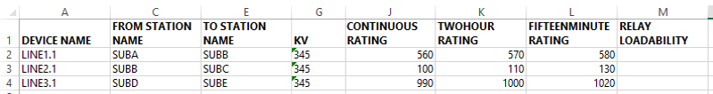
Initial Rating Collection Process
For TSPs, ERCOT will provide a spreadsheet listing the TSP-owned equipment and associated ratings.
  Expectation is for the TSP to update the spreadsheet with the loadability rating and propose a CAMR in SGEM.
  ERCOT will do the initial modeling on the TSP’s behalf.
Relay Loadability value to be updated for each device and submitted as a CAMR
For REs, the data from the Resource Asset Registration Form (RARF) will be used.

Slide 22
Topics
Overview of NERC Changes and NPRR953
Uses of Relay Loadability Rating in RTA and OPA Studies
System Change Implementation Timing and Roadmap
Initial Rating Collection Process
Ongoing Rating Maintenance Process
NMMS Changes
Open Discussion

Slide 23
Model Submission Windows
All model submissions have an effective date defining when the change enters a Production model.
A submission’s effective date can range between:
  One year in the future, and
  Current time (e.g. immediate implementation)
The time between the submission date and the effective date determines the classification of the change.
  Non-Interim Update
  Interim Update
  Downstream Production Change (DPCs)

Slide 24
Model Submission Effective Dates
Excluding, DPCs, all model submissions must have an effective date matching one of the ERCOT Production Load dates.
Production Load Schedule
  Where to find in ercot.com website?
    Grid Information > Transmission > Production Load Schedule
      http://www.ercot.com/gridinfo/transmission/opsys-change-schedule.html

Slide 25
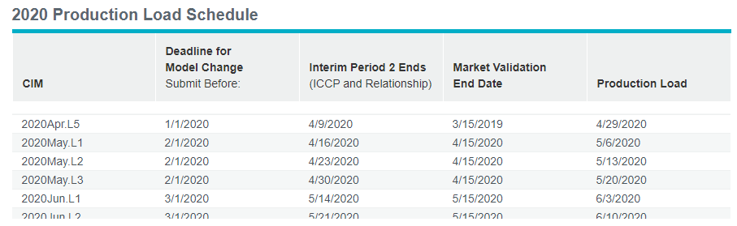
Key Dates for Production Loads
Sample Production Load Schedule
Cut off date for any model change not considered as interim update – normal timeline (non-interim update)
Last date for any model change submitted to be incorporated into the CIM model as interim update
Date production ready Network Operation Model is loaded into ERCOT systems
Model name

Slide 26
Model Submission Timeline
Non-Interim Update (ideal scenario)
  At least 3 months prior to model load date
  Deadline falls on the first day of the month
  Example:
DB Load | Production load date | Deadline for non-Interim update submission
May ML1 | 5/6/2020 | Prior to 2/1/2020
May ML2 | 5/13/2020 | Prior to 2/1/2020
May ML3 | 5/20/2020 | Prior to 2/1/2020

Slide 27
Model Submission Timeline
Interim Update (reported to IMM)
  Between the Non-Interim update cutoff and end the of Interim Period 2
  Approximately 25 days from the production load date
  Example:
DB Load | Production load date | Timeline for Interim update submission
May ML1 | 5/6/2020 | between 2/1/2020 and 4/16/2020
May ML2 | 5/13/2020 | between 2/1/2020 and 4/23/2020
May ML3 | 5/20/2020 | between 2/1/2020 and 4/30/2020

Slide 28
Model Submission Timeline
Downstream Production Change (DPC) Update
  Between the Interim Period 2 cutoff and the last day of the model
  Risks:
    Outside the normal rigorous model validation process
    Parameters updated in EMS and MMS manually instead of programmatically
  Example:
DB Load | Production load date | Timeline for Downstream Production Change
May ML1 | 5/6/2020 | between 4/17/2020 and 5/12/2020
May ML2 | 5/13/2020 | between 4/24/2020 and 5/19/2020
May ML3 | 5/20/2020 | between 5/1/2020 and 6/3/2020

Slide 29
Model Submission Timeline
Initial Validation
(NMG)
Initial Validation
(MPs)
Final Validation
(Network Modeling & EMS Prod)
May NOMCR Processing
Model for Week 1
Model for Week 1
May 6
Prod
Model for Week 2
Model for Week 2
May 13
Prod
Model for Week 3
Model for Week 3
May 20
Prod
NOMCR xxxxx-x for 5/6
15
15
15
6
13
20
FEB
MAR
APR
Interim Period 2, 4/16
MAY
Weekly DB loads for May
JUN
All Model Changes for May due Prior to Feb 1
Prod Snapshot 4/21
CIM Models
Posted for May
Market Model
May Model Changes

Slide 30
Topics
Overview of NERC Changes and NPRR953
Uses of Relay Loadability Rating in RTA and OPA Studies
System Change Implementation Timing and Roadmap
Initial Rating Collection Process
Ongoing Rating Maintenance Process
NMMS Changes
Open Discussion

Slide 31
Modeling Relay Rating
To update the data in the Network Operations model the user can:
  Manually update single entry
  Use one of the data entry templates
Data entry templates will be updated to accommodate this new rating.

Slide 32
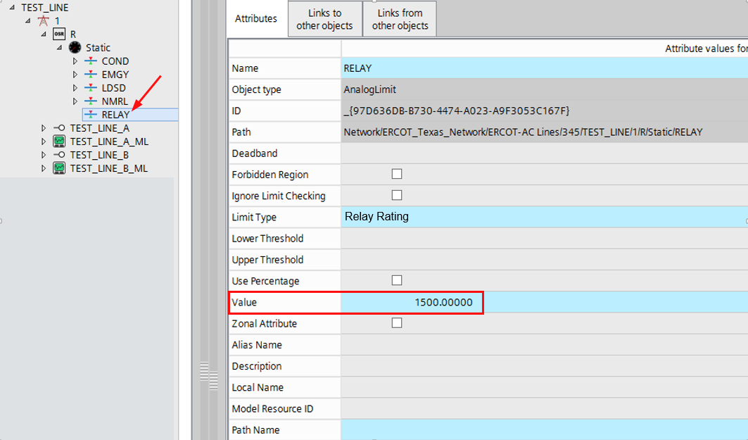
Manually Update Single Entry

Slide 33
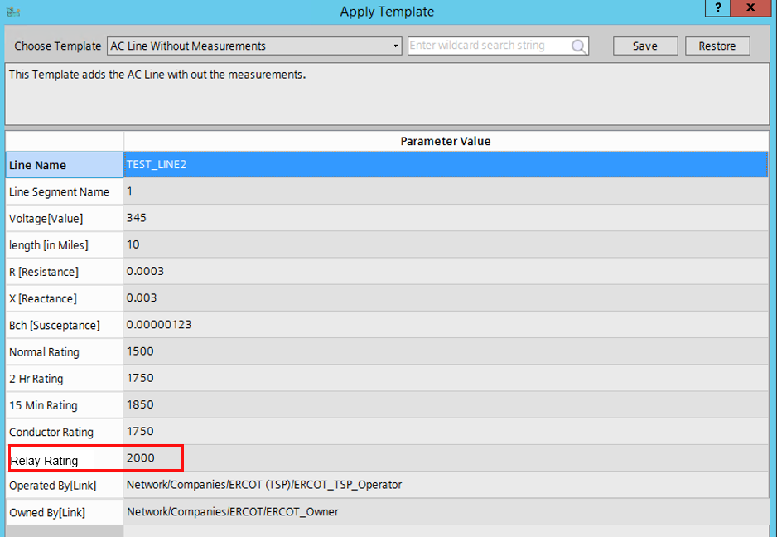
Template Example, Adding New Line

Slide 34
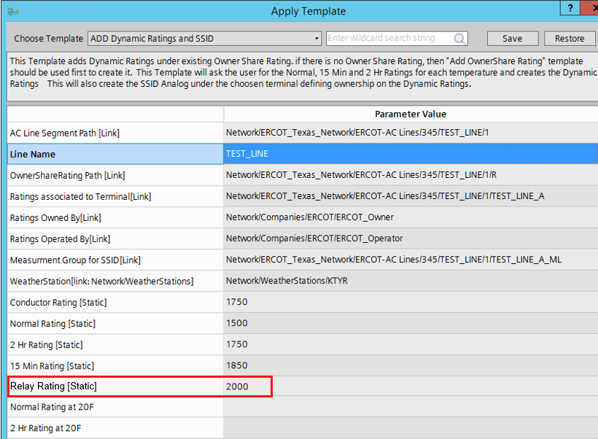
Template Example, Adding Dynamic Ratings

Slide 35
Modeling Related Document Updates
Nodal Protocols section 3.10.7.1.1 and 3.10.7.1.4
ERCOT Modeling Guidelines
  Will be updated to mention the new rating.
  Will not include expectations of this value.
Network Operations Modeling Expectations for TSPs, REs and QSEs
  Will be updated to mention the new rating.
  Will include expectations of this value.
  Need feedback from Market Participants.

Slide 36
Open Discussion

