Slide 1
KP 1.3 (14) RTC Constraints
Update on Load Resource Self Provision of RRS and ECRS
Sai Moorty
Market Design and Analysis
December 3, 2019

Slide 2
UFR Load Resource Treatment Under RTC
Self Provision of RRS-BLK and ECRS-BLK at individual UFR Load Resource level
Impractical to arm and disarm UFR every 5 minutes and have UFR Load Resources participate actively in RTC
Proposal is to allow self-provision of RRS-BLK and ECRS-BLK based on DAM RRS-BLK, ECRS-BLK awards, RRS-BLK, ECRS-BLK AS Trades and DAM Self-arranged RRS-BLK, ECRS-BLK within a QSE
Self-provision MW quantities of RRS-BLK, ECRS-BLK is telemetered to ERCOT by QSE for each UFR Load Resource in its portfolio:
$TelSelfRRS$: Telemetry to indicate RRS-BLK MW amount self-provided by On-Line UFR type Load Resource
$TelSelfECRS$: Telemetry to indicate ECRS-BLK MW amount self-provided by On-Line UFR type Load Resource

Slide 3
UFR Load Resource: Telemetered Self-Provision Validation (RRS, ECRS)
Original proposal presented on August 9th :
Additional ERCOT validation of QSE submitted AS Trades for RRS_BLK and ECRS-BLK to ensure respective limits on these AS sub-types are respected
Today, AS Trades are “CONFIRMED” if the buying and selling QSE submitted AS Trades have matching first and last hours, AS-subtype, and MW quantity
Original proposal would have introduced another check by ERCOT systems before confirming QSE submitted AS Trades
Subsequent discussions resulted in NOT introducing another check by ERCOT systems
New/Updated Proposal:
No changes to current rules for “CONFIRMING” AS Trades
Pro-rating rule for self-provision telemetry of RRS_BLK and ECRS_BLK from UFR Load Resource
Tweaks to original proposal
Yes, pro-rating rules for self-provision telemetry of RRS_BLK, ECRS_BLK are still needed
Change system wide RRS and ECRS constraints to handle cases where self-provision of RRS_BLK and ECRS_BLK exceeds the prescribed limits on the respective AS sub-types (60%, 50%)
Still under evaluation
Changes to Settlements to:
No credit to QSEs that submit AS Trades for RRS_BLK and ECRS_BLK that violate prescribed limits on those AS subtypes
Additional charge/penalty as this behavior could impact prices (LMP, MCPC) for other products

Slide 4

UFR Load Resource: Telemetered Self-Provision Validation (RRS, ECRS)
Step 1 : At QSE portfolio level, check if sum of telemetered self provision of RRS is less than or equal to QSE’s RRS-BLK responsibility from DAM RRS-BLK awards, validated RRS-BLK AS Trades and Self-arrangement within QSE. Similar check for ECRS-BLK
If not, determine a Step 1 validated self-provision amount (${TelSelfRRS}^{v1}$, ${TelSelfECRS}^{v1}$), (reduce the telemetered self-provision amounts for RRS and ECRS)
Step 2 : For each UFR Load Resource, check if
$$TelSelfRRS+TelSelfECRS≤NPF−LPC$$
If not, further prorate Step 1 validated ECRS self-provision first and then Step 1 validated RRS self-provision to get Step 2 validated self-provision amount (${TelSelfRRS}^{v2}$, ${TelSelfECRS}^{v2}$)
 | QSE RRS DAM & AS Trade | QSE ECRS DAM & AS Trade | LR 1 Self Prov Tel. |  | LR 2 Self Prov. Tel. |  | LR 1 Validated - 1 |  | LR 2 Validated - 1
 |  |  | TelSelfRRS | TelSelfECRS | TelSelfRRS | TelSelfECRS | V1-RRS | V1-ECRS | V1-RRS | V1-ECRS
Ex. 1 | 40 | 20 | 20 | 10 | 20 | 10 | 20 | 10 | 20 | 10
EX. 2 | 40 | 20 | 25 | 15 | 20 | 10 | 20 | 10 | 20 | 10
 | LR 1 Validated - 1 |  | LR1 | LR 1 Validated - 2 |  | LR 2 Validated - 1 |  | LR 2 | LR 2 Validated 2
 | V1-RRS | V1-ECRS | NPF-LPC | V2-RRS | V2-ECRS | V1-RRS | V1-ECRS | NPF-LPC | V2-RRS | V2-ECRS
Ex. 1 | 20 | 10 | 41 | 20 | 10 | 20 | 10 | 15 | 15 | 0
EX. 2 | 20 | 10 | 21 | 20 | 1 | 20 | 10 | 60 | 20 | 10

Slide 5
UFR Load Resource Treatment Under RTC
RTC awards to UFR Load Resource
RRS-BLK award =${MW}_{i}^{RRS−BLKSelf}$+ additional RRS-BLK award
Additional RRS-BLK award possible if headroom (discounting self-provided total AS) available, RRS offer exists, and economics
ECRS-BLK award =${MW}_{i}^{ECRS−BLKSelf}$+ additional ECRS-BLK award
Additional ECRS-BLK award possible if headroom (discounting self-provided total AS) available, ECRS offer exists, and economics
 | LR1 | LR 1 Validated - 2 |  | LR 1 Extra AS (RRS+ECRS) eligibility | LR 2 | LR 2 Validated 2 |  | LR 2 Extra AS (RRS+ECRS) eligibility
 | NPF-LPC | V2-RRS | V2-ECRS |  | NPF-LPC | V2-RRS | V2-ECRS
Ex. 1 | 41 | 20 | 10 | 11 | 15 | 15 | 0 | 0
EX. 2 | 21 | 20 | 1 | 0 | 60 | 20 | 10 | 30

Slide 6
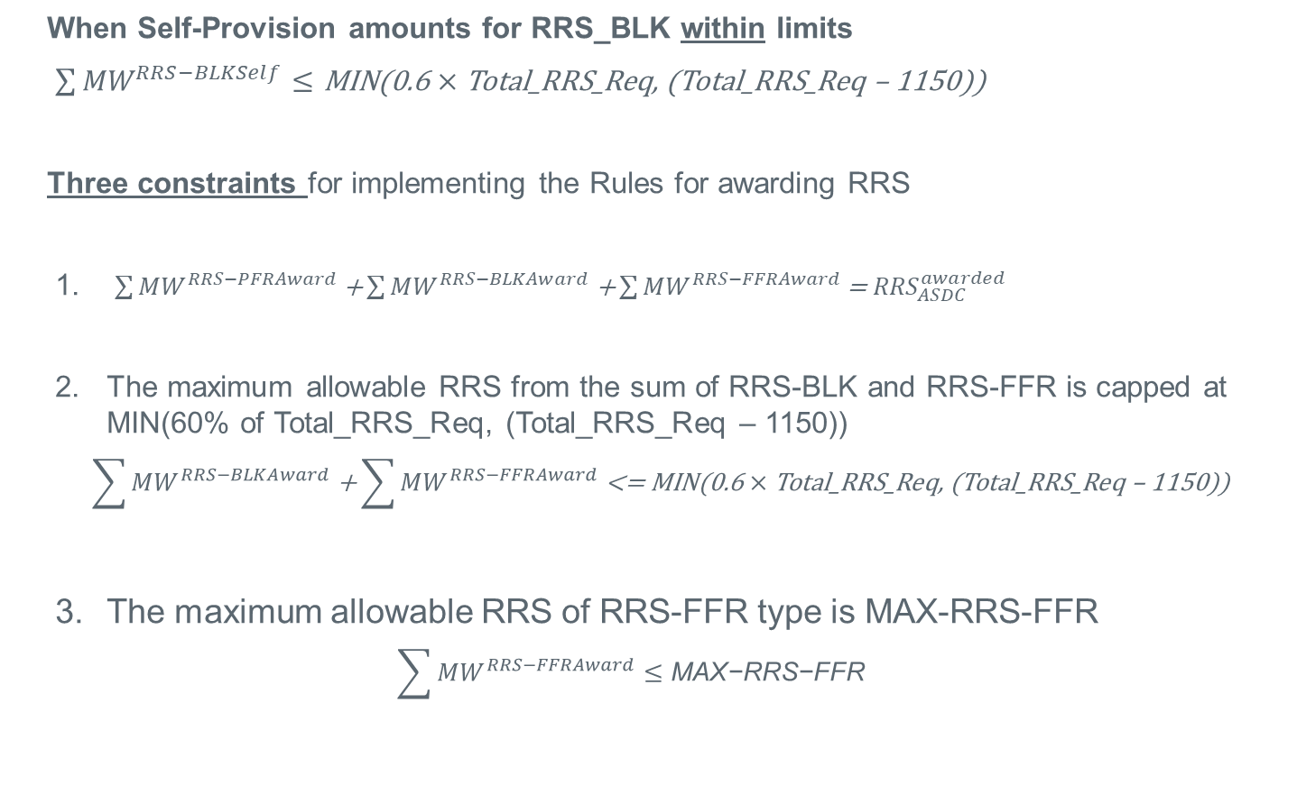
System Wide Responsive Reserve Service (RRS) Constraints
When Self-Provision amounts for RRS_BLK within limits
$\sum{{MW}^{RRS−BLKSelf}≤}$ $\text{MIN}\text{(0.6}×\text{Total}\text{_}\text{RRS}\text{_}\text{Req}\text{, (}\text{Total}\text{_}\text{RRS}\text{_}\text{Req}\text{ – 1150))}$
Three constraints for implementing the Rules for awarding RRS
$\sum{{MW}^{RRS−PFRAward}}\text{+}\sum{{MW}^{RRS−BLKAward}}\text{+}\sum{{MW}^{RRS−FFRAward}}\text{= }{RRS}_{ASDC}^{awarded}$
The maximum allowable RRS from the sum of RRS-BLK and RRS-FFR is capped at MIN(60% of Total_RRS_Req, (Total_RRS_Req – 1150))
$$\sum{{MW}^{RRS−BLKAward}}\text{+}\sum{{MW}^{RRS−FFRAward}}\text{<= }\text{MIN}\text{(0.6}×\text{Total}\text{_}\text{RRS}\text{_}\text{Req}\text{, (}\text{Total}\text{_}\text{RRS}\text{_}\text{Req}\text{ – 1150))}$$
The maximum allowable RRS of RRS-FFR type is MAX-RRS-FFR
$$\sum{{MW}^{RRS−FFRAward}}≤\text{MAX}\text{−}\text{RRS}\text{−}\text{FFR}$$

Slide 7
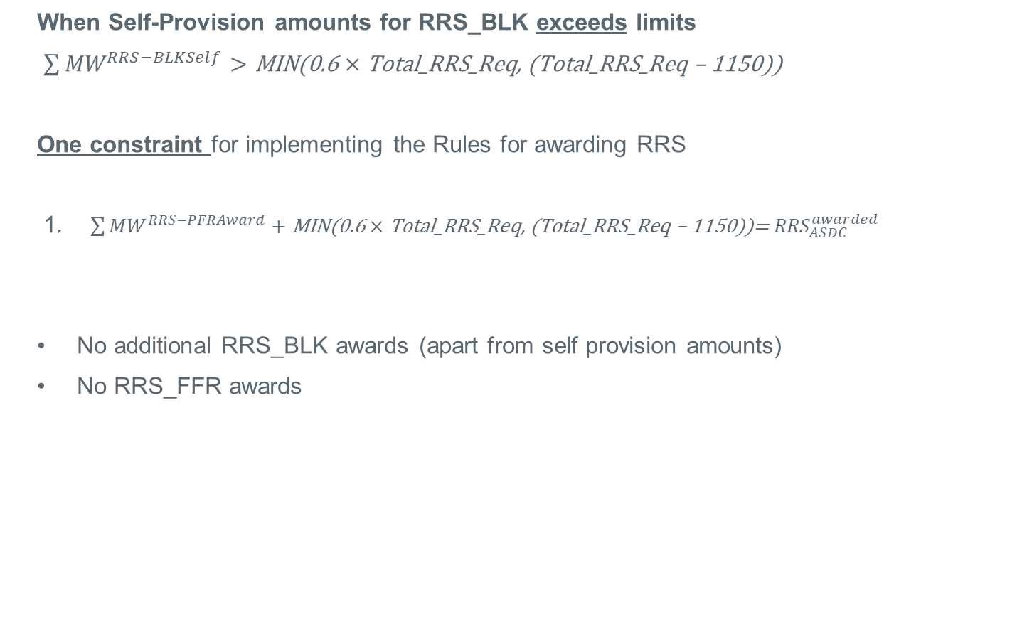
System Wide Responsive Reserve Service (RRS) Constraints
When Self-Provision amounts for RRS_BLK exceeds limits
$\sum{{MW}^{RRS−BLKSelf}}>$ $\text{MIN}\text{(0.6}×\text{Total}\text{_}\text{RRS}\text{_}\text{Req}\text{, (}\text{Total}\text{_}\text{RRS}\text{_}\text{Req}\text{ – 1150))}$
One constraint for implementing the Rules for awarding RRS
$\sum{{MW}^{RRS−PFRAward}}+\text{MIN}\text{(0.6}×\text{Total}\text{_}\text{RRS}\text{_}\text{Req}\text{, (}\text{Total}\text{_}\text{RRS}\text{_}\text{Req}\text{ – 1150))= }{RRS}_{ASDC}^{awarded}$
No additional RRS_BLK awards (apart from self provision amounts)
No RRS_FFR awards

Slide 8
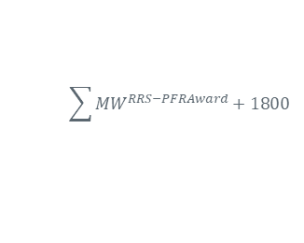
System Wide Responsive Reserve Service (RRS) Constraints
When Self-Provision amounts for RRS_BLK exceeds limits
$/MW/h
RRS ASDC
Self Prov. RRS_BLK
$$\sum{{MW}^{RRS−PFRAward}}+1800$$
RRS
MCPC
$\text{MIN}\text{(0.6}×\text{Total}\text{_}\text{RRS}\text{_}\text{Req}\text{, (}\text{Total}\text{_}\text{RRS}\text{_}\text{Req}\text{ – 1150))}$ = 1800
60% Total_RRS_Req.
Total_RRS_Req.
1800
3000
MW

Slide 9
Discussion

