Slide 1
Demand Curve for Regulation Down
Dec 3 , 2019
Murali Sithuraj
12/03/2019

Slide 2
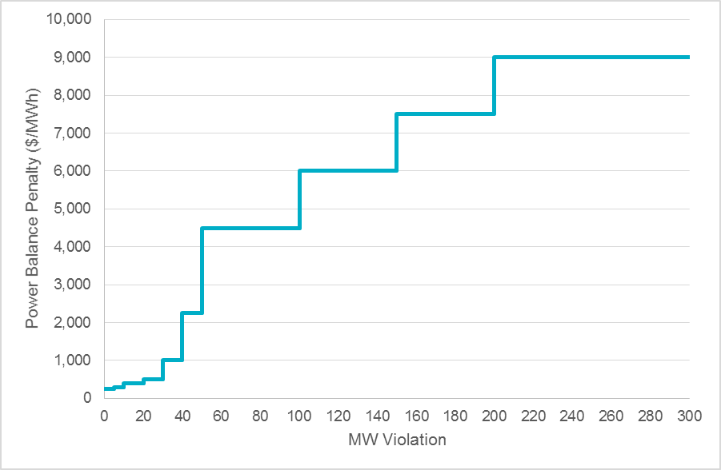
Demand Curve for Regulation-Down
ERCOT’s Proposal
For Reg-Down, the ASDC will be a constant value at a price of $9,000/MWh
AE’s Proposal
The following steps will be taken to determine the shape and price points for Reg-Down ASDC:
Reserve 100 MW of Regulation Down Service (Reg-Down) consistent with the current market’s Power Balance Penalty Curve (PBPC) pricing;
Place the remaining Reg-Down requirement at the VOLL.
Power Balance Penalty Curve
MW Violation | Penalty Value ($/MWh)
≤ 5 | 250
5 < to ≤ 10 | 300
10 < to ≤ 20 | 400
20 < to ≤ 30 | 500
30 < to ≤ 40 | 1,000
40 < to ≤ 50 | 2,250
50 < to ≤ 100 | 4,500
100 < to ≤ 150 | 6,000
150 < to ≤ 200 | 7,500
200 or more | 9,001
Reg-Down Plan 2020
Max | 617 MW
Min | 138 MW
Avg | 291 MW
100 50 40 30 20 10 5

