Slide 1
System Protection Working Group (SPWG)
Update to ROS
January 9, 2020
Micheal Davis, Jr, P.E.

Slide 2
SPWG Meeting
Meeting held on November 13, 2019
Next meeting is scheduled for March 3-4, 2020
2020 SPWG Leadership Nominees:
  Chair: John Karlik, P.E. | Austin Energy
  Vice Chair: Vincent Roberts, P.E. | Texas-New Mexico Power (TNMP)
Some topics discussed:
  NPRR953’s revised definition and comments for evaluating a process for data submittals
  SPWG 2020 case-building schedule and procedure
  Some operational activities
    End-to-end testing between two companies
    Uploading relay data into software program for studies
      Reviewed a bug fix to enable proper translation of uploaded dated

Slide 3
Transmission Operator Protection System Misoperations 2019 Q2
ERCOT Protection System Misoperations Data – 138kV and 345kV Combined
Gradual increase in rolling average misoperation rate in the last year, 6.2% to 7.9%

Slide 4
Protection System Misoperations – 2019 Q2
 |  | Q2 | 2019 YTD
# of Misoperations | Total | 69 | 107
 | 345 kV | 20 | 26
 | 138 kV | 48 | 78
 | < 100 kV | 1 | 3
By Category | Failure to Trip | 5 | 5
 | Slow Trip | 0 | 0
 | Unnecessary Trip during Fault | 39 | 63
 | Unnecessary Trip – Non Fault | 25 | 39
 | SPS | 0 | 0
By Relay System Type | Electromechanical | 11 | 15
 | Solid State | 1 | 1
 | Microprocessor | 45 | 72
 | Other/ N/A | 4 | 19
By Equipment Protected | Line | 23 | 37
 | Transformer | 14 | 21
 | Generator | 6 | 8
 | Shunt/Series Capacitor | 1 | 3
 | Shunt/Series Reactor | 1 | 1
 | Dynamic VAR system | 1 | 2
 | Bus | 9 | 10
 | Breaker | 9 | 20

Slide 5
Protection System Misoperations 2019 Q2

Slide 6
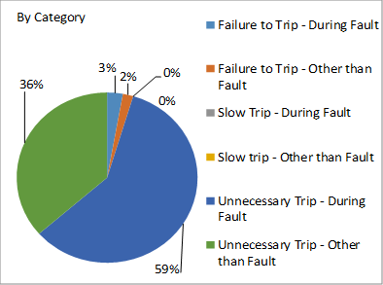
Protection System Misoperations 2019 Q2

Slide 7
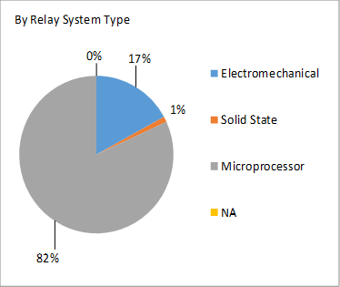
Protection System Misoperations 2019 Q2

Slide 8
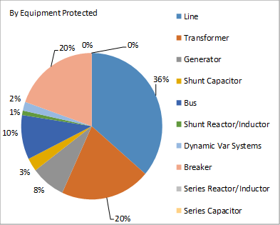
Protection System Misoperations 2019 Q2

Slide 9
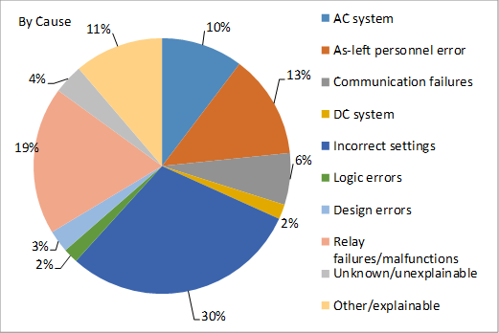
Protection System Misoperations 2019 Q2

Slide 10
Protection System Misoperations 2019 Q2
Summary of Human Performance Issues noted for 2019 Q2:
138kV bus differential overtripped due to an incorrectly wired CT polarity.
A 138kV line terminal overtripped due to an incorrectly wired CT polarity.
A 345kV auto overtripped due to an incorrectly wired CT following maintenance.
A 138kV line misoperated due to field settings not match issued settings.
A 345kV line overtripped due to a carrier cut-off switch left in the Off position.
A 138kV line overtripped due to an incorrect polarizing CT circuit polarity.
A 138kV line overtripped due to incorrect mirrored bits settings.
A 138kV line terminal over-reached and tripped for a remote bus fault due to an incorrect Zone 1 ground distance setting.
138kV bus differential misoperated due to one source not included in the differential calculations.
Two separate misoperations for external faults due to mismatch between wired CT ratio and relay setting ratio.
138kV line overtripped, carrier relaying was enabled inadvertently during construction project.
Three events with line overtrips due to an incorrect setting on ground instantaneous relays.
138kV line overtripped due to CTs wired on the wrong ratio.
Failure to Trip/Slow Trip Misoperations in 2019 Q2:
Circuit breaker failed to trip due to a failed diode. Breaker failure relays isolated the fault.
Bus differential relay had incorrect logic, resulting in a failure to trip for a bus fault.
Capacitor bank 50P1 element was set too low, resulting in blocking the capacitor protection for tripping. Bus differential relays cleared the fault.
Ground fault protection failed to trip for a line-ground fault. Fault was cleared by backup relays.

Slide 11
NPRR953 Activities
Relay Loadability Rating definition discussion:
Meeting with SPWG members and various other ERCOT personnel held on Sep. 16, 2019
Discussed various SPWG comments to the original definition in NPRR953
SPWG members expressed concerns and a revised definition was drafted
Comments to updated definition within NPRR953
ERCOT submitted a revised relay loadability rating definition on 10/29/2019
Comments were received on 10/30/2019
These comments and other details were discussed at the November SPWG meeting on 11/13/2019
Based on the discussion, the revised definition seemed to be acceptable but a separate meeting would likely be needed to discuss the update/data submittal process
Relay loadability update process
Meeting between SPWG members and ERCOT personnel held on 11/21/2019
Discussed timeline expectations for submitting updates and minimum data requirements
Evaluated possible alternatives for questions related to minimum expectations for timeline requirements and data submittals
Process will continue to be evaluated as the tools are also developed or revised
SPWG members also evaluated another slightly revised relay loadability rating definition
- This was submitted afterwards by ERCOT on 12/04/2019

Slide 12
Questions ?

