Slide 1
ONCOR LUBBOCK INTEGRATION UPDATE
Presentation for ERCOT RPG Meeting
on Nov 17, 2019
Austin, TX – ERCOT MET Center
Assets Planning
Business and Operations Support
Oncor Electric Delivery Co LLC
Plans are subject to change due to factors including, but not limited to, load, generation, engineering, system protection and system topology.

Slide 2
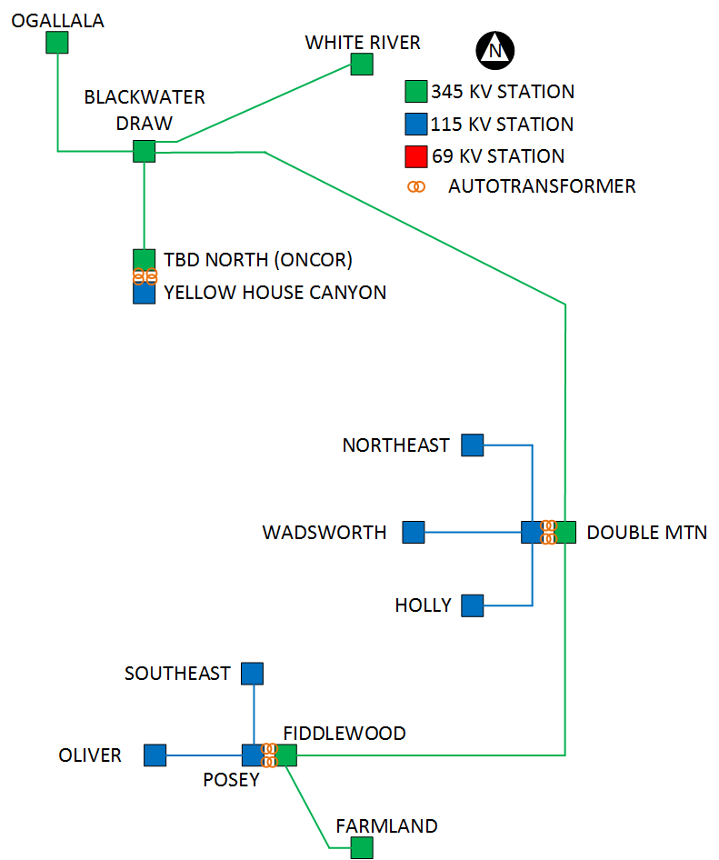

Slide 3
CCN Status
PUCT Docket | Project Title | Application Filing Date | CCN Status
48625 | Ogallala - Abernathy 345 kV Line | 9/6/2018 | Approved
48668 | Abernathy - Wadsworth 345 kV Line | 9/20/2018 | Approved
48909 | Wadsworth - New Oliver - Farmland 345 kV Line & Southeast - New Oliver - Oliver 115 kV Line | 12/19/2018 | Pending
49151 | Abernathy - North - North Loop 345/115 kV Line | 2/19/2019 | Pending

Slide 4
QUESTIONS/DISCUSSION

