Slide 1
Managing Constraints in SCED
Chad Thompson
Congestion Management Working Group
December 16, 2019

Slide 2
Redundant Constraints
In Series
Contingency A overloads Lines 1 and 2, which are in series with each other
Same Element
Contingencies A and B both overload Line 1
Redundant
Contingency A is loss of transformer, overloads line 1
Contingency B is loss of line, overloads line 1
From a modeling perspective, the line and transformer are in series with each other
Typically activate the most heavily overloaded, or whichever constraint shows up in RTCA first

Slide 3
Redundant Constraints
Procedure language
* “Nearly identical shift factors”

Slide 4
Shift Factor Cut-Off
Where did the 2 % come from?
Artifact from Zonal, where units with shift factors less than 2 % were not dispatched by RTB
Software limitations initially prevented activation of more than ~30 constraints, so this also helped to create some criteria to distinguish between constraints
When did we start considering the 2 %?
Likely since Nodal Go-Live
On July 20, 2011, Operator Procedure changes were made to clarify the use of the 2 % shift factor cut-off in real-time

Slide 5
Shift Factor Cut-Off
Procedure language

Slide 6
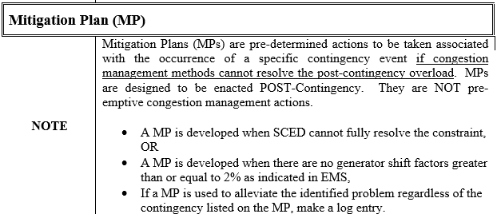
Shift Factor Cut-Off
Procedure language

Slide 7
Shift Factor Cut-Off
Inclusions
Units on Outage
Private Use Network Units
Renewables, regardless of “fuel” availability
Seasonal Mothballed Units
Exclusions
Generators in the Network Operations Model, but not participating in SCED
Non-Seasonal Mothballed Units
Settlement-Only Generators
*DC Tie “Generators”
*Synchronous Condensers

