Slide 1
Reactive Power Coordination Workshop
Alex Sills
Senior Operations Engineer
Freddy Garcia
Operations Planning Supervisor
Stephen Solis
System Operations Improvement Manager
ERCOT Public
December 13, 2019

Slide 2
Antitrust Admonition
Antitrust Admonition
Antitrust Admonition
To avoid raising concerns about antitrust liability, participants in ERCOT activities should refrain from proposing any action or measure that would exceed ERCOT’s authority under federal or state law. For additional information, stakeholders should consult the Statement of Position on Antitrust Issues for Members of ERCOT Committees, Subcommittees, and Working Groups, which is posted on the ERCOT website.1
Disclaimer
All presentations and materials submitted by Market Participants or any other Entity to ERCOT staff for this meeting are received and posted with the acknowledgement that the information will be considered public in accordance with the ERCOT Websites Content Management Operating Procedure.

Slide 3
Introductions
Presenters
  Alex Sills
    Senior Operations Engineer
  Freddy Garcia
    Operations Planning Supervisor
  Stephen Solis
    System Operations Improvement Manager
Around the Room

Slide 4
Reactive Power Coordination Workshop
  RPC Update
  Current Voltage control in ERCOT
  Break
  Response to TO questions/comments
  Break/Lunch
  Reactive Zones
  Wrap Up/Discussion/Q&A
Presenter
Stephen Solis
System Operations Improvement Manager
ERCOT Public
December 13, 2019

Slide 5
NPRR 966
Tabled at PRS until the project is developed and tested to a point where language can then be revised as necessary.
ERCOT will issue comments when it is ready to continue working on the NPRR language.
ERCOT received comments from several TOs which it hopes to address in ongoing workshops.

Slide 6
RPC tool project update
ERCOT has identified a preferred vendor and is clarifying scope for final pricing.
If possible, the chosen vendor will be presenting on the solution at the upcoming January 23, 2020 RPC workshop.
Q1 2020 will be focused on planning activities to finalize project schedule, systems architecture, detailed design documents, GUI initial design, and test plans.
ERCOT has tentatively included scope to provide the hourly reactive dispatch via Grid Geo in addition to the XML message via the ERCOT Messaging System since SCR 804 has passed and would be implemented in 2020.

Slide 7
RPC tool project update
ERCOT would like to establish a primary and secondary single point of contact for each ERCOT Transmission Operator for RPC related information, questions, and answers.
ERCOT plans to handle coordination in series of workshops and or smaller working sessions while providing quarterly updates at OWG and VPWG until NPRR 966 is un-tabled.

Slide 8

Q&A

Slide 9
Reactive Power Coordination Workshop
  RPC Update
  Current Voltage control in ERCOT
  Break
  Response to TO questions/comments
  Break/Lunch
  Reactive Zones
  Wrap Up/Discussion/Q&A
Presenter
Stephen Solis
System Operations Improvement Manager
ERCOT Public
December 13, 2019

Slide 10
Historical Reactive Control in ERCOT(2002-2009)
ERCOT had ultimate authority and responsibility for all transmission security, including any voltage stability or steady state voltage violations.
Protocols and Operating Guides were vague with most language highlighting “ERCOT, in coordination with TSPs” as being responsible for reactive control.
Coordination was managed primarily through a non-binding document titled “ERCOT Steady State Voltage Control Procedures”.
NERC standards were new and responsibilities were solely on ERCOT with TSP coordination meetings being held to identify where ERCOT would ask them for evidence to support compliance.
In practice, TSPs managed reactive control in real time and ERCOT got involved as needed primarily to issue Dispatch Instructions to compensate Generation Resources.

Slide 11
Current Reactive Control in ERCOT(2009-2019)
2009 - NERC Audit led to the forced implementation of Coordinated Functional Registration (CFR) agreements to formally document which entity (ERCOT and or TSP) performs which NERC Transmission Operator (TOP) tasks.
2010 - ERCOT was given a majority of the responsibilities for reactive control for the NERC TOP tasks in 2010 CFR and in subsequent revisions.
2010 to 2012 - ERCOT began to improve its procedures to account for these clarified responsibilities from 2010 to 2012.
2013- ERCOT began work (which is continuing) to reduce false voltage violations to allow for ERCOT operations tools to monitor voltage violations with confidence in its real time and look ahead tools.
2014- ERCOT implemented the 4 hour ahead look ahead voltage study.

Slide 12
Current Reactive Control in ERCOT(2009-2019)
2015 - ERCOT held a voltage workshop in April 2015 to collate the numerous issues that have arisen in various working groups.
2016 - NPRR 747 and NOGRR 150 passed relocating the binding language from “ERCOT Steady State Voltage Control Procedures” in to the ERCOT Protocols and Operating Guides as well as providing additional clarity on roles and responsibilities.
2017 – CFR/NERC Standard changes to the IRO/TOP standards and new definitions for Operational Planning Analysis (OPA) and Real Time Assessments (RTA) add clarity to ERCOT and TSP roles.
2018 – NPRR 776 provides common Voltage Set Point targets and measurements between TOs, ERCOT, QSE, and RE/GR.
2019 – NPRR 849 provides clarity on reactive capability requirements for Generation Resources required to provide VSS.
2019 - NOGRR 195 initiated to provide additional clarity on notification timelines as well as modification of the Voltage Set Point tolerance bands.

Slide 13
Current Reactive Control in ERCOT 2019
Processes
Constraint Management Plan (CMP) Studies
Voltage Profile Studies
ERCOT
ERCOT conducts and coordinates with TSPs to develop CMPs
ERCOT conducts and coordinates with TSP for Voltage Profile
TSP
TSPs provide some initial plans and reviews ERCOT results
TSPs provide initial set points and solutions to ERCOT identified issues
TSPs submit outages, switching plans, etc
Outage Coordination studies
ERCOT conducts and coordinates with TSPs to approve Outages
Time Horizon
Annual
Seasonal
90 days to 3 days ahead of Real Time
Next Day
Current Day
Real Time
Next Day Study (NDS)
Gap/4 hour ahead voltage study
VSAT, RTCA, Real Time Monitoring
Annual
Stability Screening Studies
ERCOT conducts and develops GTCs as necessary
Provide inputs to SSWG and DWG cases
ERCOT conducts and develops plans to address any violations
ERCOT conducts and develops plans to address any violations
ERCOT conducts and implements plans to address any violations
TSPs coordinate CMPs and receive NDS results
TSPs coordinate CMPs as necessary
TSPs monitor for base case voltage violations and implement plans

Slide 14
Challenges in Reactive Control in ERCOT 2019
Renewable integration increases variability in generation dispatch and associated reactive flows exposing the ERCOT Grid to more voltage stability issues, reactive switching, and need for reactive coordination
Renewable integration has incorporated a large portion of power electronics and site AVR functionality comprised of dynamic reactive power and fast acting shunts into the ERCOT Grid.
Next Day study only looks at one hour (peak hour) for next day for voltage violations.
ERCOT region is highly dependent on ERCOT for Next Day through Real Time as all TSPs do not have a State Estimator and RTCA and TSPs do not have COP information.
Increasing complexity in managing more variables (generation dispatch, demand side resources, reactive capability variations, power factor fluctuations, more TOs, shunts to large, etc.)

Slide 15
FLOAT
Forward Looking Operational Analysis Tools (FLOAT) initiative includes the following projects
  Security constrained economic dispatch (SCOPF) beyond real time
  Reactive Power Coordination Tool (RPC) beyond real time
  Security-constrained unit commitment (SCUC) for beyond DRUC
Forward-looking transmission studies will be:
  Easier
    Automates contingency analysis/redispatch
  More accurate
    Utilizes best information at time of study for future study period
    Implements corrective actions consistent with real time.
  More thorough
    Recalculates stability limits after thermal and voltage corrections
    Evaluates and ensures adequate reactive reserves
  More comprehensive
    Automation will allow study of more than just peak hour
Less dependent on last-minute real-time solutions

Slide 16
Next Day Study
Operational Planning Analysis (OPA) – Met with Daily Reliability Unit Commitment (DRUC) study (solves MW) and the Next Day Study (solves MVA and voltage limit exceedances).
Next Day Study imports the DRUC study results, COP, load forecast, and outages and then runs powerflow and contingency analysis for the peak load hour.
Next Day Study solves any MVA and voltage violations through system adjustments or with the creation of Constraint Management Plans (CMPs) or outage coordination if system adjustments are not available to solve the violations.
This ensures there are Operating Plans for all SOL exceedances.
Next Day Study results are shared with ERCOT TOs.
CMPs are coordinated with impacted TOs.

Slide 17
Next Day Study
COP for next day is much more accurate after DRUC.
Solving voltage violations can be quite an extensive effort and differ from one engineer to the next.
Reactive dispatch could vary greatly from what is implemented in real time.
In October of 2019, ERCOT enhanced its STNET application to create a MW redispatch engine similar to SCED to solve MVA violations in the Next Day Study.
In October of 2019, ERCOT also enhanced its STNET application to create a reactive redispatch engine that utilizes voltage sensitivities in the Next Day Study similar to VSS application.
  Shunts and transformer taps are utilized as controls.
  Voltage Set Points are turned off as a control.
Has improved the time it takes to run the Next Day Study as well as other weekly and monthly case creation/cleanup processes.

Slide 18
Next Day Study
Next Day Study is still only available for the peak hour.
Reactive dispatch can still vary greatly from what is implemented in real time. To resolve this:
  Multi hour assessment would need to be implemented.
  Temporal constraints would need to be implemented.
  Control costs and constraint penalties would have to be established to drive any optimization results to be closer to operational logic behind real time control actions.
  Reactive dispatch would have to be followed (with reasonable exceptions).
Modifying MW dispatch changes Qmax/Qmin of units which changes the reactive dispatch needs and control movements which can change stability limits.
Voltage sensitivities can change with each iteration of a solver.
Studies utilize voltage schedules periodically updated based off of real time observations. AVR is enabled for all taps and shunts.

Slide 19
4 hour ahead studies
Since Hourly RUC (HRUC) runs hourly and solves MW exceedances, ERCOT conducts an hourly forward looking (4 hours in future) study to assess for voltage violations and phase angle limit exceedances.
ERCOT's Reliability Risk Desk operator will run an hourly case study in EMS. The operator will load this case with the given hour to study (i.e. 4hrs ahead) with the outages and RUC data for that hour and identify any voltage issues.
If Reliability Risk Desk operator identifies an issue that operator will trouble shoot the issue using certain techniques (i.e. proper outages entered, proper unit dispatch, system configuration or need to re-configure).
The Reliability Risk Desk operator will bring his finding to the shift engineer and Transmission Security Desk. Transmission Security Desk will monitor and help troubleshoot while shift engineer will perform verification and assist in troubleshooting.
Corrective actions are identified as necessary and assumed they can be implemented in real time. If CMP would be needed, it would be coordinated with the impacted TO.
Studies utilize voltage schedules periodically updated based off of real time observations. Not all the Taps and Shunts are on AVR, and the STNET Study uses only the reactive controls on AVR for bus voltage regulation.

Slide 20
Gap studies
Gap studies is a generic term for all adhoc studies conducted by operators to assess a future condition within the current day (e.g. individual pre outage studies, assessment of requests made to ERCOT for system changes, severe weather sensitivities, etc).
ERCOT's Transmission Security Desk operator or shift engineer will run a study in EMS. The operator/engineer will load this case with the given hour to study with the outages and RUC data and identify and issues.
Corrective actions are identified as necessary. If CMP would be needed, it would be coordinated with the impacted TO.
Studies utilize voltage schedules periodically updated based off of real time observations. Not all the Taps and Shunts are on AVR, and the STNET Study uses only the reactive controls on AVR for bus voltage regulation.
Currently, the redispatch engines are not being utilized for gap or 4 hour look ahead voltage studies until training can be conducted for operators and engineers.

Slide 21
Q&A

Slide 22
Reactive Power Coordination Workshop
  RPC Update
  Current Voltage control in ERCOT
  Break
  Response to TO questions/comments
  Break/Lunch
  Reactive Zones
  Wrap Up/Discussion/Q&A
ERCOT Public
December 13, 2019

Slide 23


We will return at 10:45 AM.

Slide 24
Reactive Power Coordination Workshop
  RPC Update
  Current Voltage control in ERCOT
  Break
  Response to TO questions/comments
  Break/Lunch
  Reactive Zones
  Wrap Up/Discussion/Q&A
Presenter
Stephen Solis
System Operations Improvement Manager
ERCOT Public
December 13, 2019

Slide 25
Responses to Questions from TOs
How will auto-transformers that are auto-controlled through a small tap range and then manually controlled through the remaining range be modelled? Since actual auto controls will be changing in Real-Time it is likely the TOs will be frequently deviating from ERCOT’s RPC instruction plan?
  This needs additional discussion but currently the EMS or the RPC tool will not be able to differentiate between the small auto controlled range and the manual control range of tap positions. The applications will use the minimum and maximum tap positions modeled to identify the tap range. RPC may suggest a tap position within the control range (both auto plus manual). In such case the transformer cannot maintain the voltage at regulated bus at the target value. And hence that transformer cannot be on AVR (temporarily) when a RPC recommendation is made.

Slide 26
Responses to Questions from TOs
How will a TO’s Reactive Power Controllers that can auto control capacitors in an area with an option of three control levels -- RPC controlled, manual control or relay device controlled – be modelled and addressed in the optimization tool?
  This needs additional discussion but initial thoughts are that a setting is expected to be available in the RPC tool, which would allow it to respect and monitor the bus voltages regulated by auto controlled reactive devices (local controls), so that the RPC recommended control actions will be in line with the expected local control movements. There shall not be a conflicting switching actions between the RPC tool and the local controls. But since the local controls only monitor the local bus, and RPC tool looks at wide area, RPC recommendations will try to optimize the controls to still maintain the local bus voltage while suggesting a different control state.

Slide 27
Responses to Questions from TOs
Going forward, will ERCOT run restoration contingencies? It would seem that the application would need to adjust reactive selection based on restoration events of sectionalized breaker-to-breaker segments. Otherwise, this difference would create situations in which the TOs would likely need to deviate from ERCOT’s RPC instruction plan unless ERCOT decided to monitor for these restoration events.
  There is currently no plan to incorporate restoration contingencies into the tool's functionality. It's difficult to envision how this would work even for RTCA results; ostensibly you would only need to run contingencies for elements which are currently out of service, which is unprecedented. However, restoration events would be captured in the RPC analysis via the planned end time of an outage (the outage would appear in the RPC case-hours up until the time it ends and the equipment is restored to service).

Slide 28
Responses to Questions from TOs
How would the tool account for renewable generation within certain reactive ranges, and the TOs reactive switching sequence? The reactive curves for renewables are currently not always matching actual capability on the low 10% and the high end. Since there is no current obligation to provide reactive below 10%, it will likely be difficult for the application to match actual conditions.
  The RPC tool would only recommend switching solutions based on the single snapshot capturing expected MW output and its MVAR capabilities at that MW output based on the supplied reactive curve. ERCOT recognizes the cited issue but the long term solution is outside of RPC. TOs would still have to manage real time issues such as this albeit with a few number to address if the tool is successful.

Slide 29
Responses to Questions from TOs
Sequencing of Planned Outages between companies and switching of reactive devices between companies would create more of a communication burden between companies and potentially creates a deviation from the longer-term reactive plan.
  TOs should be communicating switching of reactive devices and switching actions for planned outages today. Because there should be fewer switching actions overall, it is assumed that the burden should not increase from today. However if TOs are not communicating switching of reactive devices and switching actions for planned outages today, then there would be an additional burden.
How does ERCOT intend to address modeling of statcoms that are not currently modeled as a unit? Are there other reactive devices that are not currently modeled, as they actually behave, and if so, how would this affect the RPC tool’s optimization recommendations and the need to deviate from the RPC instruction?
  Statcoms are modeled as a Static Var Compensator (SVC) in the Network Operations Model. ERCOT is not aware of other reactive devices that are not currently modeled, as they actually behave, but would assess the impact and or strategies to address if made aware. RPC can prioritize controls including not considering certain controls.

Slide 30
Responses to Questions from TOs
How will the tool address reactive devices behind the meter for generation and Private Use Networks that may be switched independently of a TO’s instruction?
  The RPC tool will utilize the provided COP and PUN load information provided to ERCOT but will lock down the PUNs so that the tool does not dispatch anything within the PUN. Manual actions can be taken by the operators/engineers if PUN instructions would be necessary.
  These items represent variables in the RPC problem which are outside ERCOT's immediate control. PUN reactive infrastructure and generation reactive infrastructure will be accounted for in the RPC solution but a fundamental assumption to be made by RPC is that these controls will move as needed, without being "instructed" by the RPC schedule. These controls must be allowed to change and adjust to grid conditions, but discretely controlling these devices is not a goal of the RPC tool.

Slide 31
Responses to Questions from TOs
How will the tool address reactive changes of Distributed Generation (DG) that is connected and not modeled? Due to the difficulty of accounting for these reactive changes, TOs likely would have to deviate from the mass instruction plan.
  This is a good case for exception from the scheduled reactive plan. If the reactive behavior of the DG is conforming with load, there is a good chance it will be reflected in ERCOT's load distribution factors. Otherwise, if the behavior is stochastic or non-conforming, this issue presents a challenge for RPC to forecast the appropriate conditions.

Slide 32
Responses to Questions from TOs
How will the RPC tool account for generation trips, voltage ride through issues or generation Current Operating Plans (COPs) in its optimization plan?
  The RPC tool will always utilize the best information available regarding generation availability. Any generation trips that have occurred will show as off in the real time snapshot but for future hours, the generation will be assumed to be what is in the COP plus RUC commitments. Voltage ride through issues will not be considered in this tool as the units are assumed to be able to ride through, however even outside of RPC, if a generator is expected to trip as a result of transmission fault (not counting single getaway transmission faults), then the contingency for the transmission fault should be reviewed for inclusion of the loss of that generator as part of the contingency.

Slide 33
Responses to Questions from TOs
Has ERCOT considered the impact that any adjustment in the selectable solution parameters (during the same shift or following shifts) will cause a re-sequencing of the reactive switching plan and thus create a significant adjustment by TOs?
  While system topology will always create opportunities for adjustments by the TOs, the tuning of costs and penalties will influence the solution to start from the previous solution and minimize changes from one solution to the next while still prioritizing solving of voltage violations and maintaining sufficient dynamic reactive reserves.

Slide 34
Responses to Questions from TOs
Assuming the RPC tool will attempt to adjust for high voltage Real-Time Contingency Analysis (RTCA) issues, has ERCOT evaluated the potential system risk for multiple contingency situations if the tool’s solution is to push system voltage to a lower level overall in order to meet overall bounds?
  These factors must be included in the coordinated tuning so that control boundaries (in this case voltage schedules) are included to maintain the schedules (which could be say 1.0 to 1.04 for example) until it is necessary to solve a voltage violation. If some types of voltage violations should be handled with more potential for relaxation, then control priorities and constraint penalties can be thus adjusted to allow the correct operational decisions.

Slide 35
Responses to Questions from TOs
Some TOs have distribution-level capacitors in the station that are not modeled by ERCOT. Because ERCOT does not model distribution-level capacitors and they would not be incorporated into the RPC tool’s solutions, TOs would likely have to deviate from ERCOT’s RPC instruction.
  ERCOT see distribution level reactive support in terms of power factor at the load. ERCOT utilizes adaptive Load Distribution Factors (LDFs) and Power factor schedules from its State Estimator for assumptions in look ahead studies. These can be reviewed, but is the assumed pf that is planned to be utilized in these studies.

Slide 36
Reactive Power Coordination Workshop
  RPC Update
  Current Voltage control in ERCOT
  Break
  Response to TO questions/comments
  Break/Lunch
  Reactive Zones
  Wrap Up/Discussion/Q&A
ERCOT Public
December 13, 2019

Slide 37

We will return at 1:00 PM.

Slide 38
Reactive Power Coordination Workshop
  RPC Update
  Current Voltage control in ERCOT
  Break
  Response to TO questions/comments
  Break/Lunch
  Reactive Zones
  Wrap Up/Discussion/Q&A
Presenter
Freddy Garcia
Operations Planning Supervisor
ERCOT Public
December 13, 2019

Slide 39
Objective
Ensure adequate reactive reserves are maintained
Develop a meaningful way to calculate dynamic and static reactive reserves
  Reactive Zones/Clusters
Develop a method to define Reactive Zones
  Manual studies
  Programmatically
Develop additional displays for Operator situational awareness

Slide 40
Highlights
Study completed by Bigwood Systems, Inc. to define Reactive Zones
Defined Zones using Bus-Zone correlation methodology
  13 Zones in Final Report
Next Steps, implementation into:
  NMMS
  EMS
Plans for use cases
  TPL Annual Stability Assessment
  Operation Planning studies
  Real-Time Reactive Reserve Monitoring

Slide 41
Project Scope
Study, Design, Determine, and Develop Reactive Power Zones
Produce a report, interface, and analysis of the end results
Produce application that can be used by ERCOT to create/modify Reactive Zones

Slide 42
Methodology

Slide 43
Methodology to Define Zones
Input Data
  EMS Snapshot cases for:
Stress cases using Bigwood’s CPFlow (Continuation Power Flow tool) to create voltage vectors for each bus, i.e., show how voltage changes at each bus for each step in the stress progression
Use Spectral Clustering to group buses with similar voltage vectors into Reactive Zones
Refine Zones to eliminate errors caused by incorrect input data (Ex. Lat./Long. coordinates) or to increase practicality
CASE | DATE | ERCOT.LOAD
SUMMER PEAK | 28-Jul-17 16:52:00 | 69,689.64
SPRING OFF-PEAK | 26-May-17 03:50:00 | 34,875.30
WINTER PEAK | 06-Jan-17 18:48:00 | 59,855.56
FALL OFF-PEAK | 05-Oct-16 03:51:00 | 33,954.38

Slide 44
Zone Determination
Develop a Matrix consisting of each buses change in Voltage
  Use of multiple historical SE snapshots
  Single case using CPFlow
Clustering Analysis – Bigwood Systems
  Determine reference bus/slack bus
  Group buses that are highly correlated
Zone Refinement
  Partition into desired number of zones
  Number of interface lines should be small as possible
  Manual refinement as necessary

Slide 45
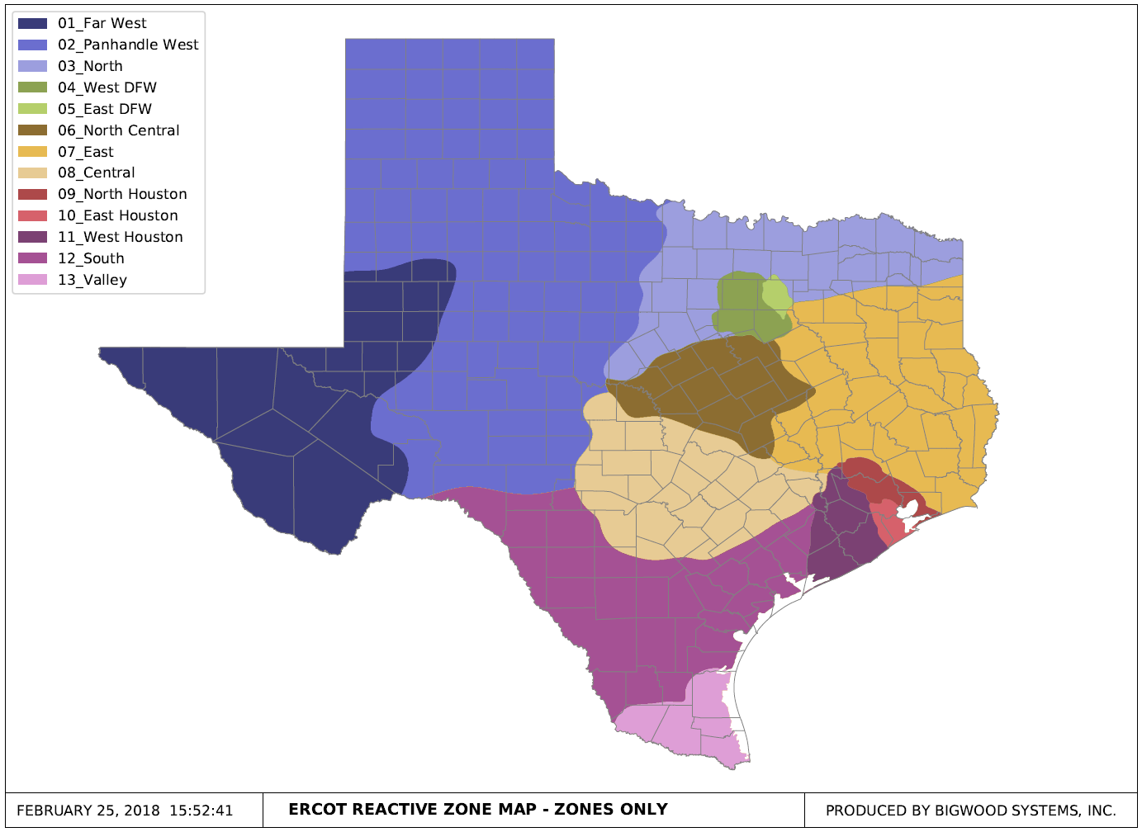
Final Reactive Zones

Slide 46
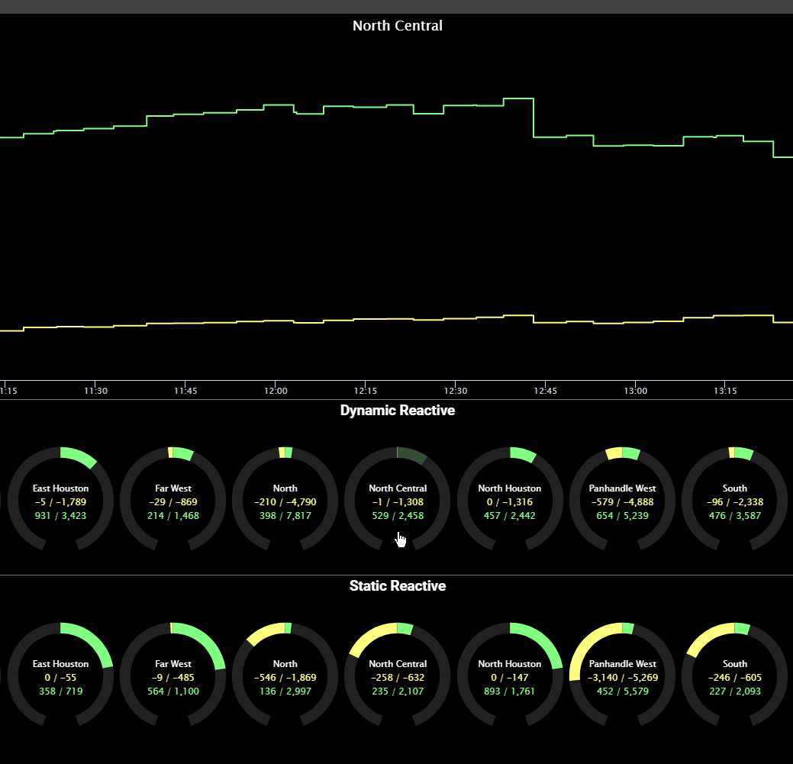
Next Steps
Import Bus to Zone definitions into NMMS and EMS
  Develop additional displays for Operator situational awareness

Slide 47
Next Steps
Begin monitoring/tracking dynamic and static reactive information by zone using real-time telemetry and generator CURL information
  Reactive Capability
  Reactive Output
  Reactive Reserve
Analysis to determine how often Zones need to be updated
  Major change in topology
  Seasonally
  Annually
Use VSAT to define Reactive Zone reliability limits
  Ex. - How large of a dynamic reactive margin is needed to maintain voltage stability for a contingency

Slide 48
Next Steps
Create alarms to trigger based off of these limits
  Ex. – Dynamic reactive margin is getting low, but there are static devices offline
    Bring on static devices to increase dynamic margin
    Bring on generation resources to stay within any stability limits if necessary
Integrate into Reactive Power Coordination Tool

Slide 49
Q&A

Slide 50
Reactive Power Coordination Workshop
  RPC Update
  Current Voltage control in ERCOT
  Break
  Response to TO questions/comments
  Break/Lunch
  Reactive Zones
  Wrap Up/Discussion/Q&A
Presenter
Stephen Solis
System Operations Improvement Manager
ERCOT Public
December 13, 2019

Slide 51
Wrap-up
ERCOT is continuing to develop an ERCOT system Reactive Power Coordination (RPC tool) expected to be tested during 2021.
ERCOT will reopen NPRR 966 via comments to that fact sometime in 2021.
ERCOT will be coordinating through workshops/meetings and information requests in 2020.
ERCOT plans to have Reactive Zone review process in place in 2020.
The next RPC workshop is scheduled for January 23, 2020.

Slide 52
Discussion / Q&A

