Slide 1
ERS QSE Training 101
Updated 4/25/2023

Slide 2
Disclaimer
This presentation is intended to be fully consistent with the Protocols, Other Binding Documents, and PUC Subst. Rule §25.507.
To the extent any part of this presentation contradicts the requirements set forth in the PUC Rule, Other Binding Documents or Protocols, the PUC Rule, Other Binding Documents or Protocols control.

Slide 3
Outline of QSE Training 101
ERS Overview
QSE Qualification
Four Key Phases of an ERS Standard Contract Term
  QSE Qualification
  Procurement
  Contract Performance
  Settlement
Other Useful Information

Slide 4

Emergency Response Service (ERS) Overview
ERS is a service provided by loads and certain types of generators willing to interrupt or export energy onto the ERCOT system prior to or during an electric grid emergency in exchange for a payment, providing ERCOT Operations with an additional reliability tool.
  “Controlled interruption of prepared customers vs. uncontrolled interruption of unprepared customers”

Slide 5
Emergency Response Service (ERS) Overview
Resources are procured for one or more of the four ERS service types:
  Non-Weather-Sensitive ERS-10 (NWS ERS-10)
  Weather-Sensitive ERS-10 (WS ERS-10)
  Non-Weather-Sensitive ERS-30 (NWS ERS-30)
  Weather-Sensitive ERS-30 (WS ERS-30)
The 10 and 30 in each of the service types designates the minutes between issuance of an ERCOT deployment instruction and full deployment of the resource, also known as the ramp period.

Slide 6

Emergency Response Service (ERS) Overview
There are two 4-month and two 2-month Standard Contract Terms (SCT) within the ERS year:
  December through March
  April through May
  June through September
  October through November

Slide 7
Emergency Response Service (ERS) Overview
Offers may be submitted to provide Emergency Response Service for one or more of the following Time Periods in the SCT.

Slide 8
Emergency Response Service (ERS) Overview
  An ERS Procurement Schedule is posted for each Standard Contract Term (SCT). https://www.ercot.com/services/programs/load/eils/index
  The procurement schedule includes all key dates associated with the SCT
  A SCT may take approximately 9 months to complete. Because of this, at any point in time, ERS providers may be working simultaneously on activities for the previous, current, and upcoming SCT.
DecMar
Procurement
Contract Performance
Compliance
Settlement
AprMay
Procurement
Contract Performance
Compliance
Settlement
JunSep
Procurement
Contract Performance
Compliance
Settlement
OctNov
Procurement
Contract Performance
Compliance
Settlement

Slide 9
Emergency Response Service (ERS) Overview
  The majority of ERCOT Protocol language related to ERS can be found in Sections 2, 3, 6, and 8. QSEs should review and be familiar with relevant requirements and rules.
  Section 2 – Defined terms related to ERS
  Section 3 – ERS procurement, QSE attestations, technical requirements, and reports
  Section 6 – ERS deployment and payment
  Section 8 – ERS Availability and Test / Event performance
  This is not an exhaustive list of protocol sections related to ERS.

Slide 10

Emergency Response Service (ERS) Overview
  The ERS Technical Requirements & Scope of Work (TRSOW) sets forth detailed requirements for participation in ERS by QSEs and ERS Resources
    Each TSROW is specific to the ERS SCT defined in the document. It primarily includes additional requirements or details not found in the protocols.
  The draft version of the TRSOW is posted to the ERS webpage under the heading “Upcoming SCT” for a 14 day stakeholder review period.
  Interested Market Participants may submit comments to ERCOT for consideration.

Slide 11
Emergency Response Service (ERS) Overview
  ERS Procurement Methodology - Procurement constraints are determined using ERS Capacity Demand Curve and Risk Factors to allocate annual spend limit to SCTs and Time Periods. Not every TP and SCT is equal!
Annual Cost Cap of $75M from Dec 1- Nov 30 (TAC §25.507)
ERS Offer Cap - $80/MW/hr
Time Period Expenditure Limits are calculated using risk weighting factors established by ERCOT ahead of each procurement and included in the RFP.
      Risk Factors represent the forecasted risk of deploying ERS during each time period
      Risk Factors can range from 1-100 (100 being greatest risk)

Slide 12
Emergency Response Service (ERS) Overview
  ERS Procurement Methodology
All ERS service types specified in the RFP will be procured using a common ERS capacity demand curve for each ERS Time Period.
      The highest offer accepted for an ERS Time Period will set the clearing price for all ERS Resources in that Time Period.
  Rules apply to:
      Prorating offers that would result in exceeding expenditure limit
      Resolving tied offers
    ERS Procurement Methodology posted to Key Documents
      https://www.ercot.com/services/programs/load/eils

Slide 13
Emergency Response Service (ERS) Overview
ERS Capacity Demand Curve
$/MW/Hr
Expenditure Limit
Offer Cap
Capacity
Demand
Curve
Capacity
Inflection
Point
MW

Slide 14
QSE Qualification

Slide 15

QSE Qualification
ERS Resources must be represented by a Qualified Scheduling Entity (QSE).
An ERS QSE is required to establish voice and critical data capabilities over the ERCOT Wide Area Network (WAN) and must maintain a 24/7 operation that can receive verbal and XML dispatch instructions.
ERCOT allows ERS QSEs to utilize QSE Service providers to satisfy technical and control room requirements (QSE Agency Agreement).
The process of establishing the WAN may take anywhere from four to six months for the QSE to complete.
QSEs work with their ERCOT account manager to become ERS qualified.

Slide 16

QSE Qualification
QSEs representing procured ERS Resources are paid a capacity payment to be available for deployment
  No additional payment for ERS Loads from ERCOT if deployed
  ERS Generators may receive energy payment for energy injected onto grid
ERCOT’s only financial relationship is with the QSE
Payment to the ERS Resource (customer) is a private contractual issue between the customer and the QSE
16

Slide 17
ERS Procurement

Slide 18
Procurement - ERID Submission
  ERS Resource ID (ERID) submission is the first mandatory step in the ERS procurement process. QSE should follow the procurement schedule posted for that SCT.
  Each Resource must go through the ERID process each SCT.
    An ERS Resource is a single site or aggregation of sites that provide the service by reducing the amount of energy used from the grid or generates energy to the grid when called on
    The resource can include sites with onsite generation.
  QSEs submit all prospective ERS Resources to ers@ercot.com using the latest version of the ERS Submission Form.
    Posted version or Pre-populated Submission Form (sent to QSEs by ERCOT).
    ERS Submission Form and Instructions are posted to ERS Key Documents http://www.ercot.com/services/programs/load/eils/index

Slide 19
Procurement - ERID Submission
  After analysis ERCOT returns Resource level information via the MIS as either approved ERID book or in an error book.
    A digital certificate is required to view/retrieve documents posted to the certified section of the MIS.
  Approved ERIDS contain availability and baseline accuracy information for every applicable baseline.
    Two baseline types: “Drop-by” (Default) or “Drop-to” (Alternate)
    Historical availability data is provided as a service to help avoid over- or under-bidding of capacity
    Aggregated resource baseline statistics are evaluated at the aggregate level, not at the site level
    See training titled “ERS QSE Training 201”

Slide 20
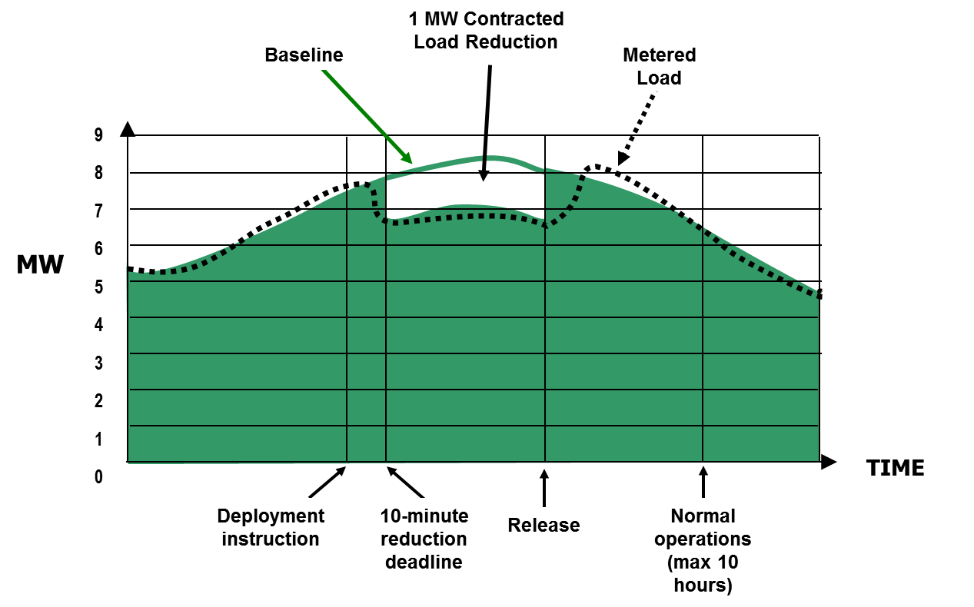
Procurement - ERID Submission
ERS Load, Default Baseline (“drop-by”)
Note that obligated reduction is from the baseline model, so it is important to understand your baselines!

Slide 21
Procurement - ERID Submission
ERS Load, Alternate Baseline (“drop-to”)
ERS Resource offer is awarded at 20 MW
In a deployment event the ERS Resource is expected to reduce load to declared Maximum Base Load of 4 MW regardless of load at time of deployment
MW
60
50
40
30
20
10
0
  Hypothetical Load Duration Curve
Peak Load: 58 MW
Avg. Hourly Load: 24 MW
20 MW Bid
Declared Maximum Base Load: 4 MW
0 10 20 30 40 50 60 70 80 90 100
  % of Hours in Contract Period

Slide 22

Procurement - ERID Submission
Fifteen-minute interval metering is required for participating in ERS as this data is used for all availability and performance measurement analysis.
  Interval data will be adjusted upwards to account for distribution losses if originating from a competitive choice area, or if originating NOIE has submitted a distribution loss study to ERCOT pursuant to Protocols, Section 13.3, Distribution Losses.

Slide 23

Procurement - ERID Submission
  In order to evaluate the applicability of a Default Baseline, ERCOT must have access to at least six months of site-specific historic interval meter data, pulled within the last 45 days.
    Interval data submitted by TDSP to ERCOT, or
    QSE installed metering (premise or end-use metering are allowed)
  ERCOT will limit the baseline option for an ERS Load to the Alternate Baseline in the following circumstances:
    If one or more sites within the ERS Load has less than 6 months of available historic interval meter data
    If the prospective ERS Load contains a non-interval metered site. In such cases the QSE is responsible for ensuring that the site is equipped with interval metering by the start of the applicable SCT
    Interval data can be provided from QSE installed metering, or
    By the relevant meter-reading entity (TDSP)

Slide 24

Procurement - Offer Submission
QSEs representing prospective ERS Resources submit offers to provide ERS using an approved ERID with an assigned ERID Number.
  ERID number assigned by ERCOT during the ERID process
For each ERS Resource, the QSE shall declare the following values for each Time Period for which an offer is being submitted:
  Submission Type (ID page)
  Baseline
  Capacity offer
  Price
  Whether capacity proration is allowed
  Proration Lower Limit
  Award Notifications are posted to certified section of the ERCOT Market Information System (MIS).

Slide 25
Contract Performance

Slide 26

Deployment of ERS
All ERS Service Types may be dispatched when PRC falls below 3,000 MW and is not projected to be recovered above 3,000 MW within 30 minutes following the deployment of Non-Spin
All ERS Service Types may be dispatched when PRC falls below 3,000 MW and is not projected to be recovered above 3,000 MW within 30 minutes following the deployment of Non-Spin
  ERCOT Operations will release ERS Resources after the emergency is over via another hotline call.
  Must be back online and ready to perform within 10 hours of the release

Slide 27

Deployment of ERS
ERCOT Operations dispatches ERS Resources via an XML
message sent to the QSE followed by a hot line phone call to all-QSEs.
QSEs in turn dispatches the ERS Resources with a 10 or 30 minute response time.
  VDI shall represent the official start of the ERS ramp period
  ERS Resources must shed or generate at least 95% of their committed obligation within 10 or 30 minutes depending on the service being provided.
Performance is measured after the fact using 15-minute interval metering (days to weeks depending on meter type)

Slide 28

Deployment of ERS
ERS Resources must respond according to their commitment and baseline assignment within 10 minutes or 30 minutes (ramp period) of the QSE’s receipt of the instruction
  Deployment obligation time is the cumulative time during the Sustained Response Period of an event during which an ERS Resource has an obligation.
  Deployment obligation time does not include the ramp time.
  ERS Resources shall be obligated for 24 hours of cumulative deployment time for any ERS Contract Period during the December through March ERS Standard Contract Term. The obligated cumulative deployment time for any ERS Contract Period during all other ERS Standard Contract Terms shall be 12 hours.

Slide 29
Deployment of ERS - Testing
ERCOT may conduct an unannounced test of any ERS Resource at any time during an ERS Time Period in which the ERS Resource is contracted to provide ERS
The Test Performance Factors for ERS Resources resulting from those tests will be used in Settlement for that and subsequent ERS SCTs
An ERS Resource that successfully completes a test shall not be subject to an additional test for at least 330 days (unless specified differently)
An ERS Resource that meets its performance obligations for all ERS deployment events during an ERS SCT shall not be subject to a test for at least the following 330 days (unless specified differently)

Slide 30
Deployment of ERS - Testing
The Test Performance Factors for ERS Resources resulting from those tests will be used in Settlement for that and subsequent ERS SCTs
Each 15-minute interval of Sustained Response in a test or deployment is assigned a score between zero and one, and the Performance Factor is the time-weighted average of those scores
  Score to pass is 0.95
Because this is an Emergency service, special emphasis is given to performance during the first 15-minute interval that is entirely within the Sustained Response time
  In addition to the averaged Performance Factor above, this first full interval must also be above 0.95 to fully pass
  A resource can have a time-weighted average interval score of above 0.95, but if the first interval is less than 0.95 they will fail

Slide 31

Performance (Non-Weather Sensitive ERS)
Performance is based on both the Availability of the ERS Resource and Test/Event Performance during the SCT.
No later than 45 days after the end of an ERS SCT in which one or more ERS deployment events occurred ERCOT will post a performance report at the Resource and QSE portfolio level

Slide 32
QSE SCT Portfolio Performance
A single availability and event performance factor for the QSE will be calculated across all Contract Periods in the SCT.
  Default Baseline: Considered available for any hour in the contracted time period in which actual load greater than 95% of its obligation
  Alternate Baseline: Considered available if the average curtailable load (excluding MBL) divided by Obligation is 1 or greater
ERS Resources will be settled using resource-level Test performance factors and the QSE SCT portfolio level Availability and Event performance factors.
  If the portfolio performs at or above 100%, it will be paid for its entire obligation.

Slide 33
Settlement

Slide 34

Settlement Payment Information
  Timing of Payments are described for each Standard Contract Term in Protocol Section 9.14.5 (1)
  Protocol states 20 Days after the final Settlement of the last Op Day of the ERS SCT is posted. (For example: May 31 - Final settlement post on July 29; add 20 days = August 18)
  Notice is sent out on the Notice Settlement exploder list
    Link to sign up for the list: http://lists.ercot.com/scripts/wa-ERCOT.exe?INDEX
    Sign up for the NOTICE_SETTLEMENTS LIST
  ERS QSE-level Payment Details Report are posted on the same day to the certified section of the MIS.

Slide 35
ERS Participation in NOIE areas
  ERS Resource located outside of a competitive service area may use a unique service identifier (UMI) in lieu of an ESI ID.
  QSEs representing ERS Resources that include sites located in a territory served by a NOIE are responsible for
    Arranging with the NOIE Transmission and/or Distribution Service Provider (TSP/DSP) to provide interval data to ERCOT; or
    Providing interval data from QSE installed metering
  Interval meter data for the sites must be provided in one of the prescribed formats within 35 days following the end of a calendar month or following an ERCOT unannounced test.

Slide 36
Other Helpful Information

Slide 37

Additional Information
Questions
  Client Services (clientservices@ercot.com)
      Contact your client rep for questions regarding QSE qualification
      General ERS questions
  Demand Integration (ERS@ercot.com)
Other ERS Information Resources
  DSWG (and subgroups) -
  https://www.ercot.com/committees/wms/dswg
  Demand Side WG Exploder List – Subscribe to the DSWG exploder list to receive email notifications of upcoming meetings, document postings and announcements regarding ERS. https://lists.ercot.com/scripts/wa-ERCOT.exe?SUBED1=DEMANDSIDEWG&A=1

Slide 38
Additional Information
Demand Response: https://www.ercot.com/services/programs/load/index
    Annual Report on ERCOT Demand Response
    Monthly ERCOT Demand Response from Pilot Projects (if any)
    Demand Response Providers List (Under Key Documents)
  Emergency Response Service: https://www.ercot.com/services/programs/load/eils/index
    ERS Offer Disclosure (available 60 days after the 1st day of SCT)
    ERS Procurement Results (posted prior to the start of the SCT)
    Current, Upcoming and Previous SCT docs
      Request for Proposal (RFP)
      Technical Requirements and Scope of Work (TRSOW)
      Procurement Schedule

Slide 39
Additional Information
ERS Forms & Supporting Documents: https://www.ercot.com/services/programs/load/eils/documents
  Sample Test Scripts, Meter Data Format Samples, Instructional documents on how to submit forms and more.
  ‘ERS QSE Training - ERS 201’ for more details on ERIDs, Availability and Test / Event performance, and deployments
Market Information System (MIS) - https://mis.ercot.com/secure
For retrieving ERS materials
Requires Digital Certificate (see your client rep)
Required docs (need to be submitted prior to Offers)
  ERS Supplement to QSE Agreements (one time only)
  NOIE Authorization Form – For sites in a NOIE area

