Slide 1
ERS QSE Training 101
Updated 8/26/2025

Slide 2
Disclaimer
This presentation is intended to be fully consistent with the Protocols, Other Binding Documents, and PUC Subst. Rule §25.507.
To the extent any part of this presentation contradicts the requirements set forth in the PUC Rule, Other Binding Documents or Protocols, the PUC Rule, Other Binding Documents or Protocols control.

Slide 3
Outline
ERS Overview
QSE Qualification
Four Key Phases of an ERS Standard Contract Term
  QSE Qualification
  Procurement
  Contract Performance
  Settlement
  Other Useful Information

Slide 4

Emergency Response Service (ERS) Overview
ERS is a service provided by loads and certain types of generators willing to interrupt or export energy onto the ERCOT system prior to or during an electric grid emergency in exchange for a payment, providing ERCOT Operations with an additional reliability tool.
  “Controlled interruption of prepared customers vs. uncontrolled interruption of unprepared customers”

Slide 5

Emergency Response Service (ERS) Overview
Resources are procured for one or more of the four ERS service types:
  Non-Weather-Sensitive ERS-10 (NWS ERS-10)
  Weather-Sensitive ERS-10 (WS ERS-10)
  Non-Weather-Sensitive ERS-30 (NWS ERS-30)
  Weather-Sensitive ERS-30 (WS ERS-30)
The 10 and 30 in each of the service types designates the minutes between issuance of an ERCOT deployment instruction and full deployment of the resource, also known as the ramp period.
There are two 4-month and two 2-month Standard Contract Terms (SCT) within the ERS year:
  December to March
  April to May
  June to September
  October to November

Slide 6
Emergency Response Service (ERS) Overview
Offers may be submitted to provide Emergency Response Service for one or more of the following Time Periods in the SCT.
Time Period | Time Period Hours
Time Period 1 | Hours Ending 0600-0900 (5:00:00 a.m. to 9:00:00 a.m.) Monday through Friday except ERCOT Holidays.
Time Period 2 | Hours Ending 1000-1300 (9:00:00 a.m. to 1:00:00 p.m.) Monday through Friday except ERCOT Holidays.
Time Period 3 | Hours Ending 1400-1600 (1:00:00 p.m. to 4:00:00 p.m.) Monday through Friday except ERCOT Holidays.
Time Period 4 | Hours Ending 1700-1900 (4:00:00 p.m. to 7:00:00 p.m.) Monday through Friday except ERCOT Holidays.
Time Period 5 | Hours Ending 2000-2200 (7:00:00 p.m. to 10:00:00 p.m.) Monday through Friday except ERCOT Holidays.
Time Period 6 | Hours Ending 0600-0900 (5:00:00 a.m. to 9:00:00 a.m.) Weekend and ERCOT Holidays.
Time Period 7 | Hours Ending 1600-2100 (3:00:00 p.m. to 9:00:00 p.m.) Weekend and ERCOT Holidays.
Time Period 8 | All other hours

Slide 7
Emergency Response Service (ERS) Overview
  ERS Procurement and Reinstatement Schedules are posted for each Standard Contract Term (SCT). https://www.ercot.com/services/programs/load/eils/index
  The procurement schedule includes all key dates associated with the SCT.
  A SCT may take approximately 9 months to complete. Because of this, at any point in time, ERS providers may be working simultaneously on activities for the previous, current, and upcoming SCT.
DecMar
Procurement
Contract Performance
Compliance
Settlement
AprMay
Procurement
Contract Performance
Compliance
Settlement
JunSep
Procurement
Contract Performance
Compliance
Settlement
OctNov
Procurement
Contract Performance
Compliance
Settlement

Slide 8
Emergency Response Service (ERS) Overview
  The majority of ERCOT Protocol language related to ERS can be found in Sections 2, 3, 6, 8, and 9. QSEs should review and be familiar with relevant requirements and rules.
  Section 2 – Defined terms related to ERS
  Section 3 – ERS procurement, QSE attestations, technical requirements, and reports
  Section 6 – ERS payment and charges
  Section 8 – ERS Availability and Test / Event performance
  Section 9 – Settlement of Emergency Response Service
  This is not an exhaustive list of protocol sections related to ERS.

Slide 9

Emergency Response Service (ERS) Overview
  The ERS Technical Requirements & Scope of Work (TRSOW) sets forth detailed requirements for participation in ERS by QSEs and ERS Resources; and is specific to the ERS SCT defined in the document. It may also include additional requirements or details not found in the protocols.
  The draft version of the TRSOW is posted to the ERS webpage under the heading “Upcoming SCT” for a 14-day stakeholder review period.
  Interested Market Participants may submit comments to ERCOT for consideration.

Slide 10
Emergency Response Service (ERS) Overview
  ERS Procurement Methodology - Procurement constraints are determined using ERS Capacity Demand Curve and Risk Factors to allocate annual spend limits.
Annual Cost Cap -$75 million for the ERS budget year; Dec 1- Nov 30
      Annual Cost Cap allocated to each time period to set an expenditure limit for each ERS Time Period.
ERS Offer Cap - $80/MW/hr
Time Period Expenditure Limits are calculated using risk weighting factors established by ERCOT ahead of each procurement and included in the RFP.
      Risk Factors represent the forecasted risk of having an EEA event during each time period
      Risk Factors can range from 1-100 (100 being greatest risk)

Slide 11
Emergency Response Service (ERS) Overview
  ERS Procurement Methodology
All ERS service types specified in the RFP will be procured using a common ERS capacity demand curve for each ERS Time Period.
      The highest offer accepted for an ERS Time Period will set the clearing price for all ERS Resources in that Time Period.
  Rules apply to:
      Prorating offers that would result in exceeding expenditure limit
      Resolving tied offers
    ERS Procurement Methodology is in Section 22 (Attachment Q) of the Protocols.
      Current Protocols

Slide 12
Emergency Response Service (ERS) Overview
ERS Capacity Demand Curve
$/MW/Hr
Expenditure Limit
Offer Cap
Capacity
Demand
Curve
Capacity
Inflection
Point
MW

Slide 13
QSE Qualification

Slide 14

QSE Qualification
ERS Resources must be represented by a Qualified Scheduling Entity (QSE).
An ERS QSE is required to establish voice and critical data capabilities over the ERCOT Wide Area Network (WAN) and must maintain a 24/7 operation that can receive XML dispatch instructions.
ERCOT allows ERS QSEs to utilize QSE Service providers to satisfy technical and control room requirements (QSE Agency Agreement).
The process of establishing the WAN may take anywhere from four to six months for the QSE to complete.
QSEs work with their ERCOT account manager to become ERS qualified.

Slide 15

QSE Qualification
QSEs representing procured ERS Resources are paid a capacity payment to be available for deployment
  No additional payment for ERS Loads from ERCOT if deployed
  ERS Generators may receive energy payment for energy injected onto grid
ERCOT’s only financial relationship is with the QSE
Payment to the ERS Resource (customer) is a private contractual issue between the customer and the QSE
15

Slide 16
ERS Procurement

Slide 17
Procurement - ERID Submission
  ERID submission is the first mandatory step in the ERS procurement process. QSE should follow the procurement schedule posted.
  Each Resource must go through the ERID process each SCT.
    An ERS Resource is a single site or aggregation of sites that provide the service by reducing the amount of energy used from the grid or generates energy to the grid when called on
    The resource can include sites with onsite generation.
  QSEs submit all prospective ERS Resources to ers@ercot.com using the latest version of the ERS Submission Form.
    Posted version or Pre-populated Submission Form (sent to QSEs by ERCOT).
    ERS Submission Form and Instructions are posted to ERS Key Documents http://www.ercot.com/services/programs/load/eils/index

Slide 18
Procurement - ERID Submission
  After analysis ERCOT returns Resources information, to the QSE by posting to the certified section of the MIS, either approved or error books.
    A digital certificate is required to view/retrieve documents posted to the certified section of the MIS.
  Approved ERIDS contain QSE availability and baseline accuracy information for each baseline for which the resource has been qualified.
    Two types: “Drop-by” (Default) or “Drop-to” (Alternate)
    Historical availability data is provided as a service to help avoid over- or under-bidding of capacity
    The baseline options for an aggregated ERS Load are based on the accuracy of the baseline at the aggregate level, not at the site level.
    See training titled “ERS QSE Training 201”

Slide 19
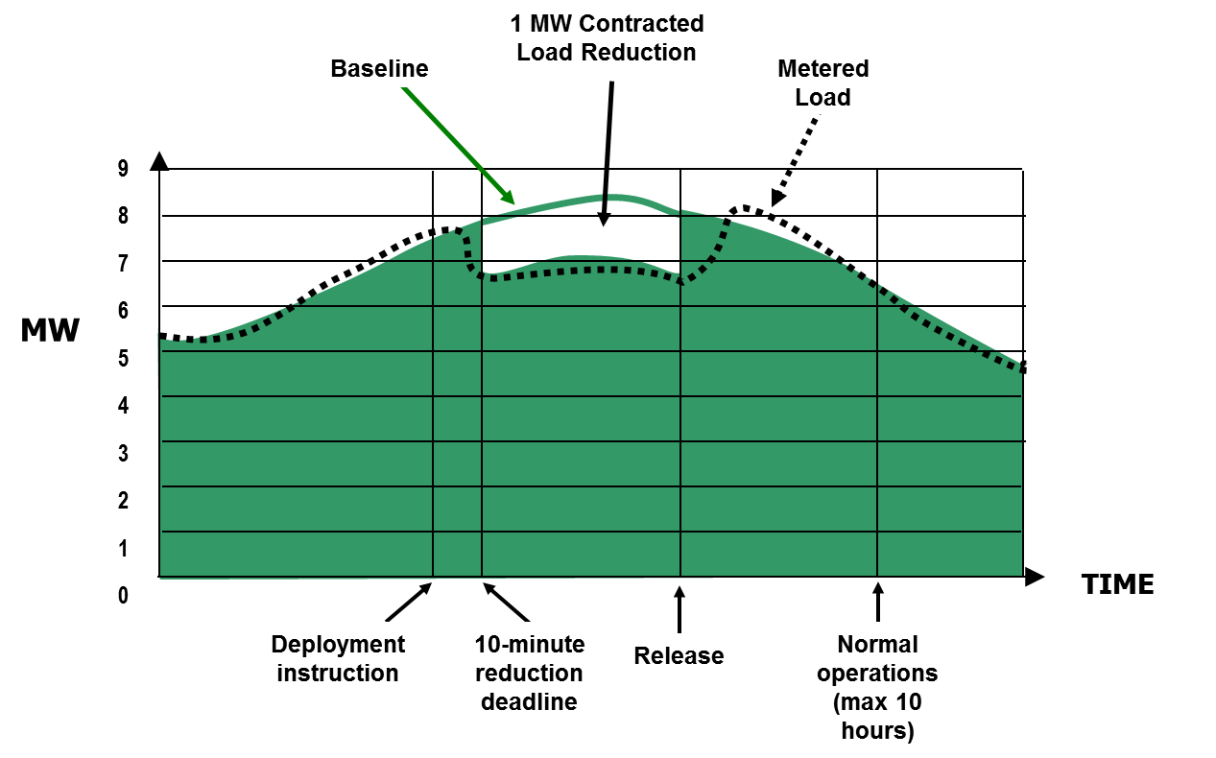
Procurement - ERID Submission
ERS Load, Default Baseline (“drop-by”)

Slide 20
Procurement - ERID Submission
ERS Load, MBL (Alternate) (“drop-to”)
ERS Resource offer is awarded at 20 MW
In a deployment event the ERS Resource is expected to shed to ≤ 4.21 MW (declared Maximum Base Load of 4 MW ÷ .95)
MW
60
50
40
30
20
10
0
  Hypothetical Load Duration Curve
Peak Load: 58 MW
Avg. Hourly Load: 24 MW
20 MW Bid
Declared Maximum Base Load: 4 MW
0 10 20 30 40 50 60 70 80 90 100
  % of Hours in Contract Period

Slide 21

Procurement - ERID Submission
Fifteen-minute interval metering is required for participating in ERS and the interval data from those meters is used for all, availability and performance measurement analysis.
  Interval data (premise or sub-metered) for each site in an ERS Resource located in a competitive choice area will be adjusted upward to account for distribution losses.
  Interval data for sites in NOIE areas also will be adjusted upward to account for distribution losses if the NOIE has submitted a distribution loss study to ERCOT pursuant to Protocols, Section 13.3, “Distribution Losses”.

Slide 22

Procurement - ERID Submission
  In order to evaluate the applicability of a Default Baseline, ERCOT must have access to at least six months of site-specific historic interval meter data, pulled within the last 45 days.
    Interval data submitted by TDSP to ERCOT, or
    QSE installed metering (premise or end-use metering are allowed).
  ERCOT will limit the baseline option for an ERS Load to the MBL performance evaluation methodology (Alternate) in the following circumstances:
    If one or more sites within the ERS Load has less than 6 months of available historic interval meter data.
    The ERS Load does not have sufficient predictability for a default baseline.
Notes:
Section 8.1.3.11 p3a for

Slide 23

Procurement - Offer Submission
QSEs representing prospective ERS Resources submit offers to provide ERS using an approved ERID with an assigned ERID Number.
  ERID number assigned by ERCOT during the ERID process
For each ERS Resource, the QSE shall declare the following values for each Time Period for which an offer is being submitted:
  Submission Type (ID page)
  Baseline
  Capacity offer
  Price
  Whether capacity proration is allowed
  Proration Lower Limit
  Award Notifications are posted to certified section of the ERCOT Market Information System (MIS).

Slide 24
Contract Performance

Slide 25
Deployment of ERS
All ERS Service Types may be dispatched when PRC falls below 3,000 MW and is not projected to be recovered above 3,000 MW within 30 minutes following the deployment of Non-Spin
ERCOT Operations dispatches ERS Resources via an XML
message sent to the QSE.
QSEs in turn dispatches the ERS Resources with either a 10- or 30-minute response time.
  XML shall represent the official start of the ERS ramp period
  ERS Resources must shed or generate at least 95% of their committed obligation within 10 or 30 minutes depending on the service being provided.
Performance is measured after the fact using 15-minute interval metering

Slide 26

Deployment of ERS
ERS Resources must respond according to their commitment and baseline assignment within 10 minutes or 30 minutes (ramp period) of the QSE’s receipt of the instruction via XML.
  Deployment obligation time is the cumulative time during the Sustained Response Period of an event during which an ERS Resource has an obligation.
  Deployment obligation time does not include the ramp time.
  Resources shall be obligated for 24 hours of cumulative deployment time for any ERS Contract Period during the December through March ERS Standard Contract Term and all other ERS Standard Contract Terms shall be 12 hours.
Notes:
Section 3.

Slide 27

Deployment of ERS
  ERCOT Operations will release ERS Resources after the emergency is over via another XML message.
  Must be back online and ready to perform within 10 hours of the release

Slide 28
Deployment of ERS - Testing
ERCOT may conduct an unannounced test of any ERS Resource at any time during an ERS Time Period in which the ERS Resource is contracted to provide ERS
The test performance factors for ERS Resources resulting from those tests will be used in Settlement for that and subsequent ERS SCTs
An ERS Resource that successfully completes a test shall not be subject to an additional test for at least 330 days (unless specified differently)
An ERS Resource that meets its performance obligations for all ERS deployment events during an ERS SCT shall not be subject to a test for at least the following 330 days. (unless specified differently)

Slide 29

Performance (Non-Weather Sensitive ERS)
Performance is based on both the availability of the ERS Resource and Test/Event Performance during the SCT.
No later than 45 days after the end of an ERS SCT in which one or more ERS deployment events occurred, ERCOT shall provide each QSE representing ERS Resources with an event performance report containing the results of ERCOT’s evaluation of the event(s) for each ERS Resource and the QSE’s portfolio-level event performance factor for the event(s) and the ERS SCT.

Slide 30

QSE SCT Portfolio Performance
A single availability and event performance factor for the QSE will be calculated across all Contract Periods in the SCT.
  Default Baseline Loads: Considered available for any hour in the contracted time period in which actual load greater than 95% of its obligation.
  MBL performance evaluation methodology (Alternate) : Considered available if the average curtailable load (excluding MBL) divided by Obligation is 1 or greater.
ERS Resources will be settled using resource-level Test performance factors and the QSE SCT portfolio level Availability and Event performance factors.
  If the portfolio performs at or above 100%, it will be paid for its entire obligation.

Slide 31
Settlement

Slide 32

Settlement Payment Information
  Timing of Payments are described for each Standard Contract Term in Protocol Section 9, “Settlement of Emergency Response Service”
  Protocol states 20 Days after the final Settlement of the last Op Day of the ERS SCT is posted. (For example: May 31 - Final settlement post on July 29; add 20 days = August 18)
  Notice is sent out on the Notice Settlement exploder list
    Link to sign up for the list:
    http://lists.ercot.com/scripts/wa-ERCOT.exe?INDEX
    Sign up for the NOTICE_SETTLEMENTS LIST
  ERS QSE-level Payment Details Report are posted on the same day to the certified section of the MIS.

Slide 33
ERS Participation in NOIE areas
  ERS Resource located outside of a competitive service area may use a unique service identifier (UMI) in lieu of an ESI ID.
  QSEs representing ERS Resources that include sites located in a territory served by a NOIE are responsible for
    Arranging with the NOIE Transmission and/or Distribution Service Provider (TSP/DSP) to provide interval data to ERCOT; or
    Providing interval data from QSE installed metering
  Interval meter data for the sites must be provided in one of the prescribed formats within 35 days following the end of a calendar month or following an ERCOT unannounced test.

Slide 34
Other Helpful Information

Slide 35

Additional Information
Got questions? “Who ya gonna call”?
  Client Services (clientservices@ercot.com)
      Contact your client rep for questions regarding QSE qualification
      General ERS questions
  Demand Integration (ERS@ercot.com)
Other ERS Information Resources
  DSWG (and subgroups) -
  https://www.ercot.com/committees/wms/dswg
  Demand Side WG Exploder List – Subscribe to the DSWG exploder list to receive email notifications of upcoming meetings, document postings and announcements regarding ERS. https://lists.ercot.com/scripts/wa-ERCOT.exe?SUBED1=DEMANDSIDEWG&A=1

Slide 36

Additional Information
3. Information – Where Is It? How Can I get?
  Demand Response: https://www.ercot.com/services/programs/load/index
    Annual Report on ERCOT Demand Response
    Monthly ERCOT Demand Response from Pilot Projects (if any)
    Demand Response Providers List (Under Key Documents)
  Emergency Response Service: https://www.ercot.com/services/programs/load/eils/index
    ERS Offer Disclosure (available 60 days after the 1st day of SCT)
    ERS Procurement Results (posted prior to the start of the SCT)
    Current, Upcoming and Previous SCT docs
      Request for Proposal (RFP)
      Technical Requirements and Scope of Work (TRSOW)
      Procurement and Reinstatement Schedules

Slide 37
Additional Information
ERS Forms & Supporting Documents: https://www.ercot.com/services/programs/load/eils/documents
  Meter Data Format Samples, Instructional documents on how to submit forms and more.
  ‘ERS QSE Training - ERS 201’ for more details on ERIDs, Availability and Test / Event performance, and deployments
Market Information System (MIS) - https://mis.ercot.com/secure
For retrieving ERS materials
Requires Digital Certificate (see your client rep)
Required docs (need to be submitted prior to Offers)
  ERS Supplement to QSE Agreements (one time only)
  NOIE Authorization Form – For sites in a NOIE area

