Slide 1
Summer 2019 Lessons Learned Discussion Topics (ERS Items)
ERCOT Staff
December 11, 2019 DSWG

Slide 2
Summer 2019 Lessons Learned Discussion Topics
Emergency Response Service (ERS):
  Reliability deployment price adder ramp.
  Crossover between procurement time periods and calculation of the adder.
  Self-deployment of ERS.
  Communicating ERS Deployment
Items were assigned by WMS to WMWG & DSWG

Slide 3
August 13 ERS deployment
Reliability deployment price adder ramp
Total Response (MWs)

Slide 4
August 15 ERS Deployment
Reliability deployment price adder ramp
Total Response (MWs)

Slide 5
Reliability deployment price adder ramp
ERS-30 Deployment
Graph is based on 15-minute interval data.
Performance is based on a prorated obligation for the 1st partial interval only (11.57 minutes) therefore prorated obligation for 1st partial interval was 86.11 MW

Slide 6
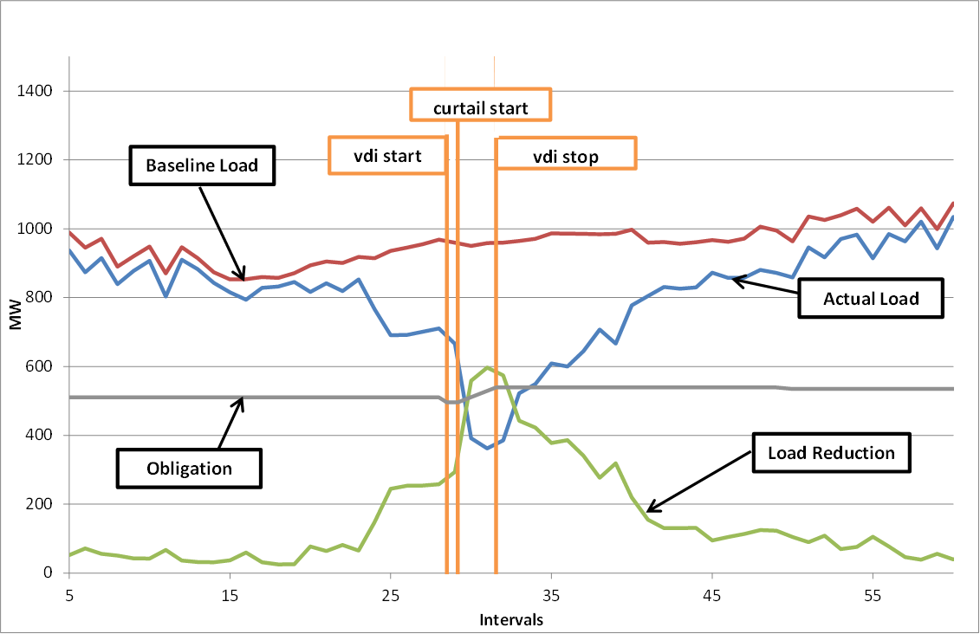
Reliability deployment price adder ramp
January 6, 2014 ERS-10 Deployment
Graph is based on 15-minute interval data.
Performance is based on a prorated obligation for the 1st partial interval and one full interval.
1 Resource had prescheduled unavailability from HE0900 - 1600 on the day of the event (14.6 MWs)

Slide 7
Crossover between procurement time periods and calculation of the adder
Current methodology uses the contracted capacity in each ERS Time Period
  Contracted capacities are not reduced by self deployments amounts
The ramp out of the adder is based on the contracted capacity for the ERS Time Period in which the recall instruction was issued.

Slide 8
Self-deployment of ERS
ERCOT’s opinion is that this is not an issue that needs to be addressed beyond what is currently in the protocols.
  May impact Resource/QSE availability/payment

Slide 9
Communicating ERS Deployment
Currently the only communication of an ERS Deployment to the market is through the operator notes
  This may not be timely or consistent

