Slide 1
Southern Cross Transmission Directives
Directive #3 : Ramp rate
ERCOT Staff
December 2019, PDCWG

Slide 2
Directive #3
ERCOT shall determine what ramp rate restrictions, if any, will be necessary to accommodate the interconnection of the Southern Cross DC tie and shall implement those restrictions and shall certify to the Commission when it has completed these actions.
Upon the interconnection of Southern Cross Transmission DC Tie, there is a potential of up to a 4100 MW change in the DC tie’s schedule (based on the projected maximum import/export capability of the tie).
In order to determine whether ramp rate restrictions should be imposed on the DC tie, ERCOT and PDCWG evaluated;
  the impact to ERCOT’s net load variability due to a DC tie ramp of this magnitude, and
  the impact on ERCOT’s ability to recover from frequency events such as Reportable Balancing Contingency Events during the DC Tie ramps.
  Existing process for managing DC Tie schedules

Slide 3
Recap of Directive #3 Discussions at PDCWG
ERCOT introduced Southern Cross Directive #3 at the April 2019 PDCWG meeting. Directive_3_Discussion_Points_v3.docx
  At the April 2019 PDCWG meeting, stakeholders requested ERCOT to provide high level overview of how the DC Ties are managed by Control Room today.
  Stakeholders also requested additional data related to usage of regulation during the DC tie ramps as well as historical net load ramp data.
At the June 2019 PDCWG meeting ERCOT presented both the items requested by the stakeholders.
  ERCOT_DC_Tie_Procedure.pptx
The August 2019 PDCWG meeting discussed potential approaches that may be utilized to manage DC Tie Ramps and if any specific restrictions were needed for Southern Cross DC Tie.
    SCT_Directive_3_Rec_PDCWG_Aug2019_v2.pptx
    Follow up with a draft recommendation based on the group’s discussion.
The October 209 PDCWG meeting discussed ERCOT’s proposed recommendation of additional protocol language management of DC Tie Schedules due to ramp limitations.

Slide 4
Proposed Approach
If system conditions near or in Real-Time show insufficient ramp capability to meet the sum of all DC Ties scheduled ramp, taking into account the full ramping capability of all available Resources and preserving sufficient PRC to avoid EEA triggers, ERCOT may request that one or more e-Tags be re-submitted with an adjusted ramp duration that would conform with the system’s ramp capability. If ERCOT determines that insufficient time exists to request re-submission of e-Tags, or that an insufficient number of e-Tags have been submitted to conform with the system’s ramp capability, ERCOT shall curtail DC Tie Schedules on a last-in-first-out basis and deny any additional e-Tags that cannot be accommodated within that ramp capability during the impacted intervals. .
Under NERC Standard INT-006-4 R1, ERCOT has the authority to reject or curtail an e-Tag that ERCOT does not expect to be capable of supporting either in magnitude or ramp.
Near Real Time in the event a ramp adjustment is needed on an approved e-tag, ERCOT will curtail one or more e-Tag(s) and include a comment to request the same be resubmitted with a different duration.

Slide 5
Example of a Ramp Duration Submission

Slide 6
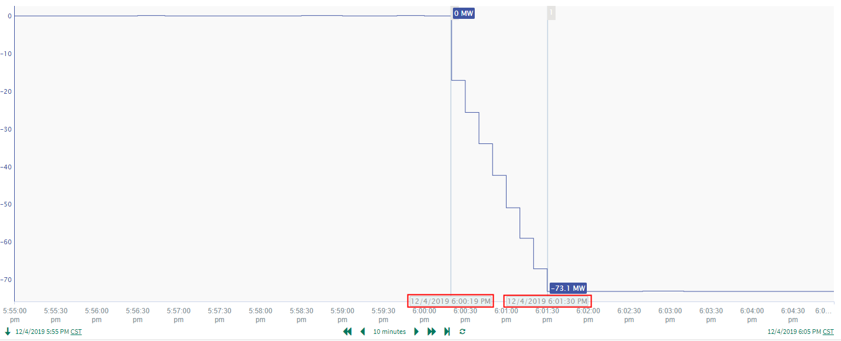
Example Real Time Flow

Slide 7
Example of a Ramp Duration Submission

Slide 8
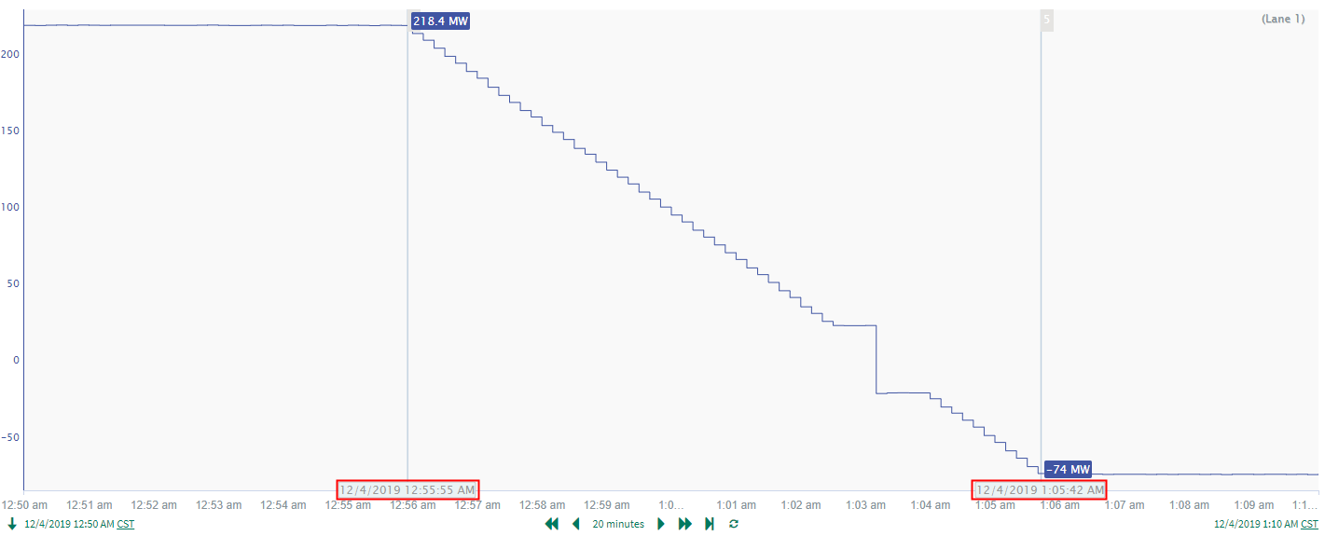
Example Real Time Flow

