Slide 1
ERCOT Frequency Control Report
November 2019
ERCOT
Operations Planning
PDCWG | December 11th, 2019

Slide 2
Summary of November 2019
CPS1: 174.54%
Current CPS1 12-Month Rolling Average: 174.58%
0 BAAL Exceedance
2 hourly CPS1 score below 100%
BAAL-003 Events have updated through 2018
2018 BAAL-003 FRM Performance: -843.17
2019 RMS1 Statistics
  Mean: 15.08 mHz
  Min: 13.11 mHz
  Max: 18.90 mHz
Energy Statistics
  Total Energy: 27,652,184 MWh
  Wind Energy: 6,358,646 MWh
  Percent Energy from Wind: 23.00%
  Solar Energy: 259.938
  Percent Energy from Solar: 0.94%
Minimum System Inertia
  Mean: 179,908
  Max: 260,577 on Nov 12th
  Min: 144,925 on Nov 19th

Slide 3
Frequency Control
CPS1, BAAL, & RMS1

Slide 4
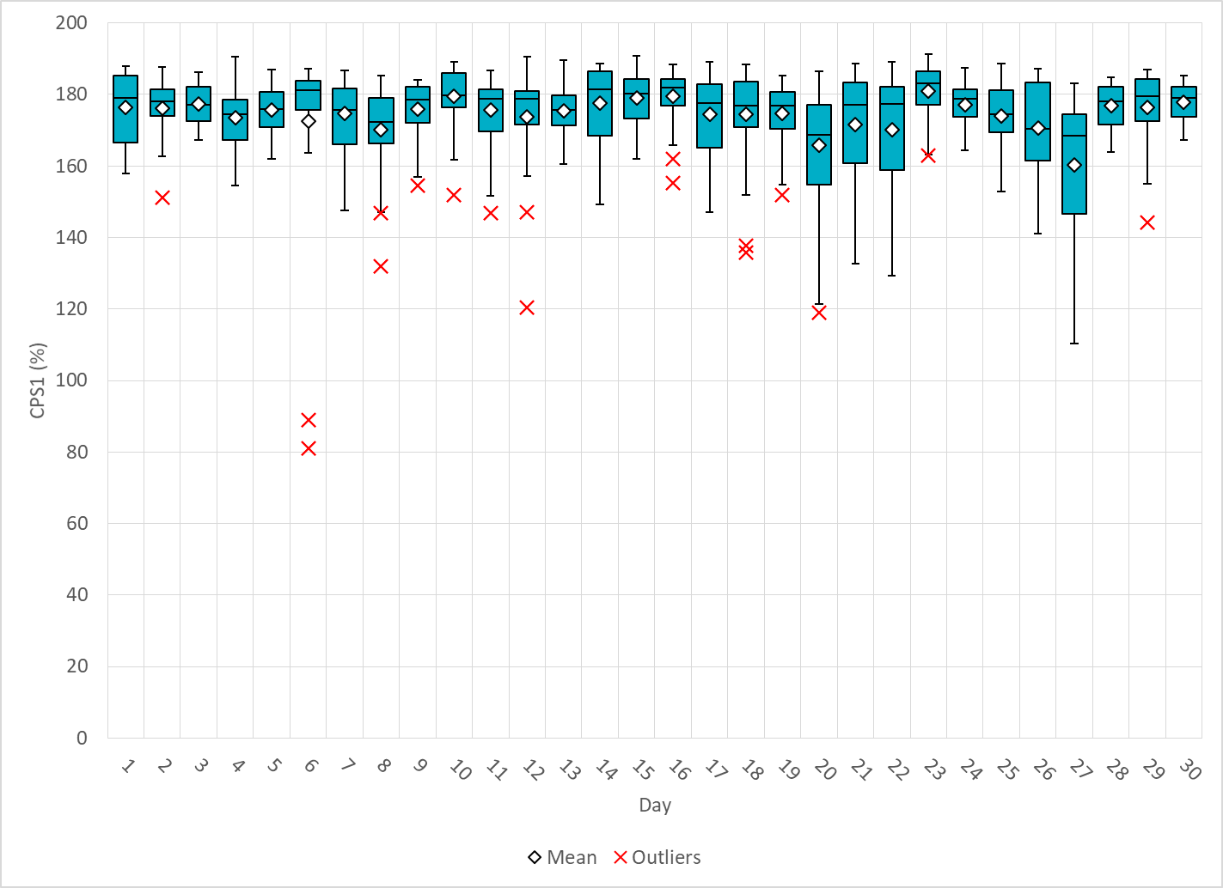
Hourly CPS1 by Day
Nov-19 CPS1 (%): 174.54
Notes:
Outliers:
11/06/2019 19:00 88.8%:
Large Down Ramp Rate from wind at the beginning of the hour which led to a large expected generation deviation minimum of -1109 MW @ 19:20
11/06/2019 20:00 81.6%
Large generation deviation of -819.4MW @ 20:35:27 due large down ramp rate from wind
Large generation deviation of -903.4MW @ 20:52:57 due to large down ramp rate from wind

Slide 5
BAAL Exceedances & Violations
There was 0 BAAL exceedances in Nov

Slide 6
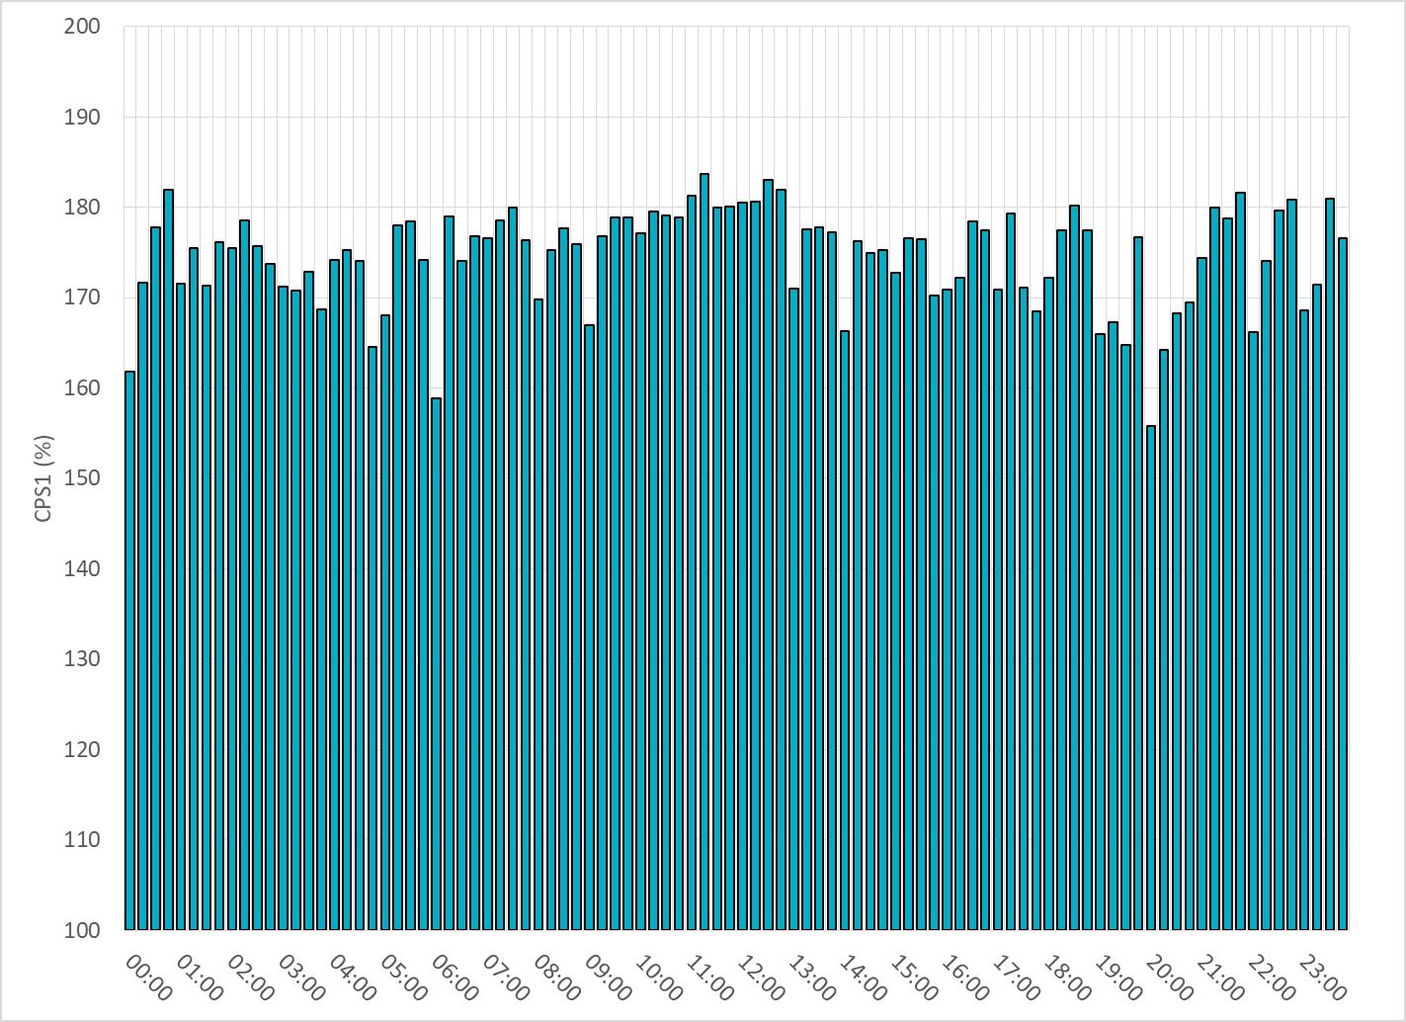
15-Minute Average CPS1%
Nov-19 CPS1 (%): 174.54

Slide 7
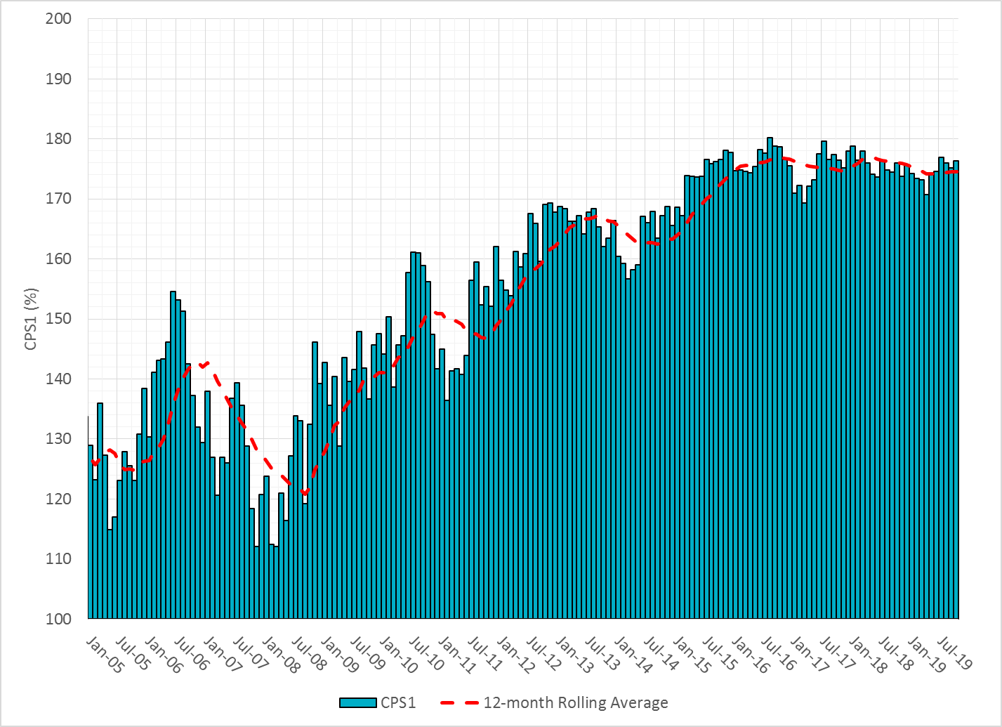
12-Month Rolling Average CPS1
Current 12-Month Rolling Average: 174.58%

Slide 8
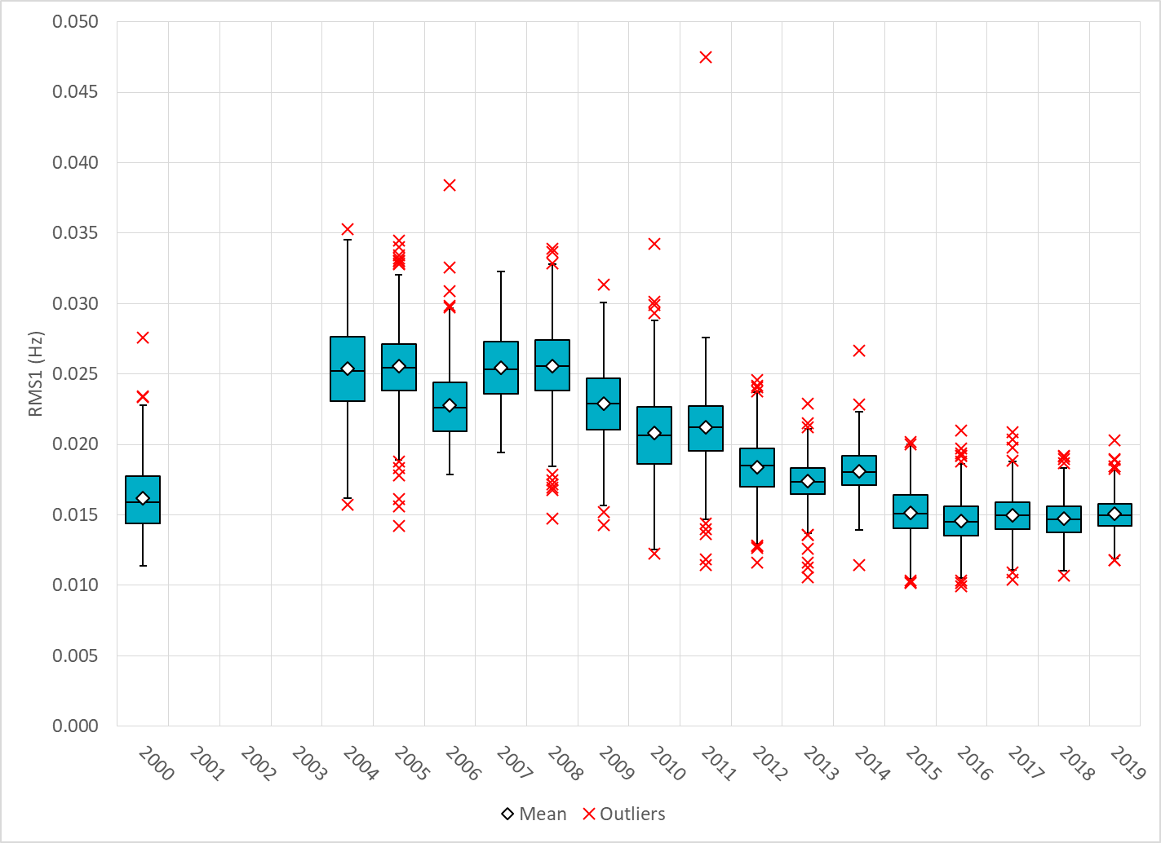
Daily RMS1 of ERCOT Frequency by Year
Notes:
Mean: 15.08 mHz

Slide 9
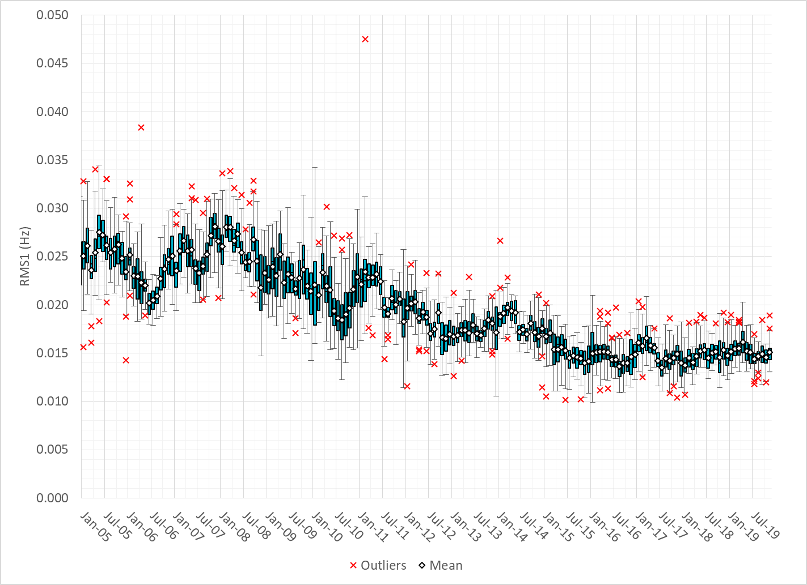
Daily RMS1 of ERCOT Frequency by Month

Slide 10
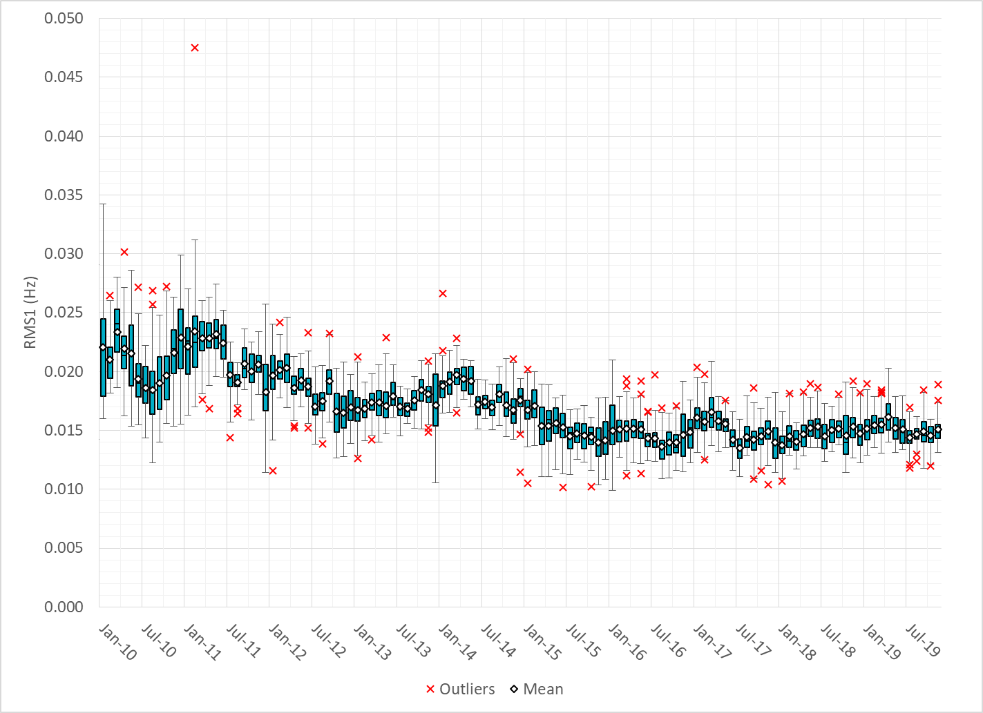
Daily RMS1 of ERCOT Frequency by Month
Notes:
Mean: 15.08 mHz
Min: 13.11 mHz
Max: 18.90 mHz

Slide 11
Frequency Profile Comparison

Slide 12
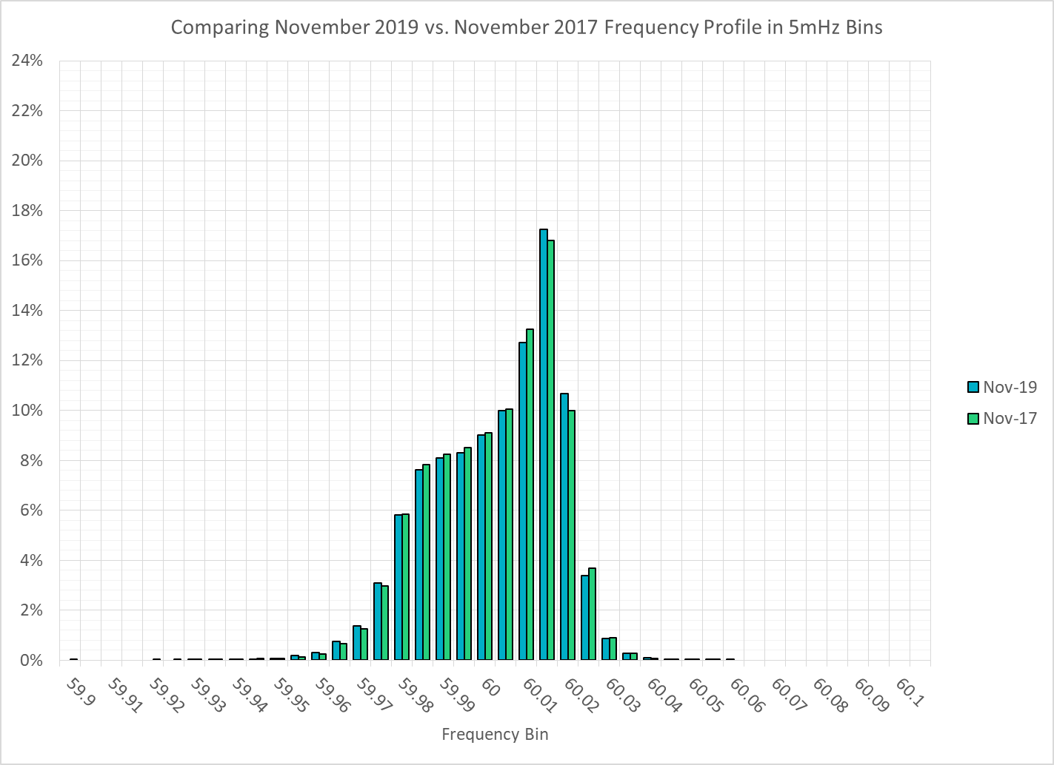
Frequency Profile Comparison

Slide 13
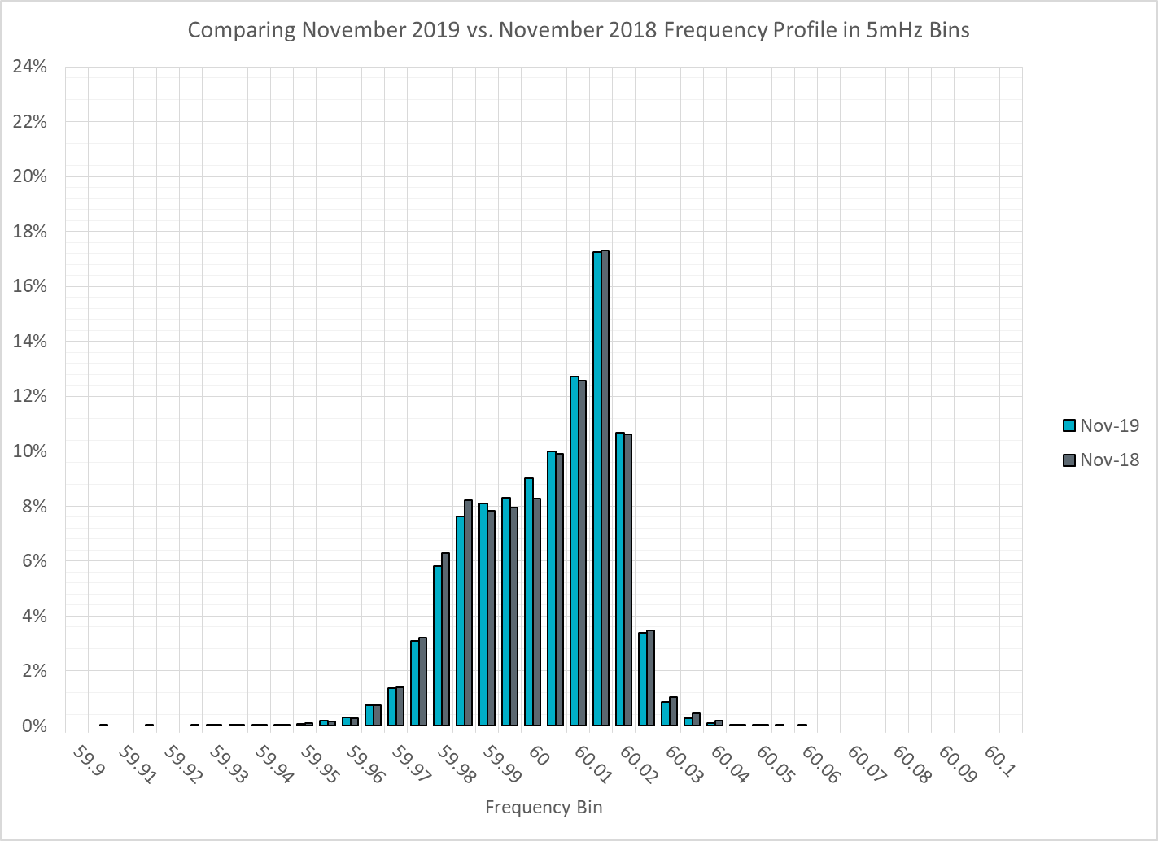
Frequency Profile Comparison

Slide 14
Time Error Correction

Slide 15
ERCOT Daily Time Error

Slide 16
Time Error Corrections Log Summary
There have been no time error corrections since December 2016

Slide 17
BAL-003 Performance

Slide 18
Op. Year 2018 BAL-003 Selected Events – Update
Notes:
BAL-003

Slide 19
Op. Year 2018 BAL-003 FRM Performance - Update

Slide 20
ERCOT Energy Statistics

Slide 21
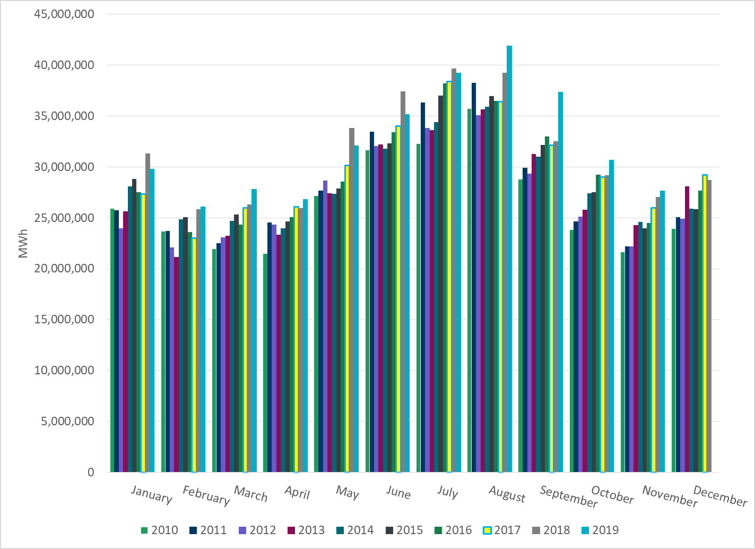
Total Energy
Notes:
27,652,184 MWh

Slide 22
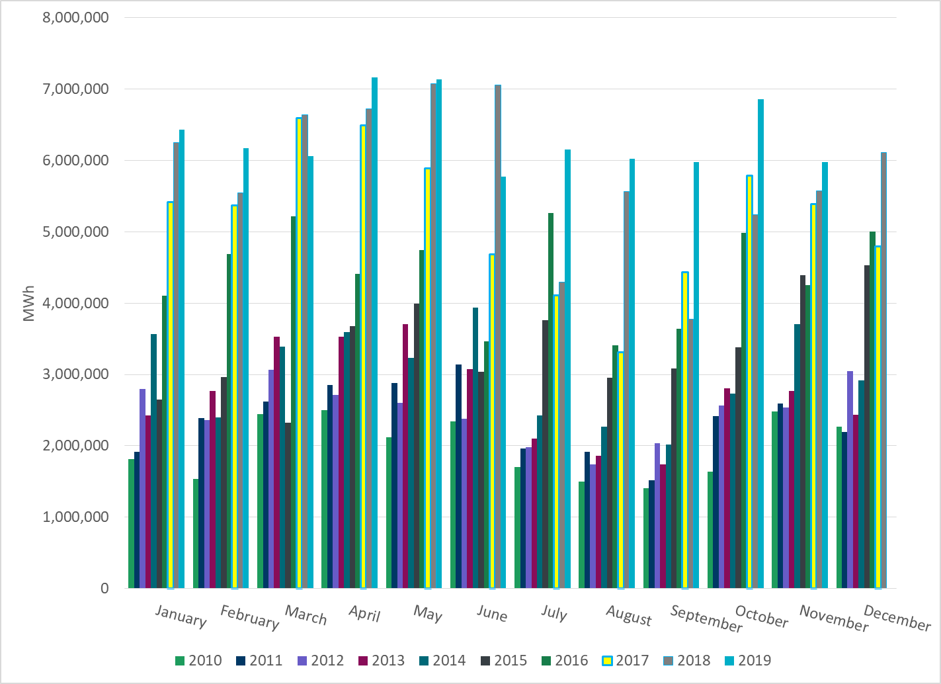
Total Energy from Wind Generation
Notes:
6,358,646 MWh

Slide 23
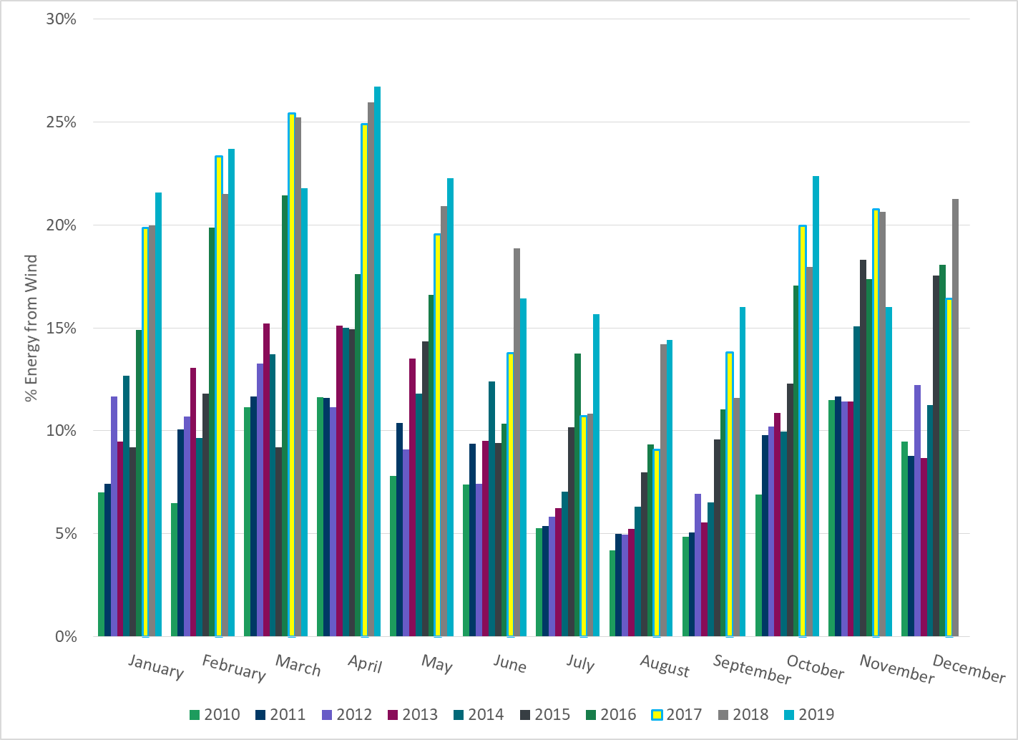
% Energy from Wind Generation
Notes:
23.00%

Slide 24
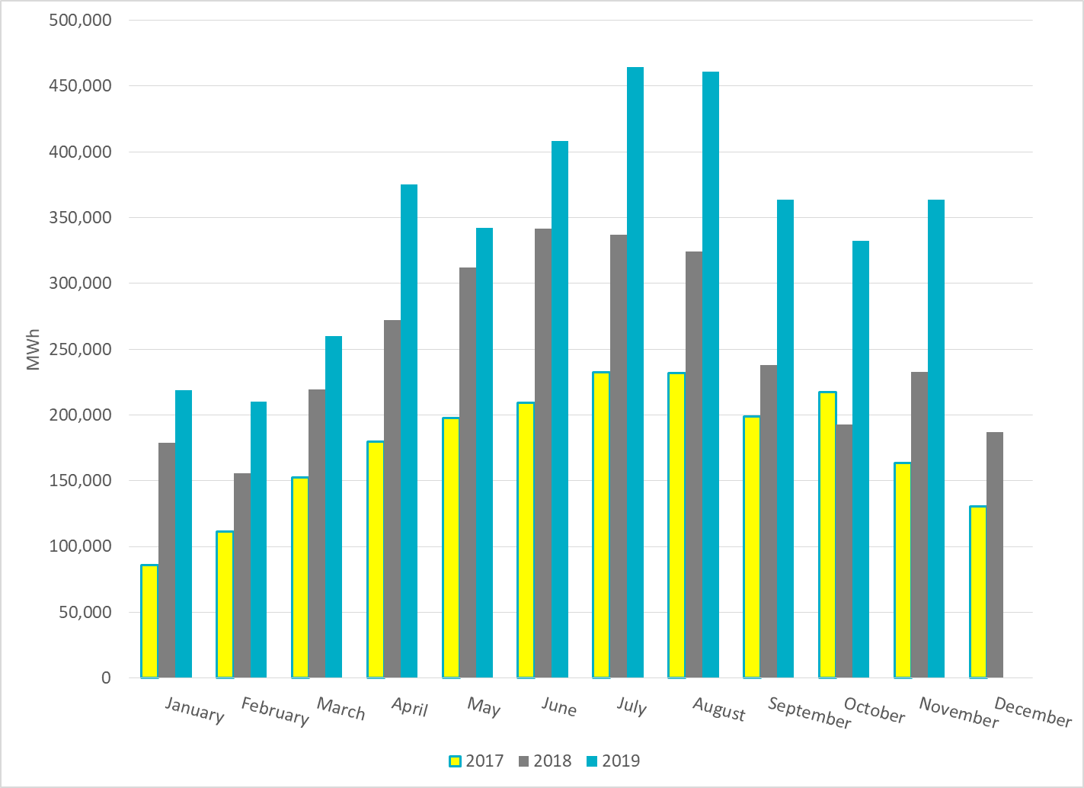
Total Energy From Solar Generation
Notes:
259,938 MWh

Slide 25
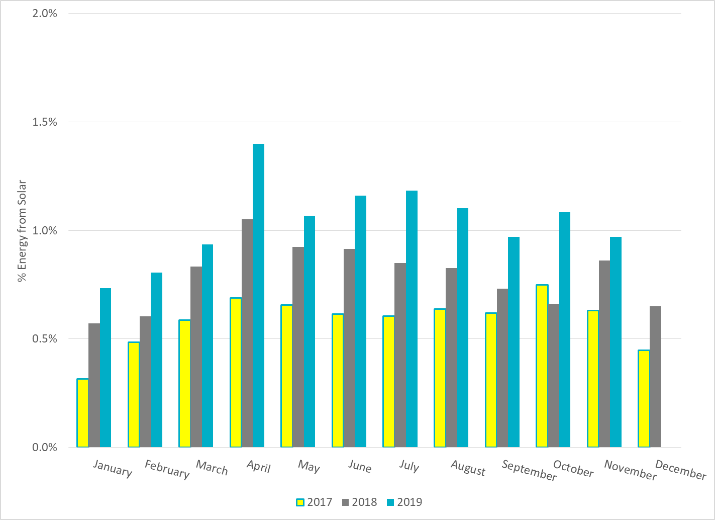
% Energy from Solar Generation
Notes:
0.94%

Slide 26
ERCOT System Inertia

Slide 27
Daily Minimum System Inertia
Notes:
Minimum Inertia = 128,759 MW*s on 11/3/2018.
Previous Minimum was 130,014 MW*s on 10/27/2017. This was also our record wind day.
Data:
Mean: 179,908
Max: 260,577 on Nov 12th
Min: 144,925 on Nov 19th

Slide 28
Questions?
Thank you!

