Slide 1
Distribution Generation Resource (DGR) Workshop
Bill Blevins
Director, Grid Operations
Dec 11, 2019

Slide 2
DGR update
All total there are now:
  1 existing DGR
  37 DGR locations in the que and 3 more that are being reviewed
  ~376 MW
  9 TDSPs
  11 Developers
  All Batteries
ERCOT has notified projects that filed affidavits.
Several projects have moved forward by supplying the DGR conditions.
ERCOT is reviewing the DGR conditions and providing approval on case by case basis as conditions are submitted.

Slide 3
Feedback received after first DGR Workshop
Two categories of comments received:
  1) Comments and suggestions regarding proposed language
    Have been incorporated into the posted proposed documents. (shown in purple)
    Any unresolved comments to be discussed today
  2) Concerns about the moratorium/expediting the process

Slide 4
Key Items Addressed in the Proposed NPRR
Provide new definitions and Resources (attributes)
  Distribution Generation Resource (DGR) (modify existing definition).
  Distribution Energy Storage Resource (DESR)
  Propose minimum size requirement of 1 MW
  Introduce new generator attribute “Inverter Based Resource”
DGR Outage scheduling requirements
  Clarify notification would only apply to “planned outages” on DSPs system
New Section 3.8.6 Applying requirements for DGR to DESR terms
New Section 3.8.7 for DGRs
  Clarify that DGRs are not allowed on any manual Load shed plan, automatic UFLS or UVLS systems
  Concerns about long term sustainability if these proliferate
Proposes long-term solution for ‘mapping’ vs current practice of modeling.
Explicitly clarifies DGR exemption from Voltage Support Service (VSS)

Slide 5
Key Items to Address in the Proposed NOGRR
DGR shall have AVR enabled and shall coordinate settings with DSP
DGR shall have PFR enabled with droop settings specified
  +/- 0.017 Hz @ 5%
Clarify shutdown response time requirements
Aligns with NPRR DGR exemption from VSS
Provide new (revised) Voltage ride-through settings for distribution-connected Resources
  Synchronous
  Inverter-based

Slide 6
Proposed NOGRR Language (cont)
2.9.2 Voltage Ride-Through Requirements for Distribution Generation Resources (DGR)
(1) For any short-circuit fault or open-phase condition that occurs on the circuit section which the DGR is connected to, the DGR is not required to comply with the ride-through requirements of this section.
(2) DGRs utilizing synchronous generation must be designed and relays must be set to ride-through the voltage conditions as shown below:
Voltage Range | Operating mode | Minimum ride-through
0.88≤V≤1.1 | Continous Operation | Infinite
0.7≤V≤0.88 | limited ride-through | Slope 4 seconds /1p.u. starting at 0.7 seconds @ 0.7 p.u. to 1.42 seconds at 0.88 p.u.
Notes:
Clarifies and adds Ride-through requirements for DGR/DESR

Slide 7
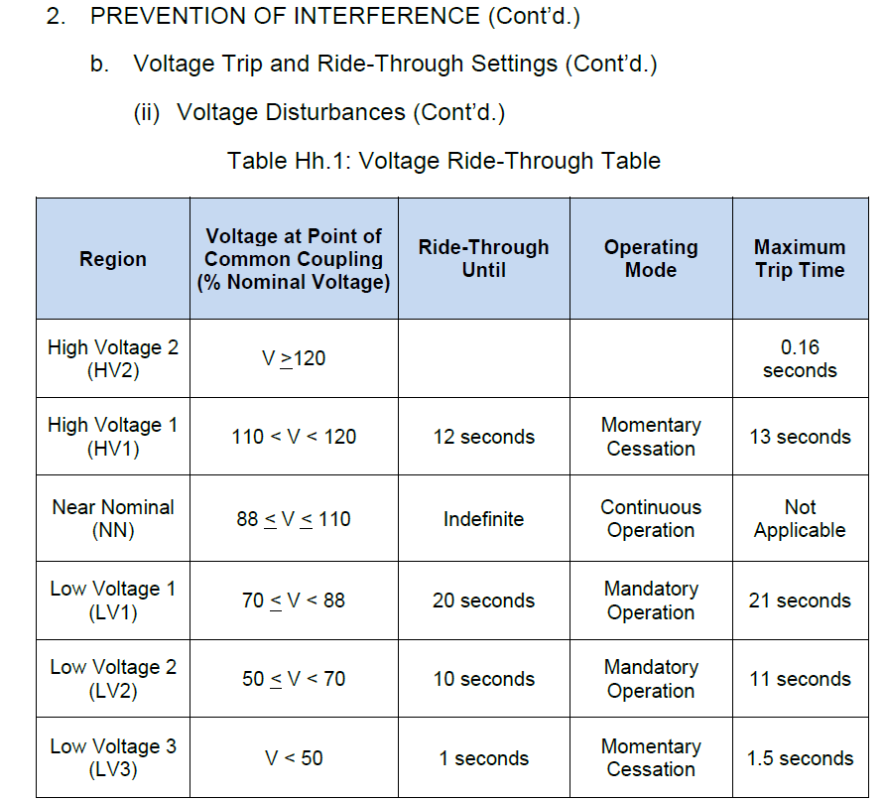
Proposed NOGRR Language (cont)
2.9.2 Voltage Ride-Through Requirements for Distribution Generation Resources (DGR)
(3) DGRs utilizing inverter-based generation must be designed and relays must be set to ride-through the voltage conditions in table 1 below:
Table 1: Revised Ride-through settings for Inverter-Based DGRs
Notes:
Clarifies and adds Ride-through requirements for DGR/DESR

Slide 8
Other Key Concepts to be Addressed
Market Notice was intended to identify operational and reliability concerns with DGRs
NPRR and NOGRR address the majority of operational concerns.
The Planning Guide has been focused on providing a clear, consistent, transparent system for interconnecting and studying Transmission-connected generators.
Need to implement a clear, consistent, transparent method for interconnecting and studying DGRs.
  Registration, tracking, and interconnection process
  Ensure various system impacts from individual and multiple units are studied
  Inclusion into ERCOT planning studies (will require changes to OBDs)

Slide 9
Comments
Submit comments or additional input by Friday, Jan. 4 for inclusion in TAC Update scheduled for Wednesday, Jan 29, 2020.
Bill Blevins
  Bill.Blevins@ercot.com
  (512) 248-6691

Slide 10
Questions?

