Slide 1
2020 Long-Term Load Forecast
Sarah Parody
Load Forecasting & Analysis
SAWG
December 13, 2019

Slide 2
Agenda
Load Forecasting Framework
Growth Driver
Normal Weather (P50) Forecast
ERCOT P50 Forecast

Slide 3
Agenda
Assumptions and Challenges
Active Models
Weather Zone P50 and P90 Forecasts
Questions

Slide 4
Load Forecasting Framework

Slide 5
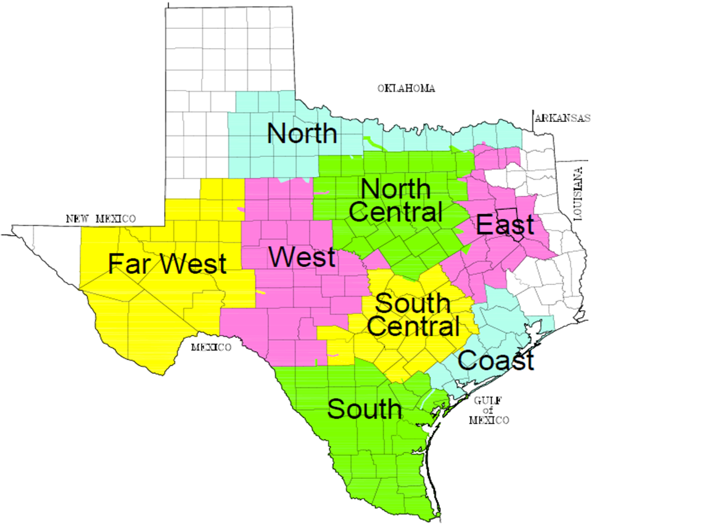
Weather Zones
2 or 3 Weather Stations in each Weather Zone

Slide 6
Load Models
Unique Model for
Each Weather Zone
Each Temperature Group
Hot
Medium
Cold

Slide 7
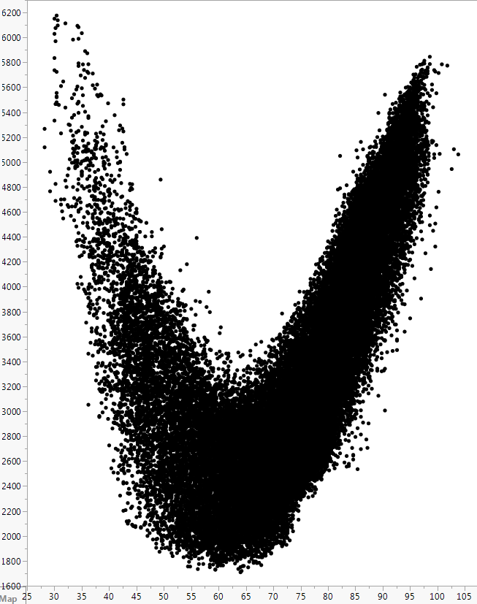
Load Models
South Load vs. Temperature
Unique Model for
Each Weather Zone
Each Temperature Group
Hot
Medium
Cold
MW
Temperature

Slide 8
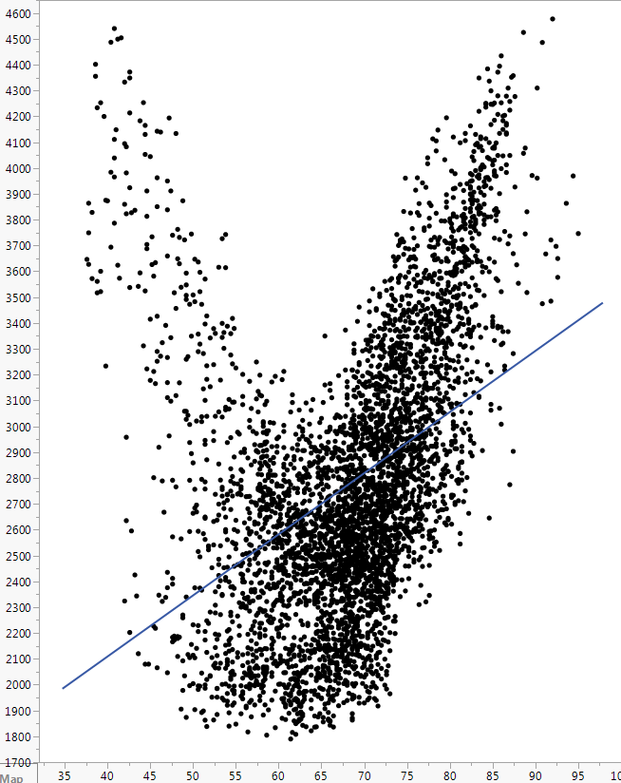
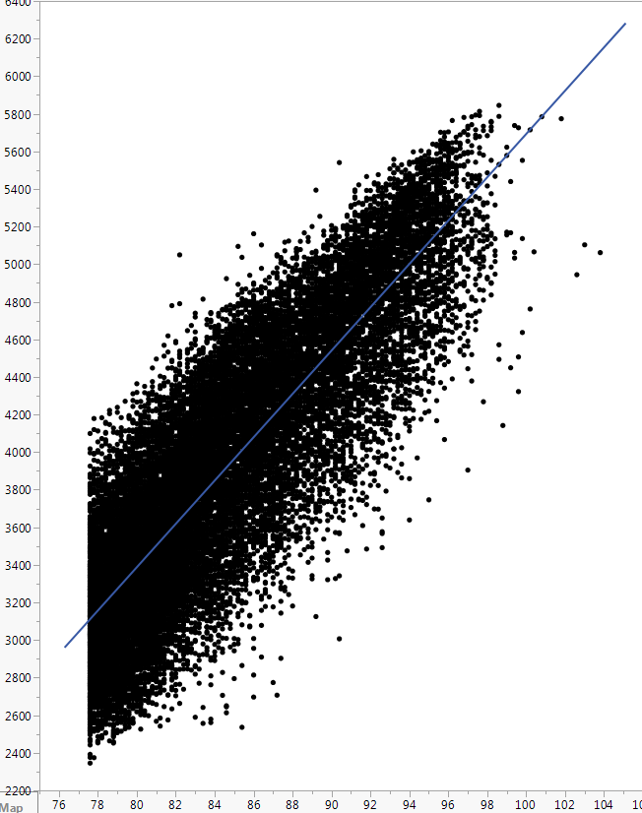
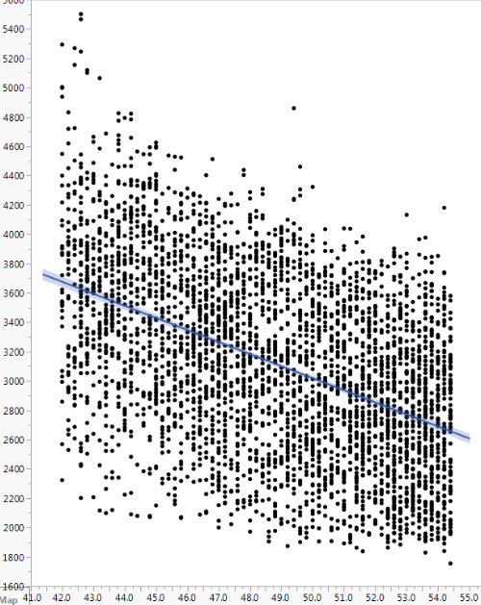
Temperature Groups
South March
South Hot
South Medium Cold
MW
MW
Temperature
Temperature

Slide 9
Months vs. Temperature Groups
South March
MW
Temperature

Slide 10
Months vs. Temperature Groups
South March
South Hot
MW
MW
Temperature
Temperature

Slide 11
Input Data
Hourly Models
From January 2014 through August 2019
Recent Snapshot
Appliance Stock
Energy Efficiency
Demand Response
Price Responsive Load

Slide 12
Input Data
Weather
Calendar
Actual Load

Slide 13
Input Data
Weather
Temperature, Temperature Squared, and Temperature Cubed
Cooling Degree Days and Heating Degree Days
Cloud Cover
Wind Speed
Dew Point

Slide 14
Input Data
Calendar
Month
Day of the Week
Holidays
Hour
Interact Hour with Day of the Week

Slide 15
Input Data
Variable Interactions
Interact a Weather Variable with a Calendar Variable
Temperature with Hour
Dew Point with Hour
Interact multiple Weather Variables with a Calendar Variable
Temperature with Dew Point and Hour

Slide 16
Growth Driver

Slide 17
Premise Forecast
Unique Model for
Each Weather Zone
Each Premise Class
Residential
Commercial
Industrial
Monthly Models

Slide 18
Input Data
From January 2014 through August 2019
Economic Measures
Population
Non-Farm Employment
Housing Stock
Error Correction Term

Slide 19
Challenges
Premise Counts increased significantly via opt-in

Slide 20
Challenges
Premise Counts increased significantly via opt-in

Slide 21
Growth Driver for Far West and West
Economic Measures from Moody’s Base Scenario
Population
Non-Farm Employment
Housing Stock

Slide 22
Normal Weather (P50) Forecast

Slide 23
Normal Weather (P50) Forecast
Coast 2020 Summer Forecasts
Year | Month | Day | Hour | Rank | Forecast based on 2004’s Weather
2020 | 8 | 22 | 18 | 1 | 21,257
2020 | 8 | 22 | 17 | 2 | 21,166
2020 | 8 | 22 | 16 | 3 | 21,083
2020 | 8 | 21 | 18 | 4 | 20,996
2020 | 8 | 21 | 17 | 5 | 20,834
Rank | 2003 | 2004 | 2005 | 2006 | 2007 | 2008 | 2009 | 2010 | 2011 | 2012 | 2013 | 2014 | 2015 | 2016 | 2017 | P50
1 | 21,257 | 20,994 | 20,757 | 20,752 | 21,015 | 20,748 | 21,295 | 21,047 | 21,857 | 21,799 | 21,132 | 20,842 | 21,582 | 21,349 | 20,738 | 21,144
2 | 21,211 | 20,840 | 20,099 | 20,542 | 20,981 | 20,368 | 21,162 | 20,950 | 21,830 | 20,910 | 20,979 | 20,839 | 21,558 | 21,064 | 20,689 | 20,935
3 | 21,191 | 20,763 | 20,095 | 20,422 | 20,769 | 20,330 | 20,938 | 20,851 | 21,631 | 20,904 | 20,926 | 20,746 | 21,353 | 20,998 | 20,542 | 20,831
4 | 21,059 | 20,740 | 20,088 | 20,294 | 20,726 | 20,305 | 20,934 | 20,814 | 21,617 | 20,825 | 20,926 | 20,718 | 21,249 | 20,977 | 20,470 | 20,783
5 | 20,923 | 20,446 | 19,976 | 20,221 | 20,708 | 20,144 | 20,844 | 20,797 | 21,568 | 20,804 | 20,897 | 20,677 | 21,211 | 20,968 | 20,462 | 20,710

Slide 24
Normal Weather (P50) Forecast
Coast 2020 Summer Forecasts
Year | Month | Day | Hour | Rank | Forecast based on 2004’s Weather
2020 | 8 | 22 | 18 | 1 | 21,257
2020 | 8 | 22 | 17 | 2 | 21,166
2020 | 8 | 22 | 16 | 3 | 21,083
2020 | 8 | 21 | 18 | 4 | 20,996
2020 | 8 | 21 | 17 | 5 | 20,834
Sort from high to low
Rank | 2003 | 2004 | 2005 | 2006 | 2007 | 2008 | 2009 | 2010 | 2011 | 2012 | 2013 | 2014 | 2015 | 2016 | 2017 | P50
1 | 21,257 | 20,994 | 20,757 | 20,752 | 21,015 | 20,748 | 21,295 | 21,047 | 21,857 | 21,799 | 21,132 | 20,842 | 21,582 | 21,349 | 20,738 | 21,144
2 | 21,211 | 20,840 | 20,099 | 20,542 | 20,981 | 20,368 | 21,162 | 20,950 | 21,830 | 20,910 | 20,979 | 20,839 | 21,558 | 21,064 | 20,689 | 20,935
3 | 21,191 | 20,763 | 20,095 | 20,422 | 20,769 | 20,330 | 20,938 | 20,851 | 21,631 | 20,904 | 20,926 | 20,746 | 21,353 | 20,998 | 20,542 | 20,831
4 | 21,059 | 20,740 | 20,088 | 20,294 | 20,726 | 20,305 | 20,934 | 20,814 | 21,617 | 20,825 | 20,926 | 20,718 | 21,249 | 20,977 | 20,470 | 20,783
5 | 20,923 | 20,446 | 19,976 | 20,221 | 20,708 | 20,144 | 20,844 | 20,797 | 21,568 | 20,804 | 20,897 | 20,677 | 21,211 | 20,968 | 20,462 | 20,710

Slide 25
Normal Weather (P50) Forecast
Coast 2020 Summer Forecasts
Year | Month | Day | Hour | Rank | Forecast based on 2004’s Weather
2020 | 8 | 22 | 18 | 1 | 21,257
2020 | 8 | 22 | 17 | 2 | 21,166
2020 | 8 | 22 | 16 | 3 | 21,083
2020 | 8 | 21 | 18 | 4 | 20,996
2020 | 8 | 21 | 17 | 5 | 20,834
Rank | 2003 | 2004 | 2005 | 2006 | 2007 | 2008 | 2009 | 2010 | 2011 | 2012 | 2013 | 2014 | 2015 | 2016 | 2017 | P50
1 | 21,257 | 20,994 | 20,757 | 20,752 | 21,015 | 20,748 | 21,295 | 21,047 | 21,857 | 21,799 | 21,132 | 20,842 | 21,582 | 21,349 | 20,738 | 21,144
2 | 21,211 | 20,840 | 20,099 | 20,542 | 20,981 | 20,368 | 21,162 | 20,950 | 21,830 | 20,910 | 20,979 | 20,839 | 21,558 | 21,064 | 20,689 | 20,935
3 | 21,191 | 20,763 | 20,095 | 20,422 | 20,769 | 20,330 | 20,938 | 20,851 | 21,631 | 20,904 | 20,926 | 20,746 | 21,353 | 20,998 | 20,542 | 20,831
4 | 21,059 | 20,740 | 20,088 | 20,294 | 20,726 | 20,305 | 20,934 | 20,814 | 21,617 | 20,825 | 20,926 | 20,718 | 21,249 | 20,977 | 20,470 | 20,783
5 | 20,923 | 20,446 | 19,976 | 20,221 | 20,708 | 20,144 | 20,844 | 20,797 | 21,568 | 20,804 | 20,897 | 20,677 | 21,211 | 20,968 | 20,462 | 20,710

Slide 26
Normal Weather (P50) Forecast
Coast 2020 Summer Forecasts
Year | Month | Day | Hour | Rank | Forecast based on 2004’s Weather
2020 | 8 | 22 | 18 | 1 | 21,257
2020 | 8 | 22 | 17 | 2 | 21,166
2020 | 8 | 22 | 16 | 3 | 21,083
2020 | 8 | 21 | 18 | 4 | 20,996
2020 | 8 | 21 | 17 | 5 | 20,834
Rank | 2004 | 2005 | 2006 | 2007 | 2008 | 2009 | 2010 | 2011 | 2012 | 2013 | 2014 | 2015 | 2016 | 2017 | 2018 | P50
1 | 21,257 | 21,208 | 21,081 | 21,499 | 21,099 | 21,858 | 21,485 | 22,220 | 22,656 | 21,458 | 21,172 | 22,031 | 21,660 | 21,074 | 21,290 | 21,536
2 | 21,166 | 20,502 | 20,895 | 21,413 | 20,756 | 21,384 | 21,266 | 22,151 | 21,250 | 21,244 | 21,132 | 21,947 | 21,406 | 21,025 | 21,257 | 21,253
3 | 21,083 | 20,421 | 20,883 | 21,358 | 20,716 | 21,277 | 21,254 | 22,128 | 21,236 | 21,211 | 21,099 | 21,589 | 21,356 | 20,902 | 21,153 | 21,178
4 | 20,996 | 20,404 | 20,603 | 21,225 | 20,641 | 21,250 | 21,170 | 22,096 | 21,152 | 21,210 | 21,001 | 21,555 | 21,348 | 20,841 | 21,131 | 21,108
5 | 20,834 | 20,382 | 20,495 | 21,131 | 20,591 | 21,156 | 21,169 | 22,040 | 21,119 | 21,188 | 20,972 | 21,545 | 21,299 | 20,792 | 21,062 | 21,052

Slide 27
Normal Weather (P50) Forecast
Coast 2020 Summer Forecasts
Rank | 2004 | 2005 | 2006 | 2007 | 2008 | 2009 | 2010 | 2011 | 2012 | 2013 | 2014 | 2015 | 2016 | 2017 | 2018 | P50
1 | 21,257 | 21,208 | 21,081 | 21,499 | 21,099 | 21,858 | 21,485 | 22,220 | 22,656 | 21,458 | 21,172 | 22,031 | 21,660 | 21,074 | 21,290 | 21,536
2 | 21,166 | 20,502 | 20,895 | 21,413 | 20,756 | 21,384 | 21,266 | 22,151 | 21,250 | 21,244 | 21,132 | 21,947 | 21,406 | 21,025 | 21,257 | 21,253
3 | 21,083 | 20,421 | 20,883 | 21,358 | 20,716 | 21,277 | 21,254 | 22,128 | 21,236 | 21,211 | 21,099 | 21,589 | 21,356 | 20,902 | 21,153 | 21,178
4 | 20,996 | 20,404 | 20,603 | 21,225 | 20,641 | 21,250 | 21,170 | 22,096 | 21,152 | 21,210 | 21,001 | 21,555 | 21,348 | 20,841 | 21,131 | 21,108
5 | 20,834 | 20,382 | 20,495 | 21,131 | 20,591 | 21,156 | 21,169 | 22,040 | 21,119 | 21,188 | 20,972 | 21,545 | 21,299 | 20,792 | 21,062 | 21,052

Slide 28
Normal Weather (P50) Forecast

Slide 29
Normal Weather (P50) Forecast
Coast 2020 Summer Forecasts
Rank | 2004 | 2005 | 2006 | 2007 | 2008 | 2009 | 2010 | 2011 | 2012 | 2013 | 2014 | 2015 | 2016 | 2017 | 2018 | P50
1 | 21,257 | 21,208 | 21,081 | 21,499 | 21,099 | 21,858 | 21,485 | 22,220 | 22,656 | 21,458 | 21,172 | 22,031 | 21,660 | 21,074 | 21,290 | 21,536
2 | 21,166 | 20,502 | 20,895 | 21,413 | 20,756 | 21,384 | 21,266 | 22,151 | 21,250 | 21,244 | 21,132 | 21,947 | 21,406 | 21,025 | 21,257 | 21,253
3 | 21,083 | 20,421 | 20,883 | 21,358 | 20,716 | 21,277 | 21,254 | 22,128 | 21,236 | 21,211 | 21,099 | 21,589 | 21,356 | 20,902 | 21,153 | 21,178
4 | 20,996 | 20,404 | 20,603 | 21,225 | 20,641 | 21,250 | 21,170 | 22,096 | 21,152 | 21,210 | 21,001 | 21,555 | 21,348 | 20,841 | 21,131 | 21,108
5 | 20,834 | 20,382 | 20,495 | 21,131 | 20,591 | 21,156 | 21,169 | 22,040 | 21,119 | 21,188 | 20,972 | 21,545 | 21,299 | 20,792 | 21,062 | 21,052

Slide 30
Normal Weather (P50) Forecast
Coast 2020 Summer Forecasts
Rank | 2004 | 2005 | 2006 | 2007 | 2008 | 2009 | 2010 | 2011 | 2012 | 2013 | 2014 | 2015 | 2016 | 2017 | 2018 | P50
1 | 21,257 | 21,208 | 21,081 | 21,499 | 21,099 | 21,858 | 21,485 | 22,220 | 22,656 | 21,458 | 21,172 | 22,031 | 21,660 | 21,074 | 21,290 | 21,536
2 | 21,166 | 20,502 | 20,895 | 21,413 | 20,756 | 21,384 | 21,266 | 22,151 | 21,250 | 21,244 | 21,132 | 21,947 | 21,406 | 21,025 | 21,257 | 21,253
3 | 21,083 | 20,421 | 20,883 | 21,358 | 20,716 | 21,277 | 21,254 | 22,128 | 21,236 | 21,211 | 21,099 | 21,589 | 21,356 | 20,902 | 21,153 | 21,178
4 | 20,996 | 20,404 | 20,603 | 21,225 | 20,641 | 21,250 | 21,170 | 22,096 | 21,152 | 21,210 | 21,001 | 21,555 | 21,348 | 20,841 | 21,131 | 21,108
5 | 20,834 | 20,382 | 20,495 | 21,131 | 20,591 | 21,156 | 21,169 | 22,040 | 21,119 | 21,188 | 20,972 | 21,545 | 21,299 | 20,792 | 21,062 | 21,052

Slide 31
Normal Weather (P50) Forecast
Coast 2020 Summer Forecasts
Rank | 2004 | 2005 | 2006 | 2007 | 2008 | 2009 | 2010 | 2011 | 2012 | 2013 | 2014 | 2015 | 2016 | 2017 | 2018 | P50
1 | 21,257 | 21,208 | 21,081 | 21,499 | 21,099 | 21,858 | 21,485 | 22,220 | 22,656 | 21,458 | 21,172 | 22,031 | 21,660 | 21,074 | 21,290 | 21,536
2 | 21,166 | 20,502 | 20,895 | 21,413 | 20,756 | 21,384 | 21,266 | 22,151 | 21,250 | 21,244 | 21,132 | 21,947 | 21,406 | 21,025 | 21,257 | 21,253
3 | 21,083 | 20,421 | 20,883 | 21,358 | 20,716 | 21,277 | 21,254 | 22,128 | 21,236 | 21,211 | 21,099 | 21,589 | 21,356 | 20,902 | 21,153 | 21,178
4 | 20,996 | 20,404 | 20,603 | 21,225 | 20,641 | 21,250 | 21,170 | 22,096 | 21,152 | 21,210 | 21,001 | 21,555 | 21,348 | 20,841 | 21,131 | 21,108
5 | 20,834 | 20,382 | 20,495 | 21,131 | 20,591 | 21,156 | 21,169 | 22,040 | 21,119 | 21,188 | 20,972 | 21,545 | 21,299 | 20,792 | 21,062 | 21,052

Slide 32
Normal Weather (P50) Forecast

Slide 33
Normal Weather (P50) Forecast
For every weather zone
For every forecasted year (2020-2029)

Slide 34
Normal Weather (P50) Forecast
Forecasted values are
Ranked from high to low
Averaged by Rank
Coast 2020 Summer Forecasts
Rank | 2004 | 2005 | 2006 | 2007 | 2008 | 2009 | 2010 | 2011 | 2012 | 2013 | 2014 | 2015 | 2016 | 2017 | 2018 | P50
1 | 21,257 | 21,208 | 21,081 | 21,499 | 21,099 | 21,858 | 21,485 | 22,220 | 22,656 | 21,458 | 21,172 | 22,031 | 21,660 | 21,074 | 21,290 | 21,536
2 | 21,166 | 20,502 | 20,895 | 21,413 | 20,756 | 21,384 | 21,266 | 22,151 | 21,250 | 21,244 | 21,132 | 21,947 | 21,406 | 21,025 | 21,257 | 21,253
3 | 21,083 | 20,421 | 20,883 | 21,358 | 20,716 | 21,277 | 21,254 | 22,128 | 21,236 | 21,211 | 21,099 | 21,589 | 21,356 | 20,902 | 21,153 | 21,178
4 | 20,996 | 20,404 | 20,603 | 21,225 | 20,641 | 21,250 | 21,170 | 22,096 | 21,152 | 21,210 | 21,001 | 21,555 | 21,348 | 20,841 | 21,131 | 21,108
5 | 20,834 | 20,382 | 20,495 | 21,131 | 20,591 | 21,156 | 21,170 | 22,040 | 21,119 | 21,188 | 20,972 | 21,545 | 21,299 | 20,792 | 21,062 | 21,052

Slide 35
ERCOT P50 Forecast

Slide 36
ERCOT P50 Forecast
Historical Year | Month | Day | Hour | Rank | Actual Load
2008 | 8 | 1 | 17 | 1 | 17,623
2008 | 8 | 1 | 16 | 2 | 17,478
2008 | 8 | 1 | 18 | 3 | 17,463
2008 | 8 | 8 | 17 | 4 | 17,222
2008 | 8 | 8 | 18 | 5 | 17,184
Coast 2008 Summer Actual Load

Slide 37
ERCOT P50 Forecast
Historical Year | Month | Day | Hour | Rank | Actual Load
2008 | 8 | 1 | 17 | 1 | 17,623
2008 | 8 | 1 | 16 | 2 | 17,478
2008 | 8 | 1 | 18 | 3 | 17,463
2008 | 8 | 8 | 17 | 4 | 17,222
2008 | 8 | 8 | 18 | 5 | 17,184
Sort from high to low
Coast 2008 Summer Actual Load

Slide 38
ERCOT P50 Forecast
Historical Year | Month | Day | Hour | Rank | Actual Load
2008 | 8 | 1 | 17 | 1 | 17,623
2008 | 8 | 1 | 16 | 2 | 17,478
2008 | 8 | 1 | 18 | 3 | 17,463
2008 | 8 | 8 | 17 | 4 | 17,222
2008 | 8 | 8 | 18 | 5 | 17,184
Coast 2008 Summer Actual Load
Ranks

Slide 39
ERCOT P50 Forecast
Historical Year | Month | Day | Hour | Rank | Actual Load
2008 | 8 | 1 | 17 | 1 | 17,623
2008 | 8 | 1 | 16 | 2 | 17,478
2008 | 8 | 1 | 18 | 3 | 17,463
2008 | 8 | 8 | 17 | 4 | 17,222
2008 | 8 | 8 | 18 | 5 | 17,184
P50 Forecast | Forecast Year
21,536 | 2020
21,253 | 2020
21,178 | 2020
21,108 | 2020
21,052 | 2020
Coast 2008 Summer Actual Load
Ranks
and Coast 2020 Forecast

Slide 40
ERCOT P50 Forecast
Historical Year | Month | Day | Hour | Rank | Actual Load
2008 | 8 | 1 | 17 | 1 | 17,623
2008 | 8 | 1 | 16 | 2 | 17,478
2008 | 8 | 1 | 18 | 3 | 17,463
2008 | 8 | 8 | 17 | 4 | 17,222
2008 | 8 | 8 | 18 | 5 | 17,184
P50 Forecast | Forecast Year
21,536 | 2020
21,253 | 2020
21,178 | 2020
21,108 | 2020
21,052 | 2020
ERCOT P50 Coincident Forecast for 2020
Forecast Year | Month | Day | Hour | COAST | EAST | FWEST | NCENT | NORTH | SCENT | SOUTH | WEST | ERCOT
2020 | 8 | 4 | 17 | 20,798 | 2,648 | 4,963 | 26,012 | 1,498 | 12,908 | 5,763 | 2,107 | 76,696
2020 | 8 | 1 | 17 | 21,536 | 2,742 | 4,932 | 25,197 | 1,455 | 12,143 | 5,711 | 1,927 | 75,643
2020 | 8 | 4 | 18 | 20,572 | 2,672 | 4,944 | 25,607 | 1,470 | 12,637 | 5,652 | 2,041 | 75,597
2020 | 8 | 4 | 16 | 20,712 | 2,664 | 4,920 | 25,525 | 1,465 | 12,465 | 5,728 | 2,037 | 75,515
2020 | 8 | 7 | 17 | 20,982 | 2,656 | 4,836 | 25,097 | 1,404 | 12,350 | 5,891 | 1,975 | 75,192

Slide 41
ERCOT P50 Forecast
Historical Year | Month | Day | Hour | Rank | Actual Load
2008 | 8 | 1 | 17 | 1 | 17,623
2008 | 8 | 1 | 16 | 2 | 17,478
2008 | 8 | 1 | 18 | 3 | 17,463
2008 | 8 | 8 | 17 | 4 | 17,222
2008 | 8 | 8 | 18 | 5 | 17,184
P50 Forecast | Forecast Year
21,536 | 2020
21,253 | 2020
21,178 | 2020
21,108 | 2020
21,052 | 2020
ERCOT P50 Coincident Forecast for 2020
Forecast Year | Month | Day | Hour | COAST | EAST | FWEST | NCENT | NORTH | SCENT | SOUTH | WEST | ERCOT
2020 | 8 | 4 | 17 | 20,798 | 2,648 | 4,963 | 26,012 | 1,498 | 12,908 | 5,763 | 2,107 | 76,696
2020 | 8 | 1 | 17 | 21,536 | 2,742 | 4,932 | 25,197 | 1,455 | 12,143 | 5,711 | 1,927 | 75,643
2020 | 8 | 4 | 18 | 20,572 | 2,672 | 4,944 | 25,607 | 1,470 | 12,637 | 5,652 | 2,041 | 75,597
2020 | 8 | 4 | 16 | 20,712 | 2,664 | 4,920 | 25,525 | 1,465 | 12,465 | 5,728 | 2,037 | 75,515
2020 | 8 | 7 | 17 | 20,982 | 2,656 | 4,836 | 25,097 | 1,404 | 12,350 | 5,891 | 1,975 | 75,192

Slide 42
ERCOT P50 Forecast
P50 Forecasts for each Weather Zone are mapped into a Historical Calendar by Rank
2008 Historical Calendar was selected
Evaluated 2007 through 2018
2008 had the least amount of diversity between Weather Zone peaks and ERCOT peak

Slide 43
ERCOT P50 Coincident Peak Forecast

Slide 44
ERCOT P50 Coincident Peak Forecast

Slide 45
ERCOT P50 Coincident Peak Forecast

Slide 46
Coast P50 Peak Forecast

Slide 47
East P50 Peak Forecast

Slide 48
North P50 Peak Forecast

Slide 49
South Central P50 Peak Forecast

Slide 50
South P50 Peak Forecast

Slide 51
West P50 Peak Forecast

Slide 52
North Central P50 Peak Forecast

Slide 53
Far West P50 Peak Forecast

Slide 54
ERCOT P50 Coincident Peak Forecast

Slide 55
ERCOT Annual Energy

Slide 56
ERCOT Annual Energy
November and December forecasted

Slide 57
Assumptions and Challenges

Slide 58
Assumptions
Inherent Levels from the Input Data of
Appliance Stock and Energy Efficiency
Demand Response
4 CP Impact
Behind-the-Meter DG
Price Responsive Load
Electric Vehicles

Slide 59
Challenges
Weather Volatility
Economic Uncertainty
Policy Impacts

Slide 60
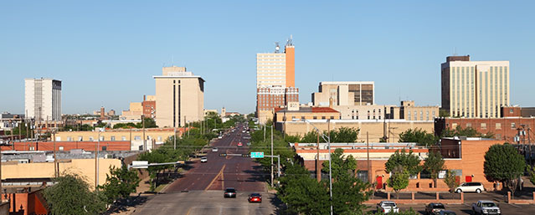
Load Forecast Adjustments
Lubbock added to North Forecast from 2021 on
Based on Lubbock’s Peak Forecast of its growth
“Fiber Services in Lubbock, TX.” About NTS, NTS Communications, Inc., 2018, www.ntscom.com/aboutnts/primary-locations/lubbock-tx.

Slide 61
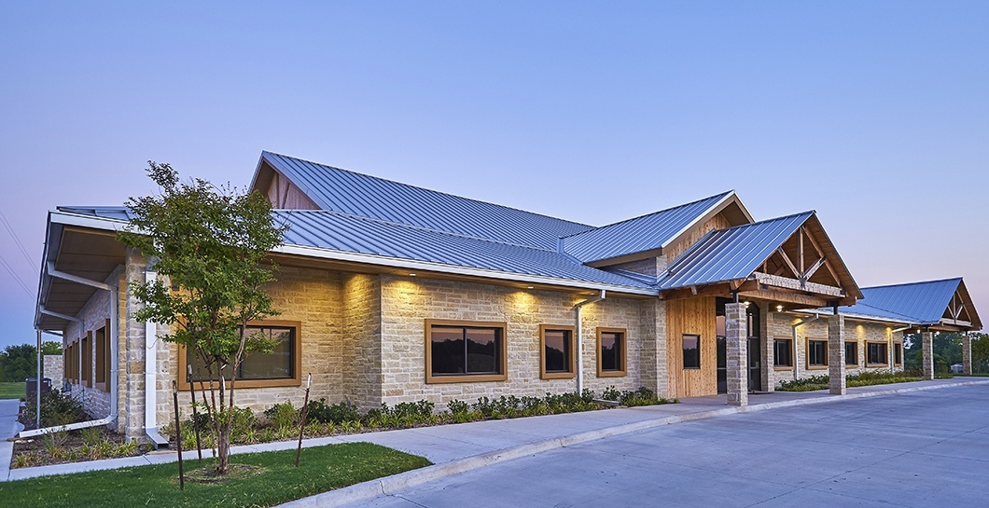
Load Forecast Adjustments
Rayburn added to East Forecast from 2020 on
Based on Rayburn’s Actual Seasonal Peaks in 2019
“RCEC.” PROJECTS>OFFICE>RCEC, Alliance Architects, 2019, www.alliancearch.com/projects/office/rcec/.

Slide 62
Load Forecast Adjustments
Adjustments added for Large Industrial Facilities
Coast
425 – 650 MW phased in over time
South
75 – 930 MW phased in over time
Far West
400 MW

Slide 63
Active Models

Slide 64
Ensemble of Active Models
Neural Network models based on linear and higher order nodes
Neural Network models based on a single linear node
Linear Regression representation of the Neural Network models
Exact same variables and relationships
Easier to share the model form with Market Participants
Results are very close
Models are maintained for daily and hourly energy forecasting

Slide 65
Weather Zone P50 and P90 Forecasts

Slide 66
90th Percentile (P90) Forecast
Coast 2020 Summer Forecasts
Rank | 2004 | 2005 | 2006 | 2007 | 2008 | 2009 | 2010 | 2011 | 2012 | 2013 | 2014 | 2015 | 2016 | 2017 | 2018 | P50 | P90
1 | 21,257 | 21,208 | 21,081 | 21,499 | 21,099 | 21,858 | 21,485 | 22,220 | 22,656 | 21,458 | 21,172 | 22,031 | 21,660 | 21,074 | 21,290 | 21,536 | 22,394
2 | 21,166 | 20,502 | 20,895 | 21,413 | 20,756 | 21,384 | 21,266 | 22,151 | 21,250 | 21,244 | 21,132 | 21,947 | 21,406 | 21,025 | 21,257 | 21,253 | 22,029
3 | 21,083 | 20,421 | 20,883 | 21,358 | 20,716 | 21,277 | 21,254 | 22,128 | 21,236 | 21,211 | 21,099 | 21,589 | 21,356 | 20,902 | 21,153 | 21,178 | 21,804
4 | 20,996 | 20,404 | 20,603 | 21,225 | 20,641 | 21,250 | 21,170 | 22,096 | 21,152 | 21,210 | 21,001 | 21,555 | 21,348 | 20,841 | 21,131 | 21,108 | 21,771
5 | 20,834 | 20,382 | 20,495 | 21,131 | 20,591 | 21,156 | 21,170 | 22,040 | 21,119 | 21,188 | 20,972 | 21,545 | 21,299 | 20,792 | 21,062 | 21,052 | 21,743
66

Slide 67
90th Percentile (P90) Forecast
Coast 2020 Summer Forecasts
Rank | 2004 | 2005 | 2006 | 2007 | 2008 | 2009 | 2010 | 2011 | 2012 | 2013 | 2014 | 2015 | 2016 | 2017 | 2018 | P50 | P90
1 | 21,257 | 21,208 | 21,081 | 21,499 | 21,099 | 21,858 | 21,485 | 22,220 | 22,656 | 21,458 | 21,172 | 22,031 | 21,660 | 21,074 | 21,290 | 21,536 | 22,394
2 | 21,166 | 20,502 | 20,895 | 21,413 | 20,756 | 21,384 | 21,266 | 22,151 | 21,250 | 21,244 | 21,132 | 21,947 | 21,406 | 21,025 | 21,257 | 21,253 | 22,029
3 | 21,083 | 20,421 | 20,883 | 21,358 | 20,716 | 21,277 | 21,254 | 22,128 | 21,236 | 21,211 | 21,099 | 21,589 | 21,356 | 20,902 | 21,153 | 21,178 | 21,804
4 | 20,996 | 20,404 | 20,603 | 21,225 | 20,641 | 21,250 | 21,170 | 22,096 | 21,152 | 21,210 | 21,001 | 21,555 | 21,348 | 20,841 | 21,131 | 21,108 | 21,771
5 | 20,834 | 20,382 | 20,495 | 21,131 | 20,591 | 21,156 | 21,170 | 22,040 | 21,119 | 21,188 | 20,972 | 21,545 | 21,299 | 20,792 | 21,062 | 21,052 | 21,743
66

Slide 68
Coast P50 and P90 Peak Forecasts

Slide 69
East P50 and P90 Peak Forecasts

Slide 70
Far West P50 and P90 Peak Forecasts

Slide 71
North P50 and P90 Peak Forecasts

Slide 72
North Central P50 and P90 Peak Forecasts

Slide 73
South P50 and P90 Peak Forecasts

Slide 74
South Central P50 and P90 Peak Forecasts

Slide 75
West P50 and P90 Peak Forecasts

Slide 76
Questions?

Slide 77
Slide 28 Normal Weather (P50) Forecast

Slide 78
Slide 32 Normal Weather (P50) Forecast

Slide 79
Slide 43 ERCOT P50 Coincident Peak Forecast

Slide 80
Slide 44 ERCOT P50 Coincident Peak Forecast

Slide 81
Slides 45 and 54 ERCOT P50 Coincident Peak Forecast

Slide 82
Slide 56 ERCOT Annual Energy
December estimated

Slide 83
Slide 68 Coast P50 and P90 Peak Forecasts

Slide 84
Slide 69 East P50 and P90 Peak Forecasts

Slide 85
Slide 70 Far West P50 and P90 Peak Forecasts

Slide 86
Slide 71 North P50 and P90 Peak Forecasts

Slide 87
Slide 72 North Central P50 and P90 Peak Forecasts

Slide 88
Slide 73 South P50 and P90 Peak Forecasts

Slide 89
Slide 74 South Central P50 and P90 Peak Forecasts

Slide 90
Slide 75 West P50 and P90 Peak Forecasts

