Slide 1
Discussion on proposed Solar PV Growth Projection using s-curve
SAWG

Slide 2
S-Curve Growth Projections
Initial Methodology Proposed at April 12, 2019 SAWG Meeting
http://www.ercot.com/calendar/2019/4/12/172702-SAWG
Review of methodology at the Oct 31 SAWG meeting
Consensus that rather than have a single curve, the desire was to have 3 curves representing conservative, moderate, and high renewable growth scenarios
Update the data set to include 2016-2018 available rooftop DG
Review “fixed” variables
Total potential = 18,433 MW + 25% = 23,041 MW.
AWST Study examined areas of Low, Med and High intensity development in each of the 4 city urban (metropolitan) areas.
Open areas with little to no development in the urban areas was not included in the study
Top 20 Metro areas in ERCOT indicate ~80% of population is in 4 metro areas.
“Estimated” data from 2016-2018 included in the model
Start of Fast Growth: 2019 (selected for ITC Credit rampdown)

Slide 3
S-Curve Major Variables
Scenarios selected for Rooftop Solar PV growth:
Conservative
Moderate
Aggressive
Variables selected with ranges:
Market Saturation: Note: The larger the number, the greater the final installed MW.
Conservative 15%
Moderate 20%
Aggressive 25%
Takeover Time (Years): Note: the larger the number, the slower the growth
Conservative 10
Moderate 7
Aggressive 4

Slide 4
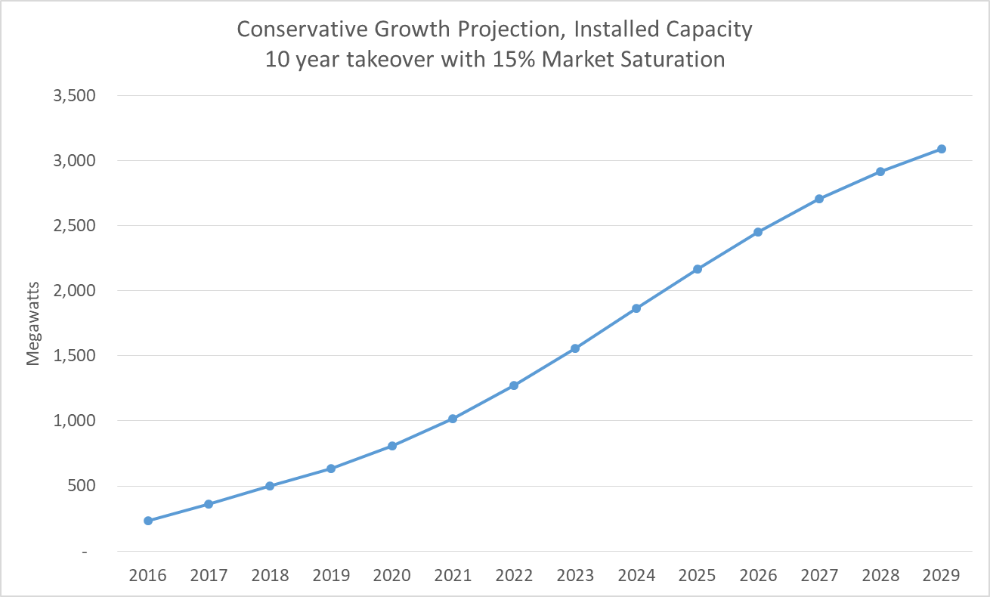
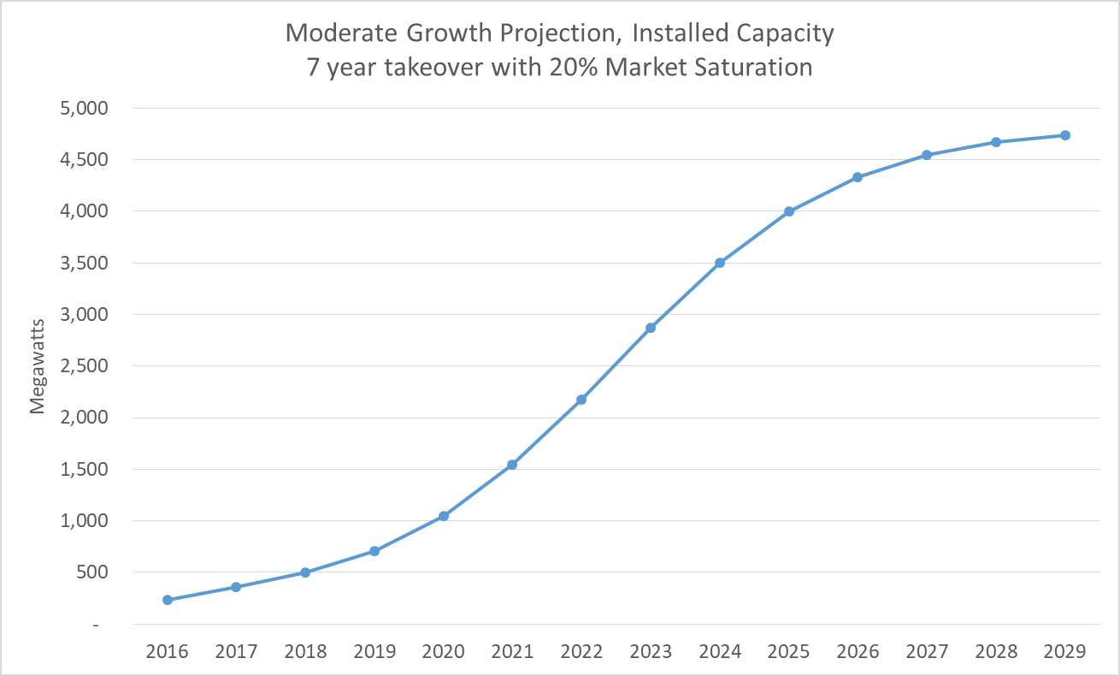
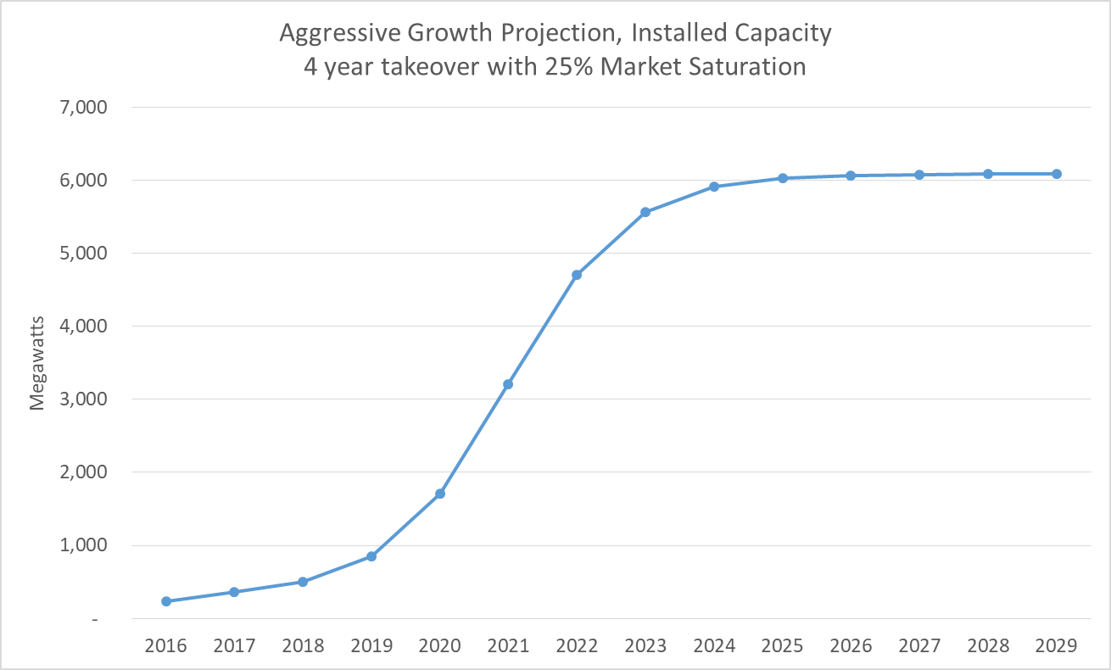
Scenario Results

Slide 5
Observations
Scenarios yield widely varying projections
Conservative reaches 3000 MW by 2029
Moderate reaches 3000 MW by 2024 and 4500 MW by 2027
Aggressive reaches 3000 MW by 2021 and 6000 MW by 2025
Interconnection queue for Transmission connected Solar PV shows potential of 10541 MW by EOY 2021.
http://www.ercot.com/content/wcm/lists/167030/Capacity_Changes_by_Fuel_Type_Charts_September_2019.xlsx
Discussion?

