Slide 1
IRR Peak Average Capacity Contribution Comparison: Peak Net Load versus Peak Load
Supply Analysis Working Group
Connor Anderson
Resource Adequacy
December 13, 2019
Notes:
Welcome to

Slide 2
IRR Contribution Comparisons, Summer 2019 (Presented at 10/31 SAWG Meeting)

Slide 3
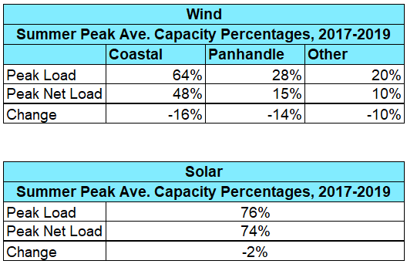
IRR Contribution Comparisons, Summer 2017-2019

Slide 4
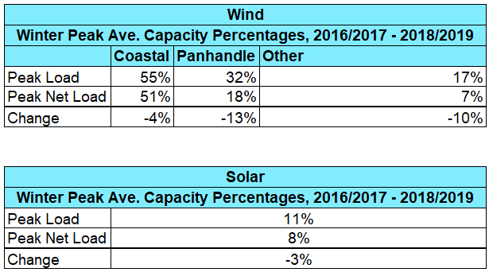
IRR Contribution Comparisons, Winter 2016/2017 – 2018/2019

Slide 5
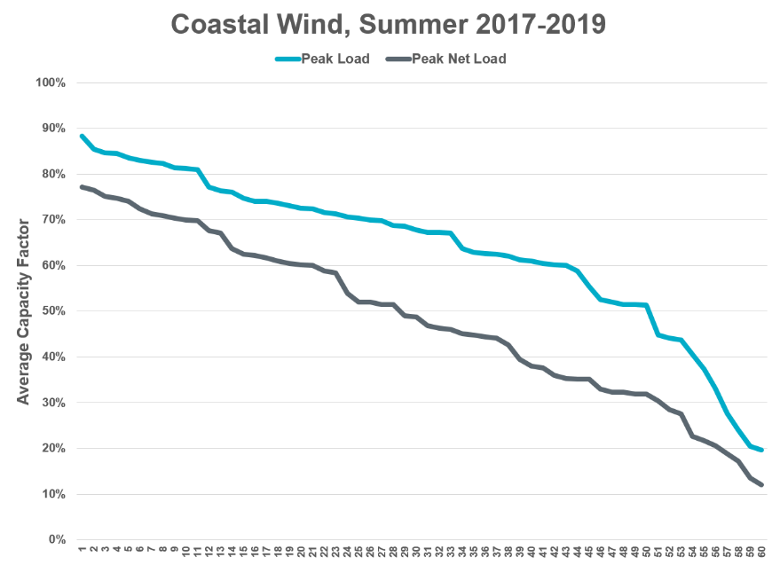
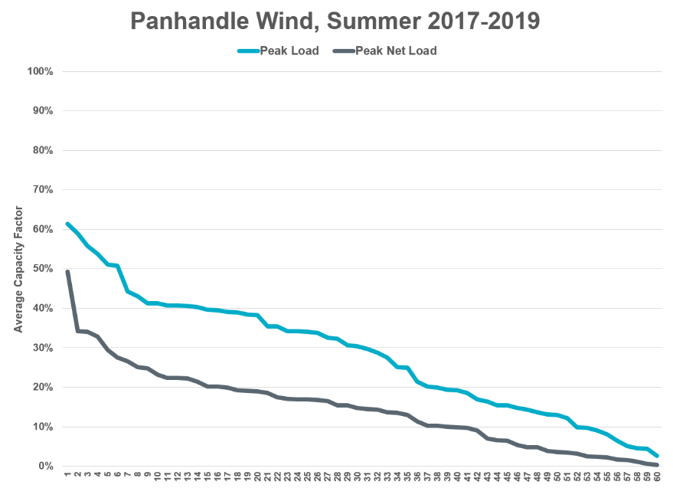
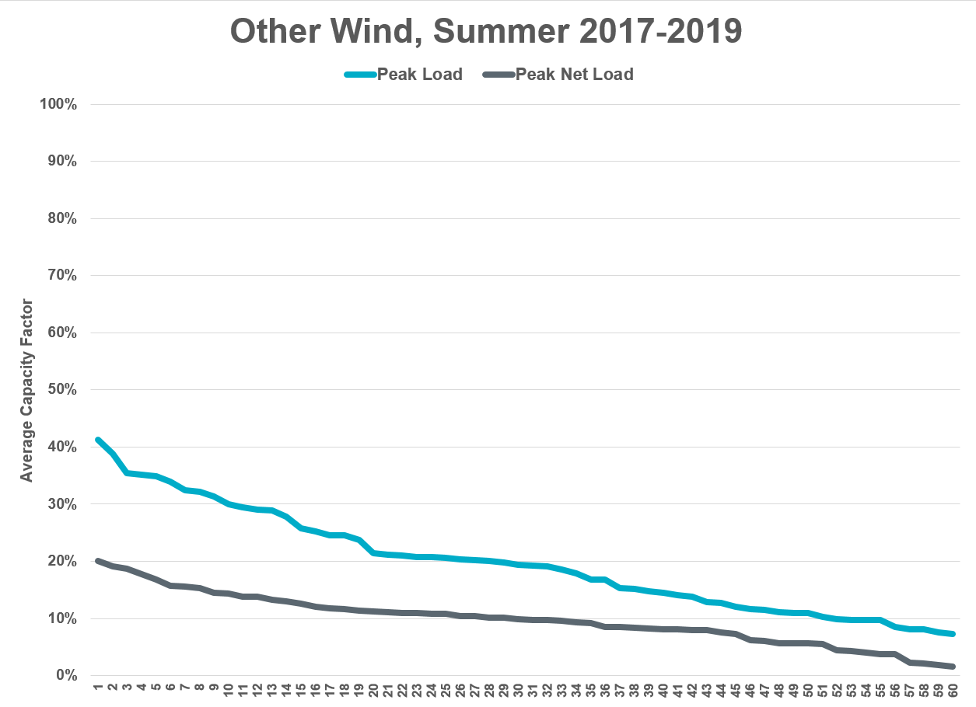
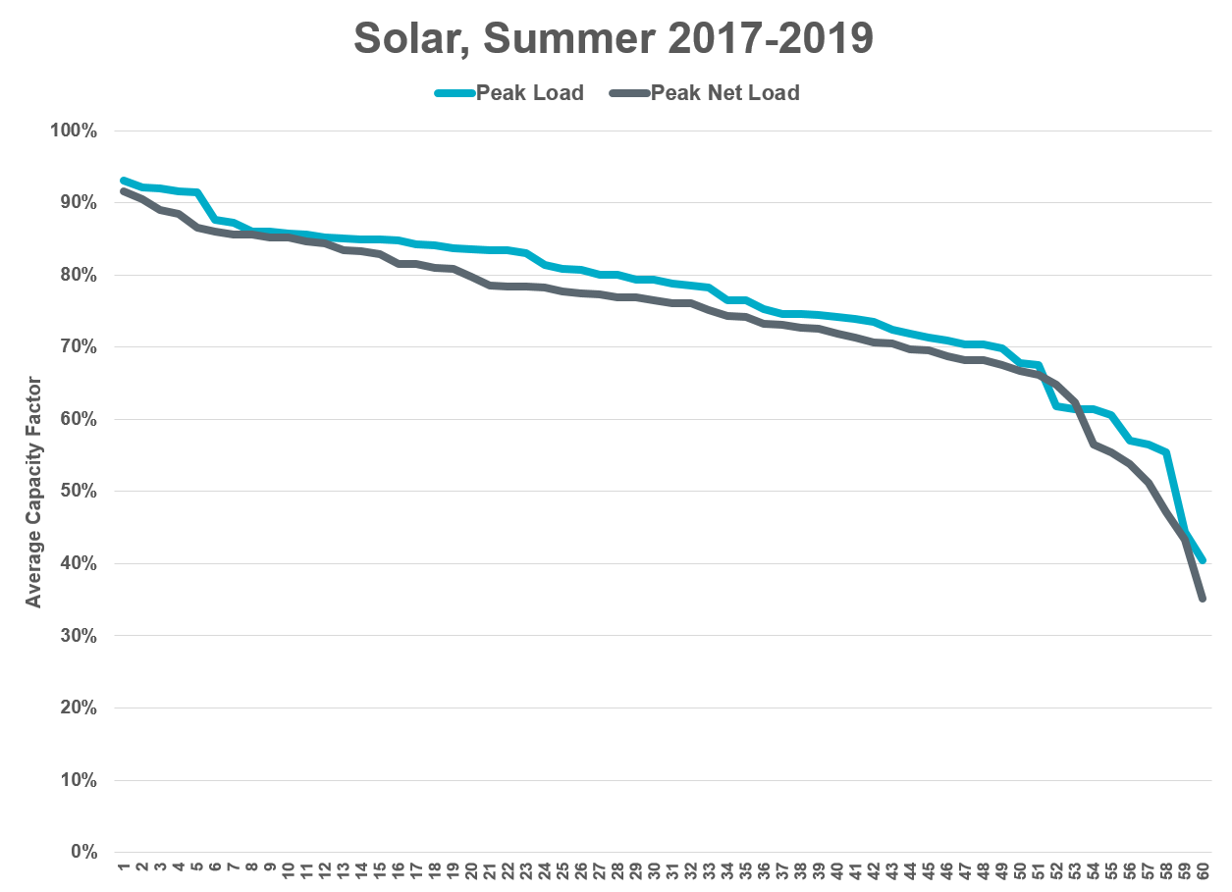
Hourly Contribution Variability, Summer 2017-2019

Slide 6
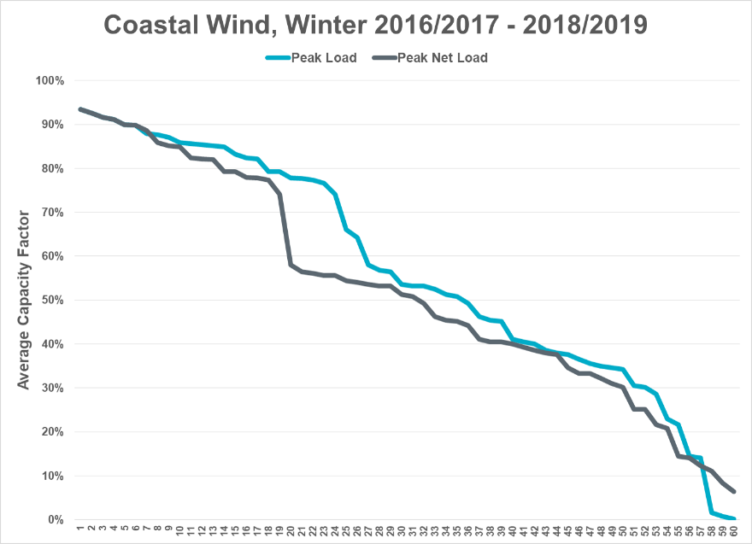
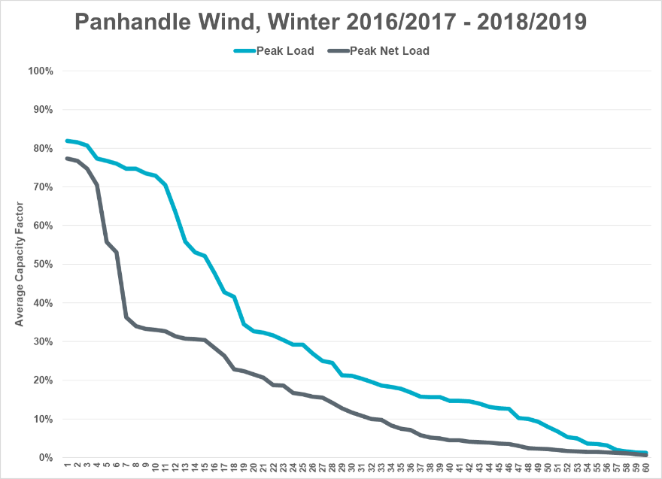
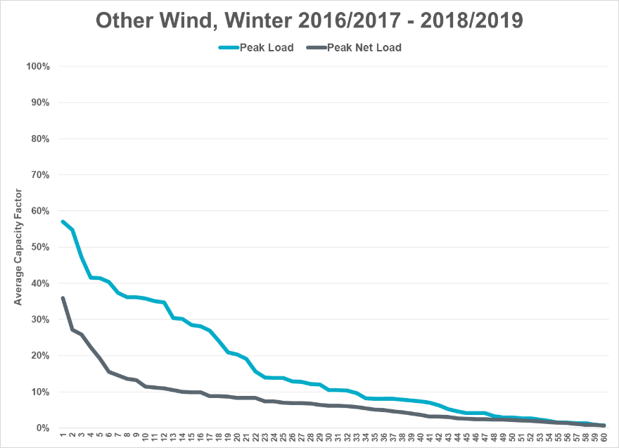
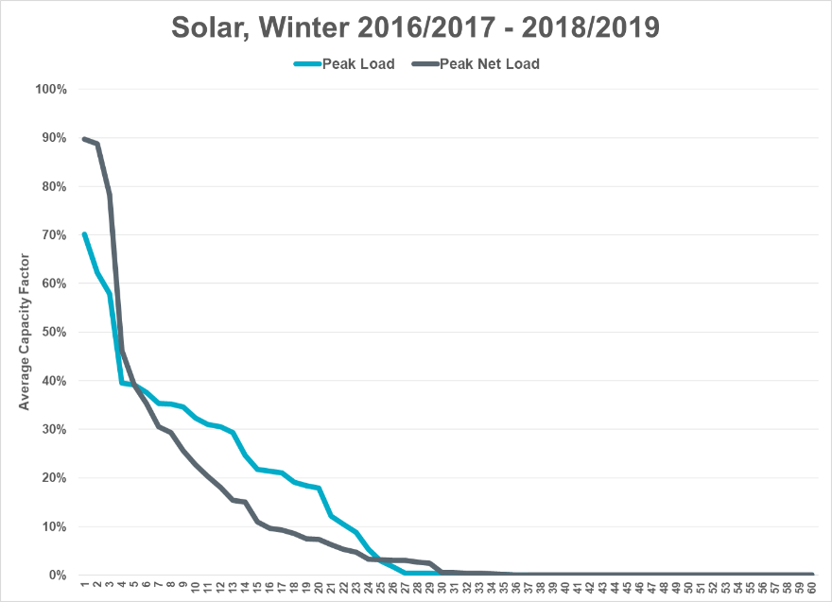
Hourly Contribution Variability, Winter 2016/2017 – 2018/2019

