Slide 1
PDCWG Inertia Update
Julia Matevosyan
Resource Adequacy
ERCOT
12/11/2019

Slide 2
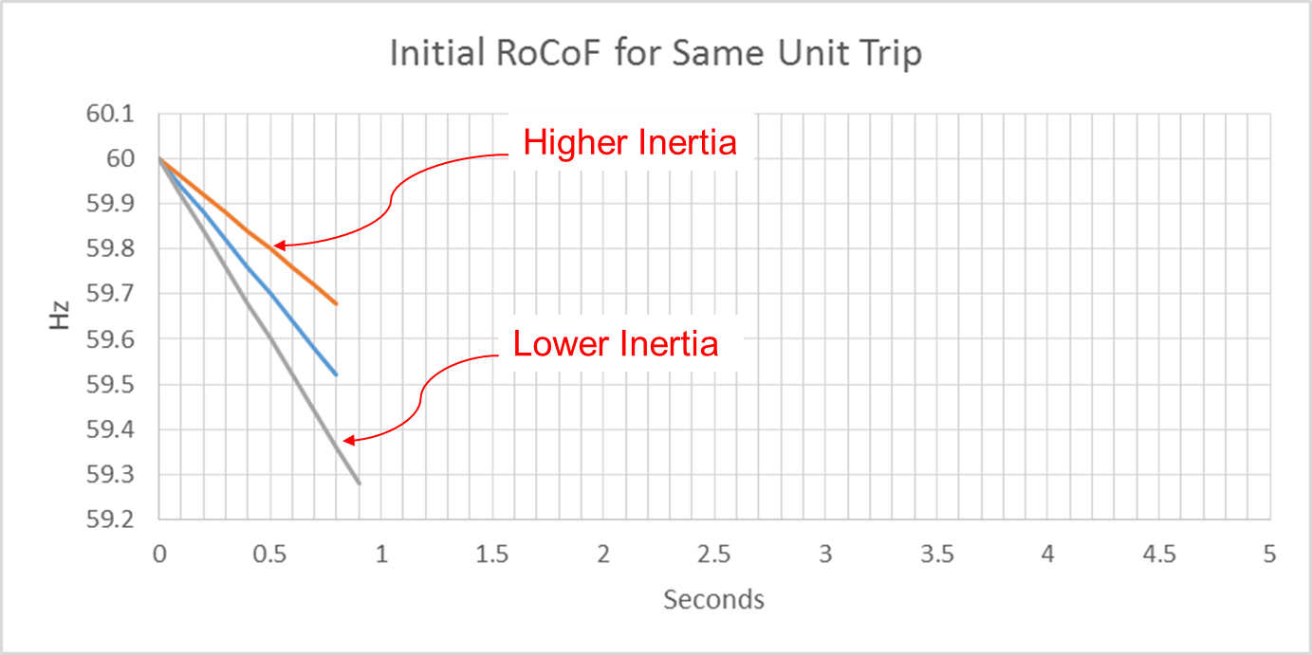
Effect of Synchronous Inertia on System Frequency
With increasing integration of inverter-based generation, there could be periods when total inertia of the system could be low since less synchronous machines will be dispatched.
  During such situations, it is essential to have adequate frequency response capabilities
UFLS trigger
Notes:
UFLS trigger indicates the frequency (59.3 Hz) at which the first stage of involuntary underfrequency load shedding will happen. ERCOT plans and operates the system such that for the simultaneous trip of two largest generating units (2750 MW), UFLS should not be triggered, though it still can happen in some extreme unexpected situations.

Slide 3
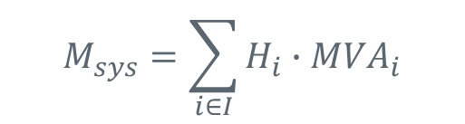
Inertia Calculation
In 2013, as instantaneous wind power penetration reached 30%, ERCOT started analyzing impacts of inverter-based generation on system inertia.
In 2015, ERCOT implemented a real-time inertia calculation using inertia parameters of each individual synchronous generator and its status (on/off) telemetry.
$$M_{sys}=\sum_{i∈I}{H_{i}∙{MVA}_{i}}$$
where I is the set of online synchronous generators or condensers,
MVA_{i} is MVA base of on-line synchronous generator or synchronous condenser i, and
H_{i} is inertia constant for on-line generator or synchronous condenser i in a system (in seconds on machine MVA_{i})

Slide 4
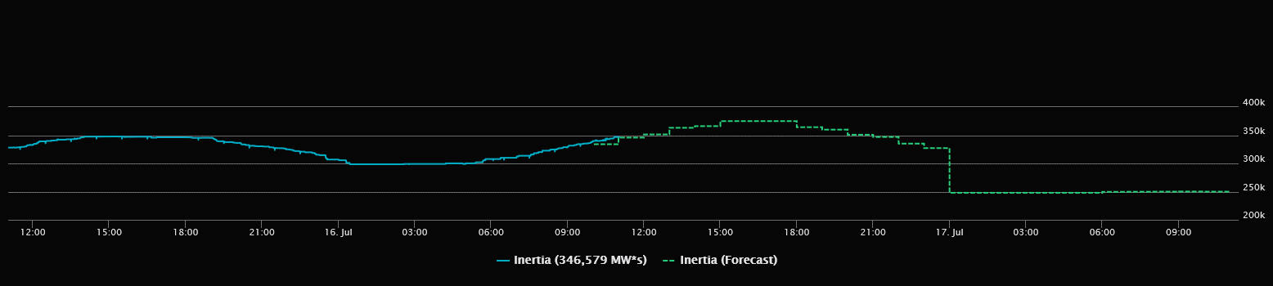

Inertia Monitoring in Real-Time and Forecasting
In 2016, inertia monitoring was implemented in the control room.

Slide 5
ERCOT Inertia 2013-2019
Date and Time | 2013 3/10/13 3:00 AM | 2014 3/30/14 3:00 AM | 2015 11/25/15 2:00 AM | 2016 4/10/16 2:00 AM | 2017 10/27/17 4:00 AM | 2018 11/03/18 3:30 AM | 2019(Jan-Dec) 3/27/2019 1:00 AM
Min synch. Inertia (GW*s) | 132 | 135 | 152 | 143 | 130 | 128.8 | 134.5
System load at minimum synch. Inertia (MW) | 24,726 | 24,540 | 27,190 | 27,831 | 28,425 | 28,397 | 29,883
Non-synch. Gen. in % of System Load | 31 | 34 | 42 | 47 | 54 | 53 | 50
Notes:
For each box, the central mark (red line) is the median, the edges of the box (in blue) are the 25th and 75th percentiles, the whiskers correspond to +/- 2.7 sigma (i.e., represent 99.3% coverage, assuming the data are normally distributed. The corresponding lowest inertia in each year is given in the table.
The circle on each boxplot is showing inertia during time when highest portion of load was served by wind generation in that year. In 2019 it was on November 26 3:52 am, 57.87%.

Slide 6
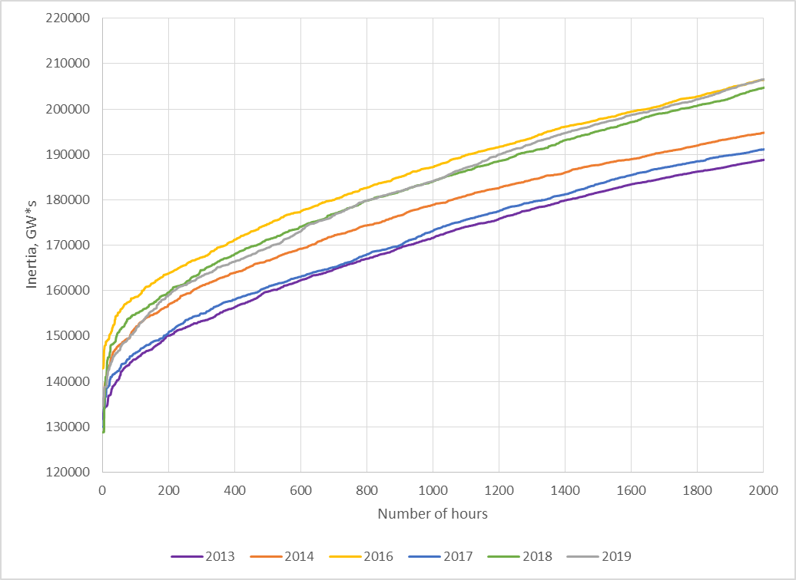
Inertia duration curve
Jan- Nov

Slide 7
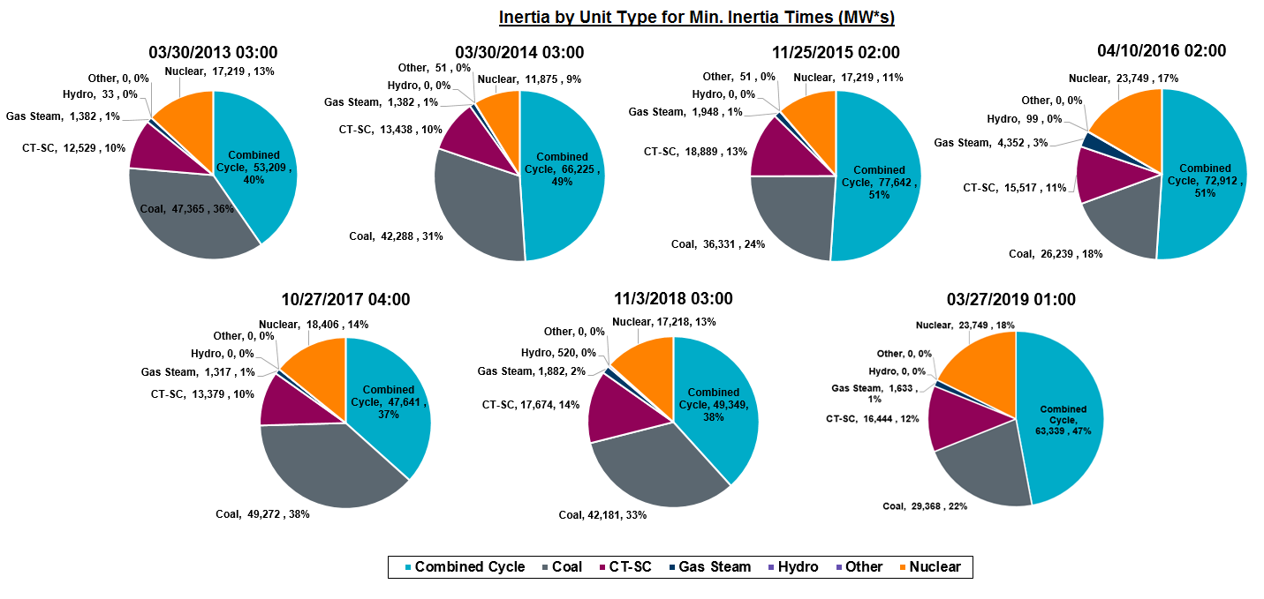
Inertia by Unit Type during Minimum Inertia Times
Needs to be redone to move Hase and Midlothian from CTs.

Slide 8
Combined Cycle Inertia
Jan- Nov

Slide 9
Coal Inertia
Jan- Nov

Slide 10
Combustion Turbine Inertia
Jan- Nov

Slide 11
How is inertia information is being used?
RRS requirements are determined in the beginning of the year, for the whole year, based on historic inertia conditions.
ERCOT determines actual RRS needs based on expected inertia conditions in the Day-Ahead and closer to real-time, and monitors RRS sufficiency in the control room.
Inertia is monitored versus Critical Inertia value in real time.

Slide 12
Critical Inertia
Critical Inertia is the minimum level of inertia at or below which a system cannot be operated reliably with existing frequency control practices.
For ERCOT Critical Inertia is the minimum level of inertia that, after a trip of 2,750 MW, will give Load Resources sufficient time to respond before frequency reaches the UFLS (59.3 Hz).
From a series of dynamic studies Critical Inertia for ERCOT was found and set to 100 GWs (if 2 STP units are online).
Critical Inertia is monitored in the control room and operator may take actions to increase critical inertia above 100 GWs, when needed.
With implementation of NPRR863, FFR response time is faster than that of Load Resources and trigger frequency is higher, Critical inertia can potentially be decreased to 90 GWs (based on dynamic studies)

Slide 13
“Base” Inertia Analysis
What is the lowest inertia level that ERCOT system can go down to with current operational practices?
Analysis is based on low inertia (<145 GWs) instances for 2013-2019
Determining minimum inertia from components that are online “at all times” due to various operational practices:
Private Use Networks (generation at industrial load sites)
Generators providing RRS (min 1,150 MW of RRS is required from generation, each generator cannot be awarded RRS for more than 20% of its capacity)
Nuclear generation (always online unless on maintenance)

Slide 14
“Base” Inertia Analysis (2013-2018 data)
Critical inertia 100 GW·s
Additional 5 GW·s of inertia needed
Min inertia Private Use Networks, 32GW·s
95 GW·s of base inertia
Min inertia from AS providers, 45 GW·s
Min nuclear units inertia,18 GW·s

Slide 15
“Base” Inertia Analysis (2013-2019 data)
Critical inertia 100 GW·s
Additional 21 GW·s of inertia needed
Min inertia Private Use Networks, 32GW·s
79 GW·s of base inertia
Min inertia from AS providers, 29 GW·s
Min nuclear units inertia,18 GW·s

Slide 16
PUN Inertia
Jan- Nov

Slide 17
Inertia from AS providers during minimum inertia times
Date of inertia min | Inertia of non-PUN units carrying AS (MW*s) | AS Requirement: RRS, Reg Up, Reg Dn (MW) | RRS from Load (MW) | RRS from Hydro (MW)
03/27/2019 1:00 | 46,854 | 2984, 237, 324 | 1785 (59.8%) | 315 (11%)
11/3/2018 3:00 | 51,719 | 2985, 205, 201 | 1791 (60%) | 44 (1.5%)
10/27/17 4:00 | 56,089 | 2808, 196, 217 | 1404 (50%) | 265 (9.4%)
4/10/16 2:00 | 52,317 | 3000, 277, 279 | 1499 (50%) | 289 (9.6%)
11/25/15 2:00 | 54,291 | 3002, 272, 325 | 1501 (50%) | 303 (10.1%)
3/30/14 3:00 | 61,148 | 2800, 309, 293 | 1151 (41.1%) | 160 (5.7%)
3/10/13 3:00 | 42,687 | 2800, 273, 329 | - | -
Date and Time | 2013 3/10/13 3:00 AM | 2014 3/30/14 3:00 AM | 2015 11/25/15 2:00 AM | 2016 4/10/16 2:00 AM | 2017 10/27/17 4:00 AM | 2018 11/03/18 3:30 AM | 2019(Jan-Dec) 3/27/2019 1:00 AM
Min synch. Inertia (GW*s) | 132 | 135 | 152 | 143 | 130 | 128.8 | 134.5
System load at minimum synch. Inertia (MW) | 24,726 | 24,540 | 27,190 | 27,831 | 28,425 | 28,397 | 29,883
Non-synch. Gen. in % of System Load | 31 | 34 | 42 | 47 | 54 | 53 | 50

Slide 18
Summary
Negative trend in Coal plant inertia due to retirements
Slight increase in overall minimum inertia compared to 2018
Negative trend in inertia provided from Resources carrying Ancillary Services, possibly due to increase in % of RRS provided by Load Resources
Minimum Base Inertia may decline as a result

Slide 19

Thank you! Questions?
Julia Matevosyan
jmatevosjana@ercot.com

