Slide 1
BEST Force Meeting ERCOT Austin December 6, 2019
Broad Reach Power LLC
Hybrid Resources – DC Coupled
Doug Moorehead
Managing Partner & Chief Technology Officer

Slide 2
Key Points up front
DC/DC architecture variants
Treat DC coupled resources as hybrid asset – single point of interconnect and single dispatchable asset
UL 1741 SA battery inverter guidelines related to Intermittent Renewable Resource (“IRR”) performance exemptions
Emergency conditions for DC coupled hybrid resources
Telemetry availability and battery State of Charge (“SOC”)
Grid Forming/Weak Grid

Slide 3
DC coupling: energy storage and solar
*image source: Dynapower public file
Hybrid resource: either asset can be tied directly to the inverter DC bus or be controlled by the DC/DC power converter
Architecture will most likely be defined as the higher utilization asset be tied directly to the inverter DC bus to minimize electrical losses and maximize roundtrip efficiency
Example: 100MW battery with 20MW PV: DC coupled PV architecture
100MW PV with 20MW battery: DC coupled battery
In general, DC coupling is “16% better”: 8% improvement in CapEx costs and 8% improvement in roundtrip efficiency and capture of DC clipped energy (compared to equivalent AC connected co-located resources.
“No electron is wasted” in either electrical architecture – no clipped energy losses

Slide 4
UL 1741 SA battery inverter proposed guideline

Slide 5
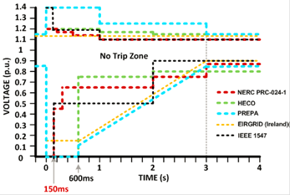
UL 1741 SA battery inverter proposed guideline
UL 1741 SA Voltage and Frequency ride through shaped like IEEE 1547
Required minimal duration before the inverter can fault, disconnect, or recover
ERCOT should be able to develop 10, 100, 1000MW UL1741-SA standard grid interface models

Slide 6
Should existing IRR performance exemptions apply?
Intermittent Renewable Resource “IRR”?
A Generation Resource that can only produce energy from variable, uncontrollable Resources, such as wind, solar, or run-of-the river hydroelectricity. (ERCOT definition)
Variability performance concerns/challenges:
Large and sudden ramps
Intermittent energy supply
Capacity uncertainty
Example: 100MWac solar facility with 50MW DC coupled battery (undefined MWh). In other markets, this is referred to as a solar facility with 50% capacity factor on energy storage.
Can ERCOT treat some percentage of capacity same as standalone storage?

Slide 7
Emergency conditions: How much capacity can be delivered by a hybrid resource? (example)
115MWdc solar plant
10MW DC coupled battery
100MWac interconnect limit
“What can the facility deliver to the grid during the emergency assuming the PV array is 105MW during the interval?”
Even if the interconnection limit is waived, output will be limited to 100MWac POI output.
“Overload” capacity on utility scale inverters is limited to “seconds to single digit minutes” of overload capacity. The AC connected power converter will need to be electrically sized for the overload condition to achieve over the interconnect limit, as well as all down stream medium voltage and high voltage transformers and switchgear.

Slide 8
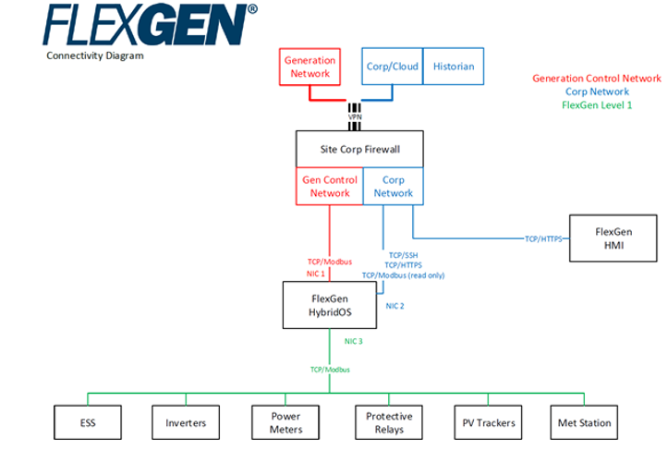
DC coupled hybrid plant: Telemetry
Consider the plant 100% digital
Any measured or recorded condition or state of operation is available worldwide
Common for plant output to be available locally or centralized location
Readily interface into existing SCADA and cybersecurity platforms and control

Slide 9
Grid Forming/Weak Grid
1. Grid forming / Weak grid
We are capable to transfer 100MW solar + storage into island grid mode during grid emergency shut down and also restore the system in fast fashion which gives the grid operator additional flexibility how to manage highly penetrated renewable challenges in grid. This same would apply to intermittent situations when wind sub station may trip off during storm.
2. Model for a hybrid resource:
We have battery power system model available which includes all storage aspects in it – SOC, active power, reactive power. ERCOT has not requested that level of detail before but we have it available if needed

Slide 10
Thank you!
Doug Moorehead
Managing Partner and Chief Technology Officer
757-328-3309
dmoorehead@broadreachpower.com

