Slide 1
Overview of Battery Additions in ERCOT (past, present and future)

Slide 2
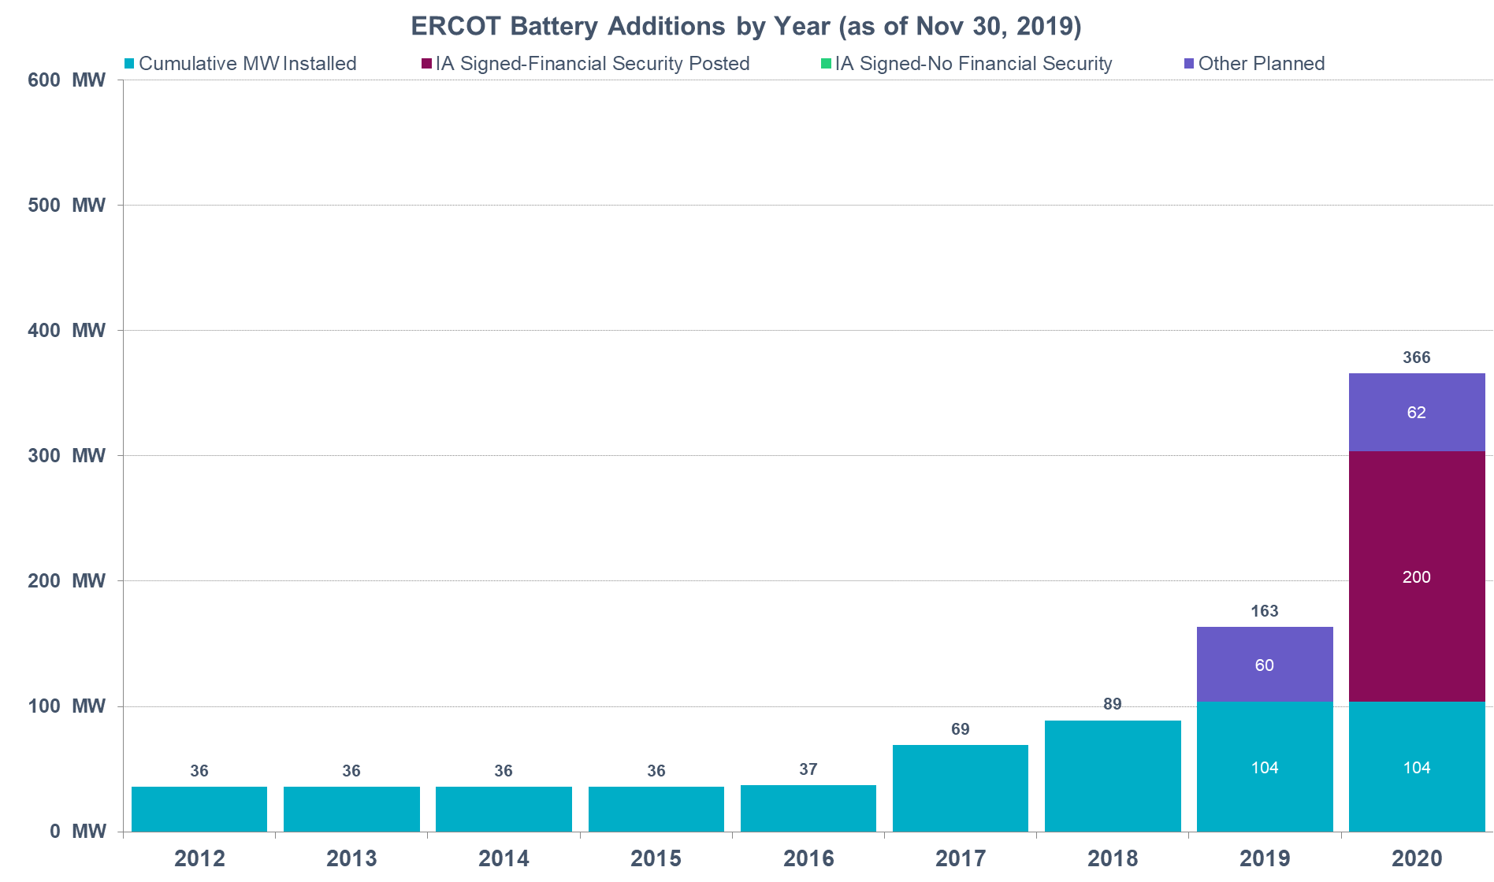
Fuel Type Chart (as of Nov 30th 2019)
  Distribution Generation Resources
  (not included in this chart with affidavits and supporting documentation submitted to ERCOT):
  38 projects 349 MW (including all projects from the blue textbox)
Batteries on the distribution system
(included in this chart):
1 existing project 2 MW
7 “planned” projects 62 MW (Full RARF submitted)

Slide 3
GIS Summary for Batteries (as of Nov 30, 2019)
Total amount of battery projects in the interconnection queue 7,214 MW, up by 1587 MW since last month.
Report run Dec 1, 2019: 7,214 MW
Report run Dec 1, 2018: 2,048 MW
Report run Dec 1, 2017: 0 MW
Full Interconnection Study started for 50 battery projects with total capacity of 4,387 MW up by 707 MW since last month’s GIS.
GIS report does not include batteries planned to be interconnected on the Distribution System

Slide 4
GIS, Battery Project Details (as of Nov 30)
 | Number of Projects | Capacity, MW | % of Total MW of Batteries with FIS Started | Min Project Size, MW | Max Project Size, MW | Average Project Size, MW
Co-located with new PVGR | 23 | 2,017 | 46% | 20 | 325 | 88
Co-located with new WGR | 3 | 275 | 6% | 50 | 120 | 92
Co-located with existing CT | 1 | 260 | 6% | 260 | 260 | 260
Stand-alone Batteries | 23 | 1,835 | 42% | 20 | 202 | 80
* Co-located means the same Point of Interconnection (POI)

Slide 5

Thank you! Questions?
Julia Matevosyan
jmatevosjana@ercot.com

