Slide 1
PDCWG Report to ROS
Chair: Chad Mulholland, NRG
Vice Chair: Jimmy Jackson, CPS
ROS
December 5th, 2019

Slide 2
Report Overview & Notes
Report Overview
  Meeting Minutes
  BAL-001-TRE-1 FMEs & IMFR
    2 FMEs in the month of October
  Frequency Control Report

Slide 3
Meeting Minutes
PDCWG Meeting 11/14/19
  Southern Cross DC Tie – Directive 3, DC Tie Ramping Limits
    Topic tabled; revisit in December
  NOGRR 195
    Generator Voltage Control Tolerance Band
      Time requirements for response/notification need further clarification
      Explanation of AVR needs additional development based on stakeholder input
      Develop language to clarify that these changes are not intended for any type of compliance metrics
      Expanded discussion and explanation of generator/operator capabilities and system reliability needs
      ERCOT provided specific examples to the PDC of scenarios where problems were encountered due to voltage tolerance band interpretation
  Proposal to Limit Generator RRS Bids/Offers Based on Inertia Forecast
  Coming soon – SAR-12 (Standard Authorization Request) for BAL-001-TRE (NERC Regional Standard for Primary Frequency Response): Widening generator deadbands
  Regulation & Frequency Control Reports

Slide 4
Frequency Measurable Events Performance

Slide 5
Frequency Measurable Events
There were 2 FMEs in October
  10/14/2019 15:31:36
    Loss of 576 MW
    Interconnection Frequency Response: 834 MW/0.1 Hz
    11 of 41 Evaluated Generation Resources had less than 75% of their expected Initial Primary Frequency Response.
    10 of 41 Evaluated Generation Resources had less than 75% of their expected Sustained Primary Frequency Response.
  10/30/2019 21:29:39
    Loss of 746 MW
    Interconnection Frequency Response: 898 MW/0.1 Hz
    5 of 38 Evaluated Generation Resources had less than 75% of their expected Initial Primary Frequency Response.
    5 of 38 Evaluated Generation Resources had less than 75% of their expected Sustained Primary Frequency Response.

Slide 6
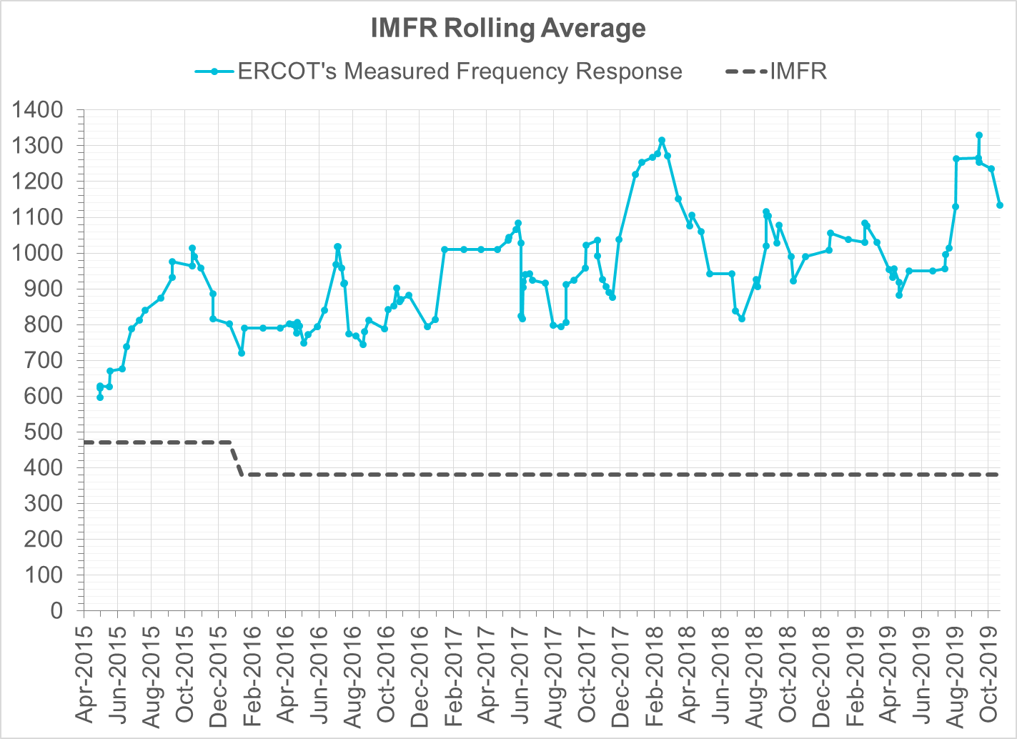
Interconnection Minimum Frequency Response (IMFR) Performance
IMFR Performance currently 1134.33 MW/0.1Hz
Frequency Response Obligation (FRO): 381 MW/0.1 Hz

Slide 7
Frequency Control Report
October 2019

Slide 8
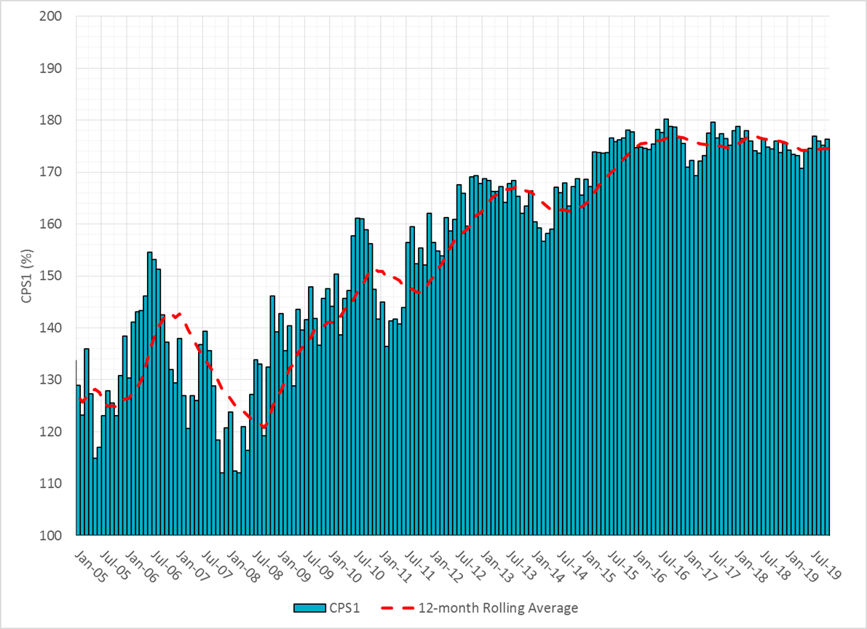

CPS1 Performance

Slide 9
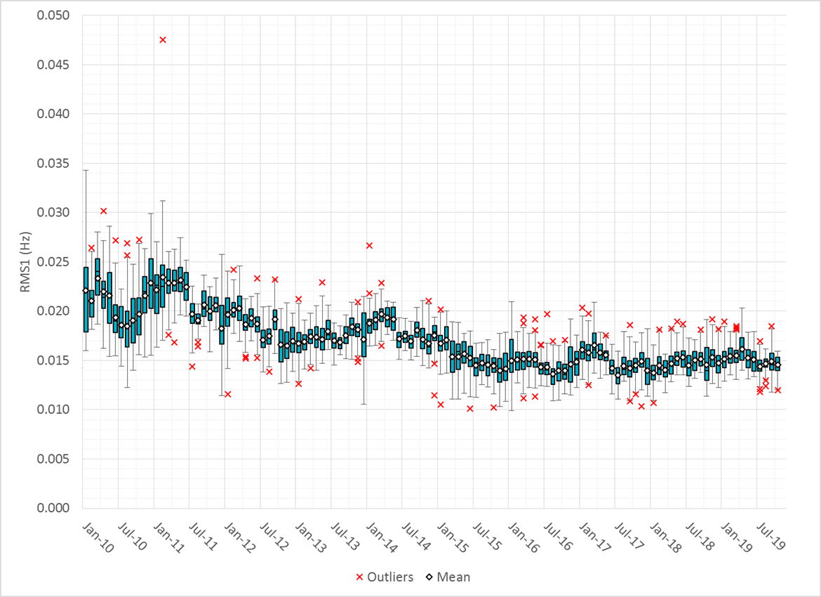
RMS1 Performance of ERCOT Frequency

Slide 10
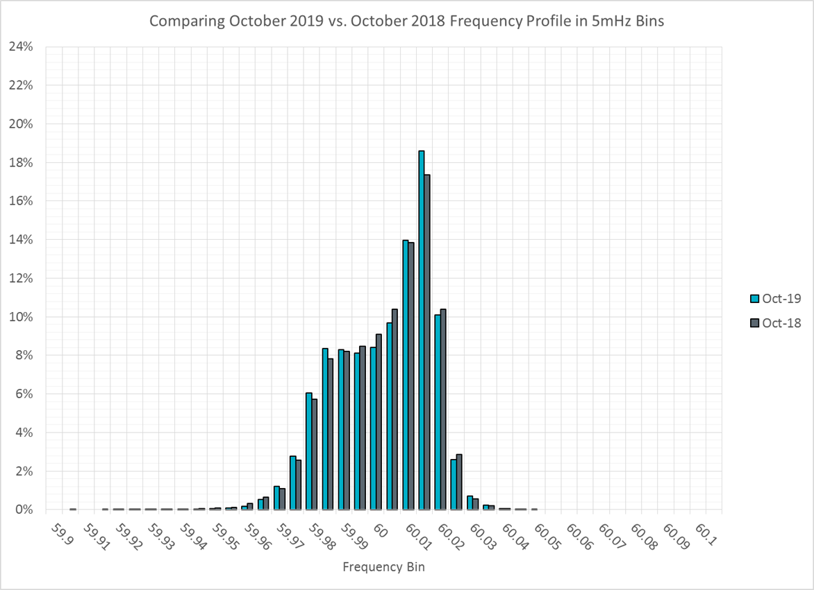
Frequency Profile Analysis

Slide 11
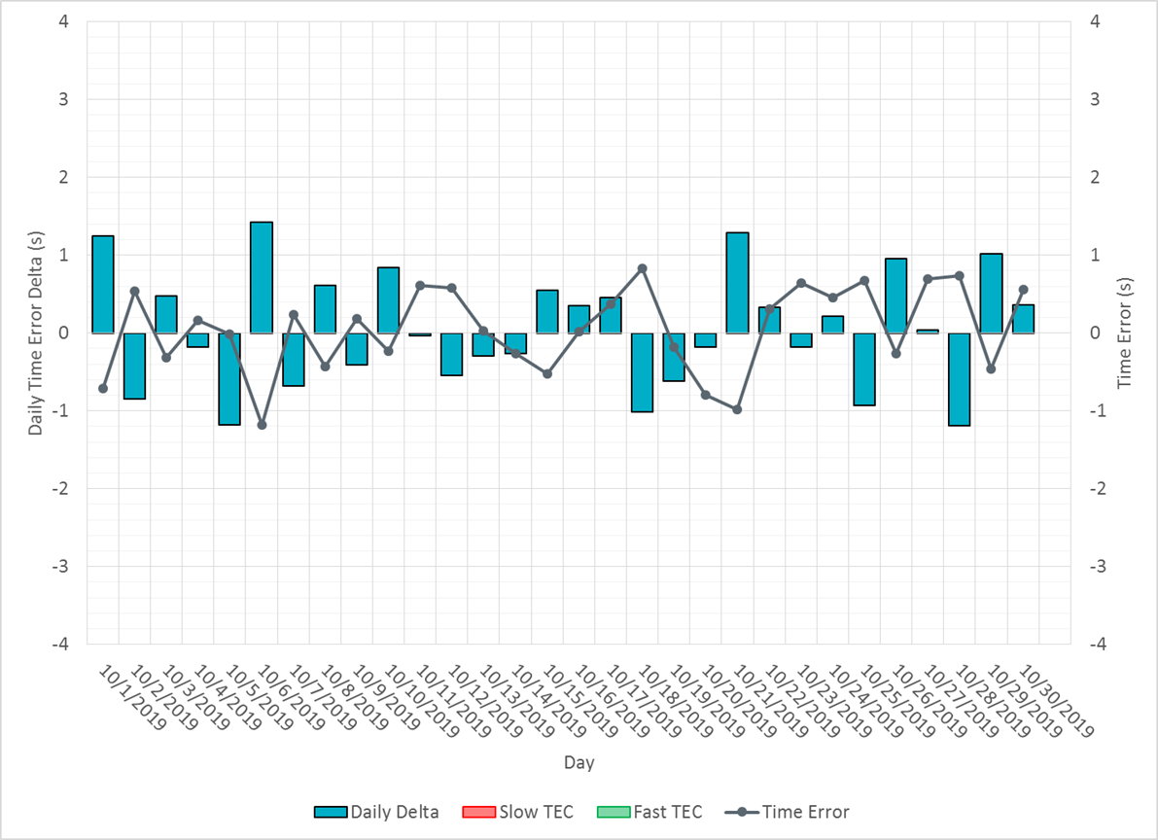
Time Error Corrections

Slide 12
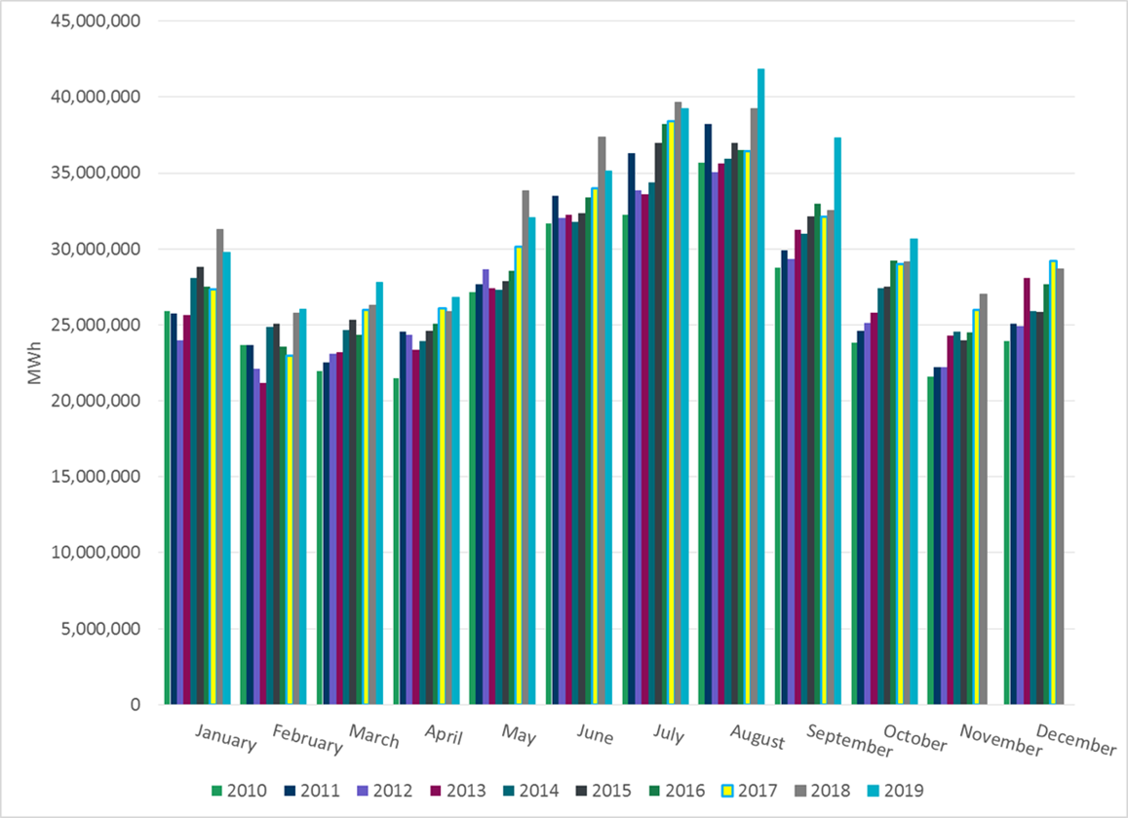
ERCOT Total Energy

Slide 13
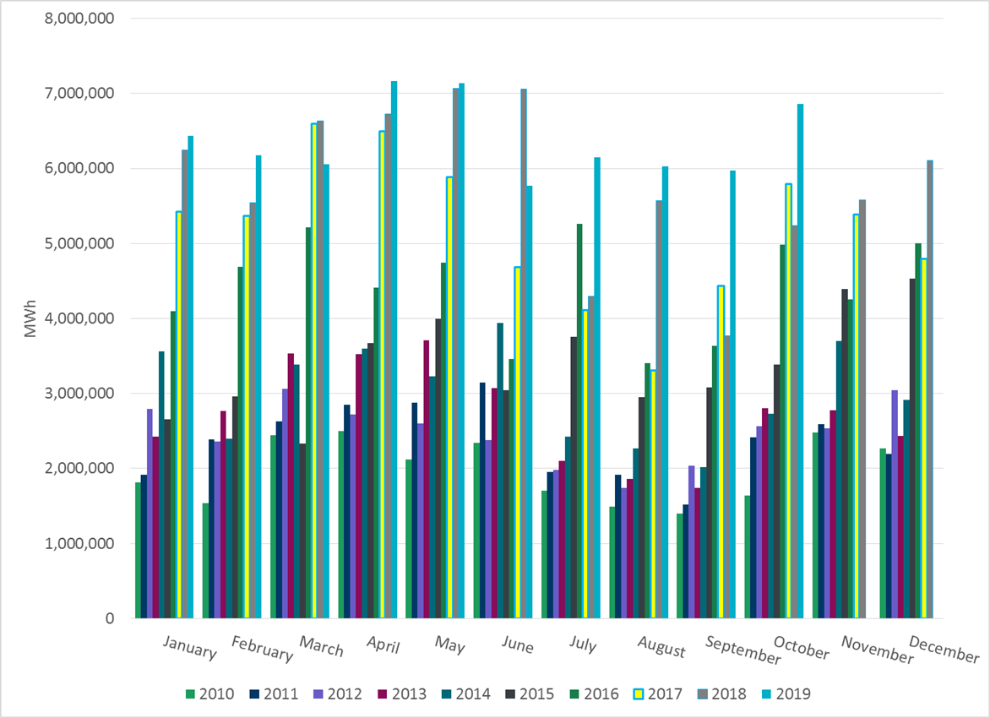
ERCOT Total Energy from Wind Generation

Slide 14
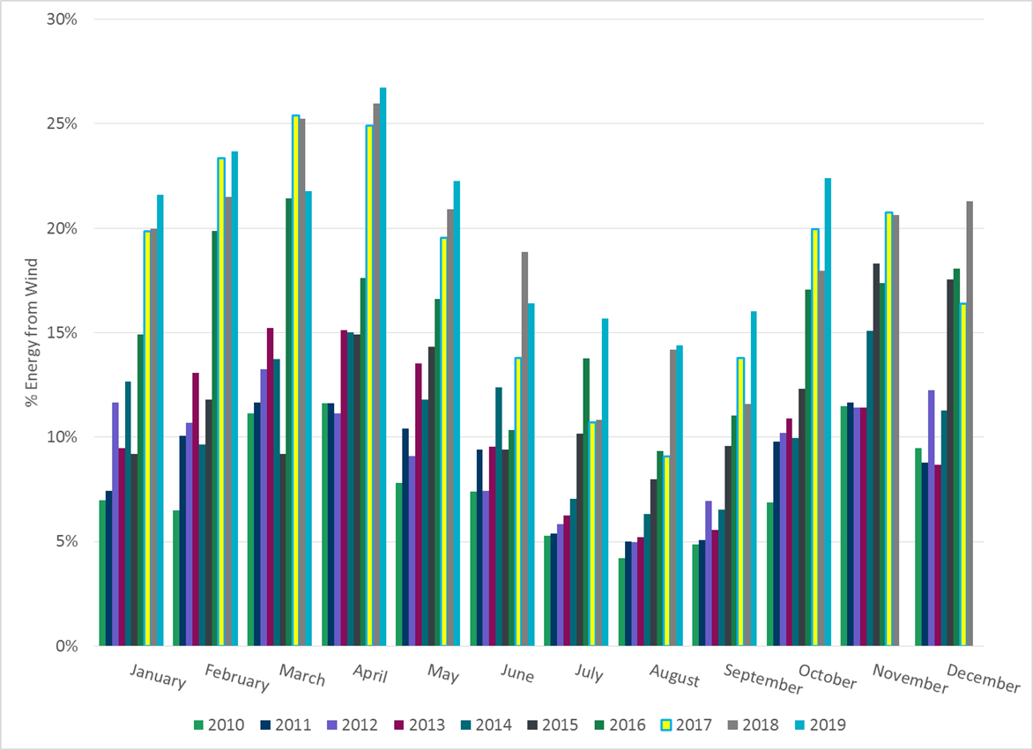
ERCOT % Energy from Wind Generation

Slide 15
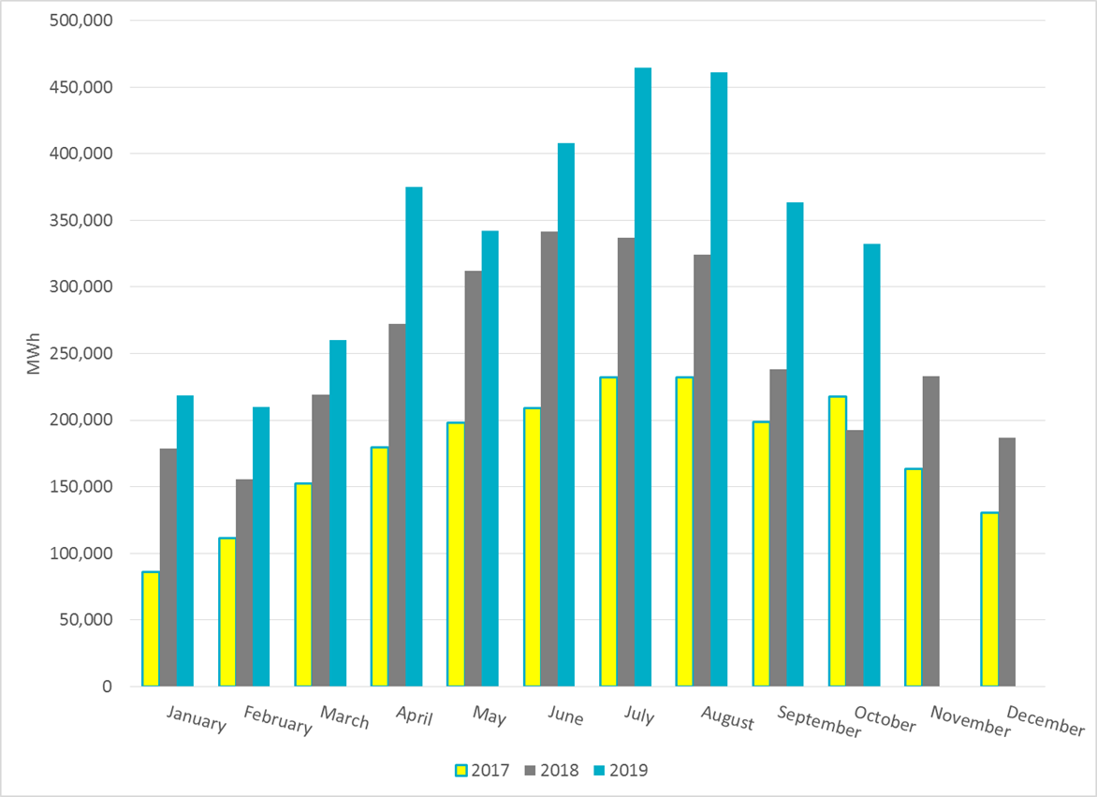
ERCOT Total Energy from Solar Generation

Slide 16
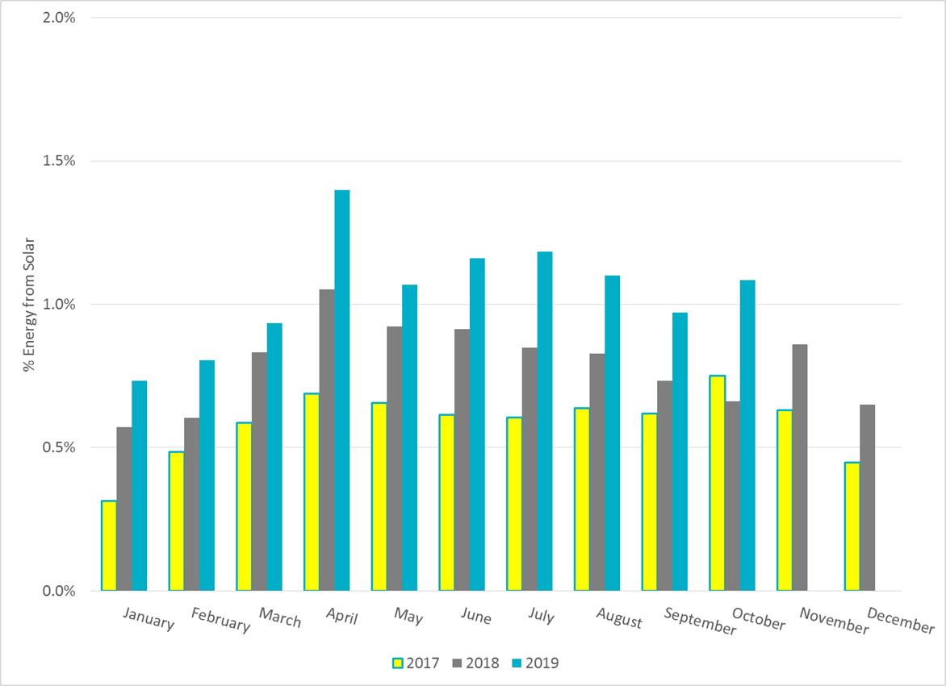
ERCOT % Energy from Solar Generation

Slide 17
Questions?

