Slide 1
Market Credit Working Group update to the Wholesale Market Subcommittee
Bill Barnes NRG, Chair
Josephine Wan Austin Energy, Vice Chair
12/04/2019

Slide 2
MCWG update to WMS
General Update
November 22 Joint MCWG/CWG Meeting
9 NPRRS reviewed for their credit impacts
826NPRR Mitigated Offer Caps for RMR Resources.
838NPRR Updated O&M Cost for RMR Resources.
963NPRR Creation of Generation and Controllable Load Resource Group (GCLR Group).
964NPRR Improvement of RMR Process and Removal of Synchronous Condenser Unit and Agreement.
967NPRR Allow Limited Duration Resource Energy Offer Curve Updates Near Real-Time and Remove the 10 MW Limit.
971NPRR Changing Energy Offer Curve Caps for Make-Whole Calculation Purposes and Replacing the Real-Time Average Incremental Energy Cost.
974NPRR Capacity Insufficiency Operating Condition Notice (OCN) Transparency.
977NPRR Create MIS Posting for RUC Cancellations.
978NPRR Alignment with Amendments to PUCT Substantive Rule 25.505.
All were operational without any credit impact.

Slide 3
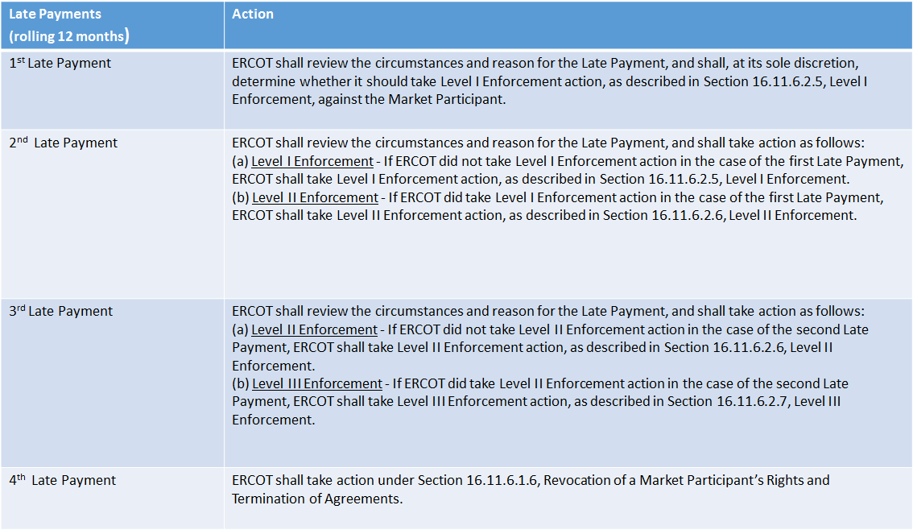
MCWG update to WMS
Late Payments
1st Late Payment
2nd Late Payment
3rd Late Payment

Slide 4
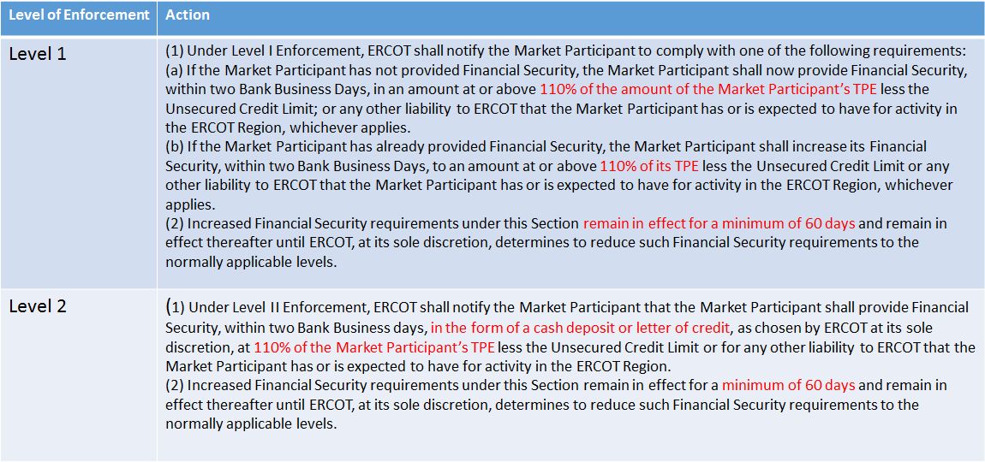
MCWG update to WMS
Late Payments

Slide 5
MCWG update to WMS
NPRR976
Review of NPRR976 Provisions for Resource Entities to Act as a Virtual QSE or Emergency QSE - What happens during the period when a replacement QSE is not set up yet?
CRR Future Credit Exposure Improvements (DC Energy)
Treatment of CRR Options in the Future Credit Exposure calculation
Calculate one Portfolio Weighted Adder (PWA) calculation where options and obligations are considered together
Including the impact of time diversification in the Future Credit Exposure calculation
Portfolios spanning different durations do not exhibit the same risk profile

Slide 6
MCWG update to WMS
NPRR976
Review of NPRR976 Provisions for Resource Entities to Act as a Virtual QSE or Emergency QSE - What happens during the period when a replacement QSE is not set up yet?
Proposal - CRR Future Credit Exposure Improvements (DC Energy)
Treatment of CRR Options in the Future Credit Exposure calculation
Calculate one Portfolio Weighted Adder (PWA) calculation where options and obligations are considered together
Including the impact of time diversification in the Future Credit Exposure calculation
Portfolios spanning different durations do not exhibit the same risk profile

Slide 7
MCWG update to WMS
Proposal – “Activity Suspension” (Wolfranium Power)
Allow a manual “activity suspension” to freeze a participant’s EAL value at the current value
Allow participants to affirmatively (1) suspend trading and (2) immediately pay all outstanding invoices (zeroing out future risk to ERCOT), after which the “Financial Security Obligation” would be frozen at a prior value until participants affirmatively contact EROCT to resume operations.
Intended to allow fully solvent participants to ride out short-duration extraordinary market periods without defaulting, while insuring that ERCOT bears no additional financial risk.
Directed at market participants that have a varying credit risk profile (traders).
Does this create perverse incentives?

