Slide 1
Hybrid Resources as Power Plants
Mark Ahlstrom, ESIG and NextEra Energy Resources

Slide 2
Explosive growth in solar + storage projects
Both co-located and full hybrid designs (trending toward hybrid?)
As an example from NextEra:
  Over half of planned PV includes storage
  All planned storage is combined with PV
The storage hybrid concept may apply broadly
  Solar + storage, wind + storage, gas + storage, or anything + storage?
  May apply, with some potential adjustments, to virtual power plants and aggregated distributed energy resources

Slide 3
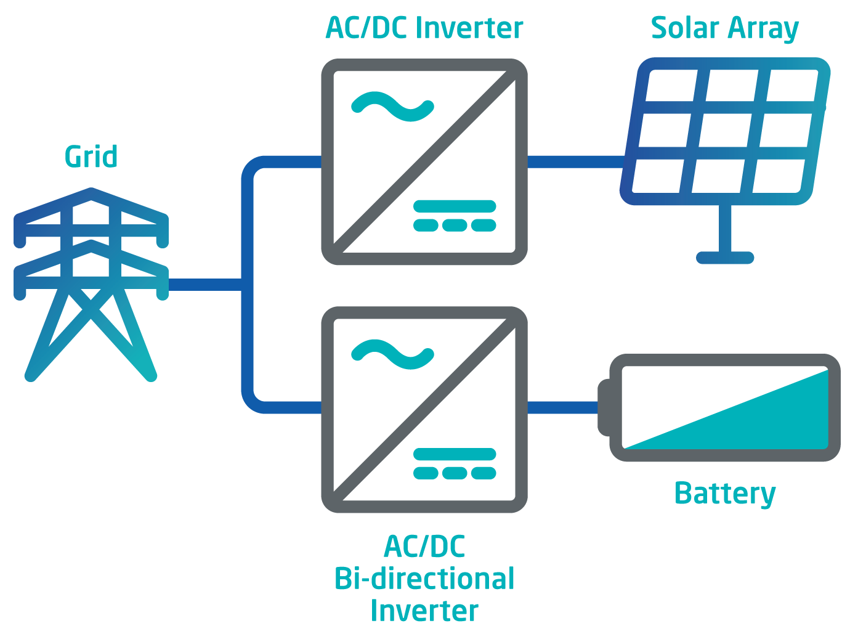
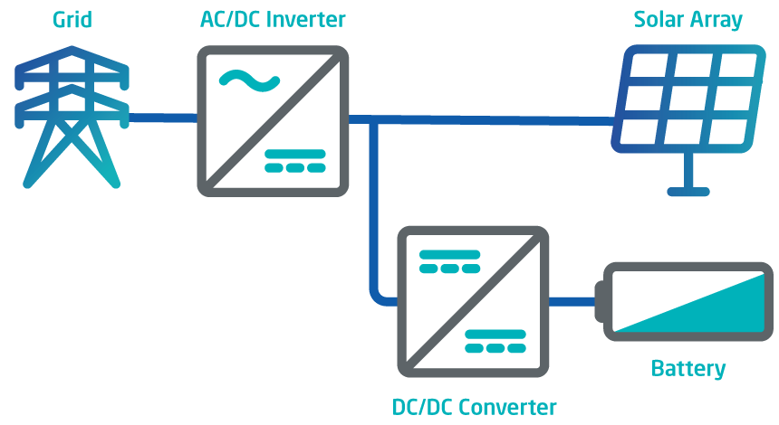
AC versus DC Coupling
AC Coupled
DC Coupled

Slide 4

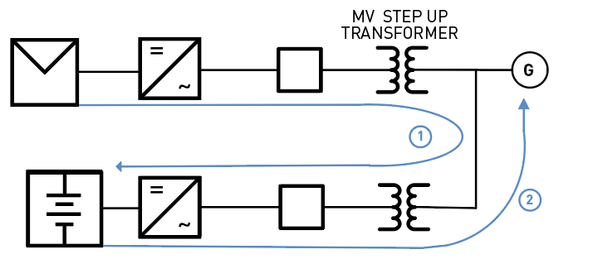
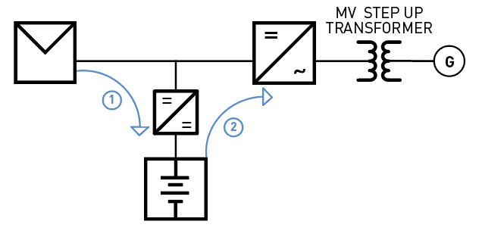
HIGHER EFFICIENCY
52
52
DC-COUPLED
3 power electronic conversions
1 battery charge and discharge
1 transformer conversion
AC-COUPLED
3 power electronic conversions
1 battery charge and discharge
3 transformer conversions
Efficiency = 89.2%
= .95 * .982 * .982 * .984 * .99
Efficiency = 86.2%
= .95 * .984 * .99 * .99 * .984 * .984 * .99
Assumed efficiencies: PV inverter = 98.4%, Battery inverter = 97.5%, DC-DC = 98.2%, transformer = 99%, batteries = 95% round trip

Slide 5
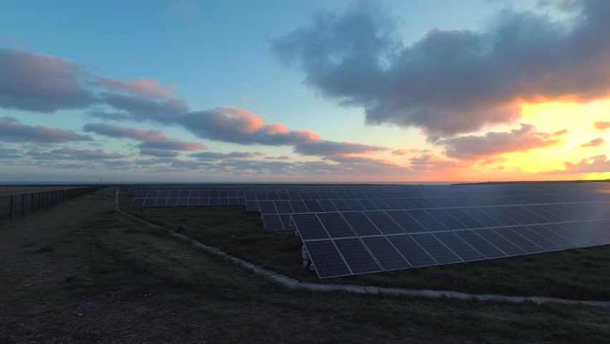
LOW VOLTAGE HARVEST (LVH)
ONLY WITH DC-COUPLED
PV inverters harvest DC input when the array or string voltage is above a certain threshold. This impacts generation at beginning of day, end of day and in heavy cloud cover.

Slide 6
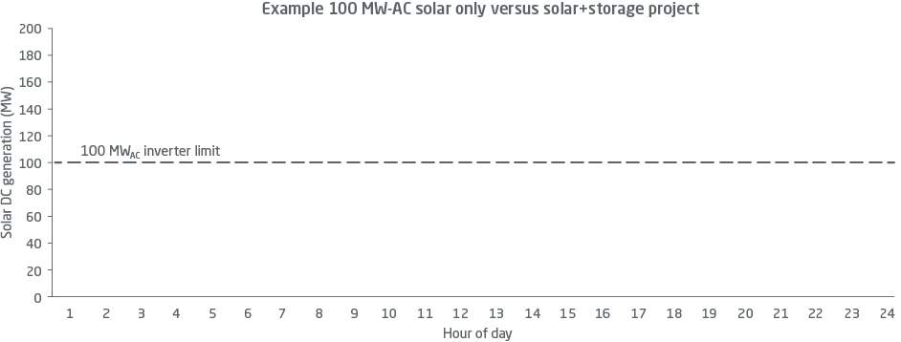
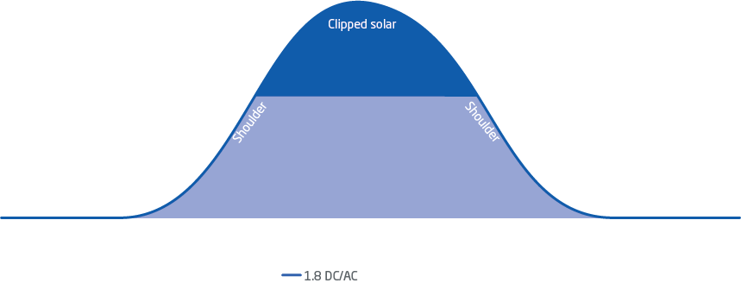


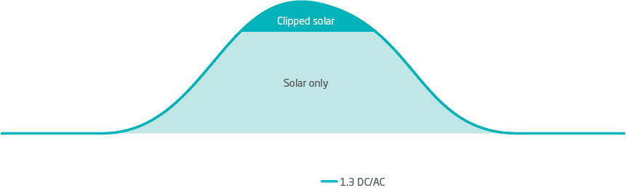

Maximizing solar with DC-coupled energy storage

Slide 7
Hybrid Resources – Definition
A combination of multiple technologies that are
physically and electronically controlled by the Hybrid Owner/Operator behind the point of interconnection (“POI”) and offered to the grid as a single resource at that POI

Slide 8
Proposed Hybrid Resources Concept
An “intelligent agent” approach whereby the Hybrid Owner/Operator internalizes the characteristics of the components behind the POI and offers energy and/or ancillary services at the POI in the same way as a conventional resource, but with more flexibility and fewer constraints through coordinated use of energy, storage, power electronics and software technologies

Slide 9
Benefits to System/Market Operator
Use existing “conventional” market participation models
Treat hybrid like conventional resources, not renewable or storage resources
Hybrid Owner/Operator manages state-of-charge (often through their offers)
Hybrid offers energy and ancillary services in both DA and RT markets
Offers of energy and ancillary services can be co-optimized from all resources
Doesn’t curtail renewable for headroom – services from battery rate-of-charge
Provides fully convex, one-part offers* without advance commitment requirements, startup costs, minimum generation levels or other constraints
* Monotonically increasing energy offers without startup or no-load fees. For a good explanation of convexity and offers, see:
https://www.iso-ne.com/static-assets/documents/2015/06/price_information_technical_session11.pdf

Slide 10
Benefits to Hybrid Owner/Operator
Can participate in all market products using an existing market participation model (changing a master data file, not creating a new participation model)
Treated like conventional resource with full co-optimization of energy and ancillary services offers using existing day ahead and real time constructs
Allows the renewable component of the Hybrid Resource to generate fully without the need to be curtailed to retain headroom to provide services
Allows the storage component of the Hybrid Resource to be charged from the renewable component of the Hybrid Resource (or from grid, if allowed)
Same incentives/penalties for performance as for conventional resources

Slide 11
PV Hybrid Resources – Offers and Operations
Offer strategy based on high-confidence PV forecast
  Offers use probabilistic PV forecast backed by storage to firm variability and forecast uncertainty (day ahead, hour ahead, eventually intra-hour?)
  Creates products by controlling the battery, NOT by retaining headroom on PV
  Battery often used around middle of its range most daylight hours, charged for evening
  Battery state-of-charge is often controlled via the offers of energy and ancillary products
  (e.g., regulation-up and spin are usually charging the battery)
Hybrid Resources internalize the non-convexities* and the renewable forecasts
  One-part offers*, Pmin=0, Pmax=offer based on P95+ forecast
  No startup time, startup cost, min-run time or other constraints
* Monotonically increasing energy offers without startup or no-load fees. For a good explanation of convexity and offers, see:
https://www.iso-ne.com/static-assets/documents/2015/06/price_information_technical_session11.pdf

Slide 12
Motivates Beneficial Behavior from the Hybrid
Sophisticated Analytics – Deeply understanding battery degradation costs, opportunity costs, forecasts and risks, and working to improve them
Using the best available forecasts of the renewable resource (and investing in improving those forecasts, including probabilistic forecasts that better reflect risk and certainty around the forecasts), because this allows offers of larger volumes of services while managing delivery risks
Forecasting and offering services so as to be most available during the most critical hours of system need, as this should align with periods of highest value
Optimizing the power plant design to maximize the services that are useful to and valued by the system while minimizing their risk of delivering such service

Slide 13
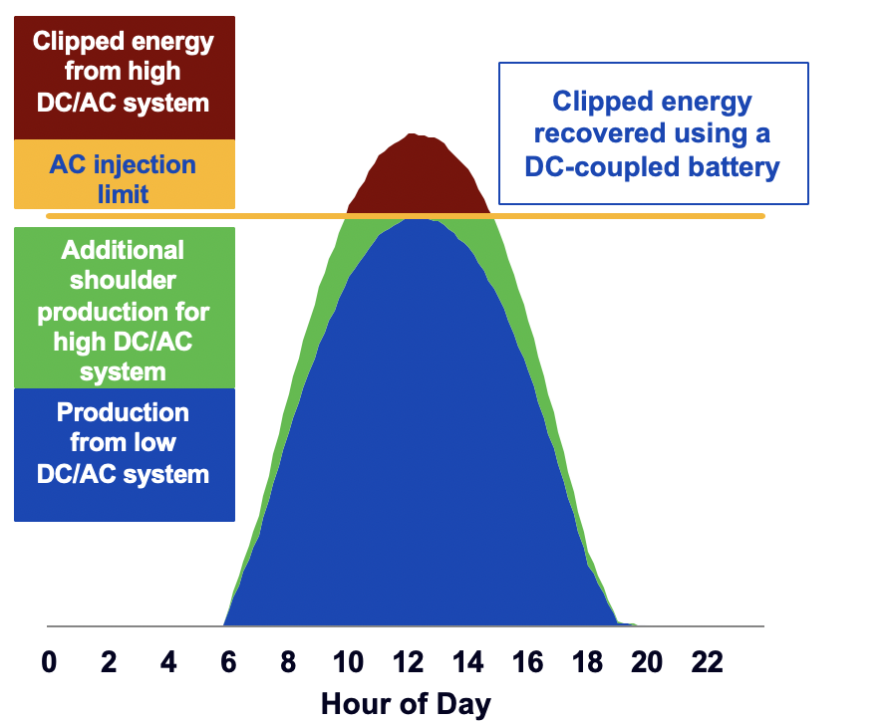
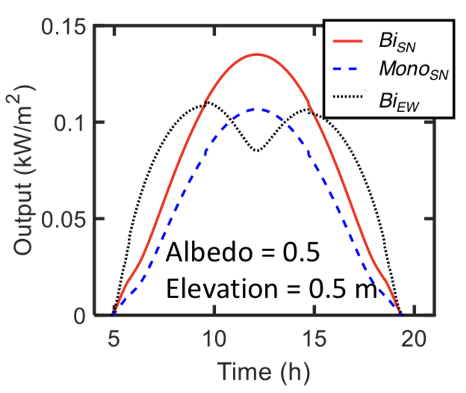
Changing Plant Design to Improve Offers
Hybridizing changes plant design
  Leads to dramatic internal design changes and higher effective renewable capacity factors
  Variability is reduced by pushing much of it into clipped region and controlling battery charge rate
  Power forecasting skill can be improved as viewed from the POI
  Many options to optimize layout, orientation, bifacial PV panels, etc.
  Optimizes use of interconnection
From Sun, Khan, Deline, Alam
Optimization and Performance of Bifacial Solar Modules: A Global Perspective
https://www.sciencedirect.com/science/article/pii/S0306261917317567

Slide 14
Hybrid Resources – Summary and Future Steps
Hybrid Resources can initially compete as “generic flexible generators”
    Allow treatment as a single resource – a unified system controlled by an intelligent agent
    Hybrid would give up renewable DIR/PIR-type settlement and other VER accommodations
    Treat Hybrid Resource comparably to a conventional generation resource with a typical forced outage rate, comparable incentives/penalties for performance and contingency treatment
Hybrid resources, operated as a single resource, will eventually change market products, market design and market participation
    No advance commitment, startup costs, minimum generation levels or other constraints
Will we build standalone storage, or mostly just Hybrid Resources?
    Which is better, a highly flexible generator or a battery storage resource?
    What, exactly, is the difference? How does it affect planning, markets and operations?

Slide 15
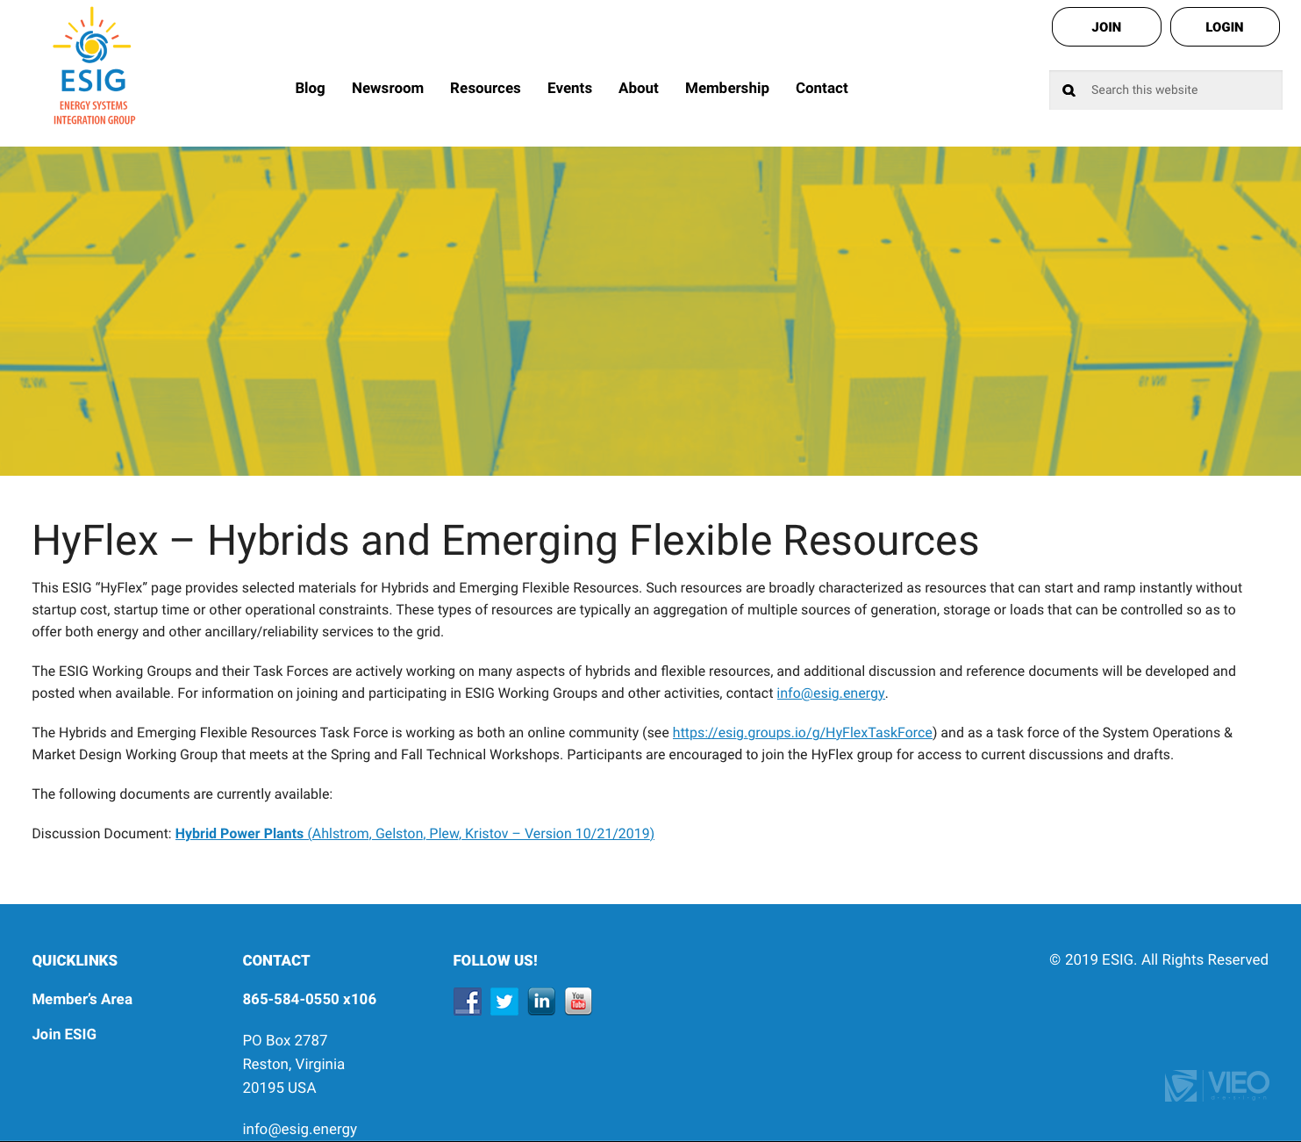
Discussion paper is available
https://www.esig.energy/hyflex-hybrids-and-emerging-flexible-resources/

Slide 16
Mark Ahlstrom
President, Energy Systems Integration Group
VP, Renewable Energy Policy, NextEra Energy Resources
mark.ahlstrom@nexteraanalytics.com
Twitter/LinkedIn @markahlstrom
www.esig.energy

