Slide 1
MIS and ERCOT.com User Workshop
December 2, 2019

Slide 2
Agenda
Introduction
Demo of Internal EMIL Application
Review MIS-Related Wireframes
Upcoming feedback opportunities

Slide 3
Introduction
Early Concept Stage
Focused on MIS and EMIL
Important we talk to users
Many opportunities for feedback in 2020

Slide 4
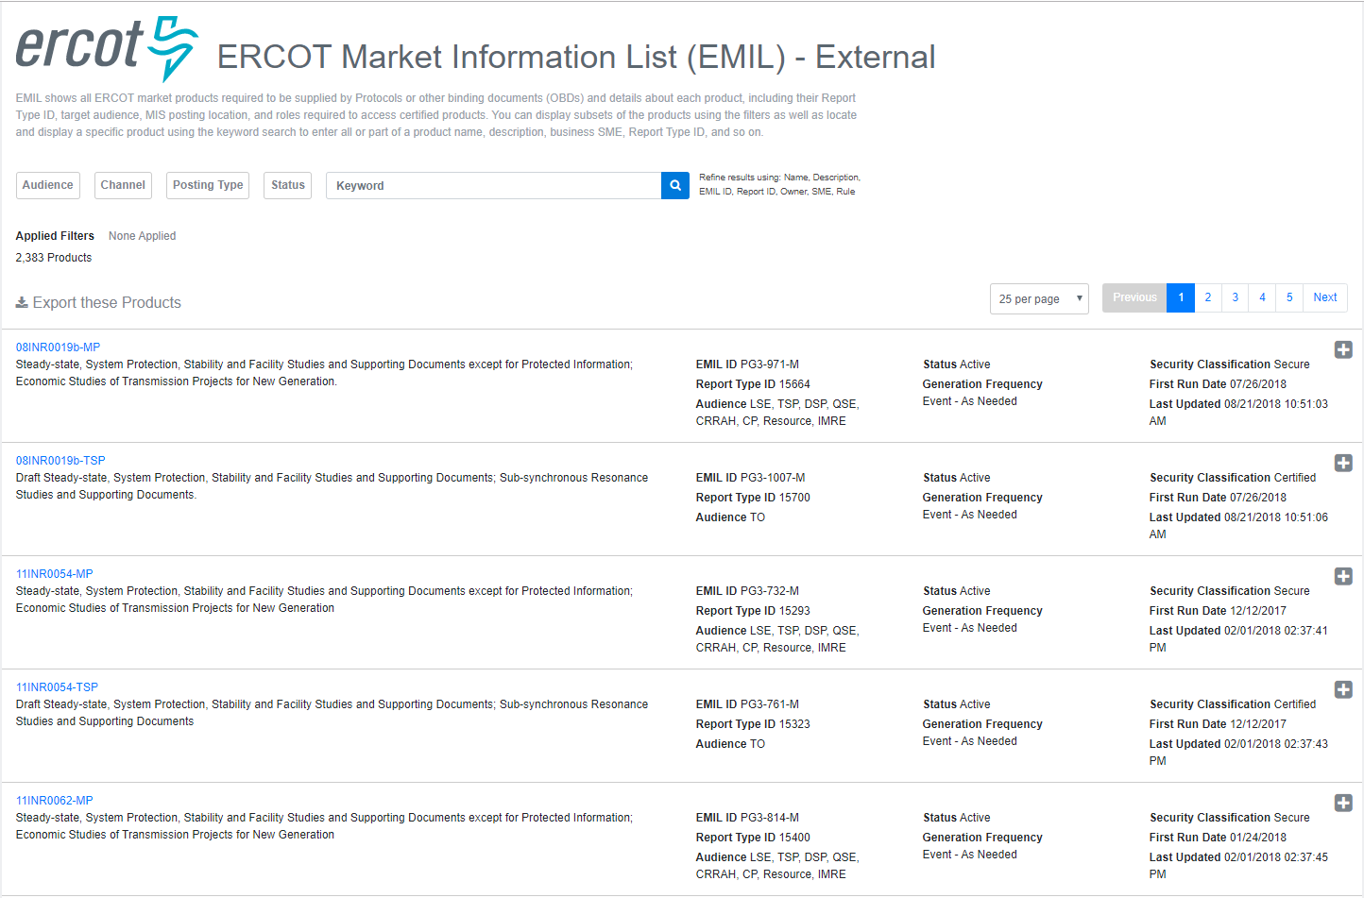
EMIL Home Screen

Slide 5
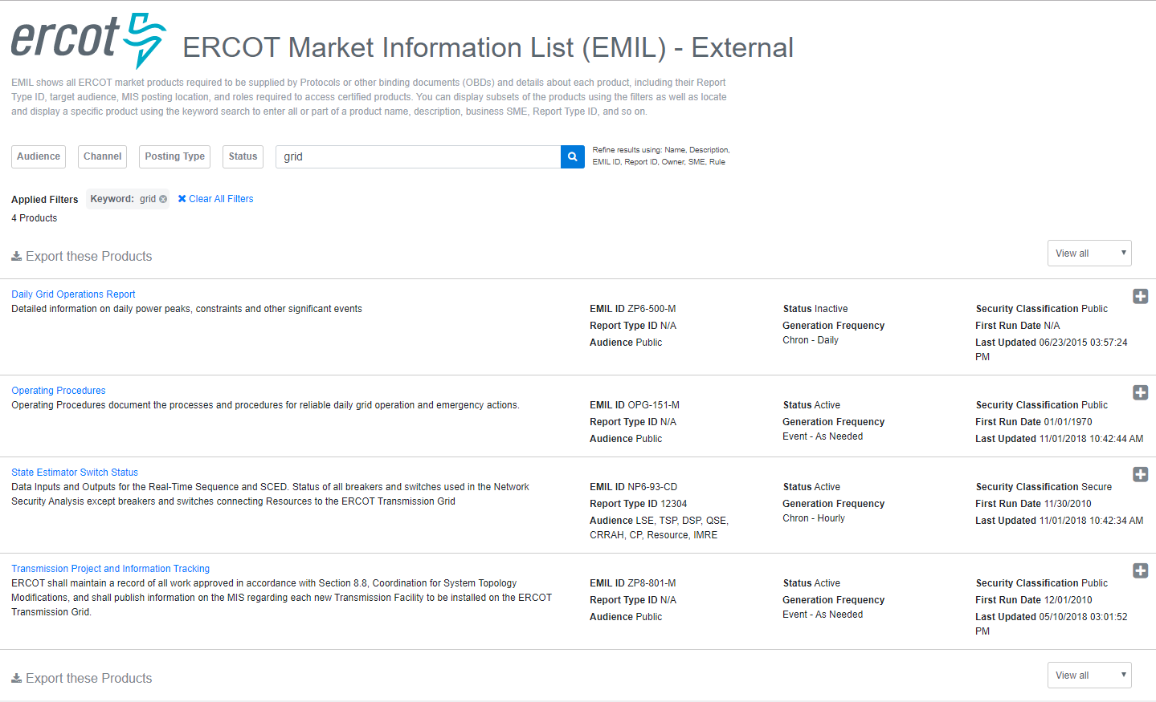
EMIL Search Results

Slide 6
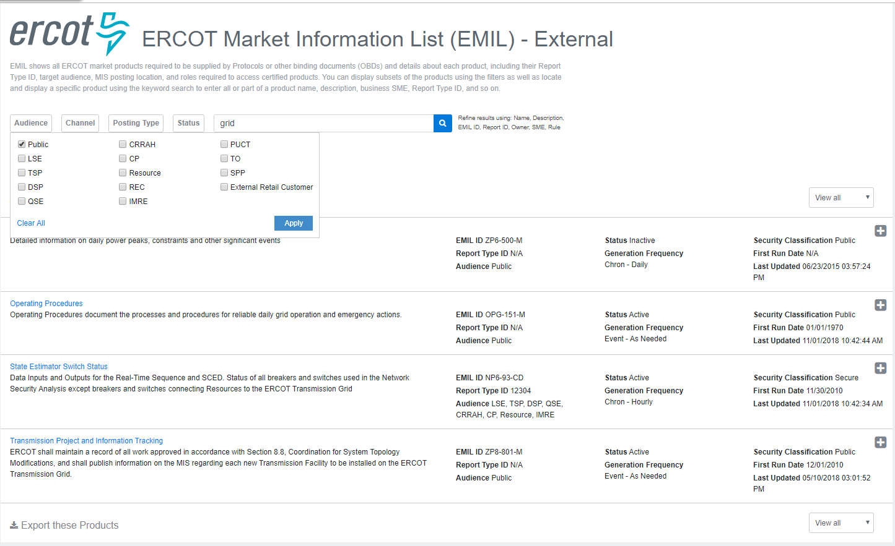
EMIL Filtered Results

Slide 7
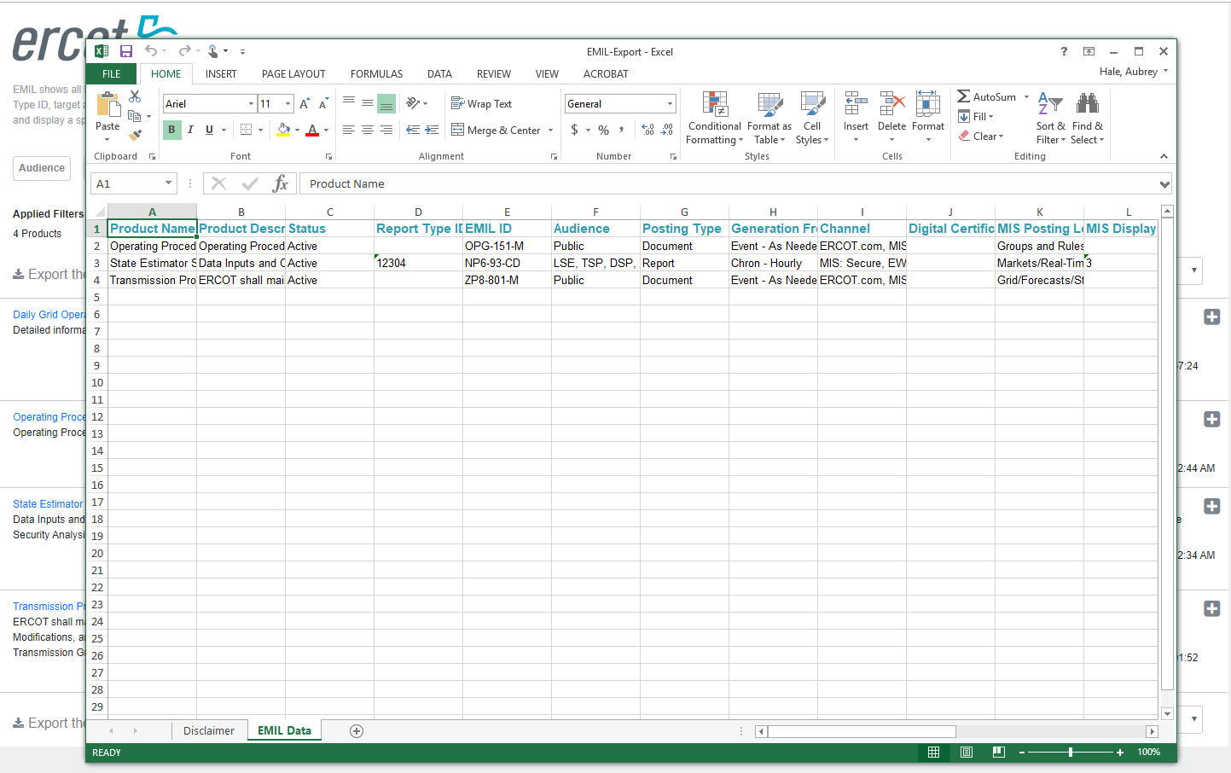
EMIL Export Results

Slide 8
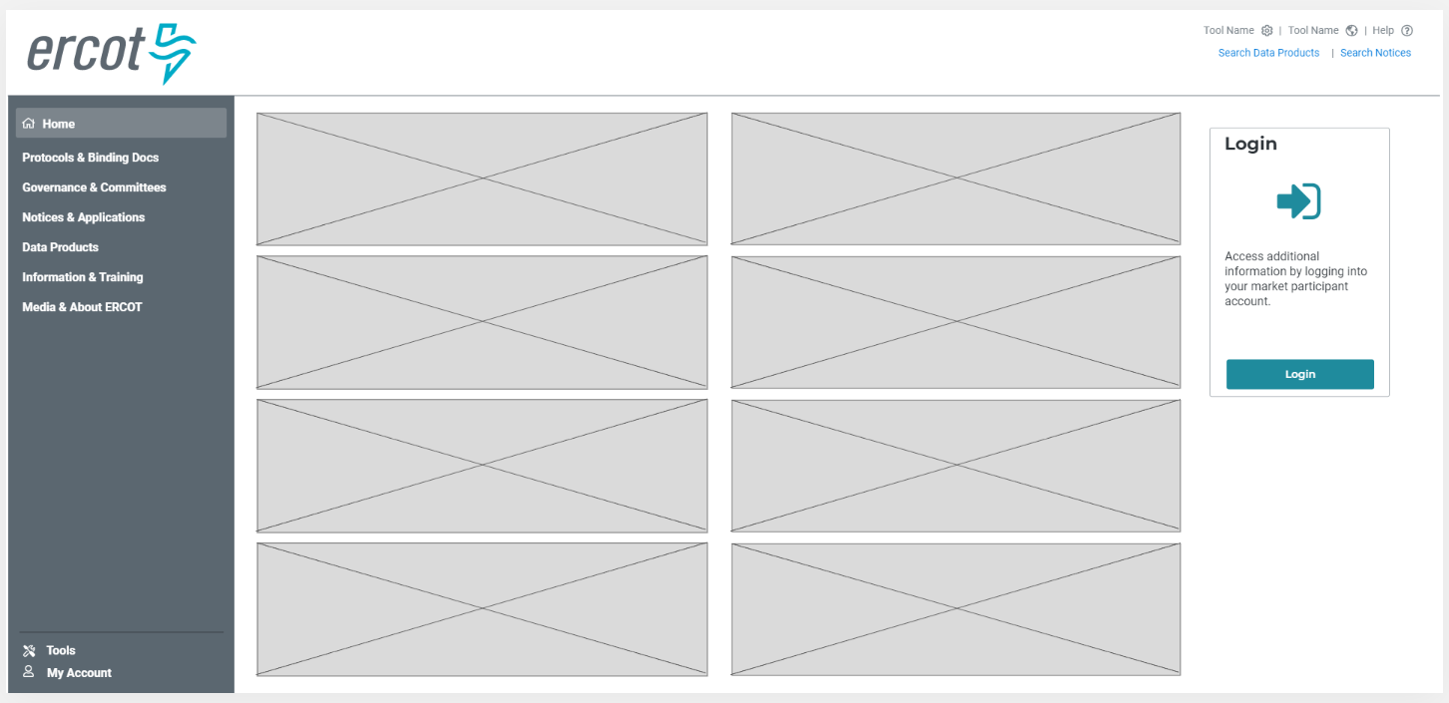
MIS Concept - Unauthenticated Home

Slide 9
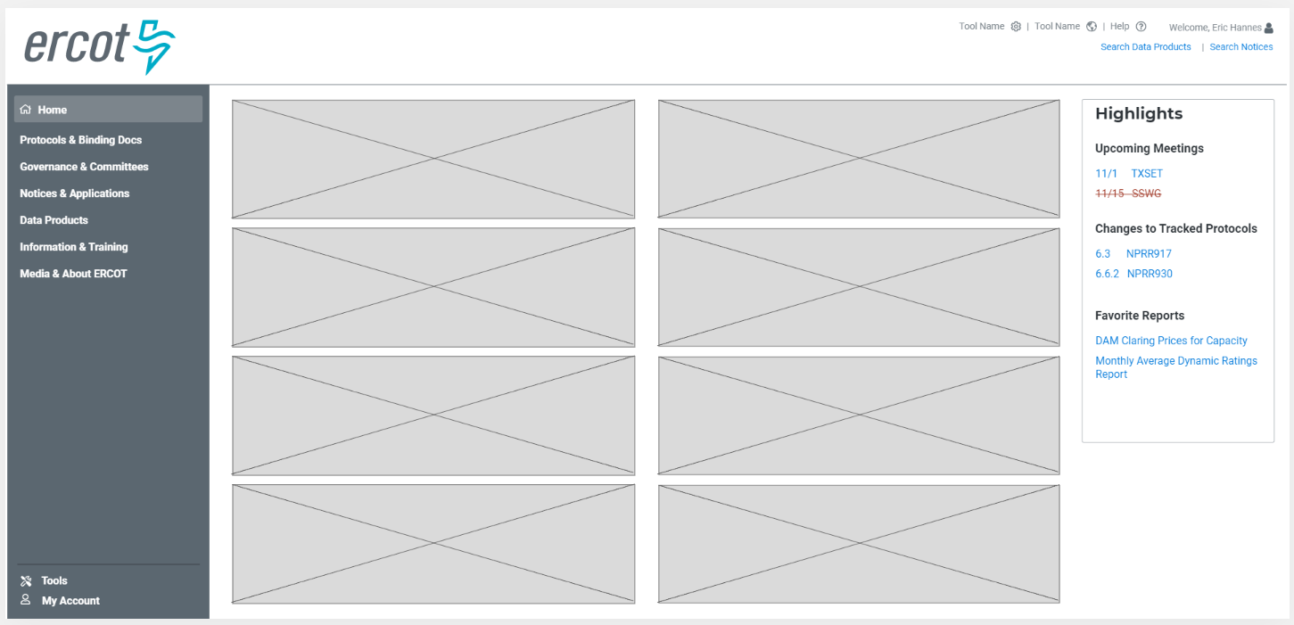
MIS Concept - Authenticated Home

Slide 10
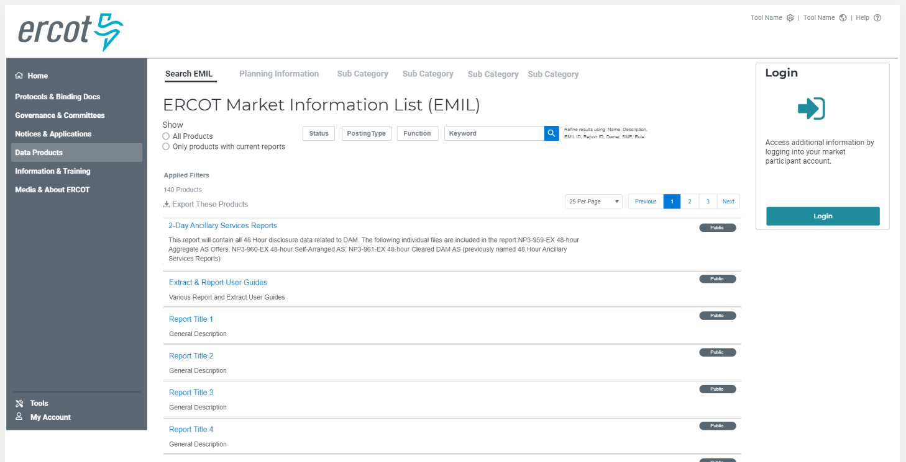
MIS Concept - Unauthenticated Report List

Slide 11
MIS Concept - Authenticated Report List

Slide 12
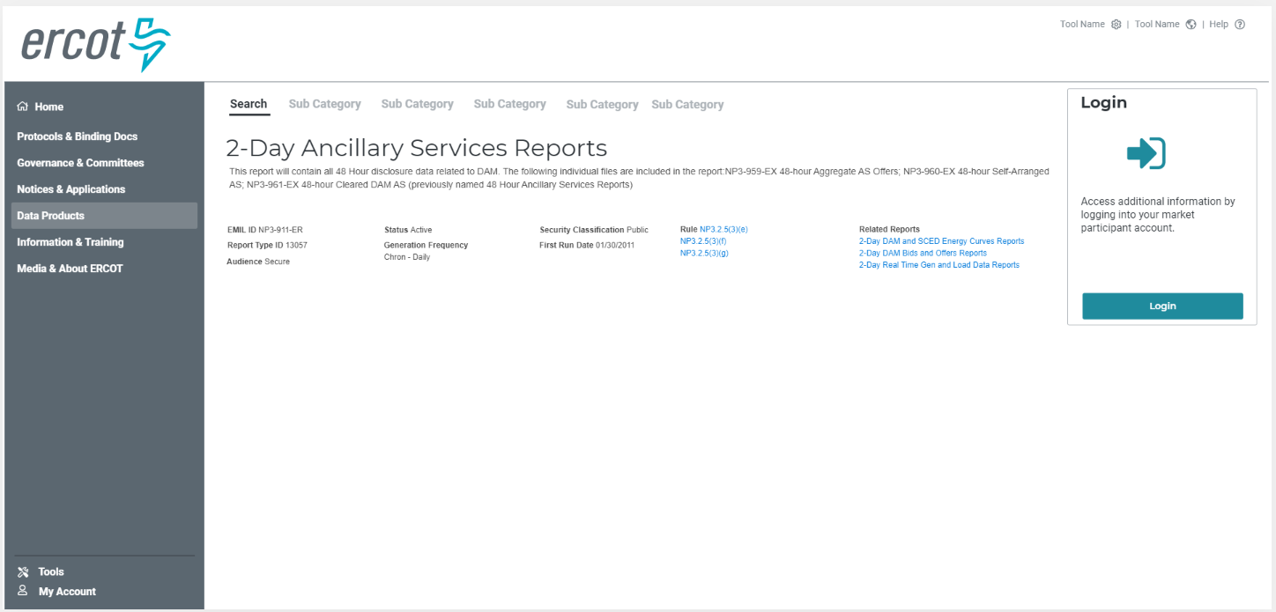
MIS Concept - Unauthenticated Data Detail

Slide 13
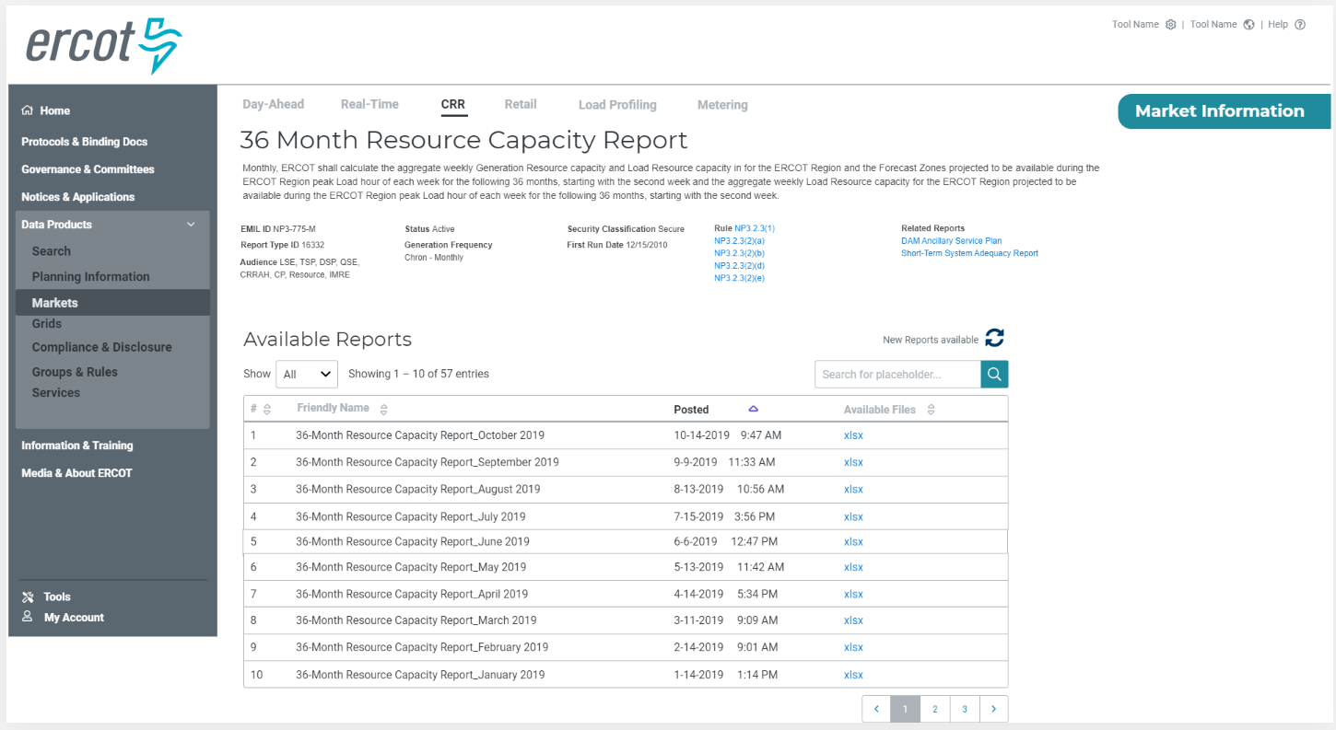
MIS Concept - Authenticated Data Detail

Slide 14
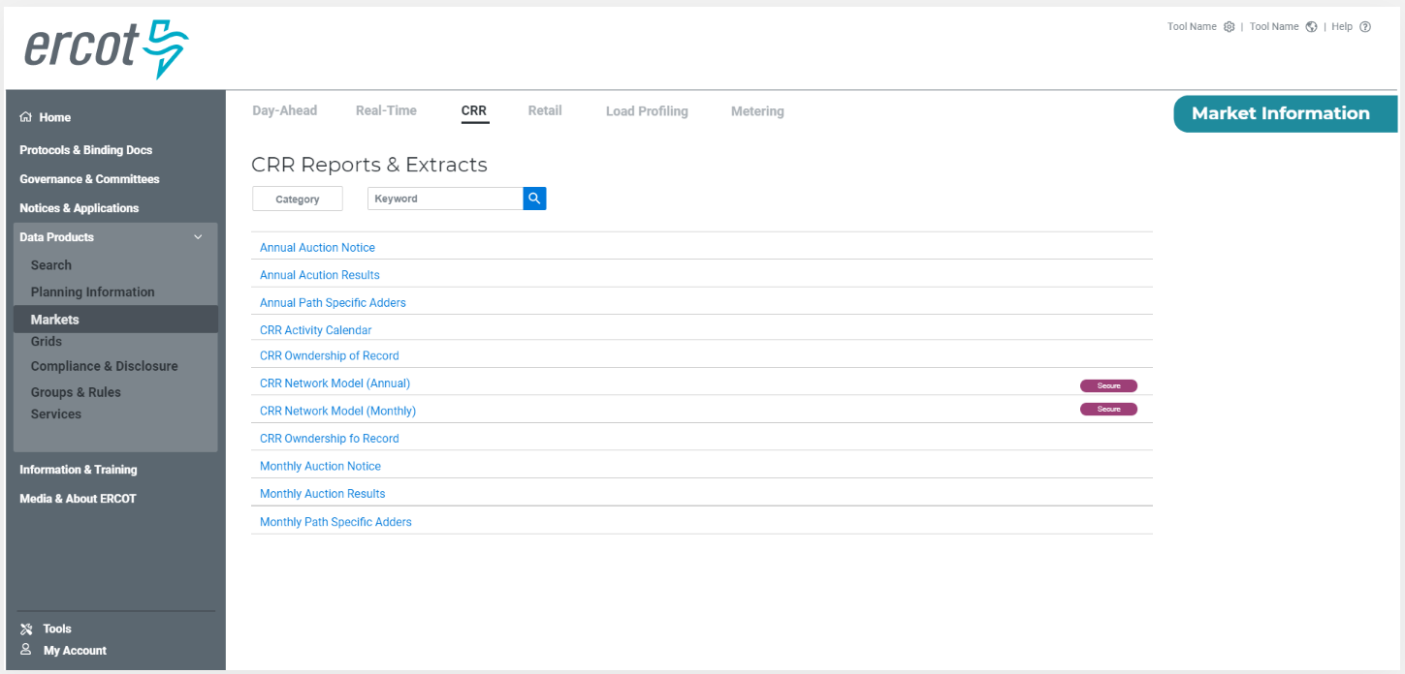
MIS Concept – Sub Categories

Slide 15

MIS Concept – Sub Categories w/ App Links

Slide 16
Feedback Opportunities
Contact Aubrey Hale ahale@ercot.com
Watch for 2020 ERCOT Workshops
http://www.ercot.com/committees/workshops

