Slide 1
Summer outage restrictions – lessons learned
December 2019

Slide 2
Summary
Outage restriction trends
Summer work prior to ERCOT Summer Outage Restrictions
CNP outage coordination
Working with ERCOT Summer Outage Restrictions
Impact of ERCOT Outage Restrictions
Lessons Learned

Slide 3
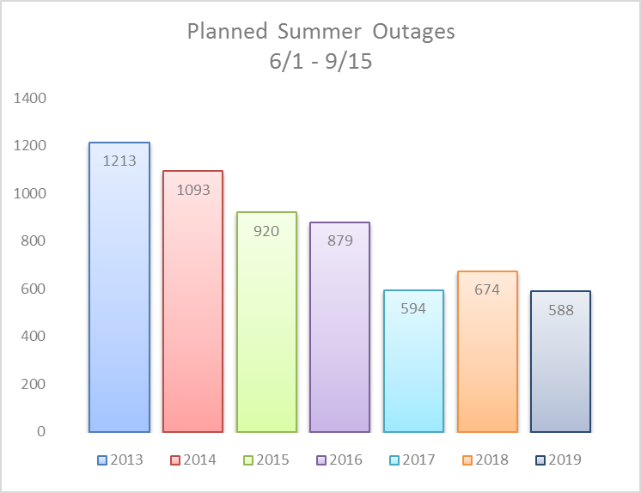
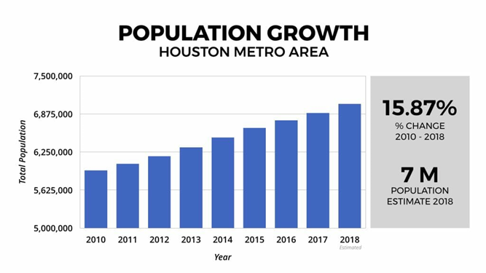
Trend of Summer Outage Restrictions
Outages have been restricted year after year due to growth and higher loads
  Texas leads the nation in growth and the Houston area ranks No. 2 in population growth while generation reserves are decreasing
  System conditions have caused summer restrictions prior to ERCOT Outage Restrictions
Reduced summer outages and more efficient outage coordination is required

Slide 4
Summer work
PRIOR TO ERCOT OUTAGE RESTRICTIONS
Limit outages during 6/1 – 9/15
Plan work that does not need outages for summer
Build transmission line by-passes
Perform more line work hot using work tags
Minimize Emergency Restore Time
Plan work for daily outages as needed
Adjust outage times as needed with regards to forecasted loads
Attend many outage coordination meetings
Carefully plan projects and evaluate outages with regards to system reliability

Slide 5
CNP Outage Coordination
Outage Scheduling Group holds 2 outage coordination meetings per week
  Discuss major projects and outages of concern up to 1+ year out & most of the upcoming projects and outage conflicts within the next few months
  Perform a detailed 2 week outage review and a 1 week outage review with input from the engineering group
Attend other outage coordination meetings: quarterly Transmission Planning meeting, monthly Transmission Construction meetings, biweekly Substation Construction meetings, weekly system modeling, and individual project meetings for each project as needed
Engineering group performs 3 month, 6 wk, 2 wk, 1 wk, 1 day, real time outage studies that we use in our outage coordination
Experienced Transmission, Substation Performance and Substation Construction matrixed to Outage Scheduling Group

Slide 6
Working With ERCOT restrictions
Limit outages 5/15 – 9/15
Schedule almost all work for daily outages
Plan to return all CNP outages by 1300 except for special exceptions
Inform Industrial Customers of outage restrictions
Request exceptions for major project outages that do not cause issues
Request exceptions for load transformer outages as needed

Slide 7
IMPACT OF SUMMER OUTAGE RESTRICTIONS
EXTENDED SUMMER PEAK
Changing Start of “Peak” from 6/1 to 5/15
Previously scheduled continuous outages and finished projects 5/15 – 5/31 as allowed by system conditions – reduced flexibility
Now plan to complete projects before 5/15 due to continuous outages needed
Increases work during shoulder months and creates more outage conflicts
Increase budget & plan to work more overtime to complete projects before 5/15
Cannot take advantage of cooler temperatures that may allow outages

Slide 8
IMPACT OF SUMMER OUTAGE RESTRICTIONS
DAILY OUTAGES
Increased number of days on outage – 2 continuous outages days vs. 5 daily
  ~ 1 - 2 hrs for switching and 2 hrs for grounding per day leaving only 3-4 hrs to work
  More days on one outage creates more outage conflicts
Increased switching increase potential for error and increased failure
  Added wear and tear on equipment
RETURN OUTAGES BY 1300
Start outages earlier to meet mandatory 1300 return time
  Started outages as early as 2300
  Some outages returned by 0600 due to area loading
  Median start time for line outages in 2019 was 0500 and return time 1200
Increase budget for overtime switching outside normal hours
Personnel safety risk of working outages at night – work may be slower
Distribution of public working at night in residential areas with lights

Slide 9
IMPACT OF SUMMER OUTAGE RESTRICTIONS
INDUSTRIAL CUSTOMERS
Inform customers of ERCOT Summer Outage Restrictions at CNP’s annual Industrial Customer Workshop
Many Industrial Customers can’t work with ERCOT outage restrictions because they need continuous outages to perform all work when the plant comes down
  Additional line outages for Industrial Customers in shoulder months create more outage conflicts
  Customers may delay outages needed for upgrades, repairs and maintenance which may create more risk to the system
REQUEST EXCEPTIONS
Some major projects require summer outages to complete on time
  Carefully evaluate outages and request exceptions for required continuous outages that shouldn’t disrupt generation or cause system reliability issues
Allow outages on customer’s load transformers by requesting an exception with ERCOT
  Customers that can roll load will often perform transformer maintenance during summer and schedule line outages during off peak months

Slide 10
Review – lessons learned
Summers are becoming more restrictive as area growth and capital projects are increasing
Increased need for outage coordination and planning
Beneficial to identify outage restrictions asap and incorporate them in planning
Anticipate to take daily outages and return before 1300
Plan dead work for summer and utilize temporary bypasses
Plan for extra manpower and cost associated with extra switching and grounding
Leave time in outage coordination process to account for outage conflict resolution
Make sure Industrial Customers are aware of outage restrictions and plan for them
Beneficial to have ability to study outages to determine if an exception is a viable option
Would be very beneficial if continuous outages were allowed on a case by case basis 5/15 – 5/31 and the Outages Restrictions were not applied to load transformers

Slide 11

Thank you!
Questions?

