Slide 1
Single Energy Storage Resource Model
Sai Moorty
Principal, Market Design and Analysis
November 4, 2019

Slide 2
Characteristics of a Single Model ESR (Phase 1)
ERCOT market systems will not consider State of Charge (SOC) related telemetry
No State of Charge Management in DAM, RUC, Real-Time market
SOC related telemetry by QSE will be used for:
PRC calculation
To increase situational awareness
Physically a single device with one electrical pathway to the modeled electrical network
The charging and discharging electrical path is the same
Limited energy storage capability (<= 24 hours). This implies that the ESR cannot discharge continuously at its rated MW for 24 hours.
Does not have temporal constraints (StartTime, MinUpTime, MinDownTime, etc.) and does not have transition times between charging and discharging
Does not have startup, shutdown and transition costs
Can smoothly transition from charging to discharging and vice-versa and there is no dead band around 0 MW
All data inputs are measured at the Point of Interconnection (POI) or Point of Common Coupling (PCC)
Single price curve from charging (Bid-To-Buy) to discharging (Offer-To-Sell) that is monotonically non-decreasing as the MW quantity increases; i.e., the single submitted price curve covers both the charging and discharging MW range

Slide 3
Characteristics of a Single Model ESR
ESR Status will be ON, ONXX, OFF, or OUT. This statement reflects current thinking that new statuses are NOT required
With the above characteristics, MMS modeling/calculations for ESRs become a dispatch problem for Real-Time (SCED), DAM and RUC processes.
An ESR will be settled at a Nodal price for both charging and discharging.
QSE responsible for maintaining state of charge (MWh) and reflecting energy capability to ERCOT via telemetry, COP, etc.

Slide 4
Single Model ESR
QSE responsibility for managing State of Charge by changing ESR (HSL,LSL) telemetry
ESR Telemetry
Resource Status (ON,OFF,OUT,etc.)
Gross MW
Gross MVAr
Net MW
Net MVar
HSL
LSL (can be negative)
10MW
HSL
Breaker
MW=BP+AS Deployed
Meter
0 MW
Resource Node
ESR
+
ESR
-
LSL (can be negative)
ESR State Of Charge (SOC) Telemetry
SOC (MWHr)
MaxLimitSOC (MWHr)
MinLimitSOC (MWHr)
MaxDisRate (MW)
MaxChgRate (MW)
-10MW
Empty
Full
MWHr

Slide 5
Combo Model Enhancements Applicable to Single Model ESR
Improvements to the use of the “Combo” model in current systems will be incorporated, if applicable:
PRC Calculation considering State of Charge (RTOLCAP calc. changes does not carry over when RTC goes live)
Mitigation changes
Allowing updates to EOC closer to Real-Time
Applicable changes to RUC to consider limited energy storage capacity of Storage Resources
Nodal price settlement for both charging and discharging, regardless of whether Storage Resource has WSL treatment
RTC will dispatch a Single Model ESR on its nodal shift factor
Reactive Capability (4 quadrant) and Voltage Support Service
Voltage/Frequency Ride-through requirements
Uniform Governor Deadband and Droop setting requirements from charging to discharging
Energy Storage Resource Performance Deployment (ESRDP)

Slide 6
Single Model ESR : Three Part Supply Offer (3PO)
For Single model ESR, submitted 3PO must have “NULL” for startup and Minimum Energy Costs
Single model ESR does not have:
Startup Costs (Hot, Intermediate, Cold)
Minimum Energy Cost
Energy Offer Curve
Single Cost curve shall be monotonically increasing from maximum charging MW (negative) to maximum discharging MW.
The maximum price on the charging curve is less than the minimum price on the discharging curve i.e. $δ>0$
10 quantity, price pairs to represent linear cost curve

Slide 7
Single Model ESR : Energy Incremental Cost Curve
Single Cost curve shall be monotonically increasing from maximum charging MW (negative) to maximum discharging MW.
The maximum price on the charging curve is less than the minimum price on the discharging curve i.e. $δ>0$
Single ESR Model
Combo ESR Model
$/MWh
$/MWh
$100/MWh
ESR-GR EOC
$100/MWh
$$δ>0$$
$4/MWh
Discharging MW (+ve)
Charging MW (-ve)
Discharging MW (+ve)
$/MWh
ESR-CLR RTM Bid
$4/MWh
Charging MW (+ve)

Slide 8
Single Model ESR : AS Participation Matrix
Note any Resource must pass AS product specific qualification process to be eligible to provide that AS product
No Change to AS Offer structure
 | RegUp |  | RegDn |  | RRS |  |  | ECRS |  | NSPIN
 | Conventional | FRRSUp | Conventional | FRRSDn | PFR | UFR | FFR | Dispatchable | Blocky
Single Device Storage Resource | X | X | X | X | X |  | X | X |  | X

Slide 9
Single ESR Model Statuses
Resource Status | COP | Telemetry | Proposed use of Generation Resource Status under RTC
ON | Y | Y | Available for energy and AS awards
ONOPTOUT | Y | Y | Considered to be same as ON
ONRUC | Y | Y | Considered to be same as ON (specific rules for EOC and AS Offer)
ONOS | Y | Y | Applying current rules for output schedules, available for energy and AS awards
OFFQS | Y | Y | Considered to be same as ON for energy, ECRS and NSPIN. Cannot be awarded Regulation or Responsive Reserve
OFF | Y | Y | Not available to for energy, RegUp, RegDn, RRS, or ECRS awards Available for NSPIN if qualified
ONTEST | Y | Y | Energy participation same as today. Not eligible for AS award
ONEMR | Y | Y | Considered to be same as ON, Not eligible for AS award QSE may appropriately set LSL and HSL to reflect operating limits
OUT | Y | Y | Not available for energy or AS awards
EMR | Y | Y | Not available for energy or AS awards
EMRSWGR | Y | Y | Not available for energy or AS awards

Slide 10
COP: Single Model ESR
For a Single Model ESR, follows the proposals for the “Combo” model of ESR:
HSL reflects duration limitation
LSL, which can be negative, will also reflect duration limitation
HSL-LSL must be greater than or equal to the total AS capability of the single model ESR

Slide 11
DAM: Single Model ESR
In DAM, for a Single Model ESR:
If Three Part Supply Offer for energy or AS Offer exists, then Single Model ESR is considered to be self-committed, i.e. On-Line
No temporal constraints, there is no StartTime, Minimum Up time, Minimum Down Time, Transition Time, etc.
DAM modeling/calculations for Single Model ESRs becomes a dispatch problem to solve

Slide 12
RUC: Single Model ESR
Single Model ESR will not be “RUCed”. In the RUC engine, for a Single Model ESR:
Single Model ESR with COP status of OFF or ONXX, is considered to be self-committed, i.e. On-Line
No temporal constraints, there is no StartTime, Minimum Up time, Minimum Down Time, Transition Time, etc.
RUC modeling/calculations for Single Model ESRs becomes a dispatch problem to solve. RUC will use as cost curve:
Cost Curve of ESR discharge MW (generation) is SWCAP (MOC proposal for ESR)
Cost Curve of ESR charge MW (consumption) is $-251/MWh (system wide price floor)
Minimizes use of ESR to serve energy

Slide 13
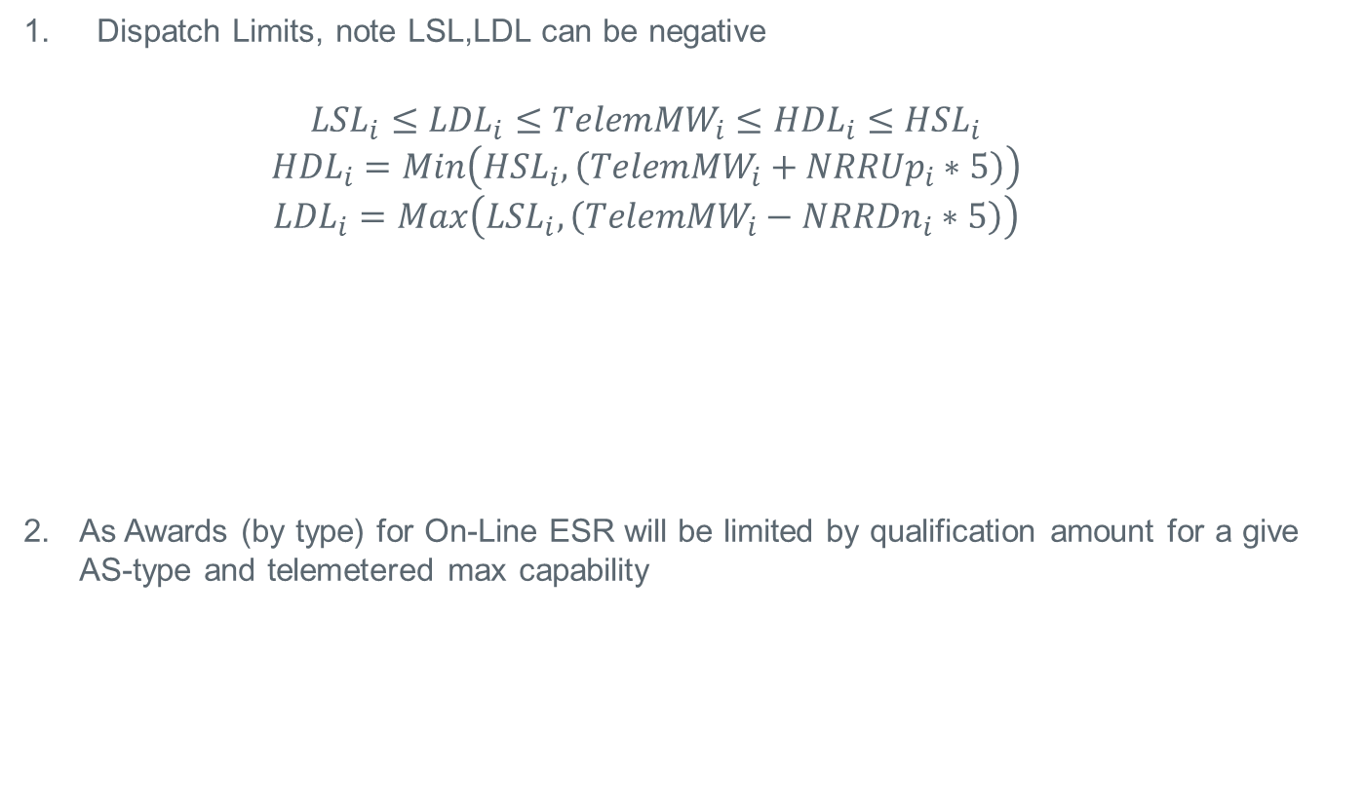
RTC: Constraints for On-Line Single ESR Model
Dispatch Limits, note LSL,LDL can be negative
$${LSL}_{i}≤{LDL}_{i}≤{TelemMW}_{i}≤{HDL}_{i}≤{HSL}_{i}$$
$${HDL}_{i}=Min\left({HSL}_{i},\left({TelemMW}_{i}+{NRRUp}_{i}∗5\right)\right)$$
$${LDL}_{i}=Max\left({LSL}_{i},\left({TelemMW}_{i}−{NRRDn}_{i}∗5\right)\right)$$
As Awards (by type) for On-Line ESR will be limited by qualification amount for a give AS-type and telemetered max capability
LSL
LDL
TelemMW
HDL
HSL
Can be negative

Slide 14
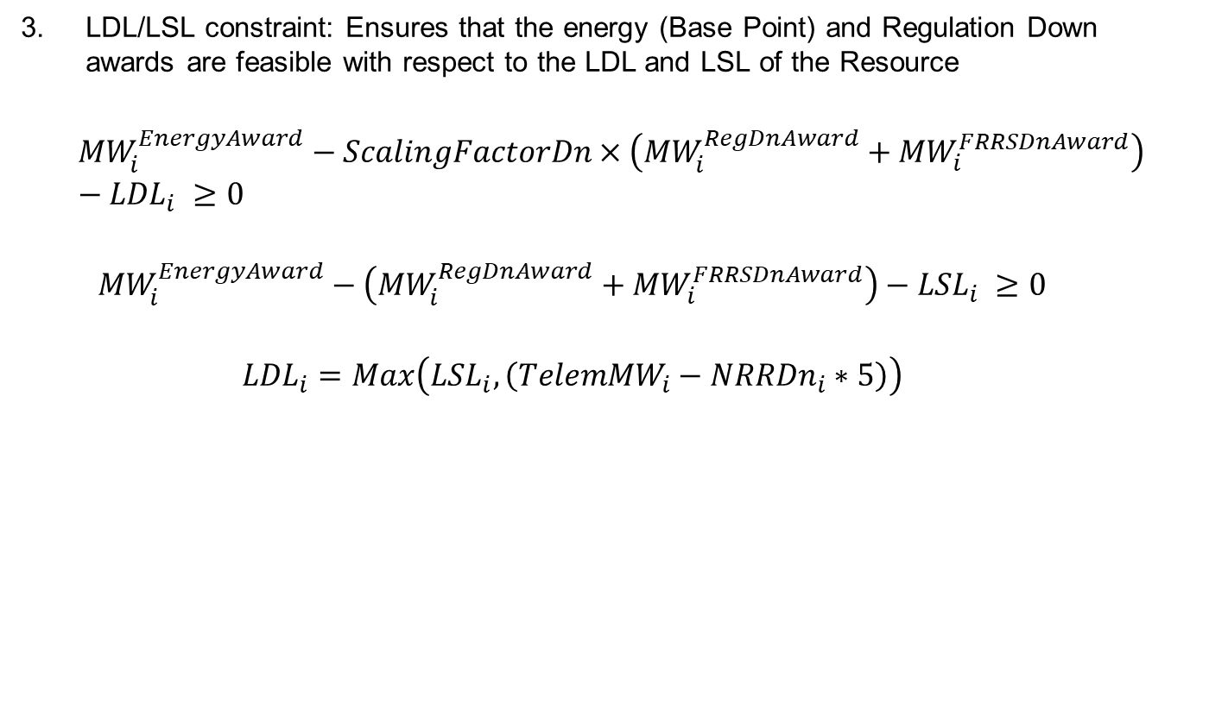
RTC: Constraints for On-Line Single ESR Model
LDL/LSL constraint: Ensures that the energy (Base Point) and Regulation Down awards are feasible with respect to the LDL and LSL of the Resource
$${MW}_{i}^{EnergyAward}−ScalingFactorDn×\left({MW}_{i}^{RegDnAward}+{MW}_{i}^{FRRSDnAward}\right)−{LDL}_{i} ≥0$$
$${MW}_{i}^{EnergyAward}−\left({MW}_{i}^{RegDnAward}+{MW}_{i}^{FRRSDnAward}\right)−{LSL}_{i} ≥0$$
$${LDL}_{i}=Max\left({LSL}_{i},\left({TelemMW}_{i}−{NRRDn}_{i}∗5\right)\right)$$
$$\left({MW}_{i}^{RegDnAward}+{MW}_{i}^{FRRSDnAward}\right)$$
LSL
LDL
$${MW}_{i}^{EnergyAward}$$
HDL
HSL
Energy awards can be positive or negative
AS awards are positive
LSL
LDL
TelemMW
HDL
HSL

Slide 15
RTC: Constraints for On-Line Single ESR Model
HDL constraint: Ensures that the energy (Base Point) and Regulation Up awards are feasible with respect to the HDL of the Resource
$${HDL}_{i}−{MW}_{i}^{EnergyAward}−ScalingFactorDn×\left({MW}_{i}^{RegUpAward}+{MW}_{i}^{FRRSUpAward}\right) ≥0$$
$${MW}_{i}^{RegUpAward}+{MW}_{i}^{FRRSUpAward}$$
LSL
LDL
$${MW}_{i}^{EnergyAward}$$
HDL
HSL
Energy awards can be positive or negative
AS awards are positive
LSL
LDL
TelemMW
HDL
HSL

Slide 16

RTC: Constraints for On-Line Single ESR Model
HSL constraint: Ensures that the energy (Base Point), Regulation Up, Responsive Reserve (PFR, FFR), ECRS and On-line NSPIN awards are feasible with respect to the High Sustained Limit (HSL) of the Resource
$${HSL}_{i}−{MW}_{i}^{EnergyAward}−{MW}_{i}^{RegUpAward}−{MW}_{i}^{FRRSUpAward}−{MW}_{i}^{PFRAward}−{MW}_{i}^{FFRAward}−{MW}_{i}^{ECRSAward}−{MW}_{i}^{NSPINAward}≥0$$
$${MW}_{i}^{RegUpAward}+{MW}_{i}^{FRRSUpAward}$$
$${MW}_{i}^{PFRAward}+{MW}_{i}^{FFRAward}$$
LSL
LDL
$${MW}_{i}^{EnergyAward}$$
HDL
HSL
$${MW}_{i}^{ECRAward}$$
$${MW}_{i}^{NSPINAward}$$
Energy awards can be positive or negative
AS awards are positive
LSL
LDL
TelemMW
HDL
HSL

Slide 17
Discussion

