Slide 1
Resource Integration & On-going Operations Resources Services
(RIOO-RS)
Project Update
21 November, 2019

Slide 2
Training & Testing Schedule
December WebEx Schedule
  12/10, 12, 16, & 17
  An email will be sent with registration details
User access will need to be coordinated by the MP with its USA
RIOO-RS system will be available mid-December - March for training and testing, with more update capability with each release
  Verify data.
  The “Update Capability” is being made available for the most frequently changed items first.
  Data will be updated and over written with production data on a regular interval.
  Data changed during the training/testing phase will not be stored.
  User registration information is the exception, this will be saved.

Slide 3
What to do in the RIOO Test System?
Get access to the system
Review your data
  Do you see the right substations
  More data will be available with subsequent releases
Actions available:
  Create a change request
  Submit your change request
  Locate your change request on the dashboard and view
Let us know:
  RIOO-HELP@ercot.com

Slide 4
Mapping Document
What got moved where in RIOO-RS – a spreadsheet
  One time effort for ERCOT
  Targeting April 2020
Glossary will be updated
  Deletions made to remove redundancy
  Modifications made for completeness or clarity

Slide 5
Information/Data issues
What’s been found, what may need to be updated:
  Connectivity
  Data that does not match the updated validation rules; special characters (#, $, *)
ERCOT provided an updated RARF, Delta Report, and Audit Report to the REs in August.
  153 of 212 received and processed
  59 missing
If the RE agrees with the updated RARF, the RE should submit the RARF to ERCOT.
If the RE does not agree with the changes, the RE should schedule a call with your Client Services Account Manager.
Audit Report may show errors if GIC data has not been submitted or validation rules have been updated.
Model may show that the RE owns equipment, an “ADD” was created, please verify ownership.
Sites may need to be split
  Less than 10

Slide 6
Discussion
or
Questions

Slide 7
Setting up Access

Slide 8
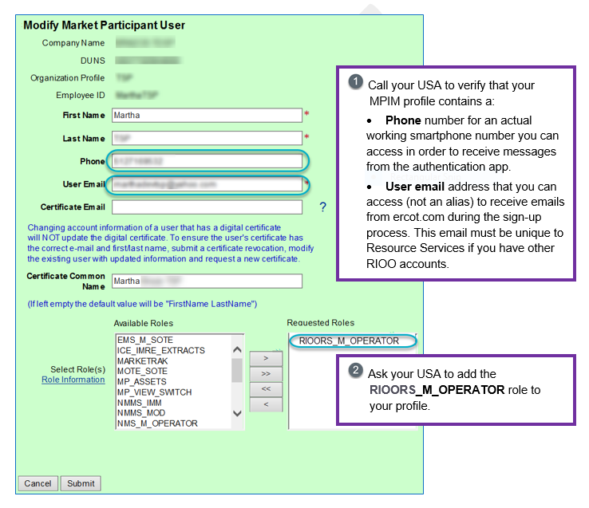
Signup and Login Process #1 – Work with Your USA
You must have the
RIOORS _M_Operator role in your Market Participant Identity Management (MPIM) profile to access and use Resource Services

Slide 9
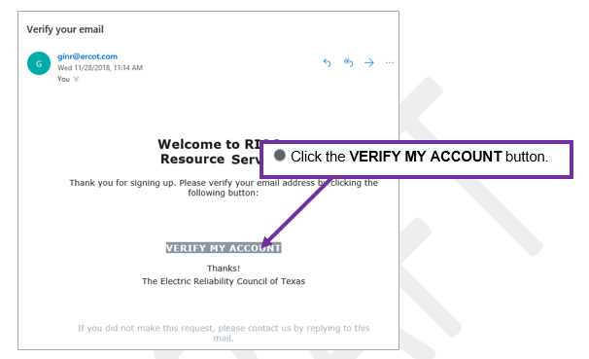
Signup and Login Process #2 –
Verify Your Account from the Welcome Email

Slide 10
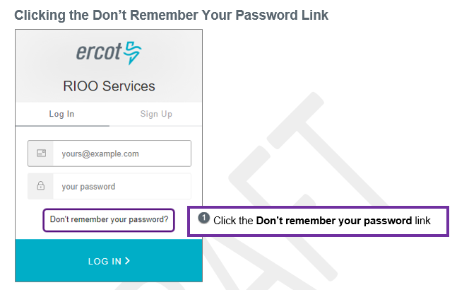
Signup and Login Process #3a – Change Your Password

Slide 11
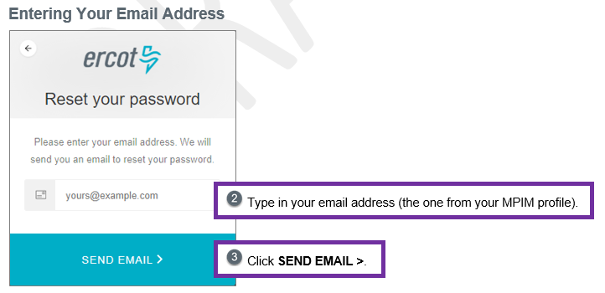
Signup and Login Process #3b – Change Your Password

Slide 12
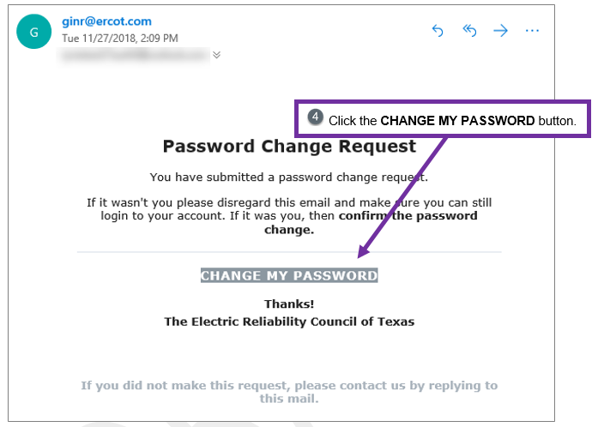
Signup and Login Process #3c – Change Your Password

Slide 13
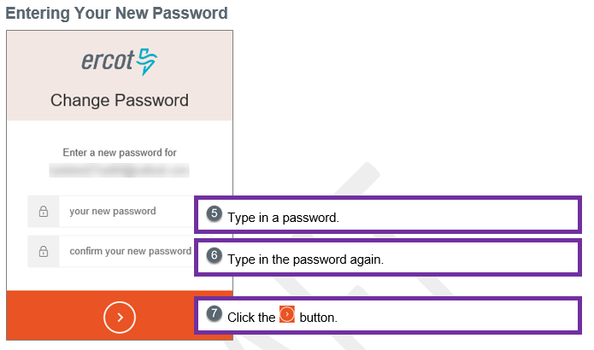
Signup and Login Process #3d – Change Your Password

Slide 14
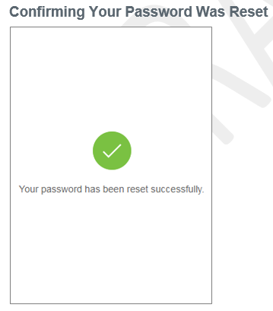
Signup and Login Process #3e – Change Your Password

Slide 15
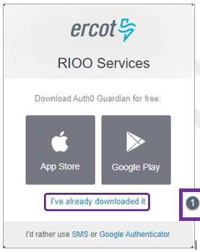
Signup and Login Process #4a – Setup Authentication
Choose Authentication Method:
- Google Authenticator
- Auth0 Guardian
- SMS

Slide 16
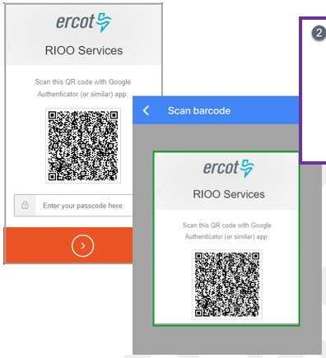
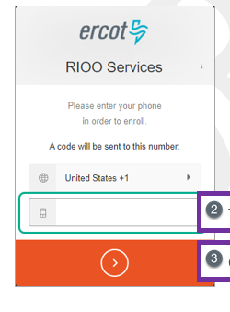
Signup and Login Process #4b – Setup Authentication
Scan QR code or enter mobile phone number for SMS

Slide 17
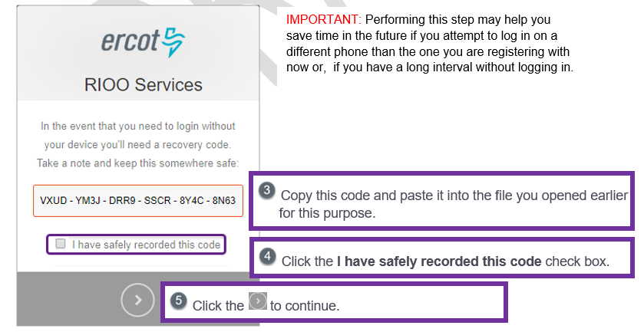
Signup and Login Process #4c – Setup Authentication
Save Recovery Code

Slide 18
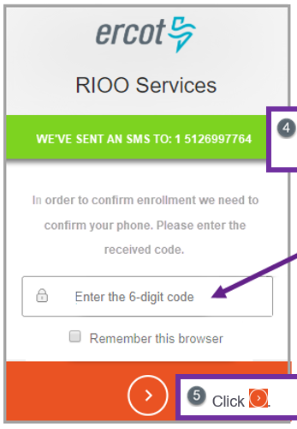
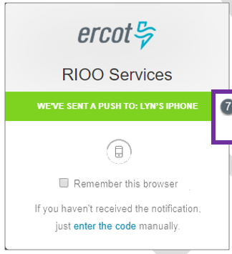
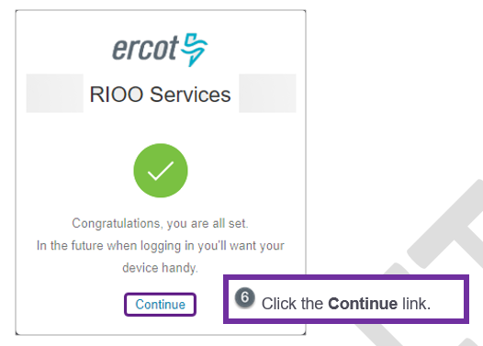
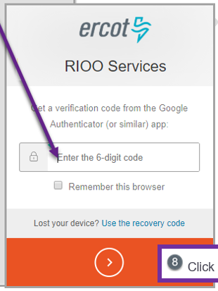
Signup and Login Process #4d – Setup Authentication
Confirm Authentication Method

Slide 19
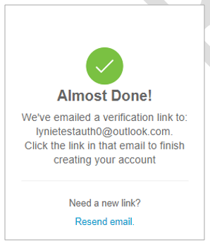
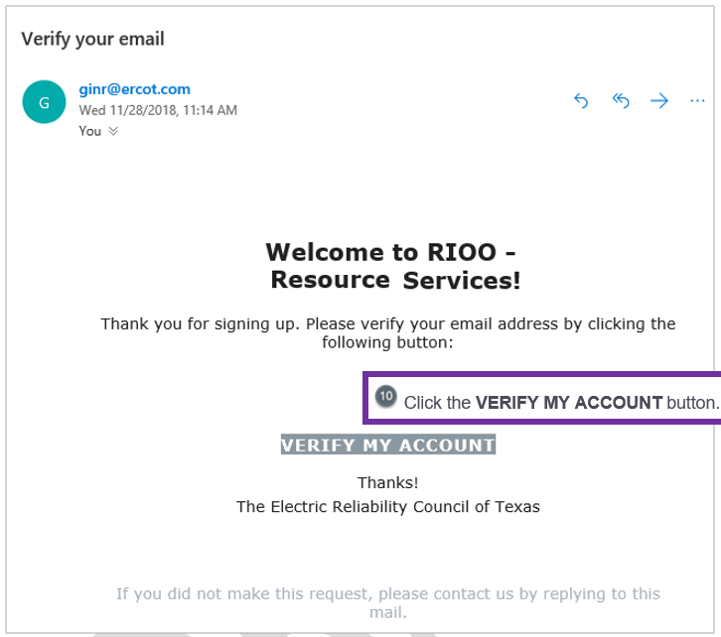
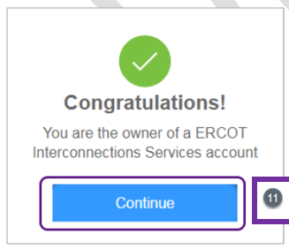
Signup and Login Process #4e – Setup Authentication
One last verification

Slide 20
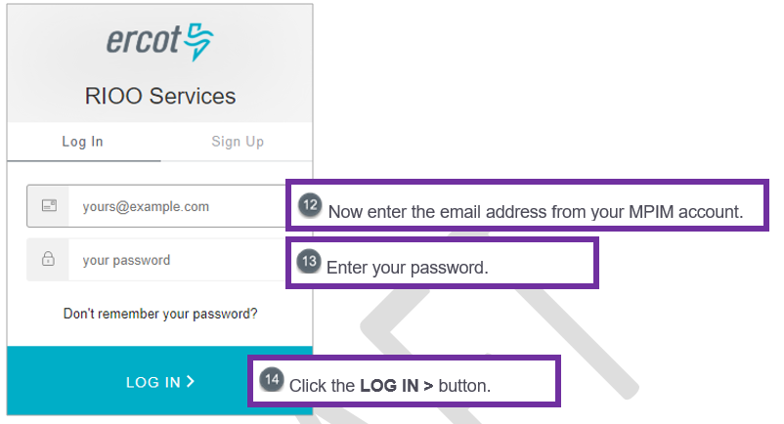
Signup and Login Process #5 – Log into the System
Respond to the Authentication PUSH message or get Authentication code

Slide 21
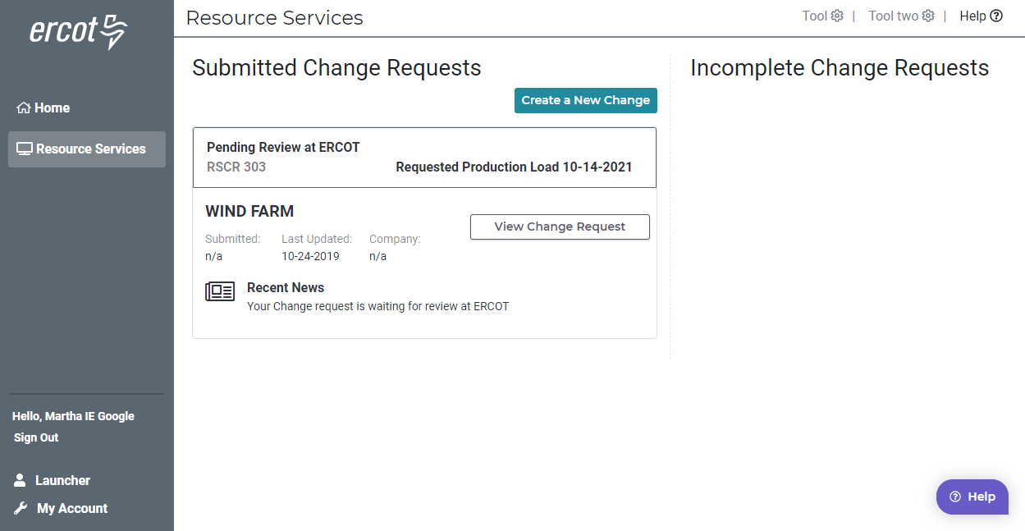

Slide 22
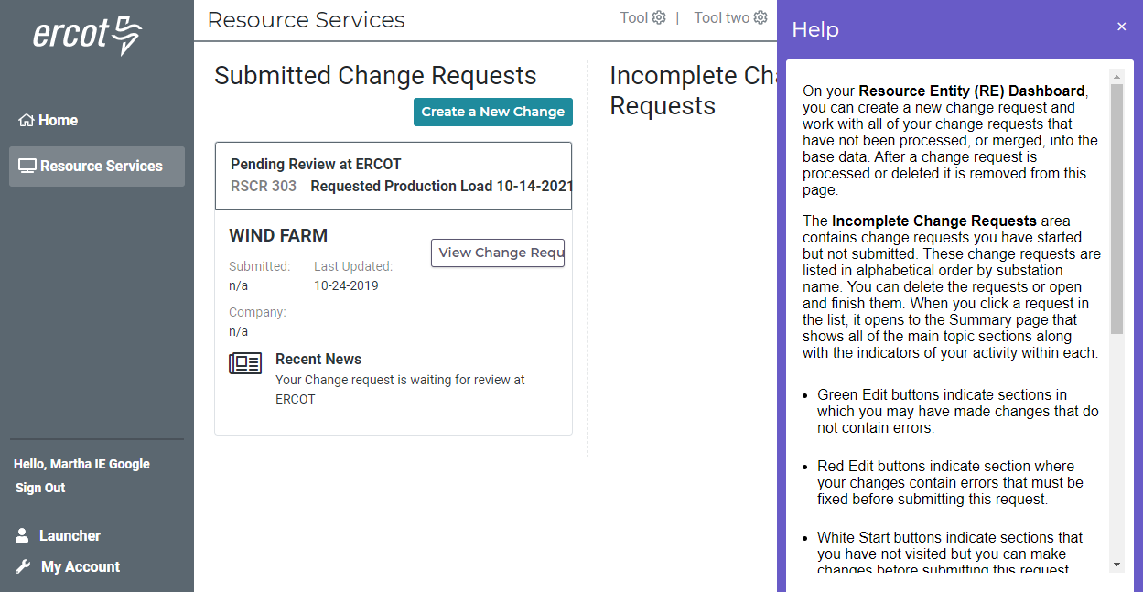

Slide 23
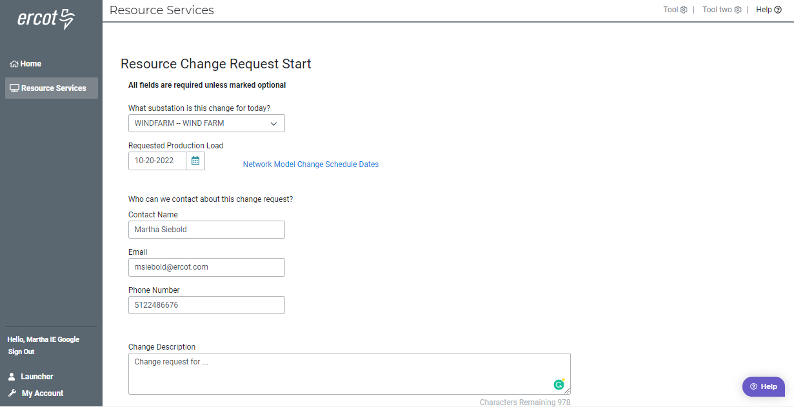

Slide 24
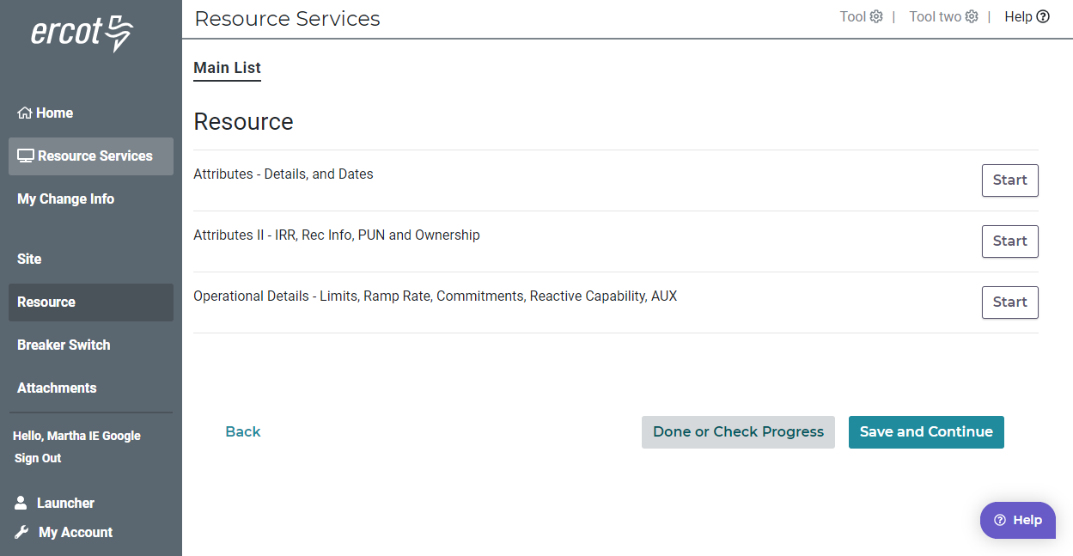

Slide 25
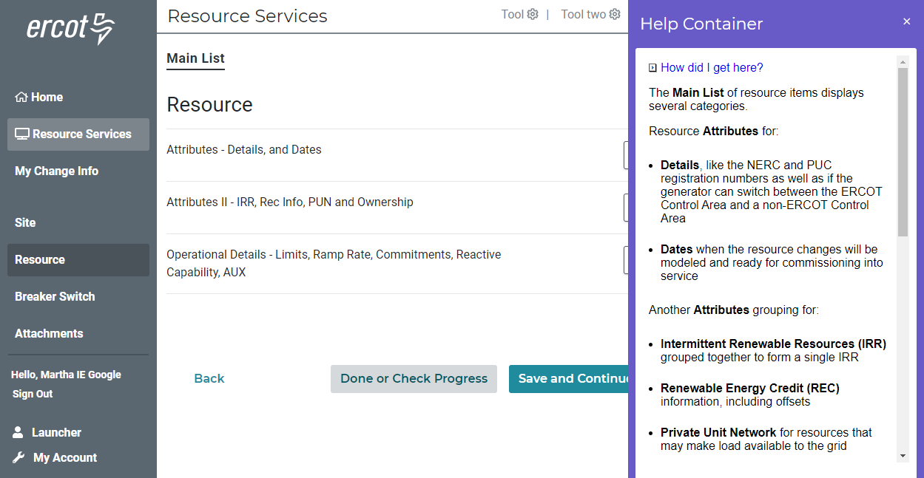

Slide 26
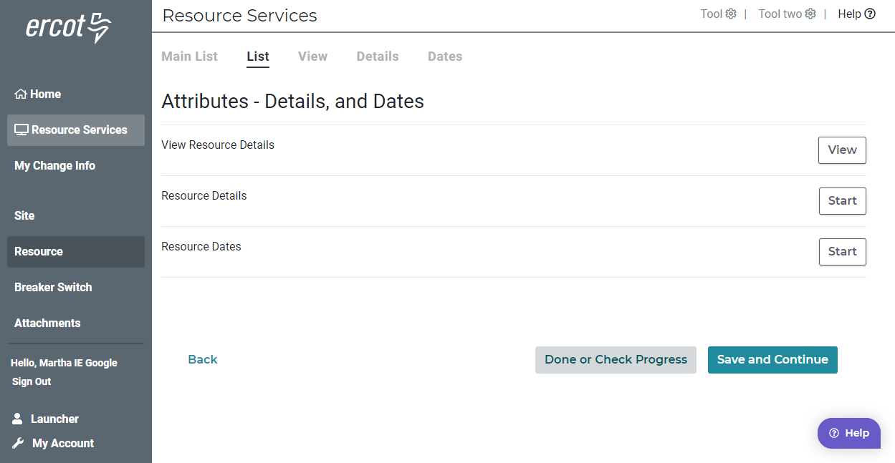

Slide 27
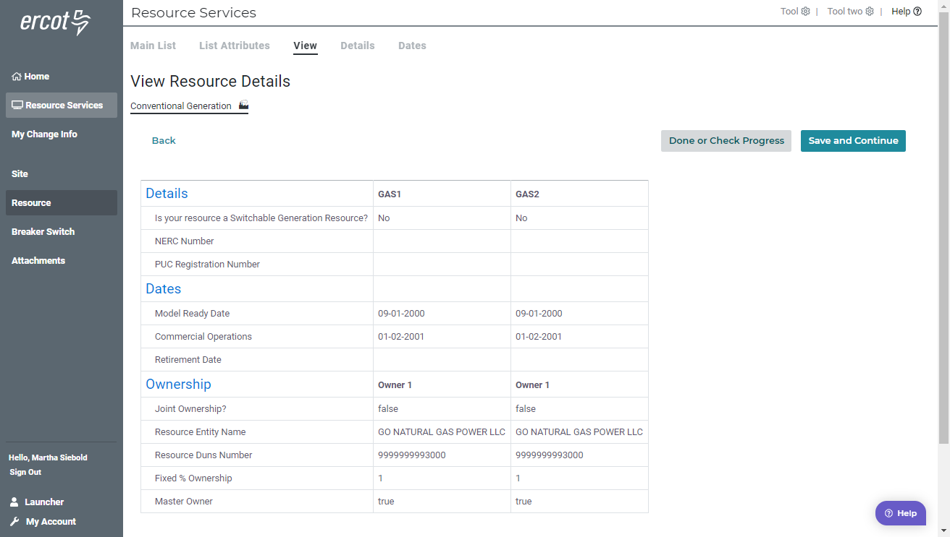

Slide 28
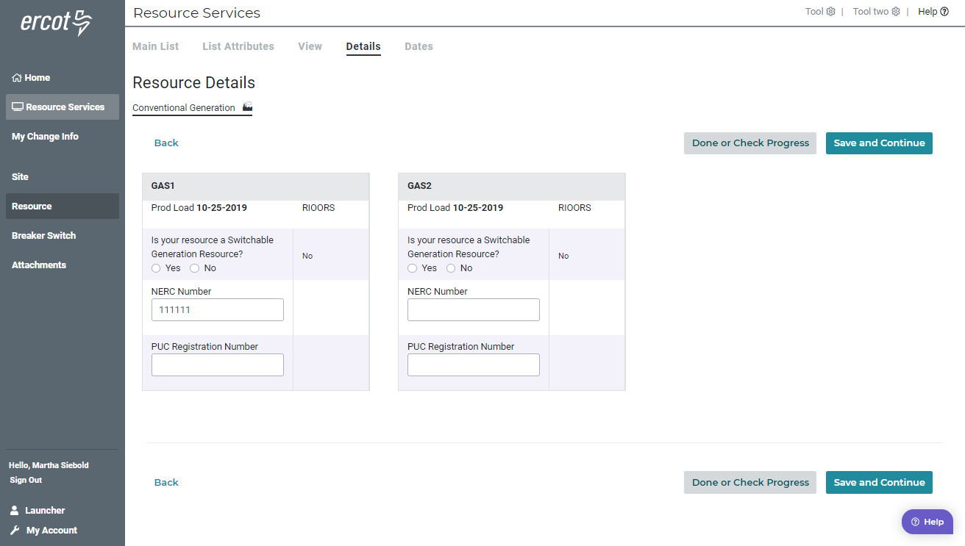

Slide 29
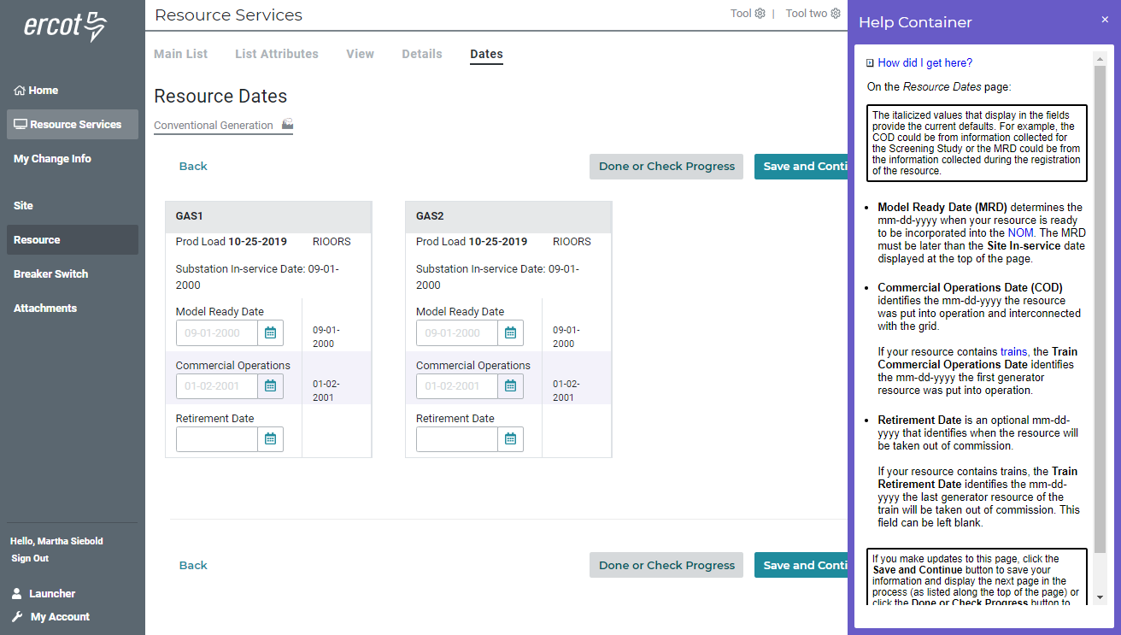

Slide 30
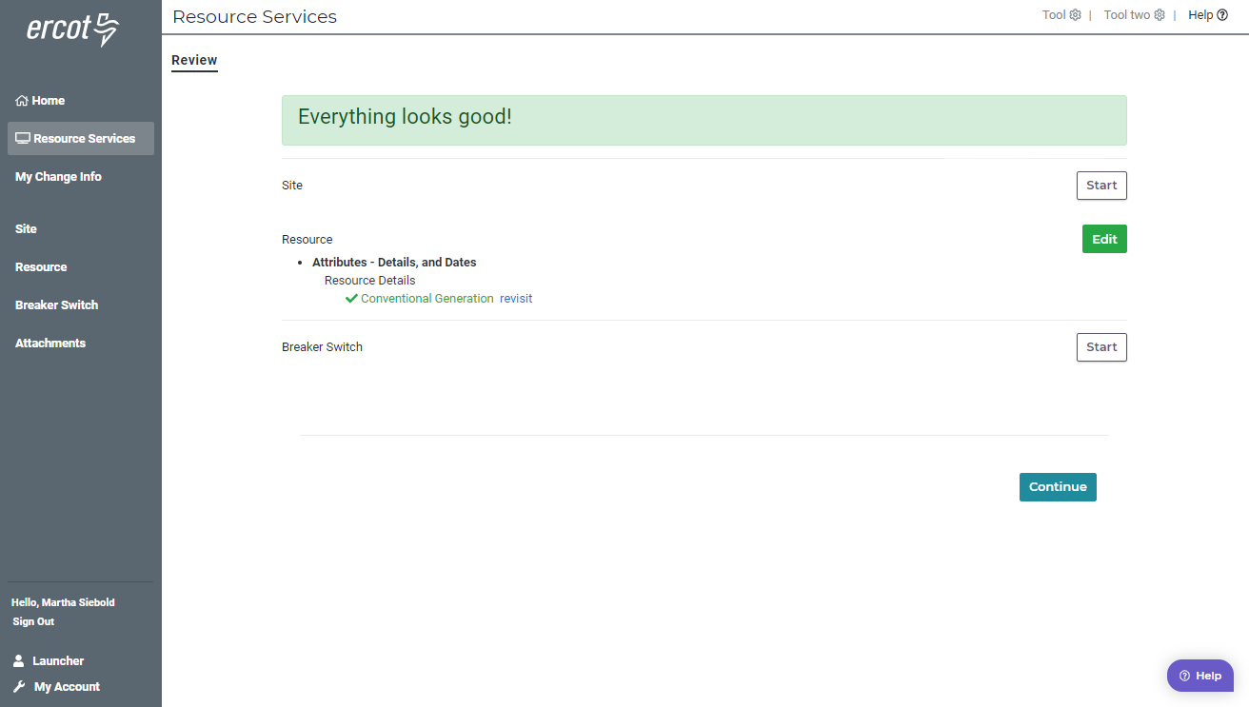

Slide 31
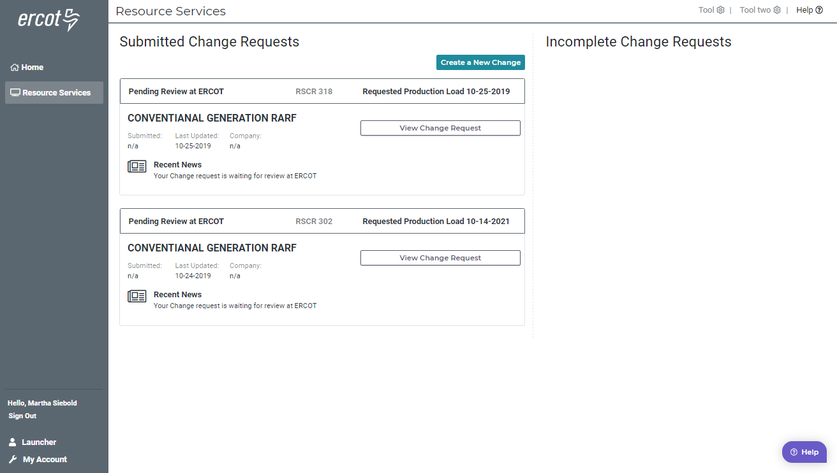

Slide 32
Discussion
or
Questions

