Slide 1
Credit Exposure Update
Spoorthy Papudesi
Credit Work Group
ERCOT Public
November 22, 2019

Slide 2
Monthly Highlights Sep 2019- Oct 2019
Market-wide average TPE decreased from $ 1,441.1 million to $ 763.6 million
High prices rolled off TPE components
Discretionary Collateral is defined as Secured Collateral in excess of TPE,CRR Locked ACL and DAM Exposure.
Average Discretionary Collateral decreased from $ 1,627.8 million to $1,361.9 million
The decrease in Discretionary Collateral is largely due to decrease in TPE and Secured Collateral
Number of active Counter-Parties increased from 241 to 244
No unusual collateral call activity

Slide 3
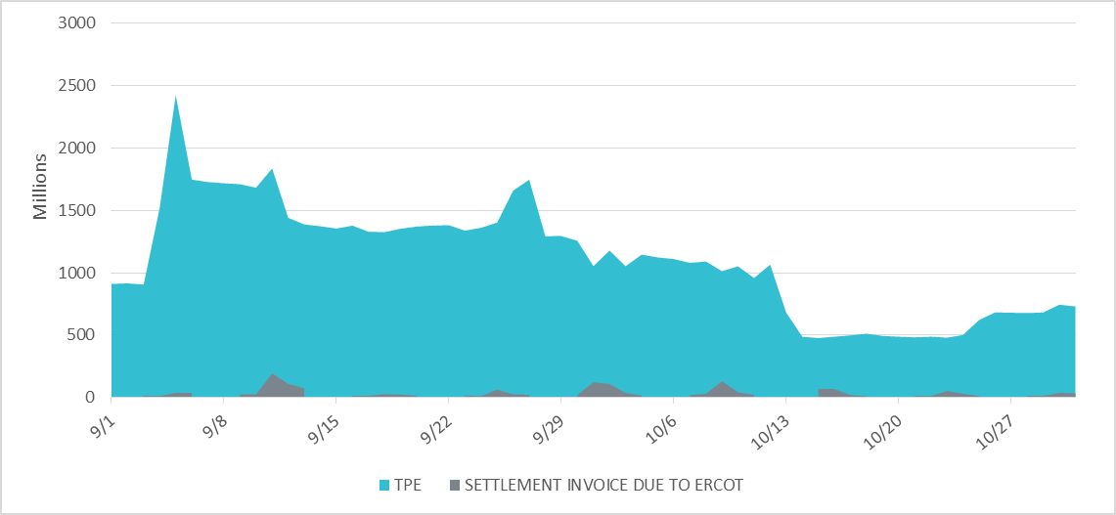
Settlement Invoice Charges/TPE Sep 2019- Oct 2019

Slide 4
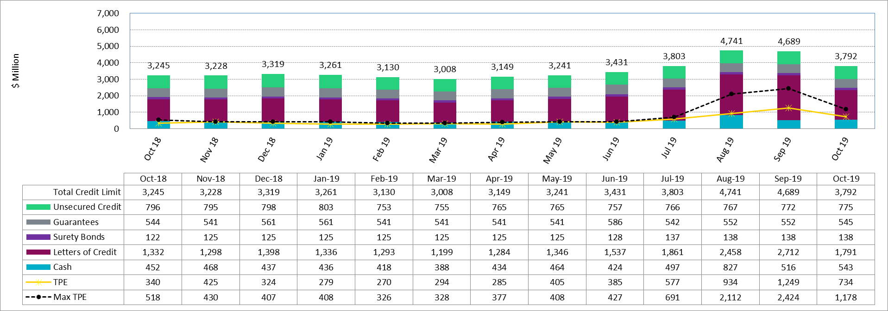
Available Credit by Type Compared to Total Potential Exposure (TPE)
*Numbers are as of month end except for Max TPE

Slide 5
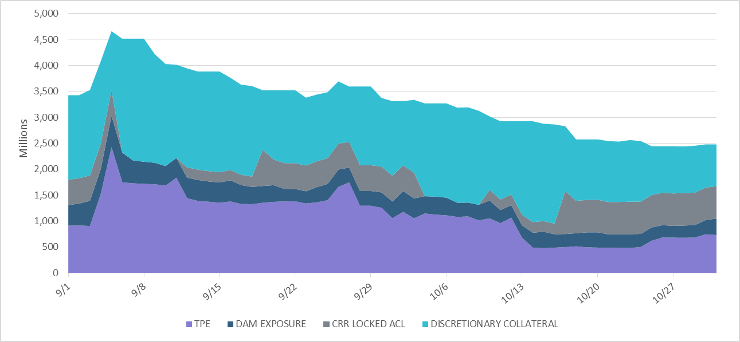
Discretionary Collateral Sep 2019- Oct 2019
At a Counter-Party level, no unusual changes were noted
Note: Discretionary collateral doesn’t include Unsecured Credit Limit or parent guarantees

Slide 6
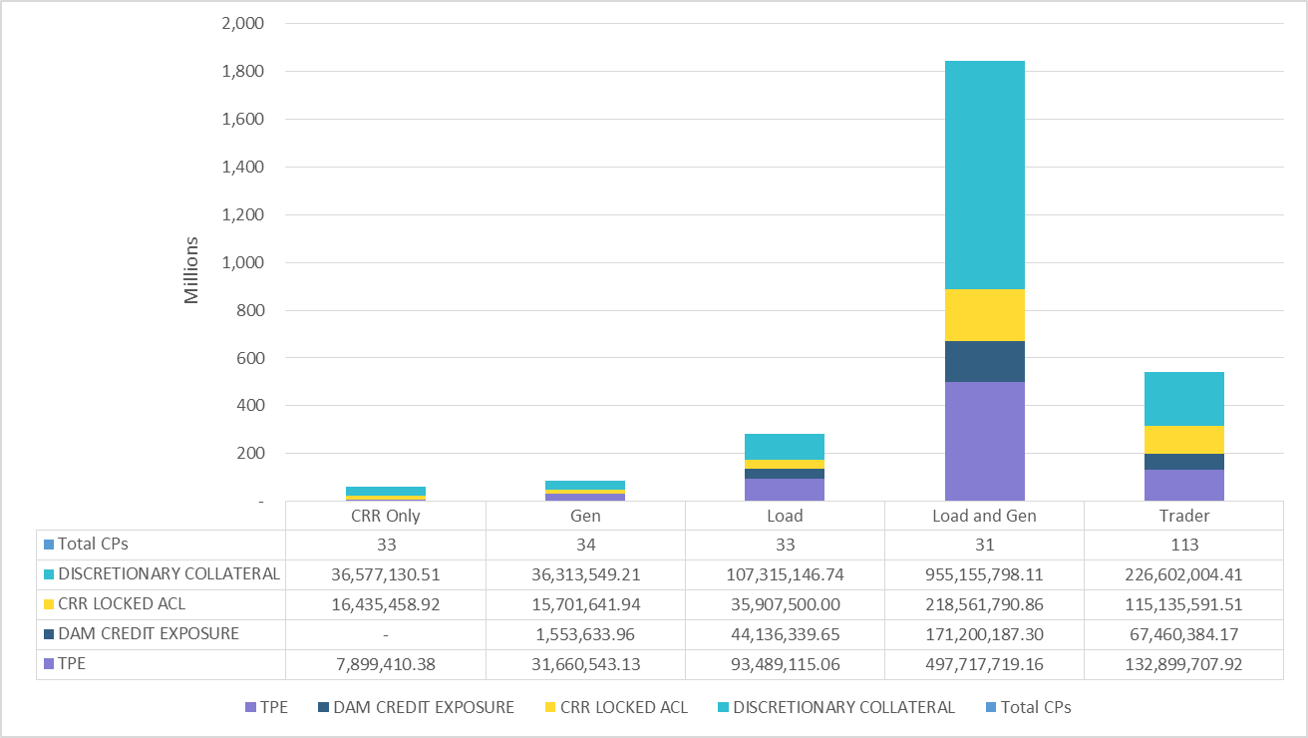
TPE and Discretionary Collateral by Market Segment- Oct 2019
Load and Generation entities accounted for the largest portion of discretionary collateral

Slide 7
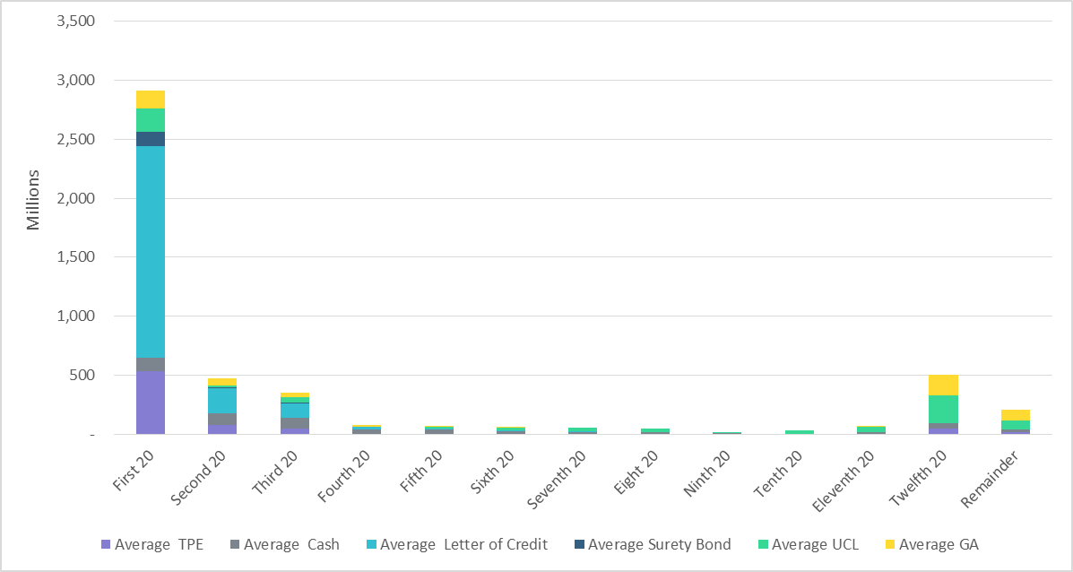
Secured Collateral and Unsecured Credit Limit (UCL) distribution/ TPE- Oct 2019
TPE in the last few buckets is mostly covered by Guarantees and UCL

Slide 8
TPE 2019
September through early October: RFAF & DFAF falls to 0.15 - 1.0
The component driving TPE was the MAXRTLE (which reflects summer conditions in August extending through early October):
TPE reduced during this period due to lower RFAF & DFAF
ERCOT average historic prices included high-price days which were lagging average ICE prices
ICE prices started to stabilize and reflect fall conditions
Mid to Late October: RFAF & DFAF rises to 0.5 – 1.46
TPE increases due to higher RFAF & DFAF as MAXRTLE decreases
There was a convergence between ERCOT and ICE price averages as the remaining ERCOT high-price days begin to roll off

Slide 9
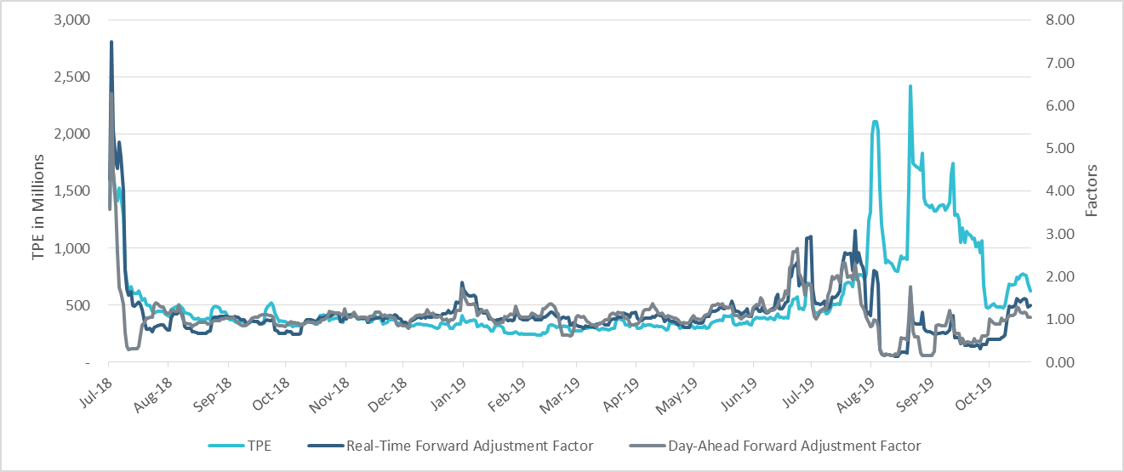
TPE and Forward Adjustment Factors Jul 2018- Oct 2019

Slide 10
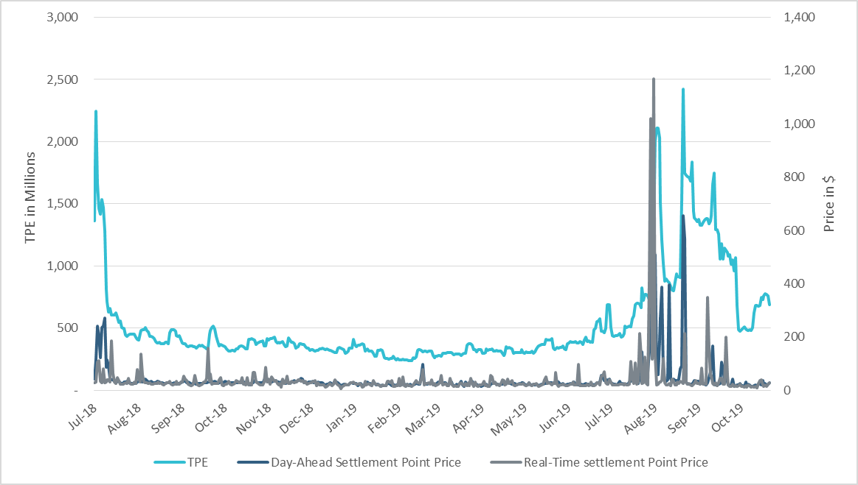
TPE/Real-Time & Day-Ahead Daily Average Settlement Point Prices for HB_NORTH Jul 2018- Oct 2019

Slide 11
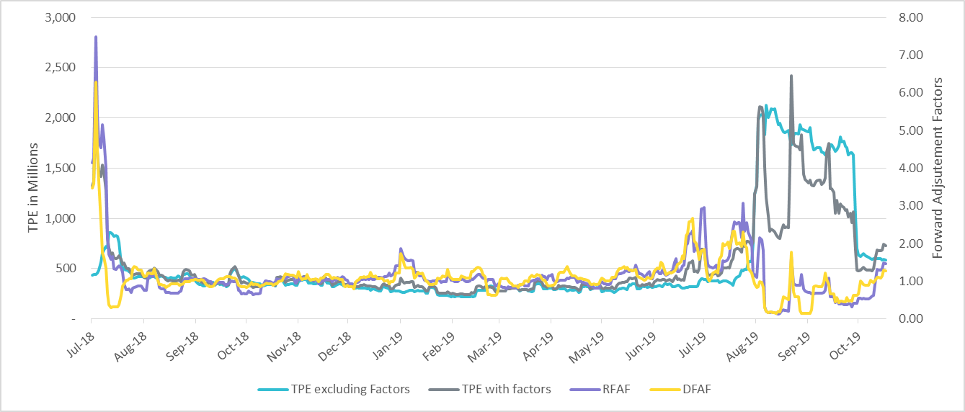
TPE with/without Forward Adjustment Factors Jul 2018- Oct 2019
The average TPE in summer 2019 is less than average TPE excluding the factors
RFAF and DFAF below 1
The TPE in July 2018 is higher than TPE excluding the factors
RFAF and DFAF above 6

Slide 12
Appendix

Slide 13
Summary of Distribution by Market Segment

Slide 14
Summary of Distribution by Rating Group

Slide 15
Distribution of TPE by Rating and Category

Slide 16
Distribution of Excess Collateral by Rating and Category
Note: Excess collateral doesn’t include Unsecured Credit Limit

Slide 17
Bottom Quintile Distribution of Excess Collateral by Rating and Category

Slide 18
Bottom Quintile Distribution of Average TPE by Rating and Category

Slide 19
Questions

