Slide 1
NOGRR 195
Freddy Garcia
November 14, 2019

Slide 2
TRE Audit Recommendation
Texas RE Audit Recommendation
  NERC VAR-001-4.2 R5
    5.2. The Transmission Operator shall provide the Generator Operator with the notification requirements for deviations from the voltage or Reactive Power schedule (which is either a range or a target value with an associated tolerance band).
    Recommendation: Consider defining a clear a measureable conditions of notification for deviations from the voltage schedule.
  Current language in Section 2 of Operating Guides
    RE shall “as soon as practicable” notify QSE, TO and/or ERCOT if unable to comply with a VSS or Voltage Set point Instruction
  Propose clear and measureable expectation while not promoting an unnecessary time delay in the communication
    “as soon as practicable, but no longer than 10 minutes from receipt of the instruction by the Resource Entity”
      Paragraphs (2) and (3) of Section 2.2.10
      Paragraphs (3) and (4) of Section 2.7.3.5

Slide 3
TRE Audit Recommendation
Scenario 1
At 12:00 ERCOT TO1 modifies the VSP target (telemetry) for GR A from 139kV to 141 kV.
At 12:01, the new VSP target is received by the QSE and GR to modify the Voltage Set Point from 139kV to 141kV.
At 12:03 ERCOT QSE A instructs GR A to increase the VSP for GR A from 139kV to 141kV.
The clock begins at 12:01 when the GR first receives the new VSP via telemetry.
Scenario 2
At 12:00 ERCOT issues an instruction to ERCOT TO 1 to instruct GR A to increase their Voltage Set Point (VSP) from 139kV to 141 kV.
At 12:03 ERCOT TO1 then instructs GR A verbally to increase the VSP from 139kV to 141kV.
At 12:05 ERCOTTO1 then modifies the VSP target (telemetry) for GR A from 139kV to 141 kV.
At 12:06, the new VSP target is received by the QSE and GR to modify the Voltage Set Point from 139kV to 141kV.
At 12:07 ERCOT QSE A instructs GR A to increase the VSP for GR A from 139kV to 141kV.
The clock begins at 12:03 when the GR first receives the verbal VSP instruction.

Slide 4
TRE Audit Recommendation
Scenario 1
At 12:03 ERCOT TO1 instructs GR A verbally to increase the VSP from 139kV to 141kV.
At 12:09 RE A that represents GR A notifies the ERCOT TO 1 that it cannot comply with the VSP.
At 12:11 RE A that represents GR A notifies QSE A that it cannot comply with the VSP and that it notified ERCOT TO1.
At 12:13 ERCOT TO1 then notifies ERCOT that GR A cannot comply with the VSP.
At 12:15 ERCOT TO1 and ERCOT coordinate an alternative corrective action .
The clock begins at 12:03 when the GR first receives the verbal VSP instruction.
The clock for the ERCOT TO1 began at 12:09 when RE A notified ERCOT TO1.(For a Force Majeure)
Scenario 2
At 12:03 ERCOT TO1 telemeters a VSP instruction to QSE A to increase the VSP for GR A from 139kV to 141kV.
At 12:09 RE A that represents GR A notifies QSE A that it cannot comply with the VSP.
At 12:11 RE A that represents GR A notifies the ERCOT TO 1 that it cannot comply with the VSP.
At 12:13 ERCOT TO1 then notifies ERCOT that GR A cannot comply with the VSP.
At 12:15 ERCOT TO1 and ERCOT coordinate an alternative corrective action.
The clock begins at 12:03 when the QSE first receives the verbal VSP instruction.
The clock for the ERCOT TO1 began at 12:11 when RE A notified ERCOT TO1. (For a Force Majeure)

Slide 5
TRE Audit Recommendation
Scenario 1
At 12:00 GR A POI voltage is outside of kV tolerance band and cannot control voltage (e.g. out of reactive capability or equipment issue)
At 12:05 RE A that represents GR A notifies QSE A that it cannot maintain POI voltage within the tolerance band
At 12:07 RE A that represents GR A notifies TO 1 that it cannot maintain POI voltage within the tolerance band
The clock begins at 12:00 when the GR A POI voltage first went outside of kV tolerance band
Scenario 2
At 12:00 GR A POI voltage is outside of kV tolerance band and cannot control voltage (e.g. out of reactive capability or equipment issue)
At 12:05 RE A that represents GR A notifies QSE A that it cannot maintain POI voltage within the tolerance band
At 12:07 QSE A that represents GR A notifies TO 1 that GR A cannot maintain POI voltage within the tolerance band
The clock begins at 12:00 when the GR A POI voltage first went outside of kV tolerance band.

Slide 6
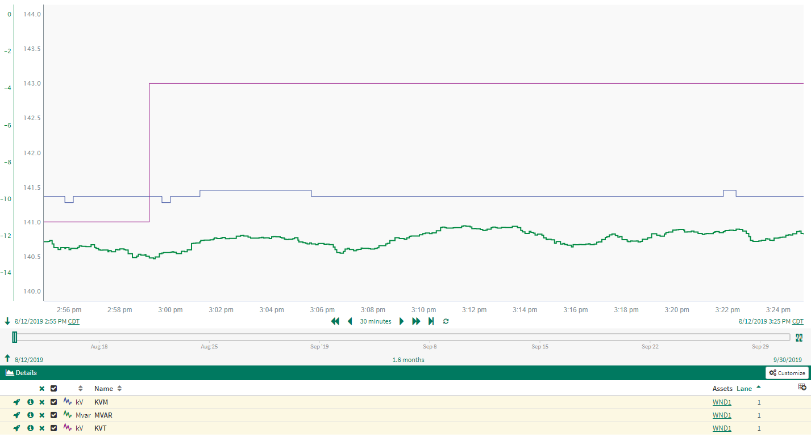
Response to Voltage Set Point Instruction
2.7.3.5(1)
Each Resource Entity shall ensure that its Generation Resource(s) responds to all VSS Dispatch Instruction or a TO Voltage Set Point instruction from its QSE or interconnecting TO within the time requirements specified in paragraph (3)(b) of Section 2.2.10, Generation Resource Response Time Requirements, even if the new Voltage Set Point is within the tolerance band identified in paragraph (4) below.

Slide 7
Voltage Set Point tolerances
Currently Voltage Set Point tolerances, +/- 2%, can be more than a 14 kV spread for Generation Resources connected to 345kV POI’s.
  Difficult to maintain reliability when Resource allowed to drift far from set point.
  Using whole numbers easier for operators to determine when out of range rather than having to calculate a band that changes dynamically because of being in %.
  NPRR 776 implemented common point of measurement eliminating metering differences between the TO and GR.
Nominal Voltage | Tolerance Band KV
345 | +/- 3kV
230 | +/- 3kV
138 | +/- 2kV
115 | +/- 2kV
69 | +/- 1kV

Slide 8
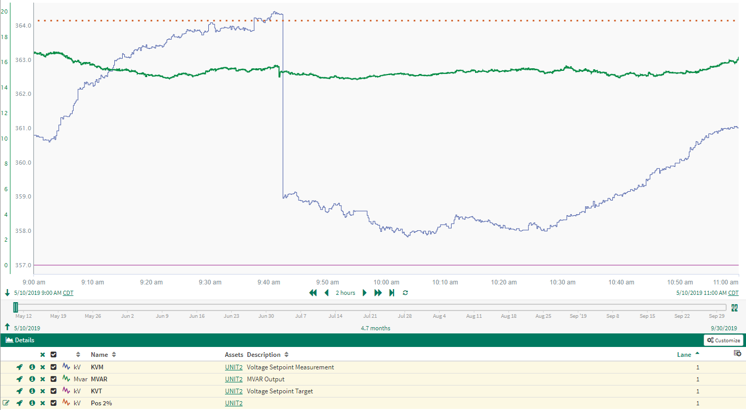
Voltage Set Point tolerance example issue
KVM vs MVAR trend shows a 5kV drop in voltage with little to no change in reactive power output
Not a change in Reactive Requirements
Change in AVR control settings (Droop and Dead band)

Slide 9
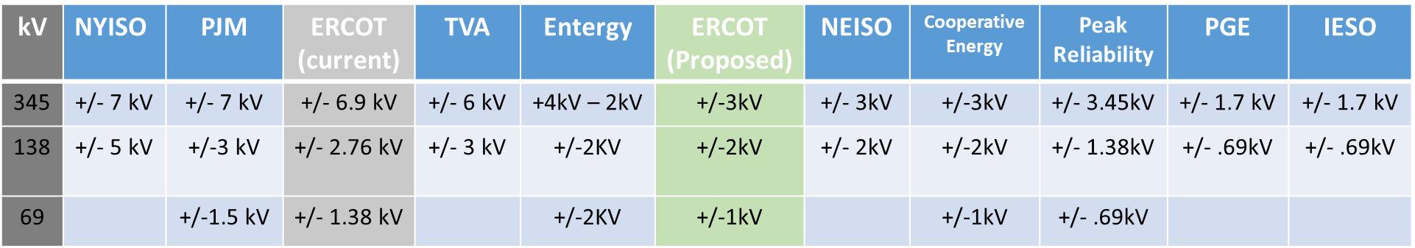
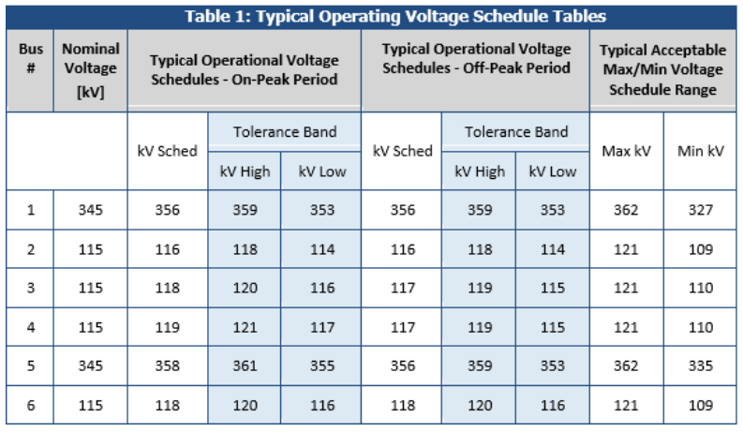
Generator Voltage Set Point tolerances
NERC Reliability Guideline Reactive Power Planning December 2016, p 23

Slide 10
Questions

Slide 11
Change in Voltage Target (KVT) with limited to no Unit MVAR Response

Slide 12
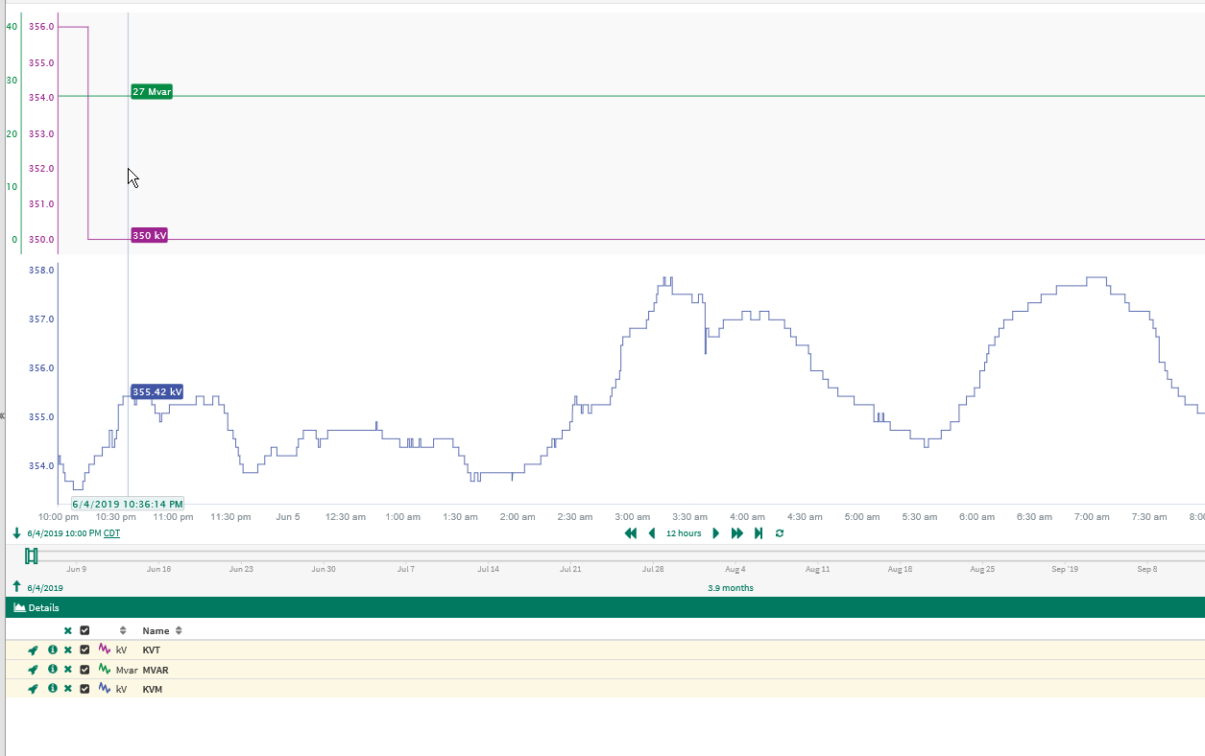
Example 1

Slide 13
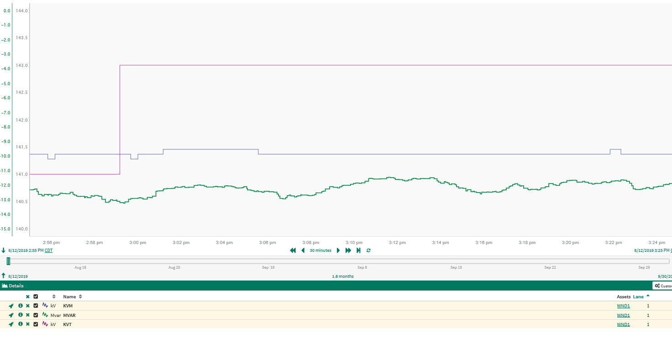
Example 2

Slide 14
Change in Point of Interconnect Voltage(KVM) with no Unit MVAR Response

Slide 15
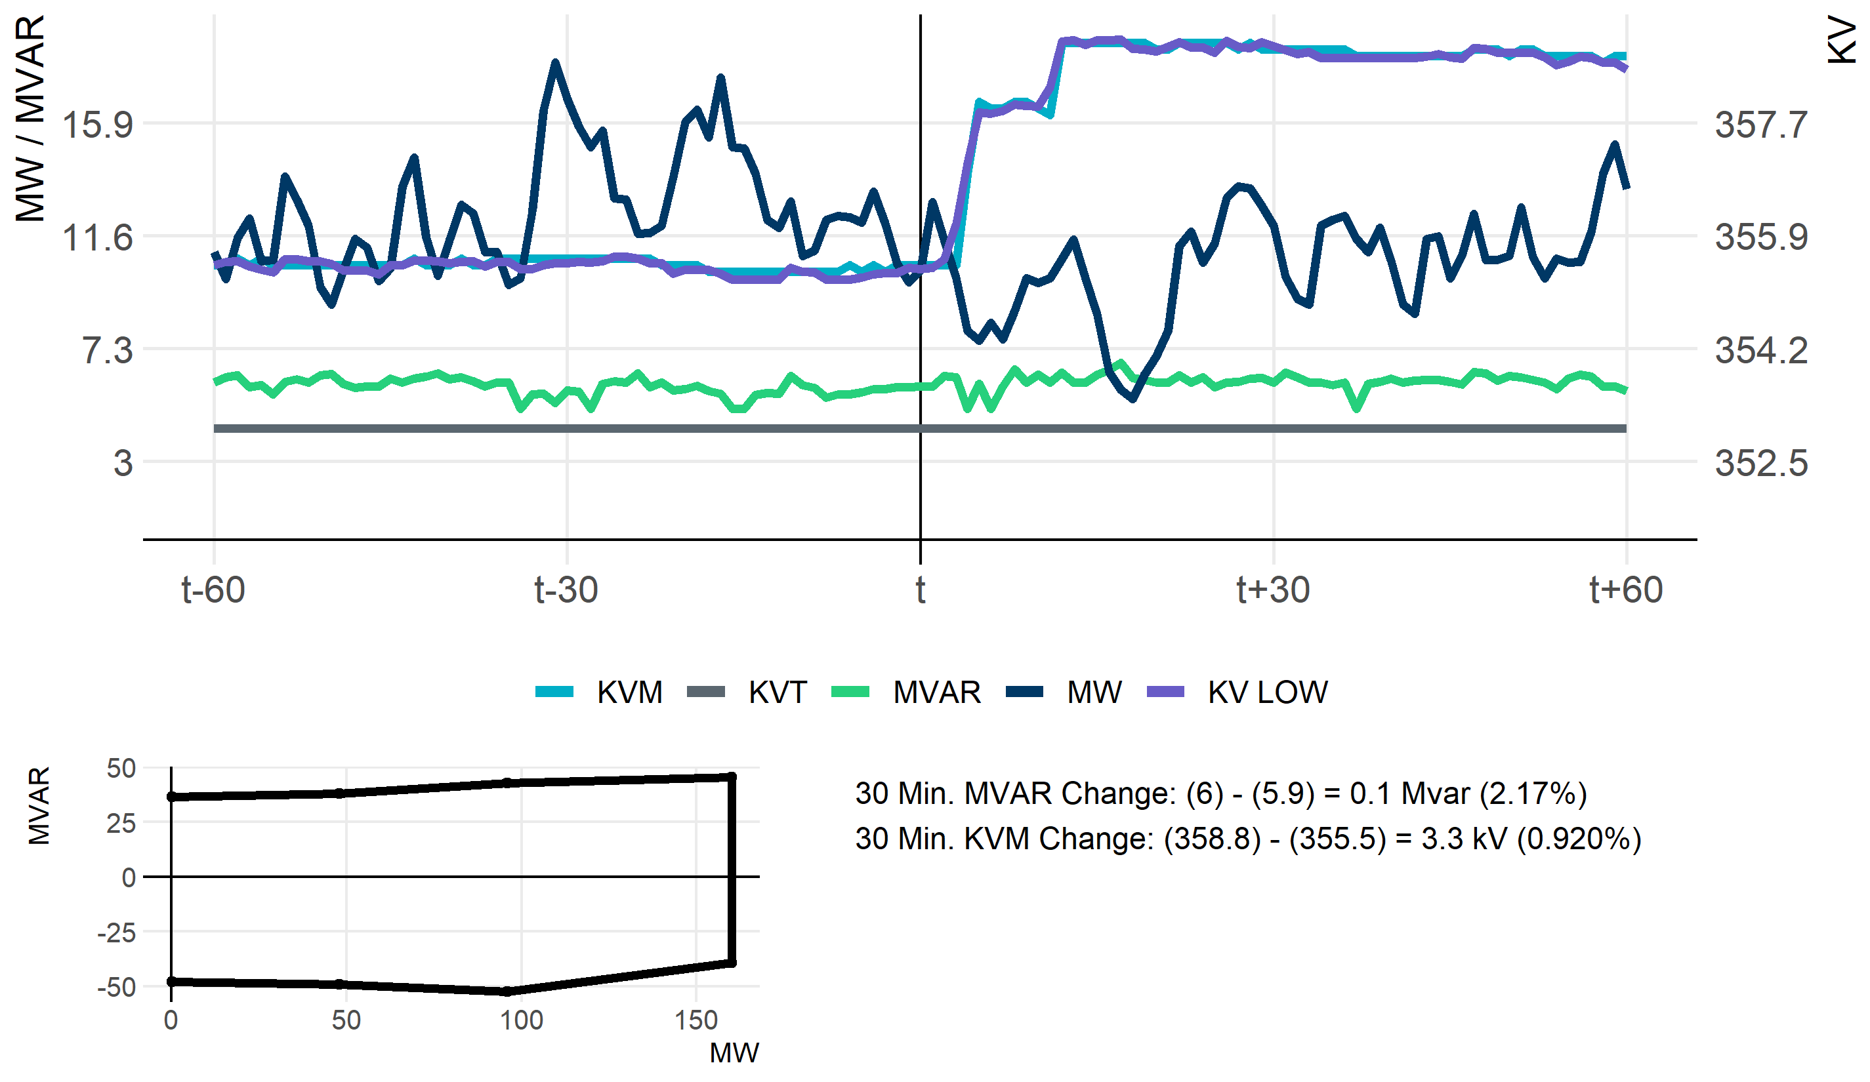
Example 1

Slide 16
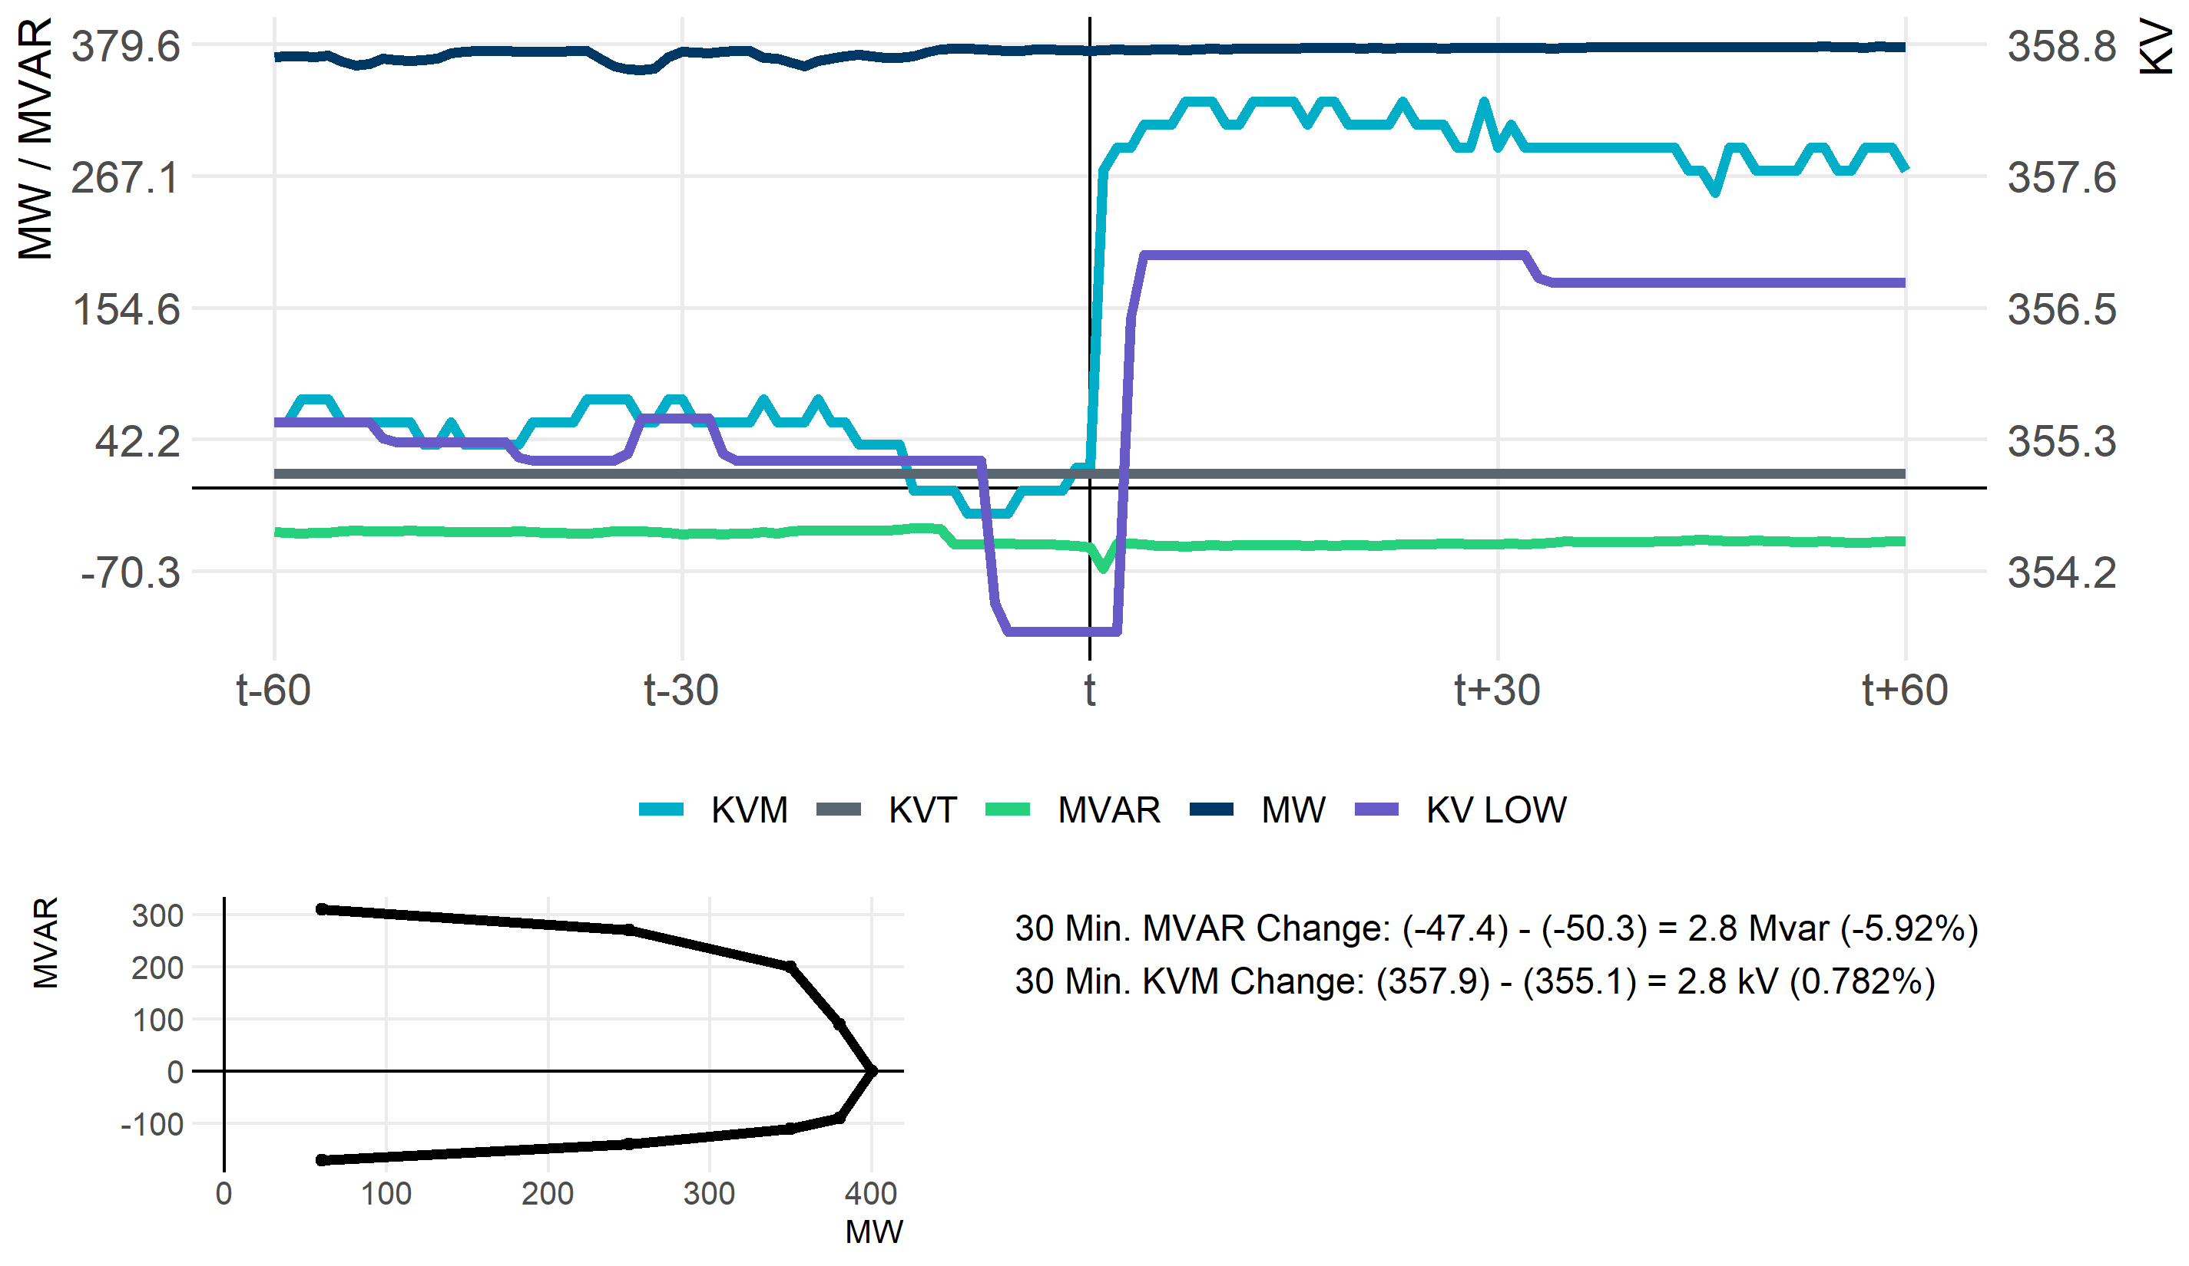
Example 2

Slide 17
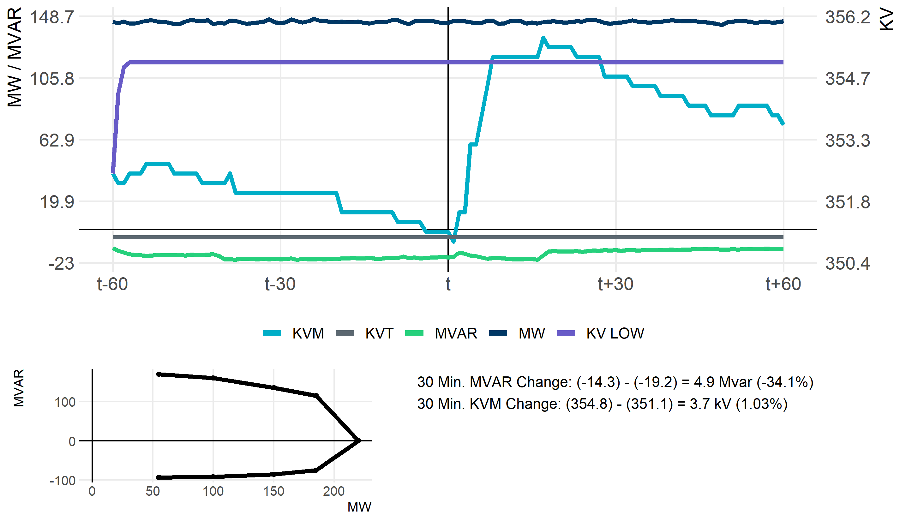
Example 3

Slide 18
Unit operating at or near 2% tolerance band

Slide 19
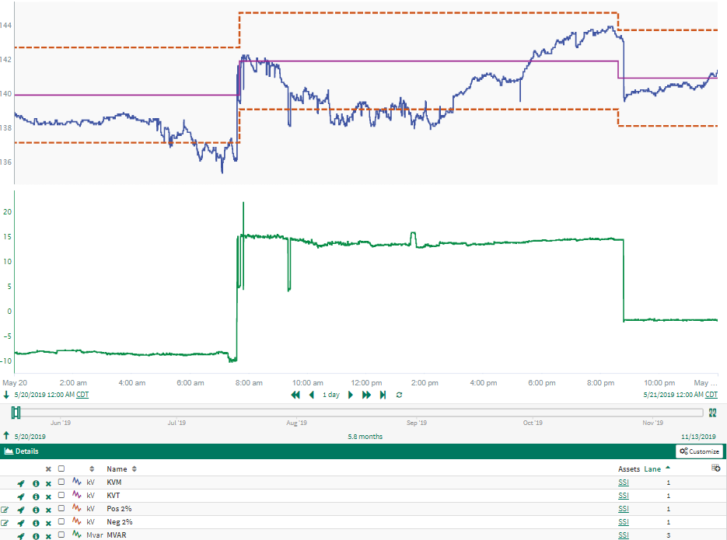
Example 1

Slide 20
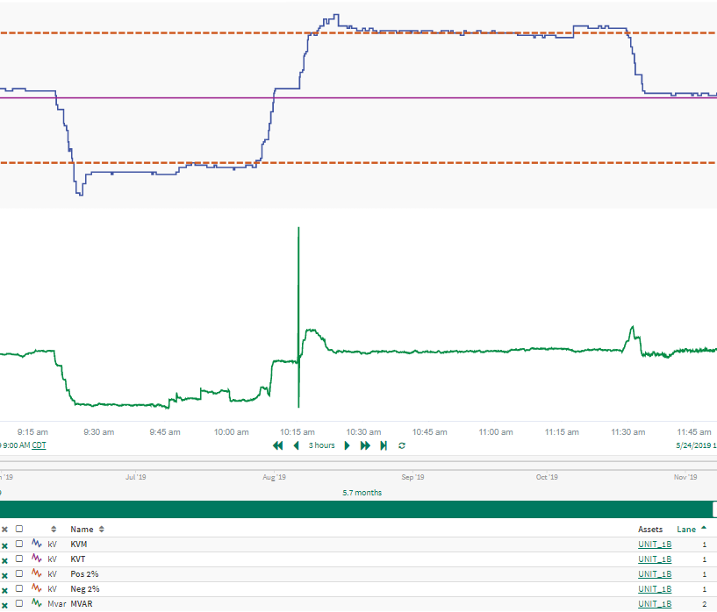
Example 2

Slide 21
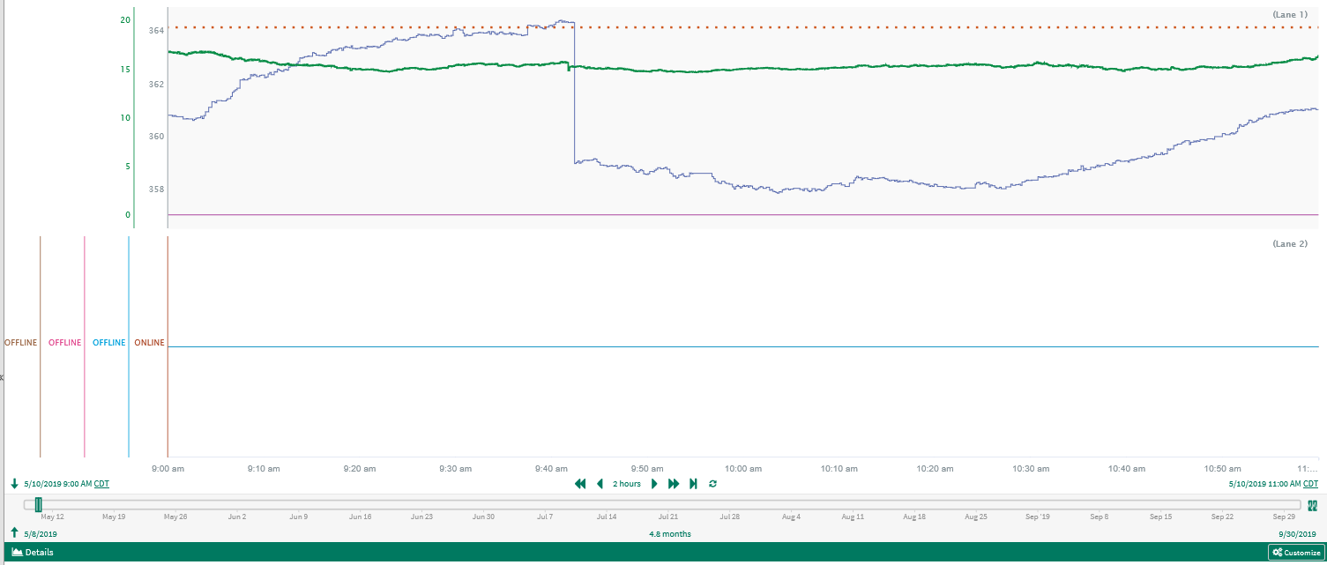
Example 3 - from presentation with Capacitor status

