Slide 1
Ercot rpg meeting
Far West Texas Project Update

Slide 2
Bakersfield–Solstice Transmission Line Addition
Agenda Items
1. | Project Overview
2. | Key Milestones
3. | Project Status
4. | Questions / Discussion

Slide 3
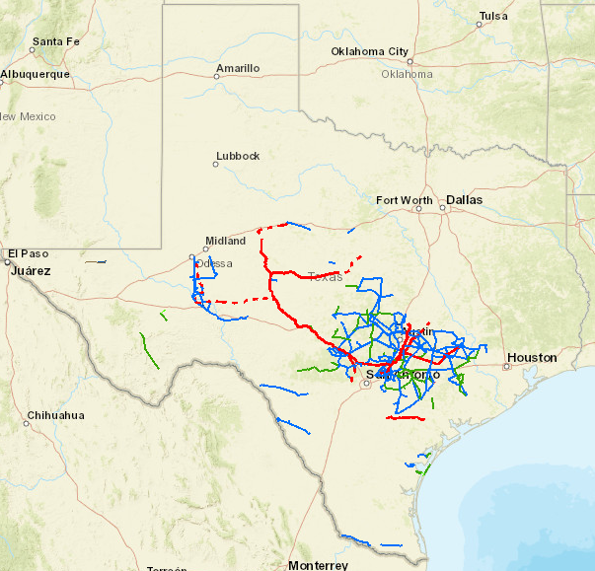
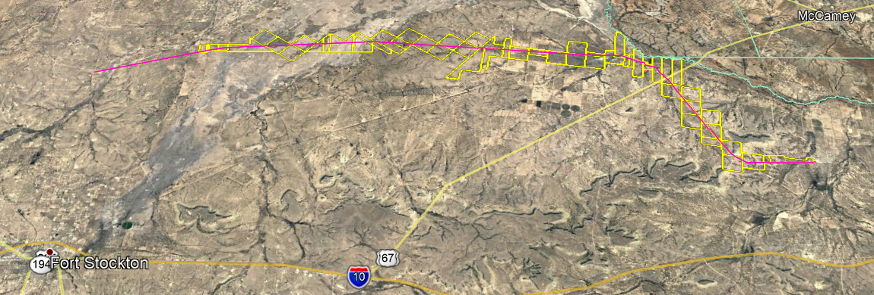
Project Overview
This portion of the Far West Texas project involves LCRA TSC and American Electric Power (AEP).
LCRA TSC scope
35 miles double-circuit 345kV transmission line between the Bakersfield and Solstice substations
Bakersfield substation terminal equipment
McCamey
Solstice
Bakersfield
Fort Stockton

Slide 4
Key Milestones
7/2017 → project charter approved
9/2017 → project kickoff with LCRA TSC and AEP to begin the CCN process
6/2018 → ERCOT designated the project as critical, approved 2nd circuit
7/2018 → Held joint open house with AEP in Ft Stockton
11/2018 → LCRA TSC and AEP filed a joint CCN Application with the PUC
5/2019 → PUC Commission Hearing / Final Order Issued
6/2019 → final notice sent / project starts
7/2019 → issued for construction prints for Bakersfield Substation
9/2019 → began receiving structures at laydown yard northeast of Ft Stockton
11/2019 → 8 of 60 parcels acquired
12/2019 → Issue for construction prints for TL
1/2020 → begin construction
12/2020 → complete construction

Slide 5
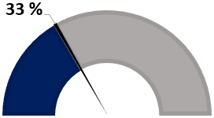
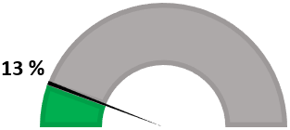
Project Status – positive and on track
Bakersfield–Solstice Transmission Line Addition
Materials
Total structure count → 160 steel lattice tower structures
Received 66 truckloads of lattice tower materials at the laydown yard that is north east of Ft Stockton
Real Estate
Approximately 35 miles LCRA TSC
8 of 60 parcels acquired
160 structures
60 parcels

Slide 6
Questions / Discussions

