Slide 1
AEP West Texas Project Update
ERCOT RPG Meeting
November 12th 2019

Slide 2
2019 Completed Projects
Raise structures on the Ft. Stockton to Solstice 138 kV line – August 2019
Lynx station and termination of Woodward 1– November 2019

Slide 3
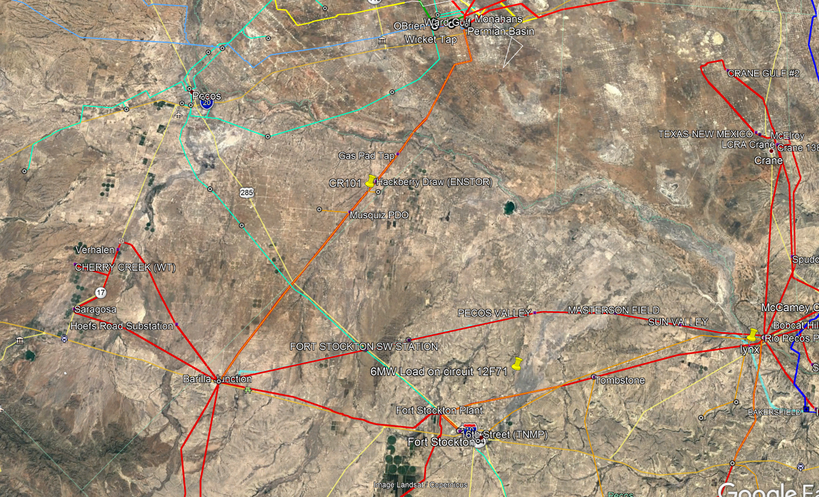
2018 and 2019 Completed Projects

Slide 4
2019 and 2020 Planned Projects
Rebuild Solstice to Saragosa 69 kV line, convert to 138 kV and build Cryo substation – January 2020
Install 138 kV phase shifting transformer at Solstice – March 2020
Termination of TNMP 16th Street – Rio Pecos 138 kV line and Woodward 2 into Lynx station – May 2020
Rebuild Barrilla Junction to Ft. Stockton SW to Rio Pecos 69 kV line, convert to 138 kV, re-terminate into Solstice, install 138 kV capacitor bank at Solstice, and build new Ft. Stockton Switch 138 kV station – November 2020
New Solstice 345 kV station, add two 50 Mvar bus reactors and 345 kV double circuit line to LCRA Bakersfield station – December 2020

Slide 5
2019 and 2020 Planned Projects

Slide 6
Solstice to Sand Lake & Solstice to Bakersfield 345 kV line project status
Engineering status – Line Engineering about 40% complete; Station Engineering 30% complete
Property and ROW purchase – Estimating ROW will be completed by end of the 1st quarter, 2020.
Material – Station: Long lead time and major material (e.g. transformers, reactors, circuit breakers etc.) have been ordered. Line: All structures and conductor has been ordered. All materials Station and Line are on schedule to arrive to meet construction schedule
Construction - Station: start site work January 2020. Complete station November 2020. Line: start clearing in January 2020 and complete line construction by 11/30/2020.
Schedule Risks:
ROW acquisition and potential condemnations a major project concern
Lattice steel materials management
Last minute route changes caused by oil and gas development in the area. We have adapted and made changes thus far, but now that the towers have been ordered, our ability to make changes is reduced
Challenges:
Finding contractors with the capacity and capability to do large lattice project and construct simultaneously from two directions.

Slide 7
Solstice to Sand Lake Solstice to Bakersfield 345 kV lines

Slide 8
Questions ?

