Slide 1
ONCOR FAR WEST TX UPDATE
Presentation for ERCOT RPG Meeting
on Nov 12, 2019
Austin, TX – ERCOT MET Center
Assets Planning
Business and Operations Support
Oncor Electric Delivery Co LLC
Plans are subject to change due to factors including, but not limited to, load, generation, engineering, system protection and system topology.

Slide 2
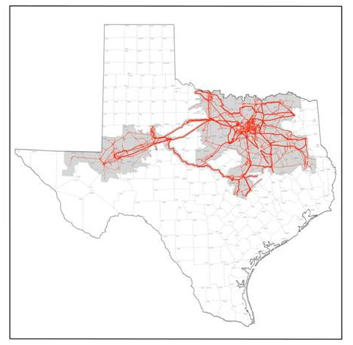
Far West Texas Projects
Far West Texas Project
Approved by ERCOT Board of Directors in Jun 2017
Odessa EVH – Riverton 345 kV Line
Bakersfield – Solstice 345 kV Line
Far West Texas Project 2
Approved by ERCOT Board of Directors on June 2018
Close 345 kV loop and new 138 kV lines
Dynamic Reactive Devices Project
Approved by ERCOT Board of Directors on June 2018
Immediate voltage support needs due to load increases
Horseshoe Draw DRD in-service June 2019
Rondo DRD planned in-service Dec 2019.
Odessa EHV – Riverton 345 kV Line
Critical Status approved by ERCOT BOD Feb 2018
CCN filed at PUC in March 2018
CCN Approved by PUC in Sept 2018
Riverton – Sand Lake – Solstice – Bakersfield 345 kV Lines
Critical Status approved by ERCOT BOD June 2018
CCNs filed at PUC November 2018
Bakersfield (LCRA) – Solstice (AEP) approved by PUC May 2019
Sand Lake – Solstice (AEP) approved by PUC July 2019
Riverton – Sand Lake 345 kV Line filed at PUC July 2019, approved Oct 2019

Slide 3
2019 Planned Transmission Projects
Spring 2019 – Scheduled In Service
Construct New Sand Lake 138 kV Switch
Construct Horseshoe Springs 138 kV Switch
Install Horseshoe Springs 138 kV Capacitors
Install Horseshoe Draw Dynamic Reactive Device
Install second circuit on Wink – Yukon 138 kV Line
Install series reactor at Wolf & Yucca 138 kV Switch
Install Moss 345/138 kV autotransformer #2
Rebuild Screwbean Tap – Screwbean 138 kV Line
Install Yucca Drive 138 kV Capacitors
Construct Dune 138 kV Switch

Slide 4
2019 Planned Transmission Projects
Fall 2019 – Scheduled In Service
Construct Nelson 138 kV Switch
Construct Blackbird 138 kV Switch
Construct Red Lakes 138 kV Switch
Convert Cowden North – Odessa North 138 kV Line
Construct New Riverton – Sand Lake 138 kV Line
Construct New Horseshoe Springs – Owl Hills 138 kV Line
Construct Quarry Field 138 kV Switch
Install Quarry Field 138 kV capacitors
Install Rondo Dynamic Reactive Device
Rebuild Garden City – Shipwreck 69 kV Line
Rebuild Wink – No Trees 138 kV Line

Slide 5
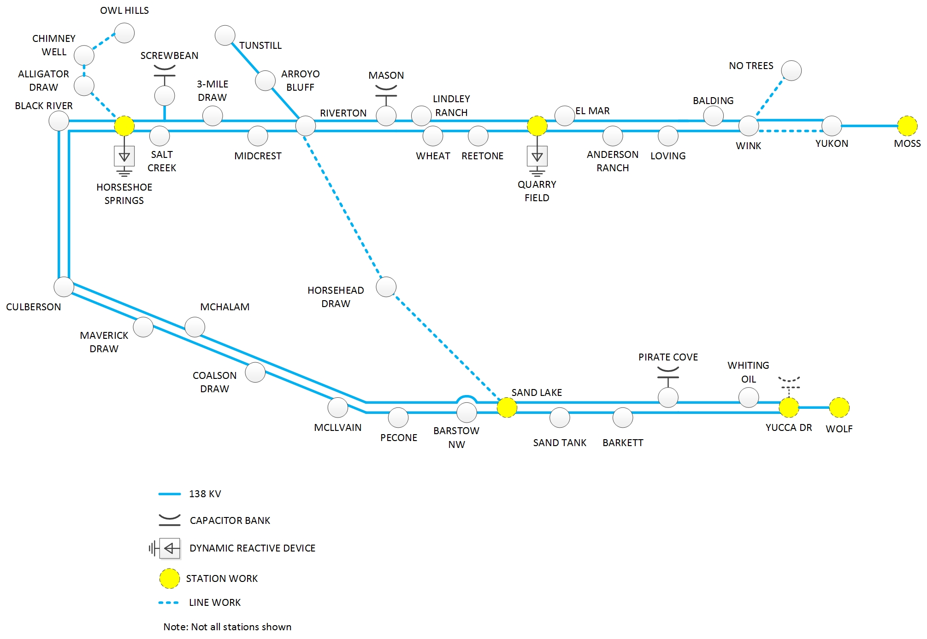
2019 Transmission Improvements

Slide 6
2020 Planned Transmission Projects
Spring 2020 – Scheduled In Service
Rebuild Andrews County South – No Trees 138 kV Line
Install Wink – Andrews County South 138 kV Second Circuit
Add Wolf to Moss 138 kV High Temperature Upgrade
Add Andrews County South 345/138 kV autotransformer #2
Add Wolf 345 kV Switch
Construct New Owl Hills – Tunstill 138 kV Line
Construct New Quarry Field – Kyle Ranch 138 kV Line*
Fall 2020 – Scheduled In Service
Construct New Riverton – Odessa EHV / Moss 345 kV Line
Construct New Riverton 345 kV Switch
Install Riverton – Sand Lake 345 kV Line
Construct New Sand Lake 345 kV Switch
Construct New Sand Lake – Solstice 345 kV Line
Rebuild Shipwreck – Midkiff 69 kV Line
Construct New Riverton – Kyle Ranch 138 kV Line* (2021)
*Pending CCN Regulatory proceedings

Slide 7
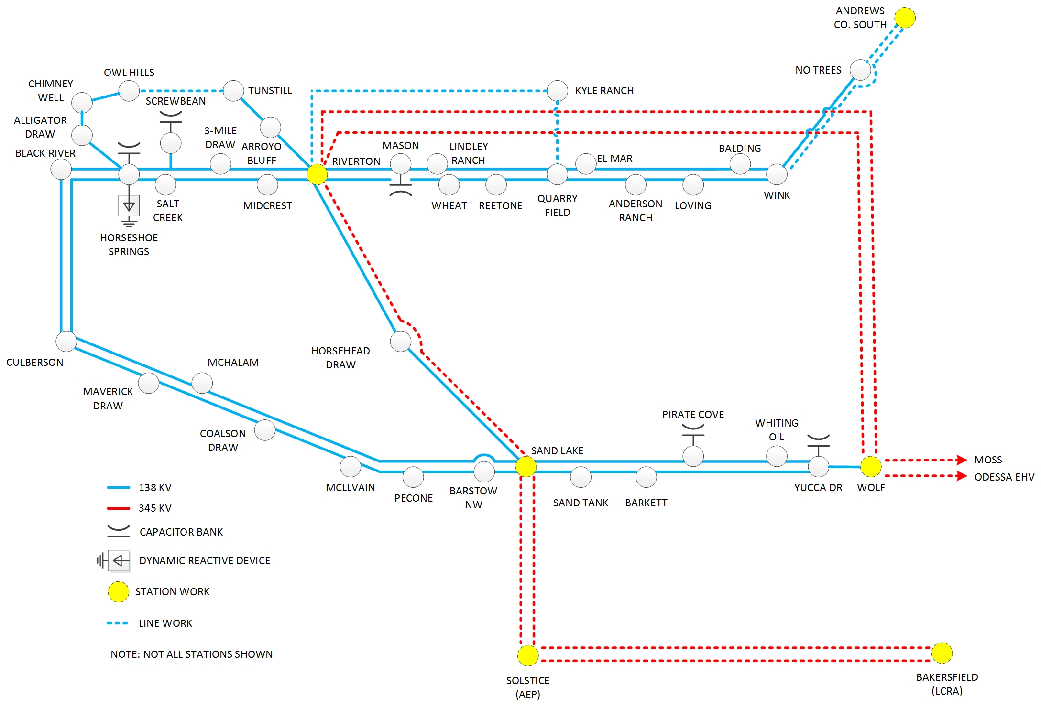
2020 Improvements

Slide 8
QUESTIONS/DISCUSSION

