Slide 1
PDCWG Report to ROS
Chair: Chad Mulholland, NRG
Vice Chair: Jimmy Jackson, CPS
ROS
November 7th, 2019

Slide 2
Report Overview & Notes
Report Overview
  Meeting Minutes
  BAL-001-TRE-1 FMEs & IMFR
    3 FMEs in the month of September
  Frequency Control Report

Slide 3
Meeting Minutes
PDCWG Meeting 10/9/19
  Southern Cross DC Tie – Directive 3, DC Tie Ramping Limits
    Discuss Protocol Changes (Curtailment option)
  ERCOT Ancillary Service Analysis – Changes for 2020
    New NPRR 968 to increase MSSC from 1,375 MW to 1,430 MW
  Energy Dispatch Performance Monitoring for Energy Storage Devices
    (NPRR 963)
  SAR-12 (Standard Authorization Request), BAL-001-TRE
  ERCOT Governor Testing Requirements
    (Nodal Operating Guide 2.2.7 clarification – NDCRC Submissions)
  Regulation & Frequency Control Reports

Slide 4
Frequency Measurable Events Performance

Slide 5
Frequency Measurable Events
There were 3 FMEs in September
  9/21/2019 03:00:17
    Loss of 462 MW
    Interconnection Frequency Response: 1,215 MW/0.1 Hz
    9 of 48 Evaluated Generation Resources had less than 75% of their expected Initial Primary Frequency Response.
    4 of 48 Evaluated Generation Resources had less than 75% of their expected Sustained Primary Frequency Response.
  9/22/2019 14:49:57
    Loss of 697 MW
    Interconnection Frequency Response: 1,244 MW/0.1 Hz
    6 of 37 Evaluated Generation Resources had less than 75% of their expected Initial Primary Frequency Response.
    6 of 37 Evaluated Generation Resources had less than 75% of their expected Sustained Primary Frequency Response.

Slide 6
Frequency Measurable Events
  9/22/2019 15:27:34
    Loss of 418 MW
    Interconnection Frequency Response: 747 MW/0.1 Hz
    8 of 41 Evaluated Generation Resources had less than 75% of their expected Initial Primary Frequency Response.
    8 of 41 Evaluated Generation Resources had less than 75% of their expected Sustained Primary Frequency Response.

Slide 7
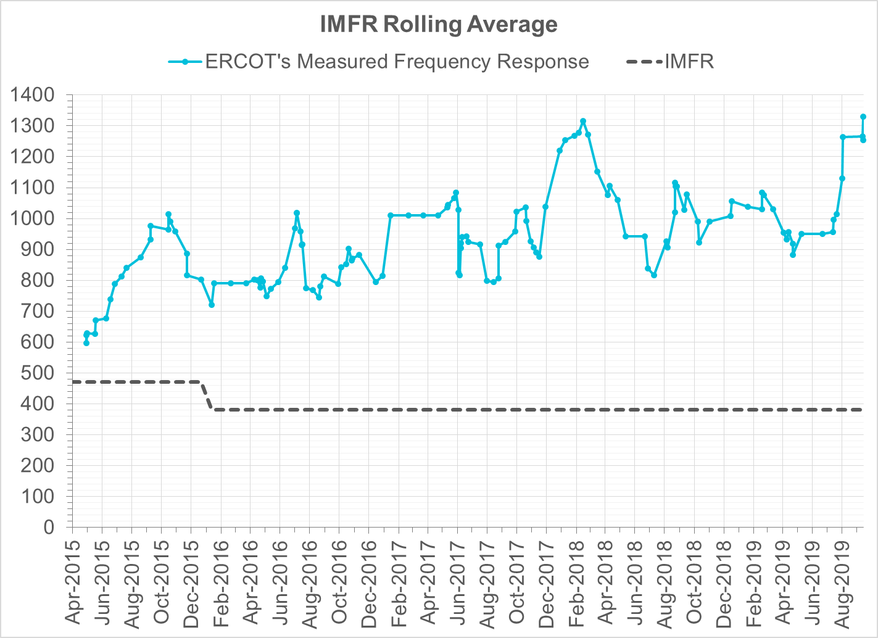
Interconnection Minimum Frequency Response (IMFR) Performance
IMFR Performance currently 1254.21 MW/0.1Hz
Frequency Response Obligation (FRO): 381 MW/0.1 Hz

Slide 8
Frequency Control Report
September 2019

Slide 9
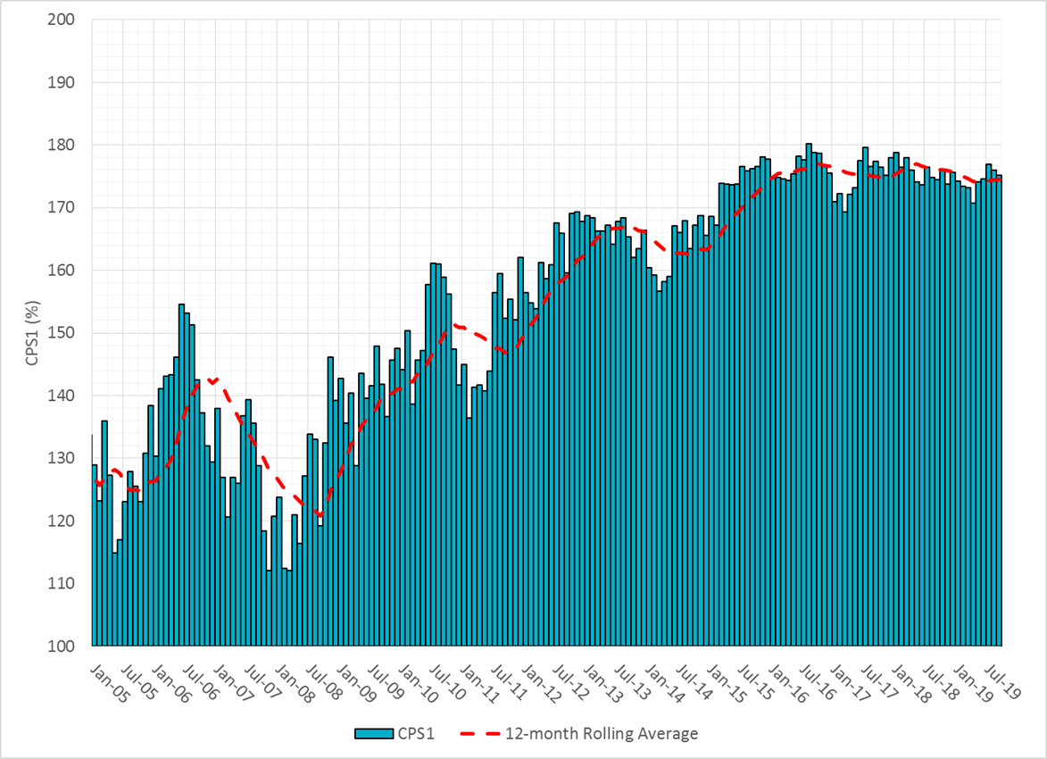

CPS1 Performance

Slide 10
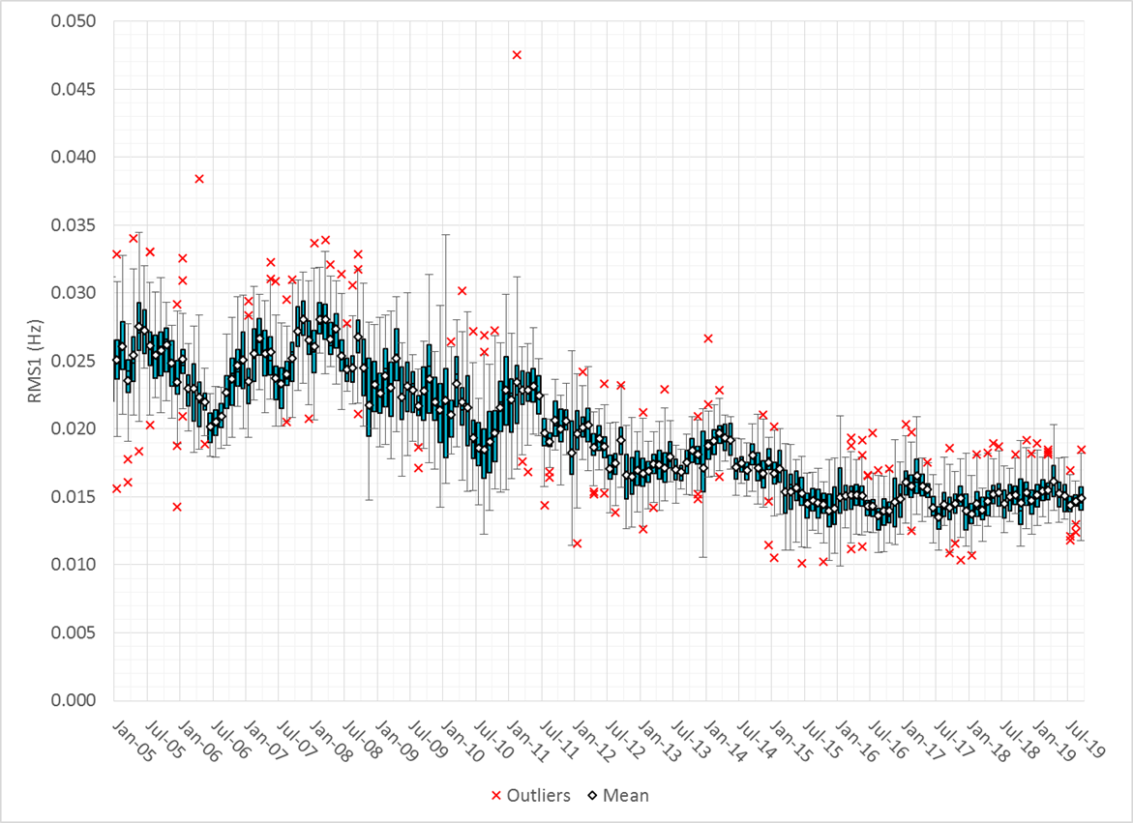
RMS1 Performance of ERCOT Frequency

Slide 11
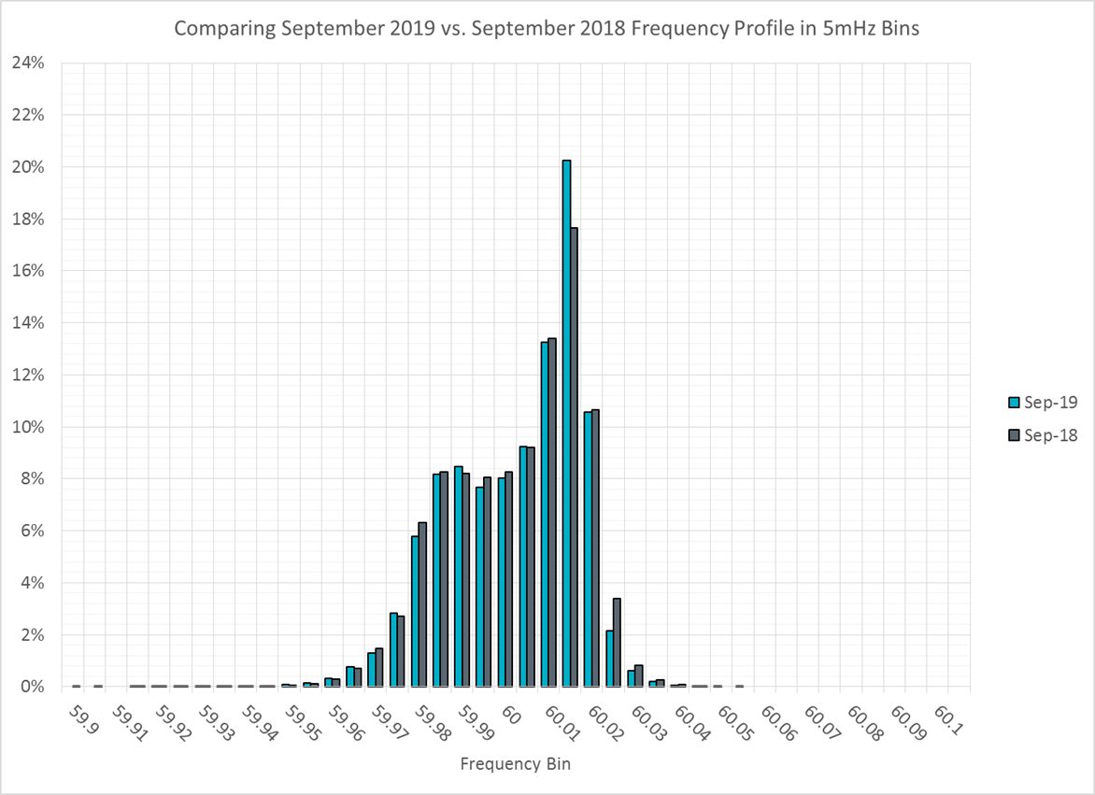
Frequency Profile Analysis

Slide 12
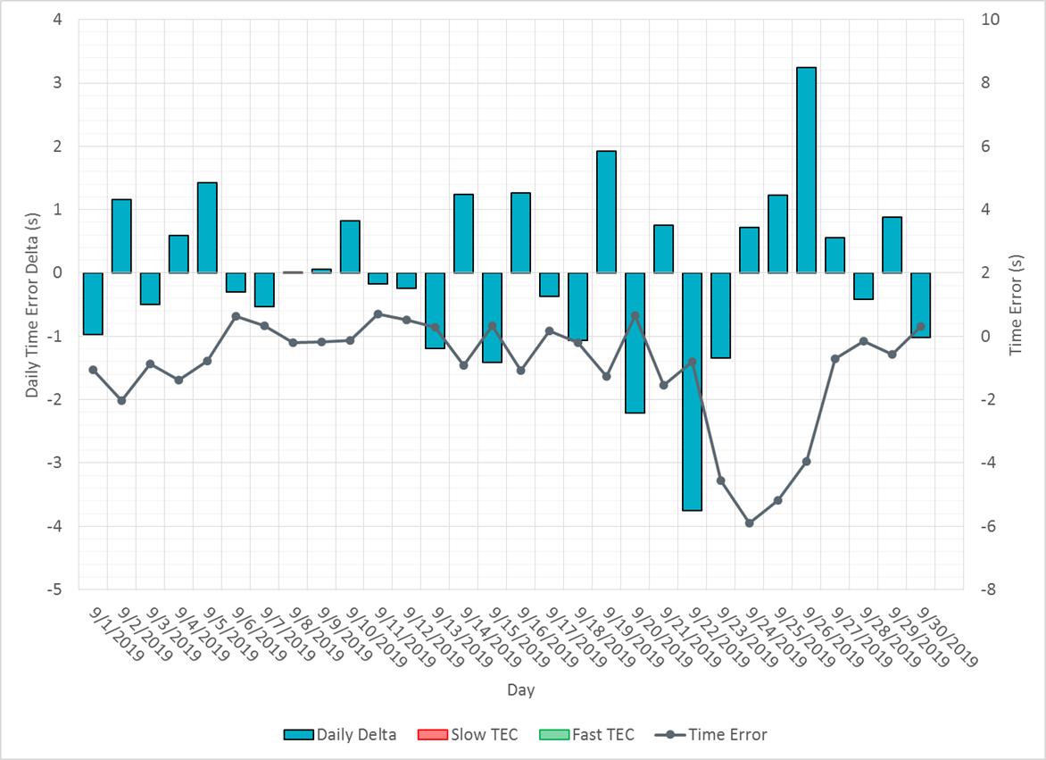
Time Error Corrections

Slide 13
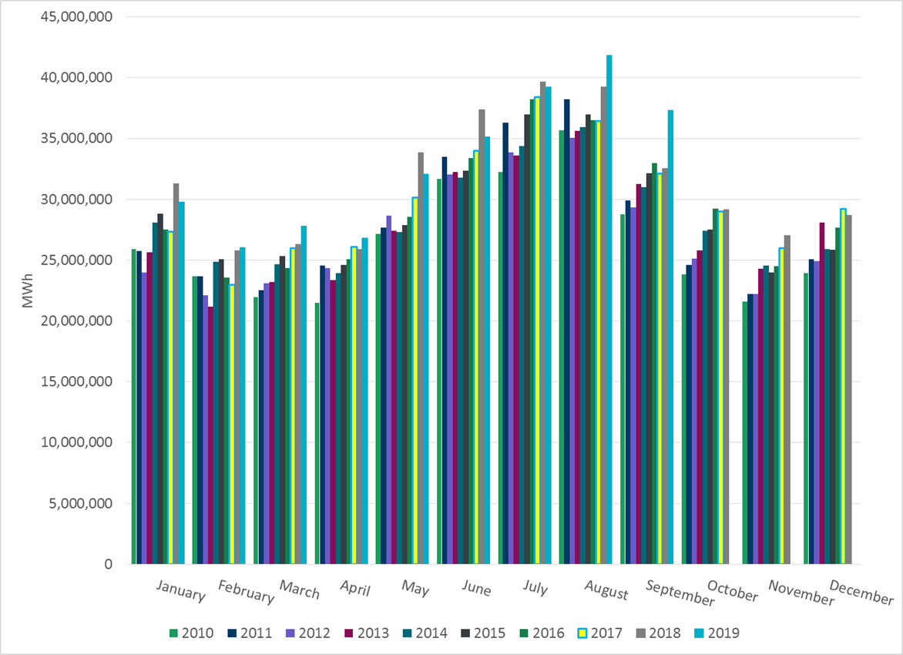
ERCOT Total Energy

Slide 14
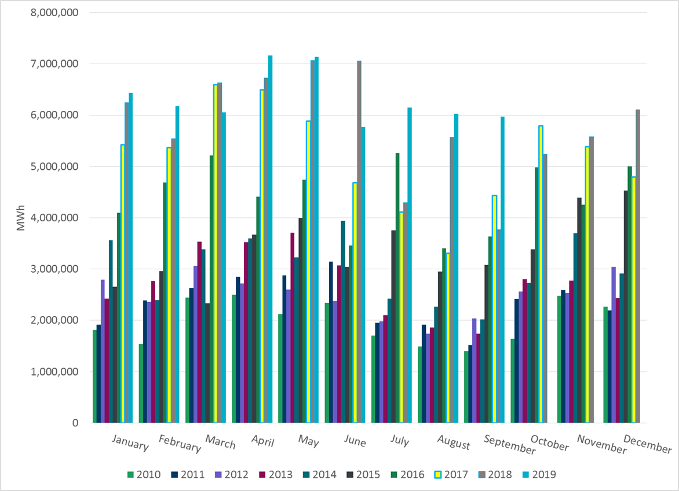
ERCOT Total Energy from Wind Generation

Slide 15
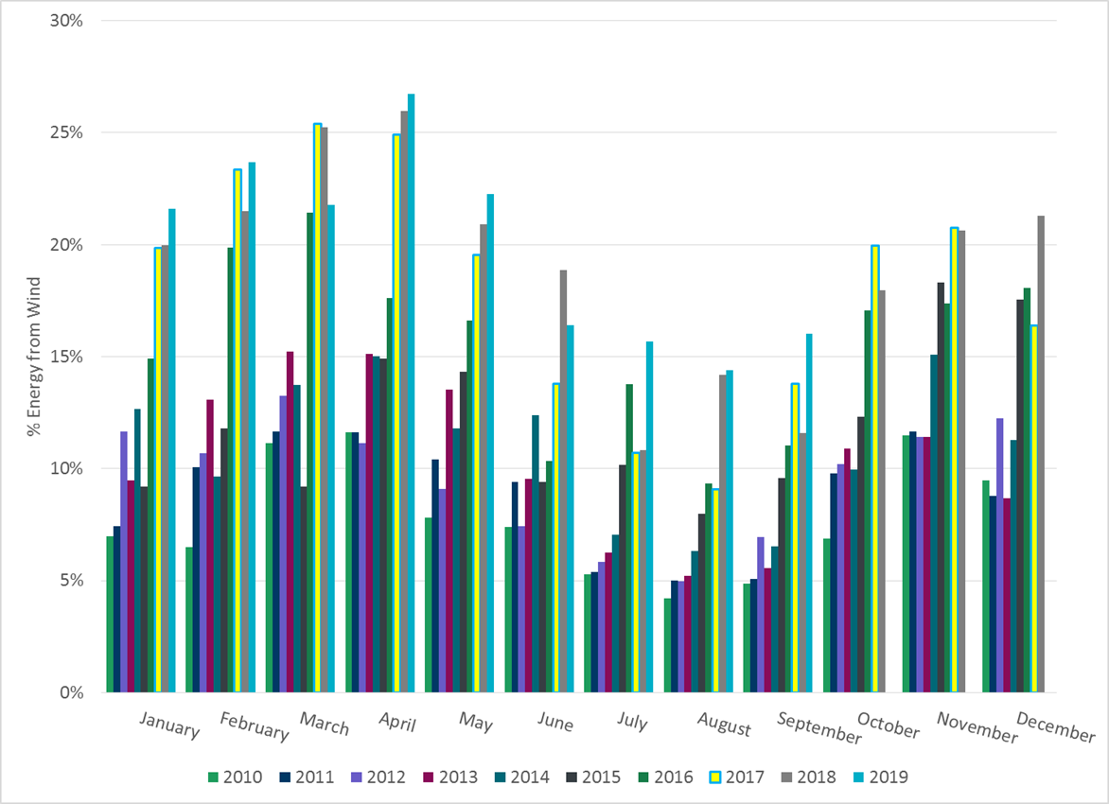
ERCOT % Energy from Wind Generation

Slide 16
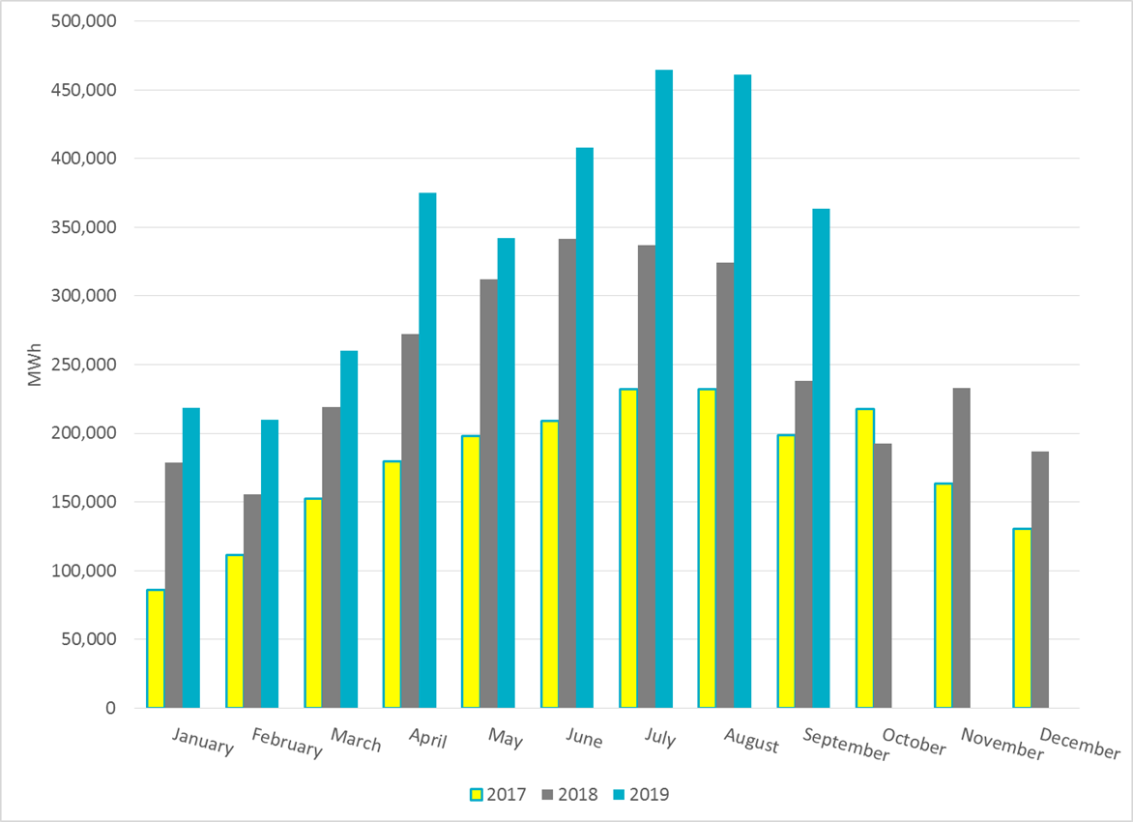
ERCOT Total Energy from Solar Generation

Slide 17
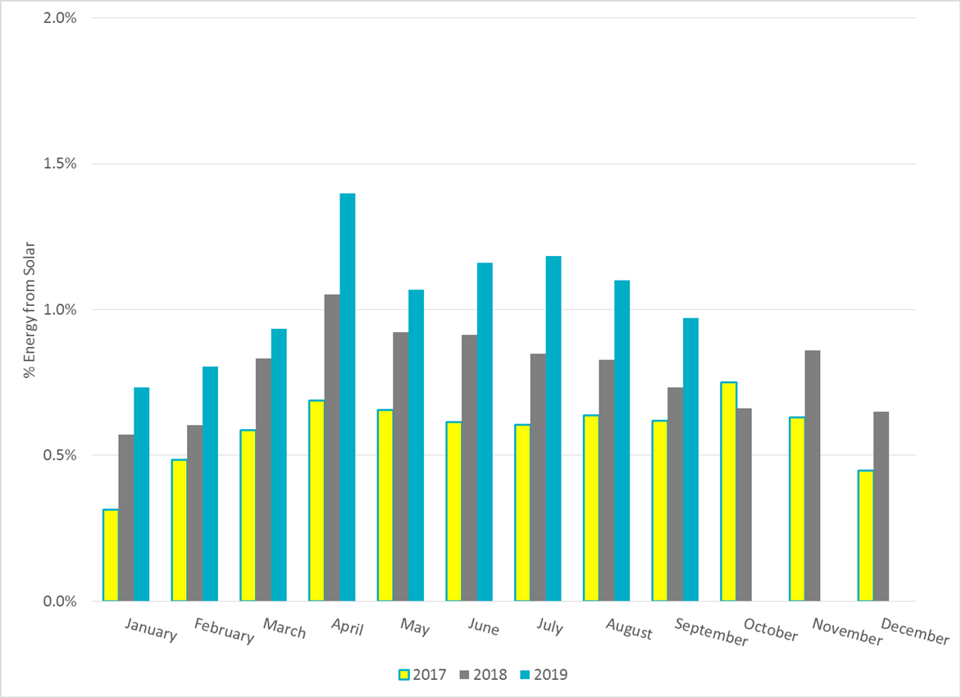
ERCOT % Energy from Solar Generation

Slide 18
Questions?

