Slide 1
Market Credit Working Group update to the Wholesale Market Subcommittee
Bill Barnes NRG, Chair
Josephine Wan Austin Energy, Vice Chair
11/06/2019

Slide 2
MCWG update to WMS
General Update
October 17th Joint MCWG/CWG Meeting
2 NPRRS reviewed for their credit impacts
928NPRR Cybersecurity Incident Notification. This Nodal Protocol Revision Request (NPRR) establishes Market Participant notification responsibilities with respect to Cybersecurity Incidents.
972NPRR Enhancing Existing CRR Transaction Limit Process. This Nodal Protocol Revision Request (NPRR) provides ERCOT with authority to not open a transaction adjustment period for a CRR Auction, even if the total number of transactions submitted exceeds the transaction limit announced prior to the auction, as long as the total number of transactions submitted does not exceed the number of transactions that can be processed by ERCOT’s systems.
All were operational without any credit impact.

Slide 3
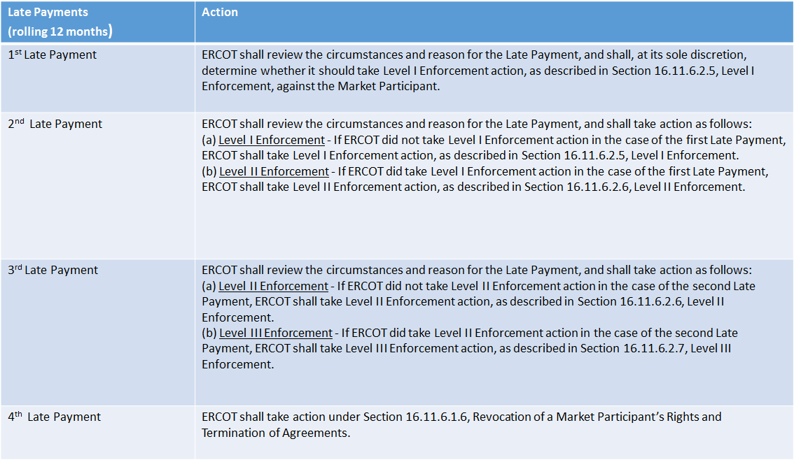
MCWG update to WMS
Late Payments

Slide 4
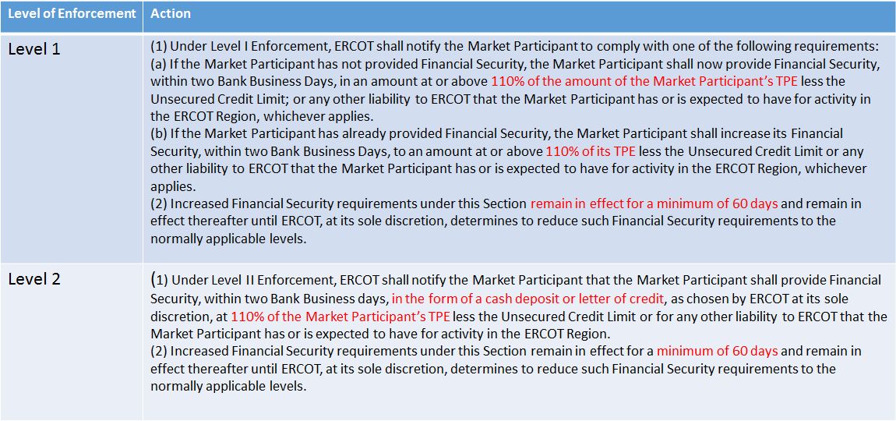
MCWG update to WMS
Late Payments

Slide 5
MCWG update to WMS
Section 16.11.4.3.3 Forward Adjustment Factors
The current FRAF/DFAF calculation uses the ICE prices following the current operating.
Proposal: Use ICE prices for the current operating day.
NPRR to be filed soon

Slide 6
MCWG update to WMS
Draft NPRR - Change to CRR Repossession Process
NPRR provides ERCOT with options for handling the repossession of a Congestion Revenue Right (CRR) portfolio resulting from a Market Participant Payment Breach or other Default.
The current process of offering the repossessed CRRs in a one-time auction, regardless of portfolio size or value, is limited and may not always be in the best interest of the market.
This NPRR will establish more options for ERCOT to void or liquidate the CRRs to be repossessed, based on the characteristics of the portfolio.

Slide 7
MCWG update to WMS
ERCOT Credit Exposure Updates
Market-wide average TPE increased from $ 1,020.1 million to $ 1,441.1 million
The increase in TPE is due to relatively high ERCOT Real Time and Day Ahead prices during August 2019
Discretionary Collateral is defined as Secured Collateral in excess of TPE,CRR Locked ACL and DAM Exposure.
Average Discretionary Collateral decreased from $ 1,730.5 million to $1,627.8 million
The decrease in Discretionary Collateral is largely due to increase in TPE
Number of active Counter-Parties increased from 241 to 242
21 collateral calls on September 5th, 2019

Slide 8
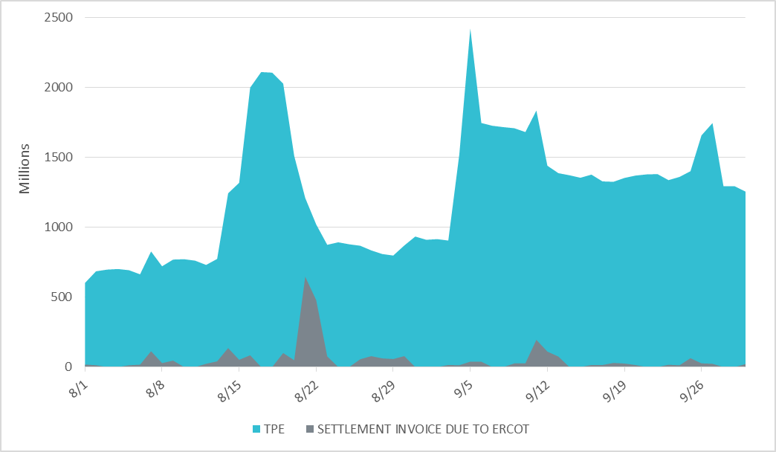
MCWG update to WMS

Slide 9
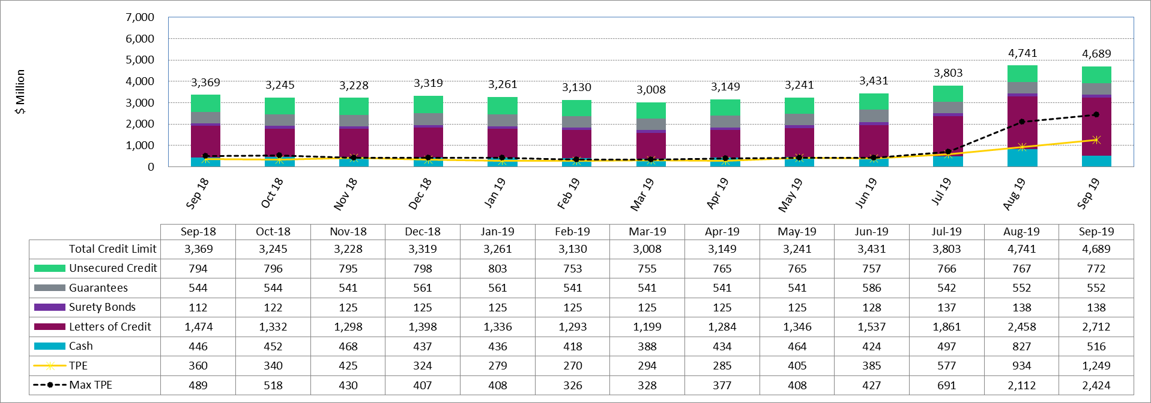
MCWG update to WMS

Slide 10
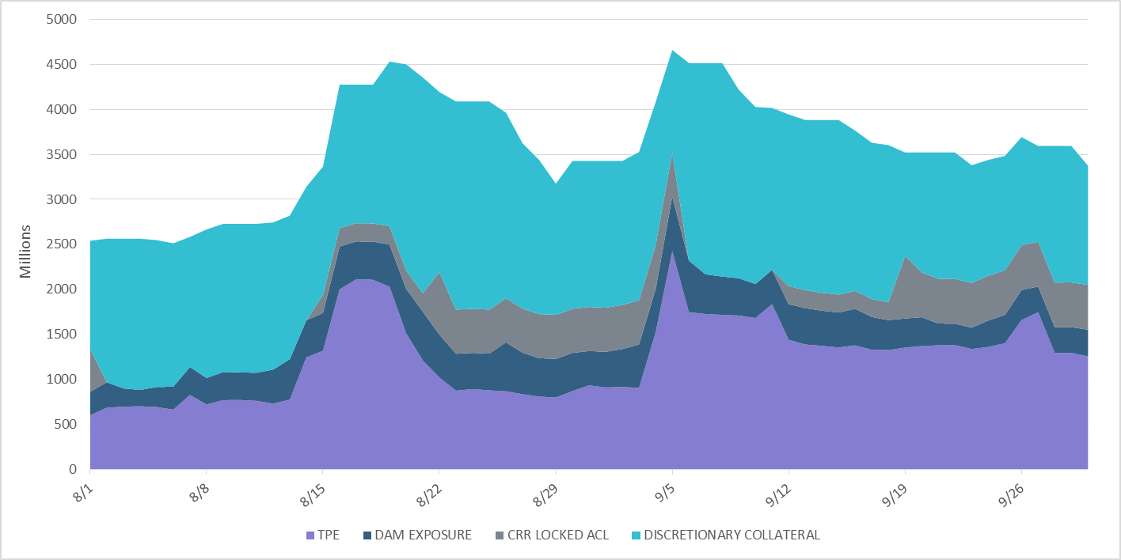
MCWG update to WMS

Slide 11
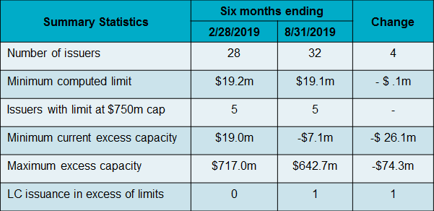
MCWG update to WMS
Letter of Credit Issuer Limits
ERCOT computed the issuer limits and reviewed outstanding LCs for the six months ending August 31, 2019

