Slide 1
Projected COD Delays Analysis Developments
SAWG Meeting
October 31st, 2019

Slide 2
Background
July SAWG meeting – GINR Trend Analysis – analysis on the commercialization rate of planned projects in 2018
This analysis builds on the previous work by looking at how projected Commercial Operations Date (COD) delays impact the success rate of a planned project becoming operational
Analysis from July 2019 SAWG meeting can be found here:
http://www.ercot.com/content/wcm/key_documents_lists/172720/SAWG__Meeting_7-31-2019_GINR_Trend_Analysis.pptx

Slide 3
Analysis Initiative
To better project the commercialization likelihood of planned projects in the queue based on interconnection progress
Last meeting we explored the ‘CDR-eligible’ criteria
Next step is to look at the frequency and timing of changes in the projected CODs reported by project developers
The expectation going into the analysis is that commercialized projects (in the past 13 months) have had low # (one or none) COD changes
Data issues/exceptions
Historical data for COD delays used in this analysis since Aug 2018 (when queue data migrated from SharePoint to oracle database)

Slide 4
Observations about the Projected COD metric
Different ways to explore this metric
# of updates (explored in this analysis)
Timing of COD delays (clustered during early, middle or late project phases?)
How far is COD pushed for a project delay? (a few weeks or several months?)
Recent ERCOT process changes effecting this metric:
Implementation and roll-out of the RIOO-IS system
Starting in June 2019, ERCOT has been sending emails to developers requesting COD updates if the projected COD is quickly approaching or has already passed
New interconnection steps for projects: Quarterly Stability Assessment (QSA)
Other factors that could impact the projected COD metric for planned projects:
PTC/ITC tax incentive developments in the form of extensions and phase-outs
Project developer experience in ERCOT market
Is COD change triggered by developer or by ERCOT Resource Integration?
Repower/upgrade projects (certain interconnection steps can be skipped)

Slide 5
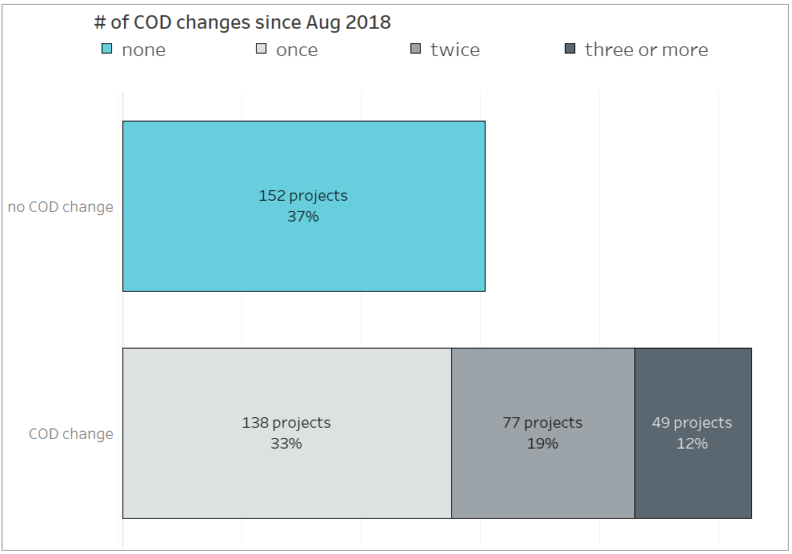
Since Aug 2018, the majority of planned projects have had a change to their projected COD
August 2018 snapshot of queue had 416 planned projects

Slide 6
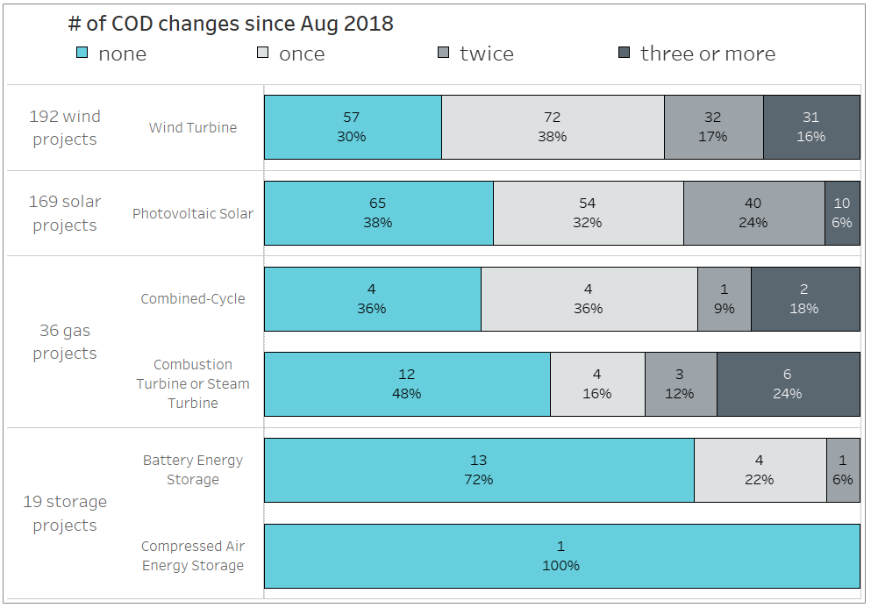
A technology breakdown shows that wind and solar projects typically have more COD updates than gas and storage projects

Slide 7
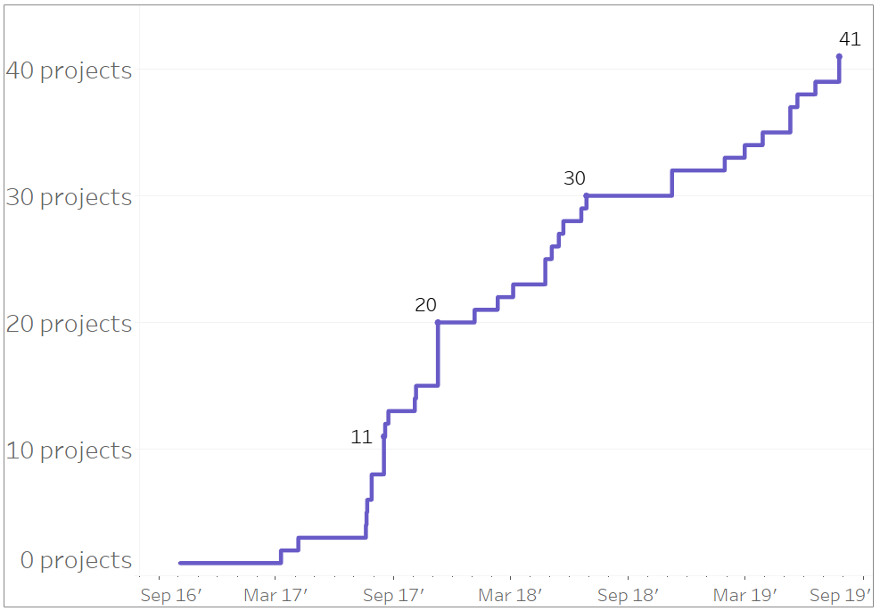
Repower/upgrade project activity in the queue
41 repower/upgrade projects have been requested since Oct 2016 (queue snapshot from 10/19/19)

Slide 8
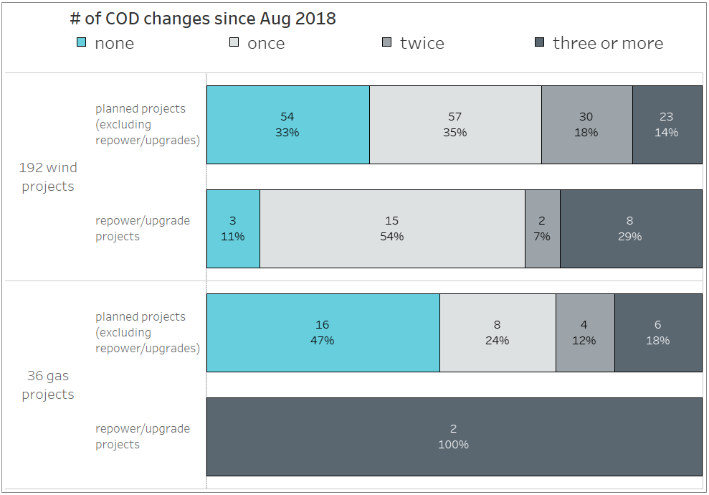
Repower/upgrade projects have had more COD delays than planned projects

Slide 9
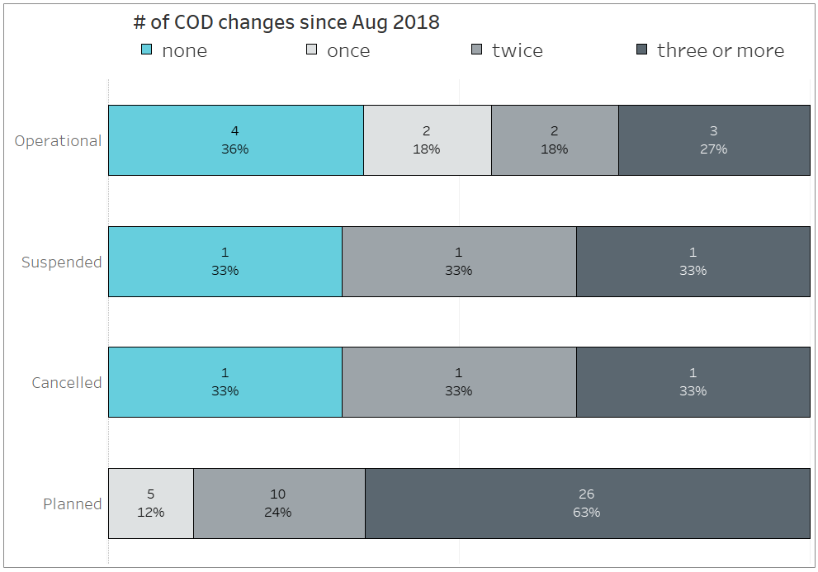
Low number of COD changes are not a good predictor that a planned project would go operational
Limited to 58 planned projects with COD between Aug 2018 and Sep 2019 from the Aug 2018 snapshot of queue

Slide 10
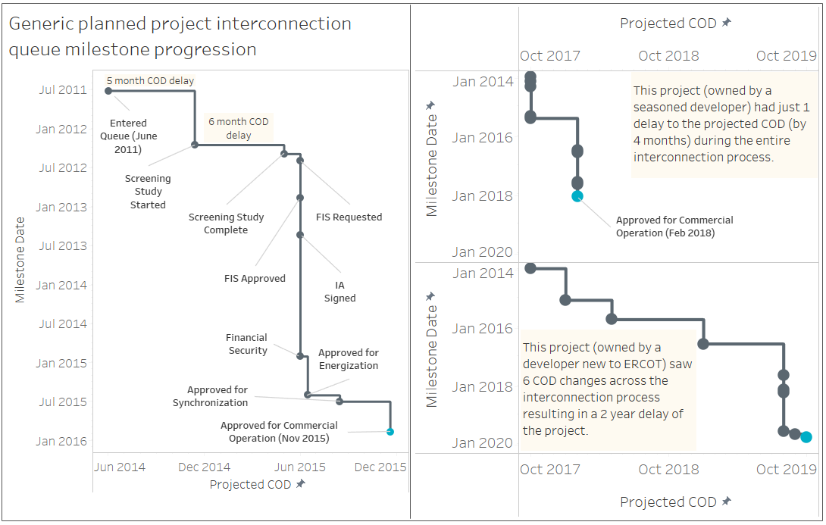
Future work focused on other elements of a COD delay

Slide 11
Wrap-up
Brainstorming: Are there other GINR trend analysis topics of interest to explore using Tableau or other data exploration tools?
Send your ideas to Dan Mantena, dmantena@ercot.com

