Slide 1
KTC-5: Single Model ESREDP
Luke Butler
ERCOT
BESTF Meeting
11/04/2019

Slide 2
ESREDP Single Model
Energy Storage Resource (ESR*) performance can be scored similarly to current Generation Resource Energy Deployment Performance (GREDP):
  GREDP (%) → ESREDP (%)
  GREDP (MW) → ESREDP (MW)
Maintain use of performance threshold variables specified in ERCOT comments to NPRR 963 submitted on 10/11/2019:
  V %
  W MW
* ESR terminology as set forth in NPRR 957, endorsed by PRS 9/12/19, IA endorsed by PRS 10/10/19

Slide 3
Example
Example 15-min Period
ESR is carrying both a Regulation-Up and Regulation-Down Responsibility of 25 MW
ESR receives both positive and negative Base-Points (BP), along with Regulation-Up and Regulation-Down requests

Slide 4
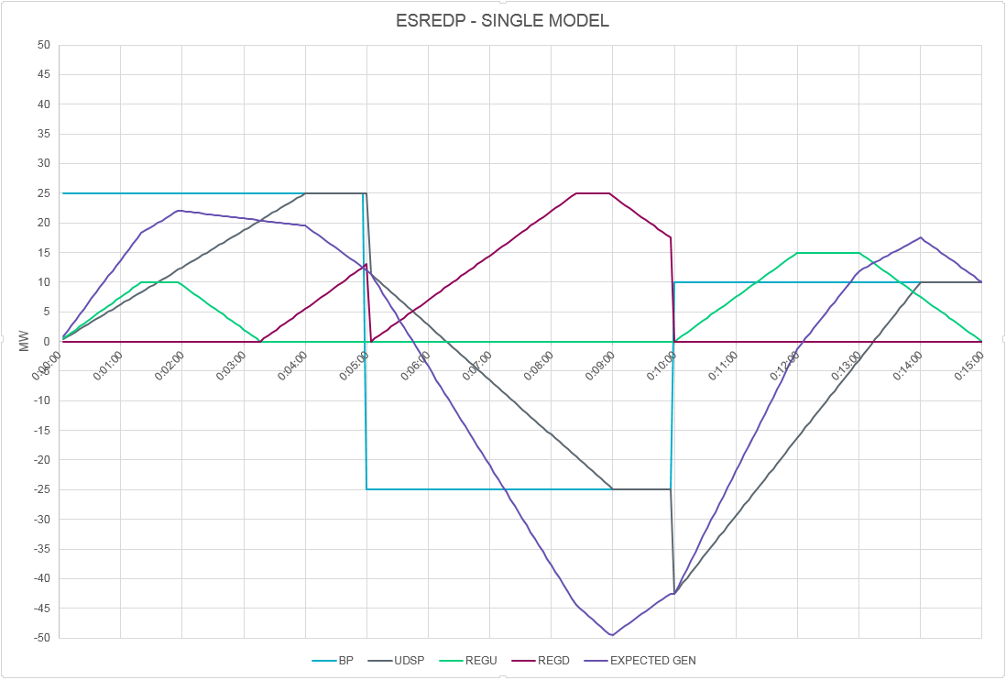
Example
*UDSP is defined in RTC Key Principle 1.4

Slide 5
Example
Int 1
Int 2
Int 3

Slide 6

Example
$$ESREDP \left(\%\right)= ABS\left[\left(\frac{ATPF−AEPFR}{ABP+ARI}\right)−1.0\right]∗100$$
Int 1
$$ESREDP \left(MW\right)=ABS(ATPF−ABP−ARI−AEPFR)$$
ATPF = Average Telemetered Power Flow
ARI = Average Regulation Instruction
AEPFR = Average Estimated Primary Frequency Response
ABP = Average Base Point
ATPF* | ARI | ABP
16.757 | 1.723 | 15.034
ESREDP (%) | ESREDP (MW)
0 | 0
*Assume perfect performance for this example, i.e., ESR Power Flow = Expected Gen

Slide 7
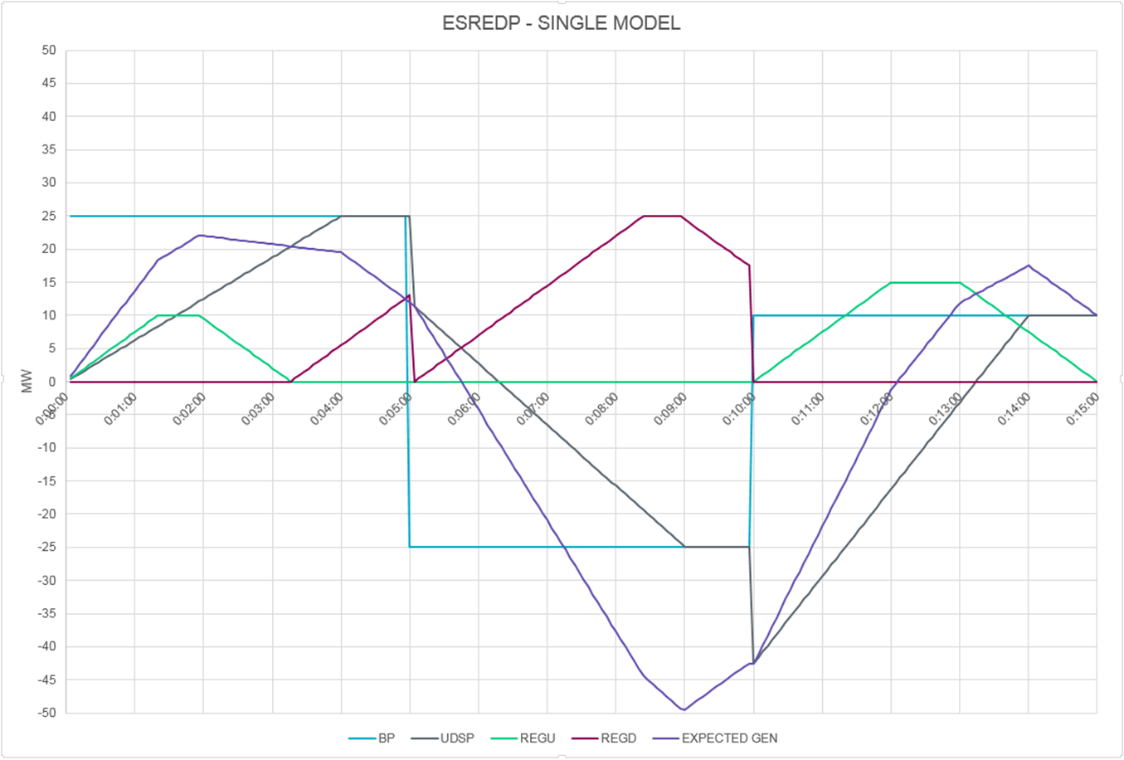
Example
$$ESREDP \left(\%\right)= ABS\left[\left(\frac{ATPF−AEPFR}{ABP+ARI}\right)−1.0\right]∗100$$
Int 2
$$ESREDP \left(MW\right)=ABS(ATPF−ABP−ARI−AEPFR)$$
ATPF = Average Telemetered Power Flow
ARI = Average Regulation Instruction
AEPFR = Average Estimated Primary Frequency Response
ABP = Average Base Point
ATPF* | ARI | ABP
-25.320 | -15.540 | -9.780
ESREDP (%) | ESREDP (MW)
0 | 0
*Assume perfect performance for this example, i.e., ESR Power Flow = Expected Gen

Slide 8
Example
$$ESREDP \left(\%\right)= ABS\left[\left(\frac{ATPF−AEPFR}{ABP+ARI}\right)−1.0\right]∗100$$
Int 3
$$ESREDP \left(MW\right)=ABS(ATPF−ABP−ARI−AEPFR)$$
ATPF = Average Telemetered Power Flow
ARI = Average Regulation Instruction
AEPFR = Average Estimated Primary Frequency Response
ABP = Average Base Point
ATPF* | ARI | ABP
-2.35 | 9.00 | -11.350
ESREDP (%) | ESREDP (MW)
0 | 0
*Assume perfect performance for this example, i.e., ESR Power Flow = Expected Gen

Slide 9
Questions?

