Slide 1
RTC Task Force General Information
Matt Mereness
October 30, 2019

Slide 2
Antitrust Admonition
Antitrust Admonition
To avoid raising concerns about antitrust liability, participants in ERCOT activities should refrain from proposing any action or measure that would exceed ERCOT’s authority under federal or state law. For additional information, stakeholders should consult the Statement of Position on Antitrust Issues for Members of ERCOT Committees, Subcommittees, and Working Groups, which is posted on the ERCOT website.1
Disclaimer
All presentations and materials submitted by Market Participants or any other Entity to ERCOT staff for this meeting are received and posted with the acknowledgement that the information will be considered public in accordance with the ERCOT Websites Content Management Operating Procedure.
1 The document is available at http://www.ercot.com/about/governance/index.html .

Slide 3
Outline of RTCTF Update
RTCTF Meeting Schedule
TAC Update
Today’s Plan for Discussion
Appendix
Stakeholder Process Summary
PUCT Direction on RTC Items

Slide 4
RTCTF Meeting Schedule
Schedule of future meetings for principles/scope of RTC:
Thursday, April 4 (Initial meeting, Charter and Approach)
Monday, April 22 (RTC Orientation Session)
Tuesday, April 30 (Begin reviewing Key Principles)
Monday, May 13
Friday, June 7
Friday, June 21
Friday, July 12
Friday, Aug. 9
Tuesday, Aug. 27
Thursday, Sept. 19
Tuesday, Sept. 24 (Special meeting for ISO Lessons Learned)
Wednesday, Oct. 9
Wednesday, Oct. 30
Tuesday, Nov. 19
Tuesday, Dec. 3 (possible move to Taylor)
Thursday, Dec. 19
Friday, Jan. 10, 2020
Wednesday, Jan. 22, 2020 > TAC Jan 29, 2020 > Board Feb 5, 2020
Posted 2020 Schedule in coordination with BEST starting in Feb 2020

Slide 5
TAC Update
At the October 23, 2019 TAC meeting, TAC voted to endorse the following Key Principle subsections:
Unanimous Endorsement:
Key Principle Subsection 1.1 (5)
Ancillary Service Demand Curves and Current Market Price Adders
Key Principle 1.3 (1), (2), (3), (4) (a & b), (5), (6), (7), (8), (10), and (11)
Offering and Awarding Ancillary Services in Real-Time
Key Principle 5 (1) - (6)
Day-Ahead Market
Non-Voting Item:
Key Principle 1.2 (3) AS Price Cap
Austin Energy discussion to move AS Price Cap to “KP8 Out of Scope”
Discuss later in agenda today as addition to Key Principle 8

Slide 6
Today’s Plan for Key Principles (KP)
ROUND 3 REVIEW:
KP1.3 (12)- Proxy curves for RTC AS
Updated language from ERCOT based on Oct 9th meeting
KP1.3 (9)- Operator ability to mitigate infeasible AS
Discuss Luminant comments
KP5(7)- AS Offers in DAM without Resource
Discuss concept benefit and Shell comments
KP2- Definition of the AS Products to Align with RTC Framework
(1)- AS products under RTC will be the products with the NPRR863 (No comments received)
(2)- ERCOT will limit AS awards to no more than the qualified quantity (No comments received)
(3)- Regulation Service Qualification (Crescent comments)
(4)- Responsive Reserve Service Qualification (Crescent comments)
(5)- Non-Spinning Reserve Qualification (No comments received)
(6)- ERCOT Contingency Reserve Service Qualification (No comments received)

Slide 7
Today’s Plan for Key Principles (KP)
ROUND 2 REVIEW:
KP1.3(14) - Proposed FFR by Crescent with ERCOT comment and moved up with (8)(c)
Crescent and ERCOT comments
KP1.3(1),(15) and KP1.4(3)-(4) - Resource Statuses and Telemetered AS Limitations
Follow-up comments from Small Group Meeting
KP1.3(4)(c) & (d) Exelon additions from Oct 9th meeting
Exelon proposal on Combined-cycle 5 minute Energy Offer Curves and Make-Whole
KP1.1(2),(6),(7) and KP3(13)-(18) RUC Items and the Reliability Deployment Pricing Run
Luminant Presentation and Comments

Slide 8
Today’s Plan for Key Principles (KP)
ISO LESSONS LEARNED ITEM:
KP1.3(16) AS Substitution proposal
Revisit concept in light of ISO Lessons Learned (Crescent Power 10 minute presentation)
Determine if consensus to reconsider prior RTCTF Aug 27th decision

Slide 9
Today’s Plan for Key Principles (KP)
INITIAL REVIEW:
KP1.2 - Separate SWOC in DAM
KP1.5 - Emergency Operation Settlement
KP1.5 - Removal of Separate Regulation and FRRS Signals
KP1.6 - Credit Exposure Changes Associated with AS Imbalance
KP1.1 - AS Demand Curve for Regulation Down
KP7 - Change in GREDP Formulation - Associated with LFC Changes
KP1.3 - Changes to Validation of AS Trades - Associated with Real-Time Self-Provision
OUT OF SCOPE ITEMS:
KP8 - Out of Scope Items: Addition of KP1.2 AS Price Cap
Austin Energy proposal with ERCOT comments

Slide 10
Today’s Plan
Key Documents for today:
KP1.1 102419 Luminant Comments
KP1.2 101419
KP1.3 102419 Combined Comments
KP1.4 102319 ERCOT Comments
KP2 100119 Siddiqi Comments
KP3 102419 Luminant Comments
KP5 101419
KP7 102319
KP8 102319 Austin Energy Comments
Any questions?

Slide 11
Appendix
Stakeholder Process Summary
PUCT Direction on RTC Items
RTCTF Posting Locations

Slide 12
RTCTF Review Process
Internal ERCOT Draft Principles and Principle Concepts (elements)
ERCOT presents concepts for meeting in presentation format
ERCOT takes feedback and posts in 2 days as initial document for MP edits
ERCOT posts all MP feedback and responds to MP redlines, concerns, alternatives
ERCOT provides responses to finalize supporting principle concept
Meeting #1 Meeting #2 Meeting #3
MPs share initial feedback, concern, request for additional information
MPs submit feedback as edits to document and any
- Concerns
Alternatives
MPs must document concerns and alternative approach prior to meeting and be prepared to discuss
Take consensus and non-consensus items to TAC for vote

Slide 13
TAC Review Process
TAC is the stakeholder body to vote on Design Principles.
RTC Key Principles are non-binding and will not go directly to the Board after TAC consideration.
Procedures set forth in Protocol Section 21 do not apply to discussions, opinions or approvals by TAC with respect to RTC Key Principles.
Section VIII of the ERCOT Board Policies and Procedures does not apply to discussions, opinions or unofficial approvals by TAC with respect to RTC Key Principles.
After TAC endorsement of all RTC Key Principles, ERCOT will compile the RTC Key Principles into a single package, and submit it to TAC for a courtesy review prior to Board review. The package will contain a full record of TAC votes.
Following TAC review of the complete RTC Key Principles package, ERCOT will submit it to the Board for discussion and consideration.
Any stakeholder opposed to an RTC Key Principle may, at this time, request Board consideration in accordance with Section VIII of the ERCOT Board Policies and Procedures.

Slide 14
PUCT Direction on RTC Design Items
Key updates PUCT Project No. 48540
June 26, 2019 Chair Memo: http://interchange.puc.texas.gov/Search/Documents?controlNumber=48540&itemNumber=60
June 27, 2019 PUCT Open Meeting: http://www.adminmonitor.com/tx/puct/open_meeting/20190627/
July 17, 2019 ERCOT Letter on RTC Timeline: http://interchange.puc.texas.gov/Search/Documents?controlNumber=48540&itemNumber=62
July 18, 2010 PUCT Open Meeting: http://www.adminmonitor.com/tx/puct/open_meeting/20190718/
Ancillary Services Demand Curves – Curves should follow current Operating Reserve Demand Curve (ORDC) parameters.
System-wide Offer Cap (SWCAP) and Power Balance Penalty Curve (PBPC) – Set SWCAP $2,000 per MWh, Max ASDC $9,000 per MWh, VOLL $9,000 per MWh. Prices capped at $9,000 per MWh exclusive of congestion costs. LCAP will apply if necessary.
Ancillary Service Offers – Creation of Proxy AS Offers if qualified and available but not offered.
Suite of Ancillary Service Products – All Ancillary Service products finalized with the approval of NPRR863.
Day-Ahead Market – The Commission did not want to add DAM enhancements to the RTC Project that would jeopardize the RTC delivery timeline.

Slide 15
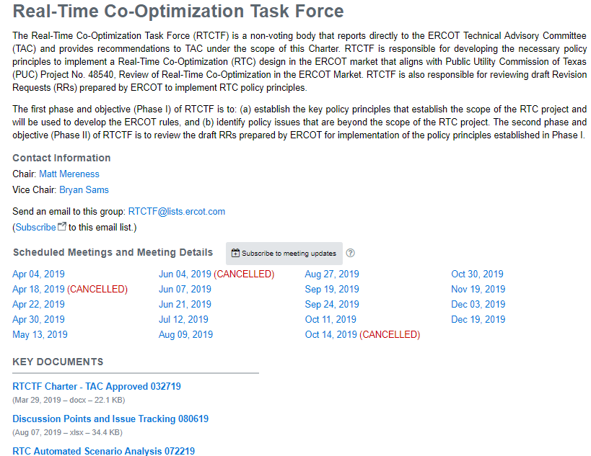
Reminder of RTCTF Posting Locations
RTCTF Home Page
RTCTF Charter
Meeting Calendar
Principle Tracking Schedule
RTC Scenario/Clearing Tool
http://www.ercot.com/committee/rtctf
RTCTF Calendar Pages
Current/new materials posted on RTCTF meeting pages
ERCOT.com/ MarketRules, PUCT Directive/RTC Page All historical materials posted
http://www.ercot.com/mktrules/puctDirectives/rtCoOptimization

