Slide 1
RIOO-RS Update
October 28, 2019

Slide 2
Wireframe Review

Slide 3
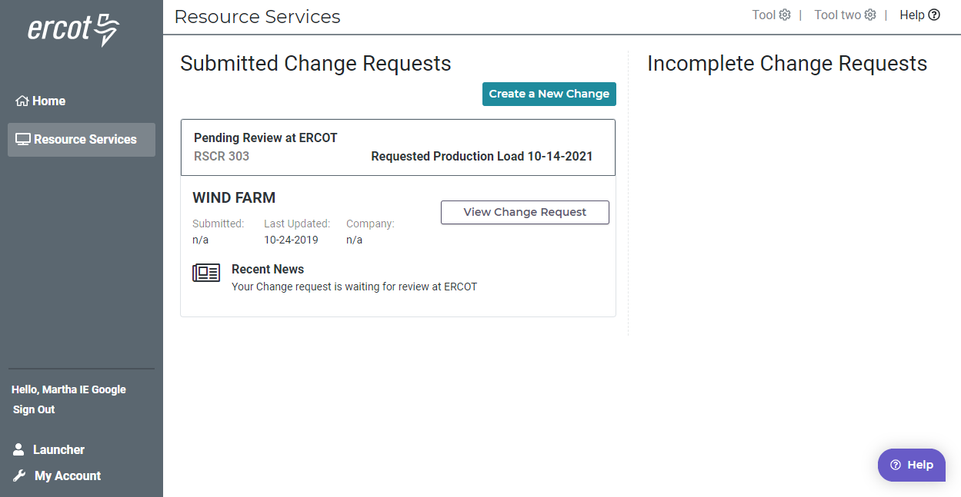
Resource Entity Dashboard

Slide 4
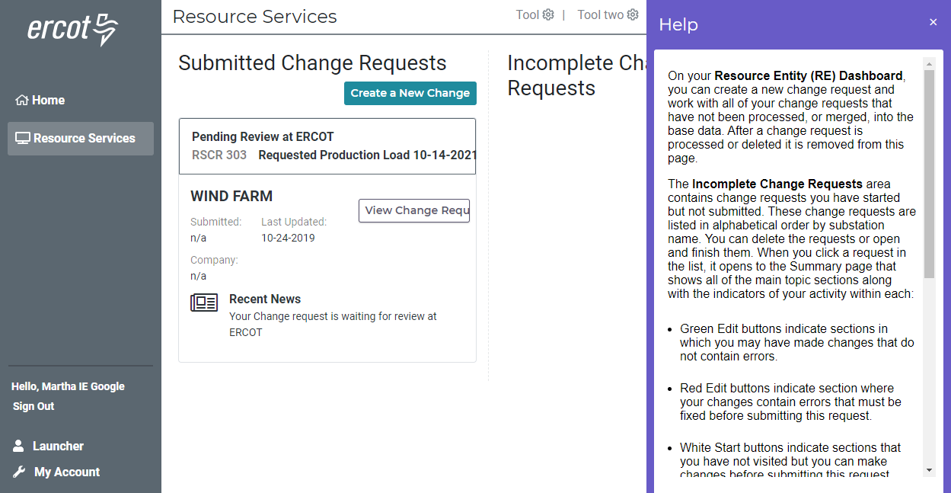
Help – on every page

Slide 5
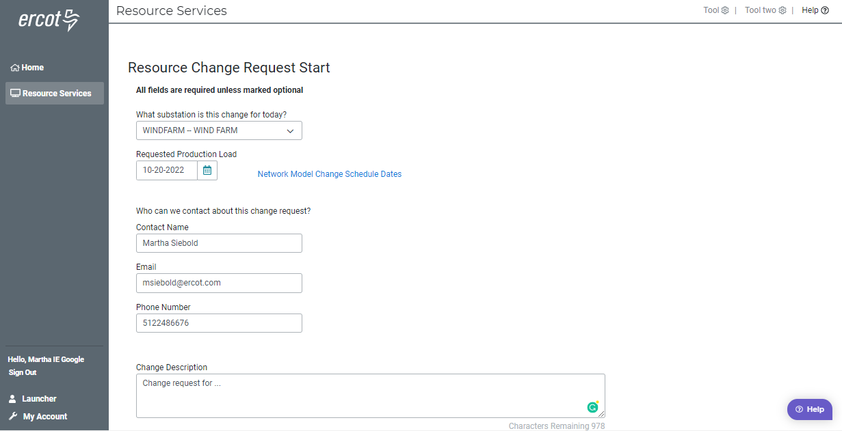
Starting your change request

Slide 6
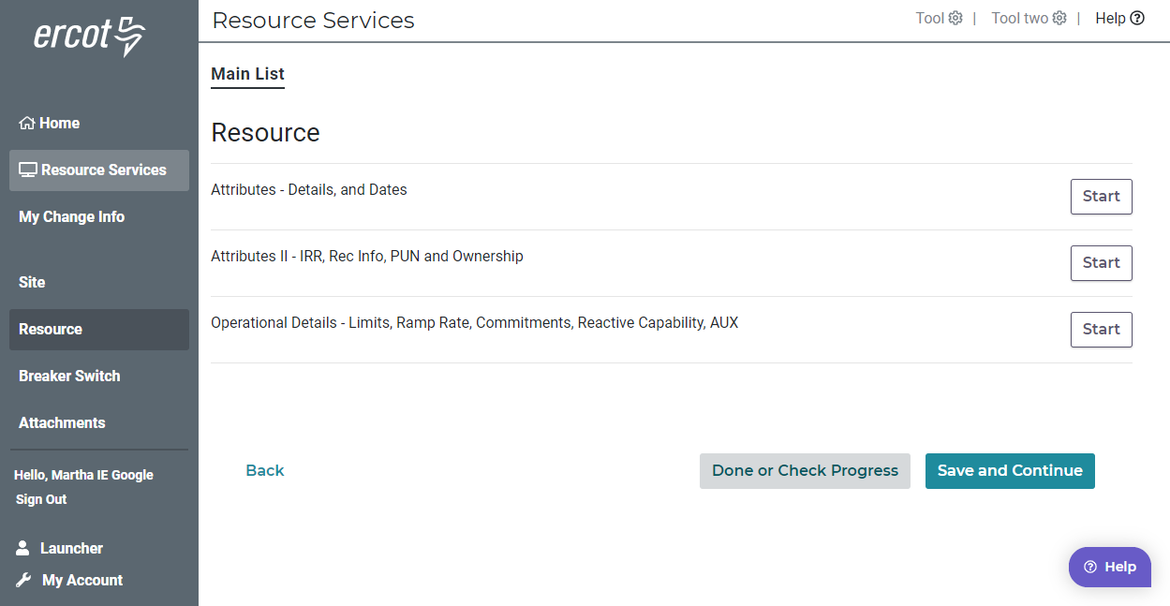
Main List

Slide 7
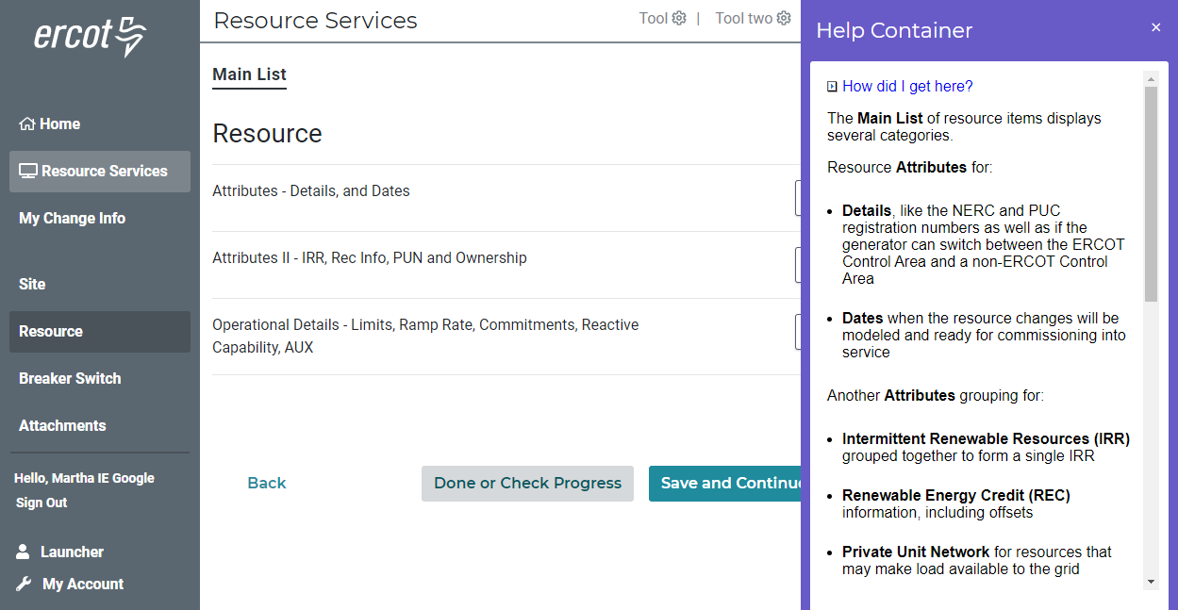
Main Lists – Help – Describes Lists

Slide 8
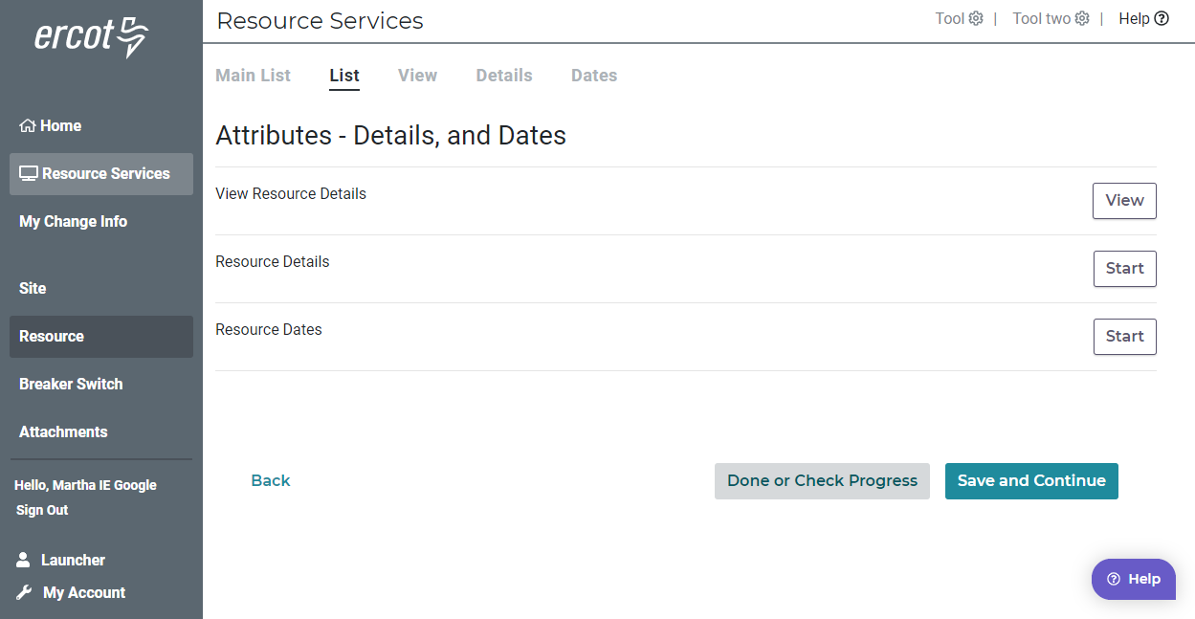
List

Slide 9
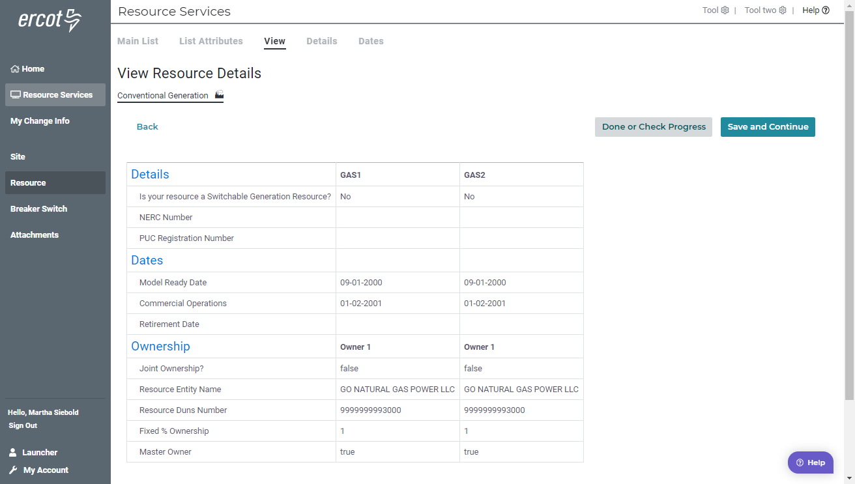
View

Slide 10
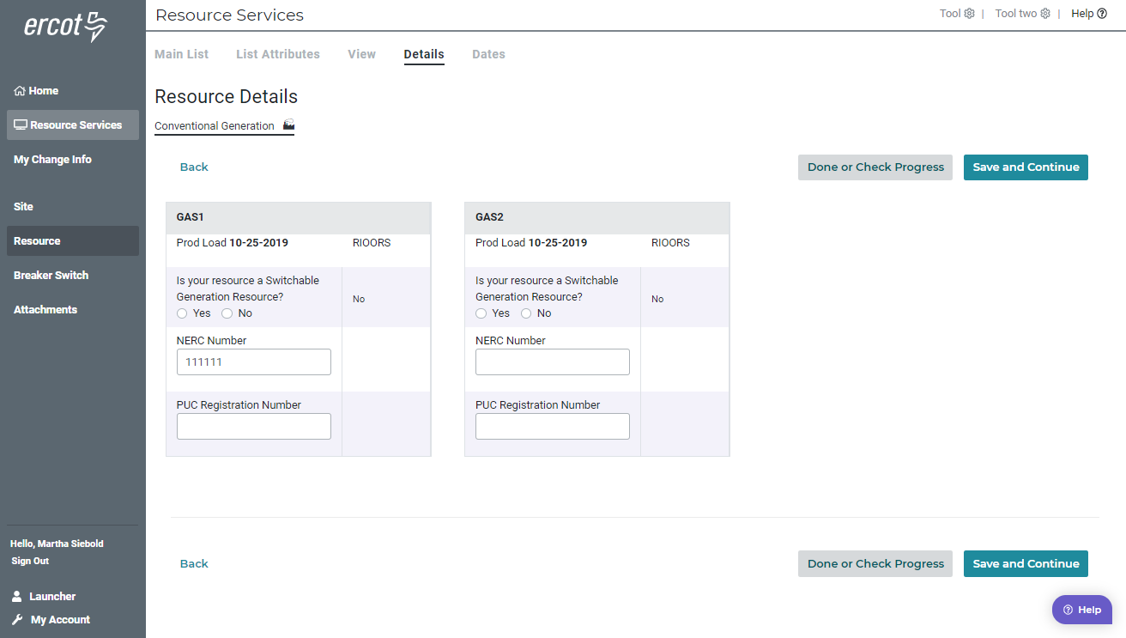
Details

Slide 11
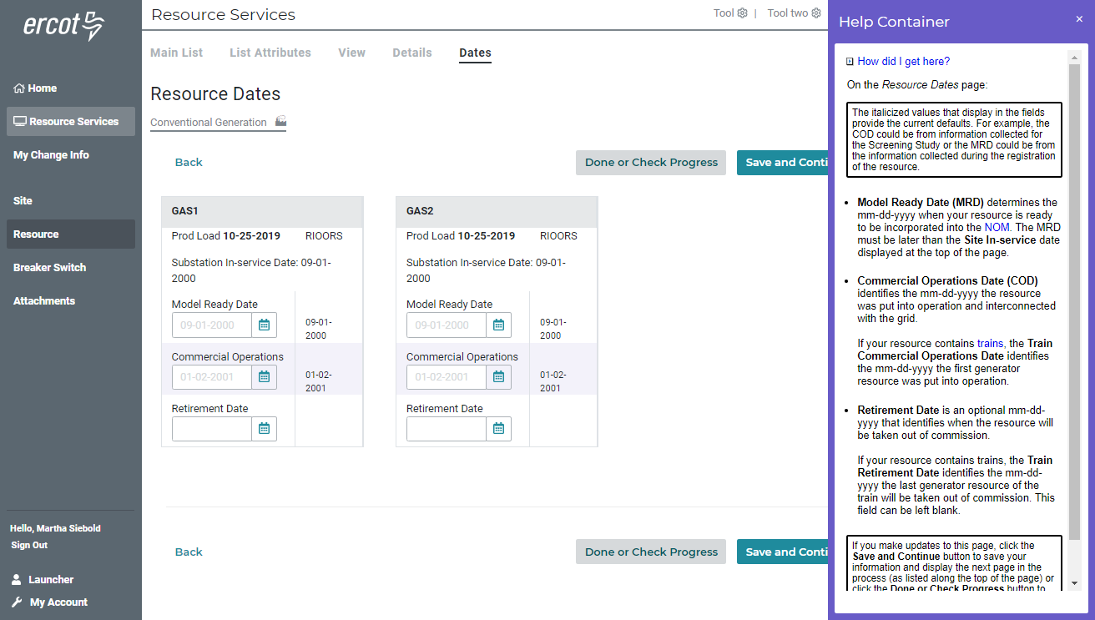
Dates

Slide 12
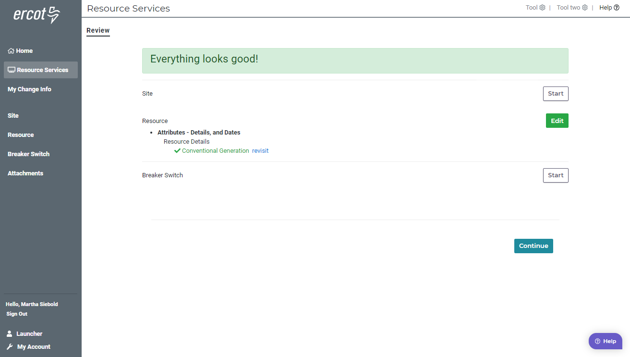
Review

Slide 13
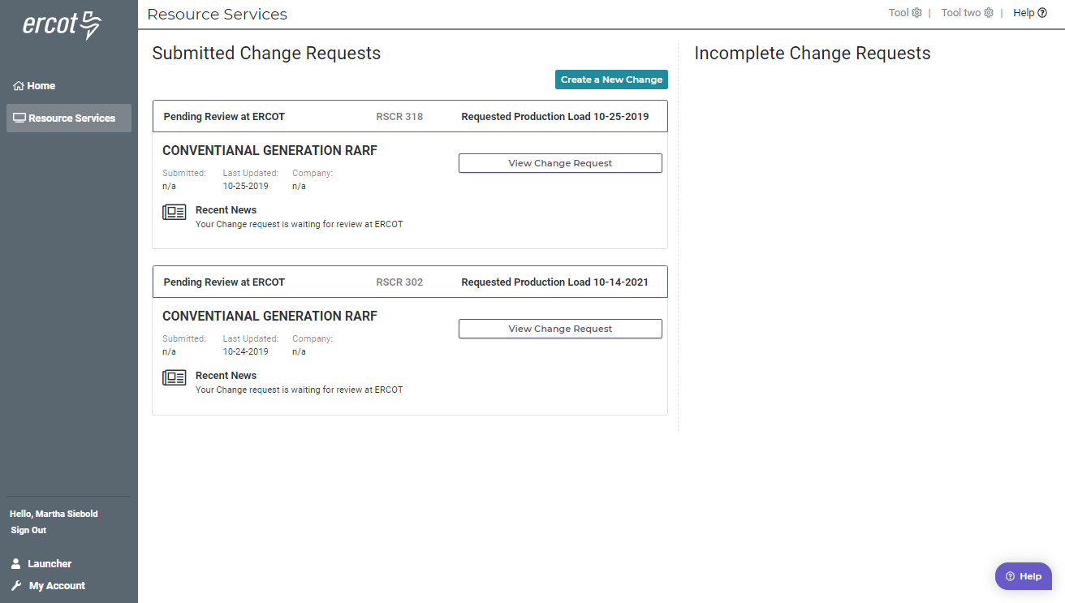
New Change Request Added to Dashboard

Slide 14
Questions?

Slide 15
Mapping Document
What got moved where in RIOO-RS – a spreadsheet
One time effort for ERCOT
Glossary will be updated

Slide 16
Information/Data issues
What’s been found, what may need to be updated:
Connectivity
Data that does not match the updated validation rules; special characters (#, $, *)
ERCOT provided an updated RARF, Delta Report, and Audit Report to the REs in August.
147 of 212 received and processed
65 missing
If the RE agrees with the updated RARF, the RE should submit the RARF to ERCOT.
If the RE does not agree with the changes, the RE should schedule a call with your Client Services Account Manager.
Audit Report may show errors if GIC data has not been submitted or validation rules have been updated.
Model may show that the RE owns equipment, an “ADD” was created, please verify ownership.
Sites may need to be split
Less than 10

Slide 17
Training / Testing Schedule
In person training in Taylor (T4) (no webex)
Schedule will be announced in October
User access will need to be coordinated with MPs USA
RIOO-RS system will be available mid-December - March for training and testing
Verify data
Updates available for most frequently changed items first
Data will be updated and over written with production data on a regular interval
RIOO-RS system will continue to be used January – March with more update capability

Slide 18
What to do in the RIOO Test System
Review your data
Do you see the right substations
More data will be available as time goes on
Create a change request
Submit your change request
Locate your change request on the dashboard and view

Slide 19
Questions?

