Slide 1
Switching Plans &
Conditional Contingency Definitions
Mario Alberto de la Garza
Network Modeling Maintenance Supervisor
10/15/2019

Slide 2
Switching Plans & Conditional Contingency Definitions
Changes In Process
Contingency Stats As Of September 2019
Challenges
Switching Plans & Conditional Contingency Definitions Pilot Project
Switching Plans
How Would SWPs Be Maintained?
How Would SWPs Affect Contingencies?
Example
Pending Items
Long Term Goals
Benefits
Q/A

Slide 3
Changes in Process
Prior to Model Maintenance Taking Over:
  One point of contact.
  Limited visibility to model changes.
Model Maintenance Taking Over:
  Multiple individuals involved.
  Increased visibility due to reviewing each NOMCR individually.

Slide 4
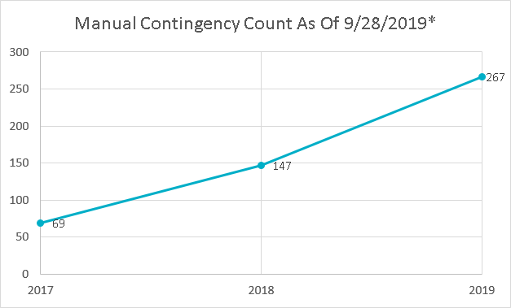
Contingencies Stats as of September 2018
*This include future 2019 Manual Contingencies.

Slide 5
Challenges
Increase in system changes.
  Multiple projects in the pipeline.
  Load growth.
Complex modeling solution to accommodate system changes.

Slide 6
Switching Plans & Conditional Contingency Definitions Pilot Project
Goals:
  Efficient way to maintain “transitional” manual contingencies.
  Reduce amount of CAMRs.
  Improve situational awareness when a “transition” happens in real time.*
  Reduce amount of DPCs.*
Proof of Concept: Switching Plans & Conditional Contingency Definitions (aka CCDs)
* Long term goals.

Slide 7
Switching Plans
What is a Switching Plan (SWPs)?
  A new modeling construct to track “transitional” (pseudo) switches (not an extension).
  Maintainable by TSPs directly.
  SWPs would be Validated by ERCOT.
SWP1
Stage 1
Switch Action 1 - Close
Stage 2
Switch Action 1 - Open
SUBA
SUBC
SUBB
CB1
CB3
CB4
CB2
Line:
A_C_1
Line:
C_B_1
PS (N.C.)

Slide 8
Switching Plans, Con’t
Goal is to capture different stages of a project through the SWP.
  Stage 1 should be “current” configuration.
  Stage 2 should be “future” configuration.
SWP1
Stage 1
Switch Action 1 - Close
Stage 2
Switch Action 1 - Open
SUBA
SUBC
SUBB
CB1
CB3
CB4
CB2
Line:
A_C_1
Line:
C_B_1
PS (N.C.)

Slide 9
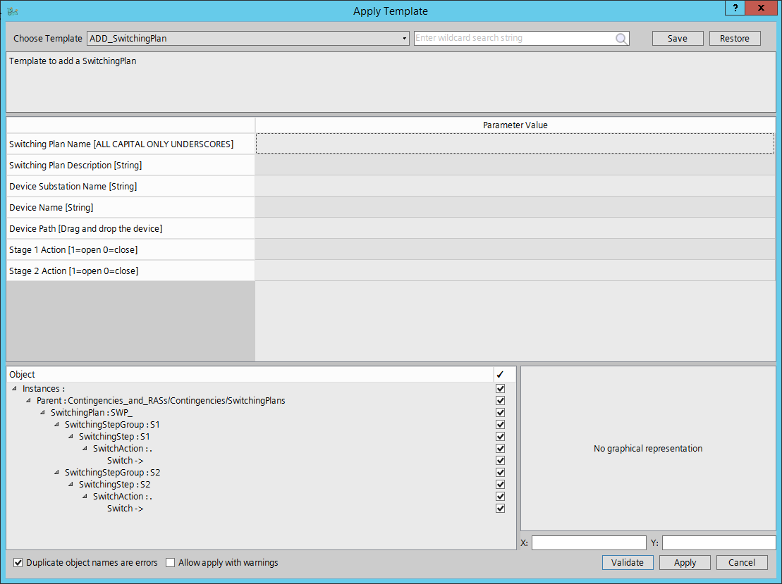
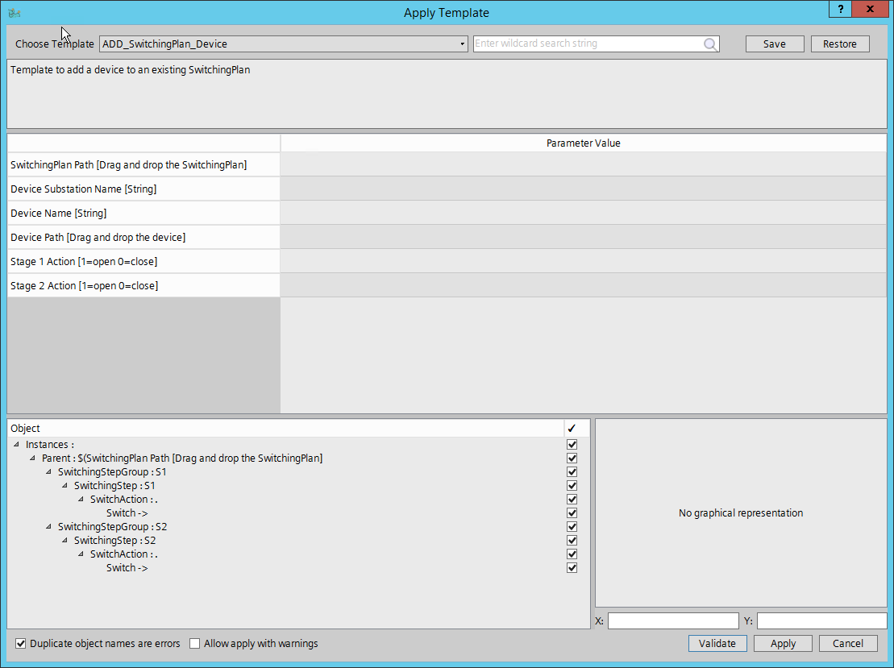
How Would SWPs Be Maintained?
The idea is for TSPs to Maintain their own SWPs.
ERCOT would provide a “directory” in the model which SWPs can be modeled under.
SWPs would be associated to a specific ownership.
Since SWPs would be associated to certain devices, when deleting an associated device the TSP would need to update the SWP(s).

Slide 10
How Would SWPs Affect Contingencies?
The Contingency Maintainer traces contingencies based of modeled statuses of breakers and switches.
CTG ID:
SAB138
SUBA
SUBB
SUBC
CB1
CB3
CB4
CB2
Line:
A_C_1
Line:
C_B_1
PS (N.C.)

Slide 11
How Would SWPs Affect Contingencies? Con’t
When a SWP is associated to a disconnector, the Contingency Maintainer would re-trace the contingencies using the data provided in the SWP stages.
If a Contingency associated to a stage matches an existing contingency, it associates the existing contingency to the stage.
If a Contingency associated to a stage does not match an existing contingency, it creates a Conditional Contingency Definition (aka CCD) and associates the CCD to the stage.

Slide 12
How Would SWPs Affect Contingencies? Con’t
SWP1
Stage 1 Example.
Stage 1
Switch Action 1 - Close
Stage 2
Switch Action 1 - Open
SUBA
CTG ID:
SAB138
SUBB
SUBC
CB1
CB3
CB4
CB2
Line:
A_C_1
Line:
C_B_1
PS (N.C.)*

Slide 13
How Would SWPs Affect Contingencies? Con’t
SWP1
Stage 2 Example.
Stage 1
Switch Action 1 - Close
Stage 2
Switch Action 1 - Open
SUBA
CTG ID:
CAC138
CTG ID:
CCB138
SUBB
SUBC
CB1
CB3
CB4
CB2
Line:
A_C_1
Line:
C_B_1
PS (N.O.)*

Slide 14
Additional Example #1
Stage 1
SWP2
Stage 1
Switch Action 1 - Close
SUBA
SUBB
Switch Action 2 - Close
Switch Action 3 - Open
CB1
PS1 (N.C.)
Line: A_B_1
PS2 (N.C.)
CB2
Switch Action 4 - Open
Line:
A_C_1
Stage 2
CB3
CB4
Line:
C_B_1
Switch Action 1 - Open
PS3 (N.O.)
PS4 (N.O.)
Switch Action 2 - Open
SUBC
Switch Action 3 - Close
Switch Action 4 - Close

Slide 15
Additional Example #1, Con’t
Stage 2
SWP2
Stage 1
Switch Action 1 - Close
SUBA
SUBB
Switch Action 2 - Close
Switch Action 3 - Open
CB1
PS1 (N.C.)
Line: A_B_1
PS2 (N.C.)
CB2
Switch Action 4 - Open
Line:
A_C_1
Stage 2
CB3
CB4
Line:
C_B_1
Switch Action 1 - Open
PS3 (N.O.)
PS4 (N.O.)
Switch Action 2 - Open
SUBC
Switch Action 3 - Close
Switch Action 4 - Close

Slide 16
Additional Example #1, Con’t
Auto-traced Contingencies, same as Stage 1 Contingencies.
SWP2
CTG ID:
SAB138
SUBA
SUBB
Stage 1
Switch Action 1 - Close
CB1
PS1 (N.C.)
Line: A_B_1
PS2 (N.C.)
CB2
Switch Action 2 - Close
Switch Action 3 - Open
Line:
A_C_1
CB3
CB4
Line:
C_B_1
Switch Action 4 - Open
PS3 (N.O.)
PS4 (N.O.)
SUBC
CTG ID:
SAC138
CTG ID:
SCB138

Slide 17
Additional Example #1, Con’t
Stage 2
SWP2
SUBA
CTG ID:
CAB138
SUBB
Stage 2
CB1
PS1 (N.O.)
PS2 (N.O.)
CB2
Switch Action 1 - Open
Line: A_B_1
Switch Action 2 - Open
Switch Action 3 - Close
Line:
A_C_1
CB3
CB4
Line:
C_B_1
Switch Action 4 - Close
PS3 (N.C.)
PS4 (N.C.)
SUBC
CTG ID:
CAC138
CTG ID:
CCB138

Slide 18
Pending Items
Testing Needed.
  Model Building.
  Contingency Maintainer.
  Other applications.
Double-Element Contingencies.

Slide 19
Long Term Goals
All the items below are part of a long wish list of how SWPs and CCDs should be utilized.
Integrate SWPs into ERCOT’s EMS.
  Develop messaging schemes for notification.
  Pre-CA SWP contingency validation.
Utilize TSPs telemetry to trigger SWP’s stages in real time.
Utilize TSPs outages to trigger SWP’s stages in the long term horizon studies.

Slide 20
Benefits
Improved process to manage contingencies.
Alleviates manual process.
Speeds up modeling process.
  Reduction of number of CAMRs.
  Reduction of number of Manual Contingencies.
Situational awareness improvements.*
Potential reduction of DPCs.*
*Based off long term goal.

Slide 21

Questions?

