Slide 1
CRR Transaction Adjustment Period
Donald House
Supervisor, Congestion Revenue Rights
CMWG
October 29, 2019

Slide 2
CRR transaction adjustment period
Transaction adjustment period needed for the 2020.1st6.AnnualAuction.Seq1 CRR Auction (October 17 – 18, 2019)
1st time since October 2011 (2012.AnnualAuction.Y1)
What is a transaction adjustment period?
How is it triggered?
How is it handled?
How is it communicated?
Could it have been avoided?

Slide 3
What is a CRR auction transaction?
Each buy bid or sell offer in an auction counts as 1 transaction
Existing baseload CRRs also take up available transactions
Baseload CRRs are grouped by the same source/sink path, Time Of Use (TOU), and effective dates, to maximize the number of available transactions
Each auction has a total transaction limit of 300,000

Slide 4
What is a participating CRR Account Holder?
A participating CRR Account Holder is any Account Holder that either owns baseload CRRs for the auction period or who has credit allocated to the auction by their Counter-Party
Only participating CRR Account Holders can submit transactions during a transaction adjustment period

Slide 5
What triggers a transaction adjustment period?
It is triggered if the total number of transactions submitted into an auction plus the number of grouped baseload transactions existing for the auction period exceeds the 300,000 transaction limit

Slide 6
What were the exact transaction numbers in this auction?
Transactions submitted into auction = 276,931
Total grouped baseload CRRs = 28,901
Total transactions (submitted + baseload) = 305,832
Participating CRR Account Holders = 199

Slide 7
How is the transaction adjustment period per Account Holder bid limit calculated?
(auction transaction limit – # of grouped baseload CRRs) # of participating CRR Account Holders
(300,000 – 28,901)/199 = 1,362
So, each participating CRR Account Holder was limited to 1,362 transactions for the transaction adjustment period instead of 4,000 transactions

Slide 8
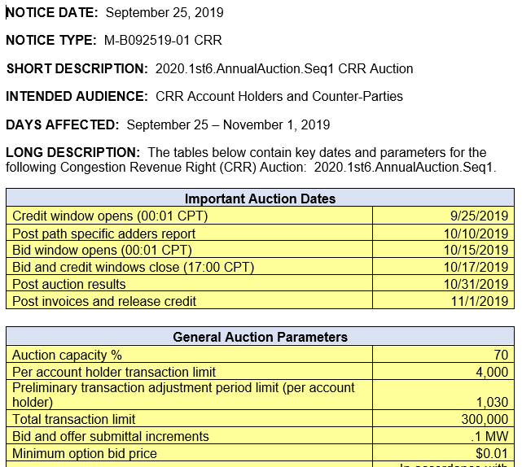
How is the transaction adjustment period per Account Holder bid limit calculated?
A preliminary transaction adjustment period limit is included on each auction notice, using all qualified Account Holders as possible participants (preliminary limit for this auction was 1,030)

Slide 9
What happens during a transaction adjustment period?
After the close of the initial auction bid window, any CRR Account Holder who submitted more total transactions than the calculated transaction adjustment period bid limit has all of their submittals removed
These impacted Account Holders must reduce and re-submit their transactions, not to exceed the transaction adjustment period bid limit

Slide 10
What happens during a transaction adjustment period?
Account Holders who did not have their transactions removed do not need to take any action
However, they can still adjust their transactions but cannot exceed the transaction adjustment period bid limit

Slide 11
Can allocated credit be changed during a transaction adjustment period?
The credit window does not reopen, and the allocated credit cannot be changed
If the credit window were reopened, CRR Account Holders who did not previously have credit allocated by their Counter-Party would be able to submit credit
This would change the number of participating account holders, which could lead to exceeding the total transaction limit again
The CRR application cannot block any qualified Counter-Parties from submitting credit during an open credit window

Slide 12
How does ERCOT communicate that a transaction adjustment period is needed?
Per Protocol 7.5.2(2)(d), within one hour after the close of each CRR Auction, ERCOT shall notify all CRR Account Holders of the total number of transactions submitted by all Participating CRR Account Holders and whether or not a transaction adjustment period is necessary

Slide 13
How does ERCOT communicate that a transaction adjustment period is needed?
The notification is posted on the CRR Market User Interface (MUI) as an operator message approximately 1 minute after the bid window is closed
If a transaction adjustment period is necessary, the posted message includes the new per Account Holder transaction limit and notes that portfolios will be removed for Account Holders who exceeded that limit

Slide 14
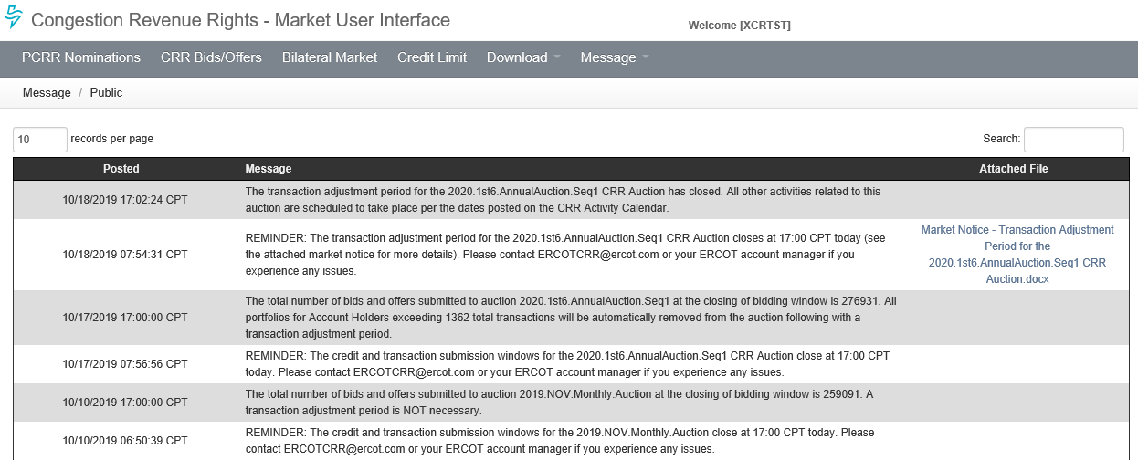
How does ERCOT communicate that a transaction adjustment period is needed?

Slide 15
How does ERCOT communicate that a transaction adjustment period is needed?
Private operator messages are posted to the MUI to all Account Holders who had their portfolios removed

Slide 16
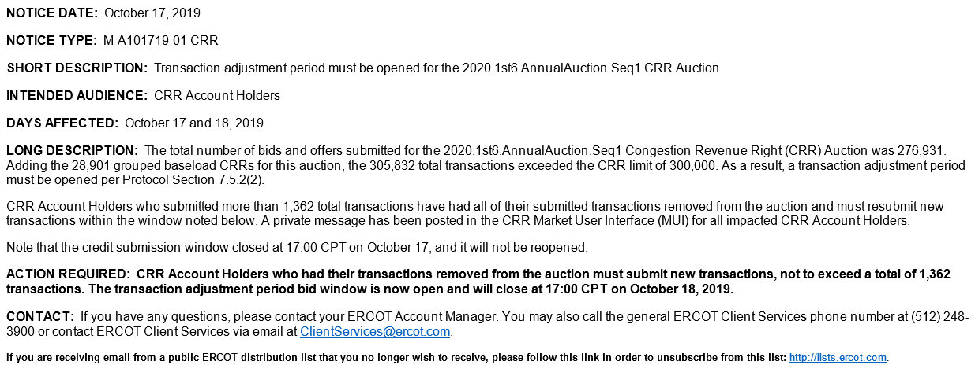
How does ERCOT communicate that a transaction adjustment period is needed?
In addition to the MUI operator messages, a market notice is sent

Slide 17
What impact did the transaction adjustment period have on this auction?
In general, for any transaction adjustment period, we expect the final number of transactions submitted to be less than the total limit
Some of the participating CRR Account Holders may choose not to submit any transactions
Many CRR Account Holders choose not to submit their maximum number of transactions
Auction results will be posted on Thursday, October 31
Further discussion of specific auction impacts should not occur until after the results are posted

Slide 18
Was exceeding the 300,000 transaction limit unexpected?
Over the last 2.5 years, the number of qualified CRR Account Holders has grown from about 210 to about 265
There has been a steady increase in the number of transactions submitted for both monthly and long-term auctions, and both have consistently been near or above 200,000 for the last year
However, this auction had about 35,000 more transactions submitted than any previous long-term auction

Slide 19
How can this be avoided in future auctions?
In September, ERCOT submitted NPRR972, Enhancing Existing CRR Transaction Limit Process
This NPPR is intended to make a transaction adjustment period much less likely for long-term auctions by giving ERCOT discretion to determine that a transaction adjustment period is not necessary if the transactions submitted can be processed by the CRR auction engine

Slide 20
How can this be avoided in future auctions?
Long-term auctions are optimized as three separate TOUs, so the 300,000 total transaction limit could be applied to each TOU instead of to the entire auction
Current CRR software is not designed to handle this, but CRR market operator discretion is a no-cost solution

Slide 21
Would NPRR972 have helped for this auction?
Yes – no individual TOU exceeded 110,000 submitted transactions, so there would have been no need for a transaction adjustment period
While ERCOT believed that NPRR972 was submitted soon enough to avoid an unnecessary transaction adjustment period in a long-term auction, the increase of 35,000 submitted transactions into this auction resulted in a transaction adjustment period quicker than anticipated

Slide 22
Would NPRR972 help for monthly auctions?
No, because all 3 TOUs are optimized together in monthly auctions
Allow 24-hour bids
The existing grouped baseload for monthly auctions is generally around 9,000 CRRs, so it would take about 291,000 submitted transactions to trigger a transaction adjustment period
Note that the grouped baseload amount for long-term auctions is generally greater than for monthly auctions, because they account for 6 months of CRRs and baseload grows from SEQ6 to SEQ1
The 2019.NOV.Monthly.Auction had 259,091 transactions submitted, which was nearly 23,000 more transactions than we have ever seen for a monthly auction

Slide 23
What are other options to reduce the likelihood of future transaction adjustment periods?
Helps only for long-term auctions:
Change the CRR software to require long-term auction transactions to be submitted by TOU (would enable tracking limits by TOU)
Helps for both monthly and long-term auctions:
Increase the total transaction limit above 300,000
The increase from 200,000 to 300,000 occurred in June 2015 with SCR779
Would require another SCR to change the total transaction limit
Must verify that the CRR engine can handle more transactions
Reduce the per Account Holder transaction limits
Currently 4,000 for long-term auctions and 10,000 for monthly auctions
Note that NPRR936, CRR Account Holder Limits, will move the limits from the Account Holder to the Counter-Party (implementation date is unknown)
12,000 for long-term auctions and 30,000 for monthly auctions
Would only require TAC approval to change these limits

Slide 24
Questions for further discussion?

