Slide 1
ERS Deployment and Performance Review for August 13th and 15th
ERCOT Staff
October 22, 2019

Slide 2
ERS10 Deployment on August 13th
On August 13th ERS10 was improperly deployed by VDI from ERCOT.
ERS10 can only be deployed when ERCOT is in EEAL2 or EEAL3 conditions as per NP 6.5.9.4.2(2)(a)(iii) & 6.5.9.4.2(3)(b)
Even though improperly deployed ERS10 deployment may be included in other presentations for the purpose of better understanding the behavior of ERS resources prior to, during , and immediately following an event.
Slides including the response from ERS-30 & ERS-10 are available in the appendix at the end of this slide deck
Resource and QSE performance pertaining to ERS10 will not be measured.

Slide 3
August 13th ERS Deployment
Total deployment time:
NWS ERS-30 & WS ERS-30_ TP 3 & 4 |  | 0:23:05
ERS-30_TP3 only |  | 0:04:36

Slide 4
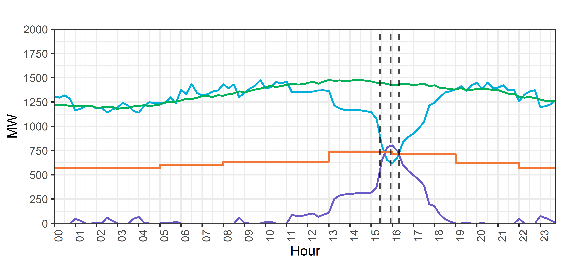
August 13th, 2019 ERS Fleet Deployment (NWS-30, WS-30)
Deployment Instruction
Start Sustained
Response Period
Recall Instruction

Slide 5
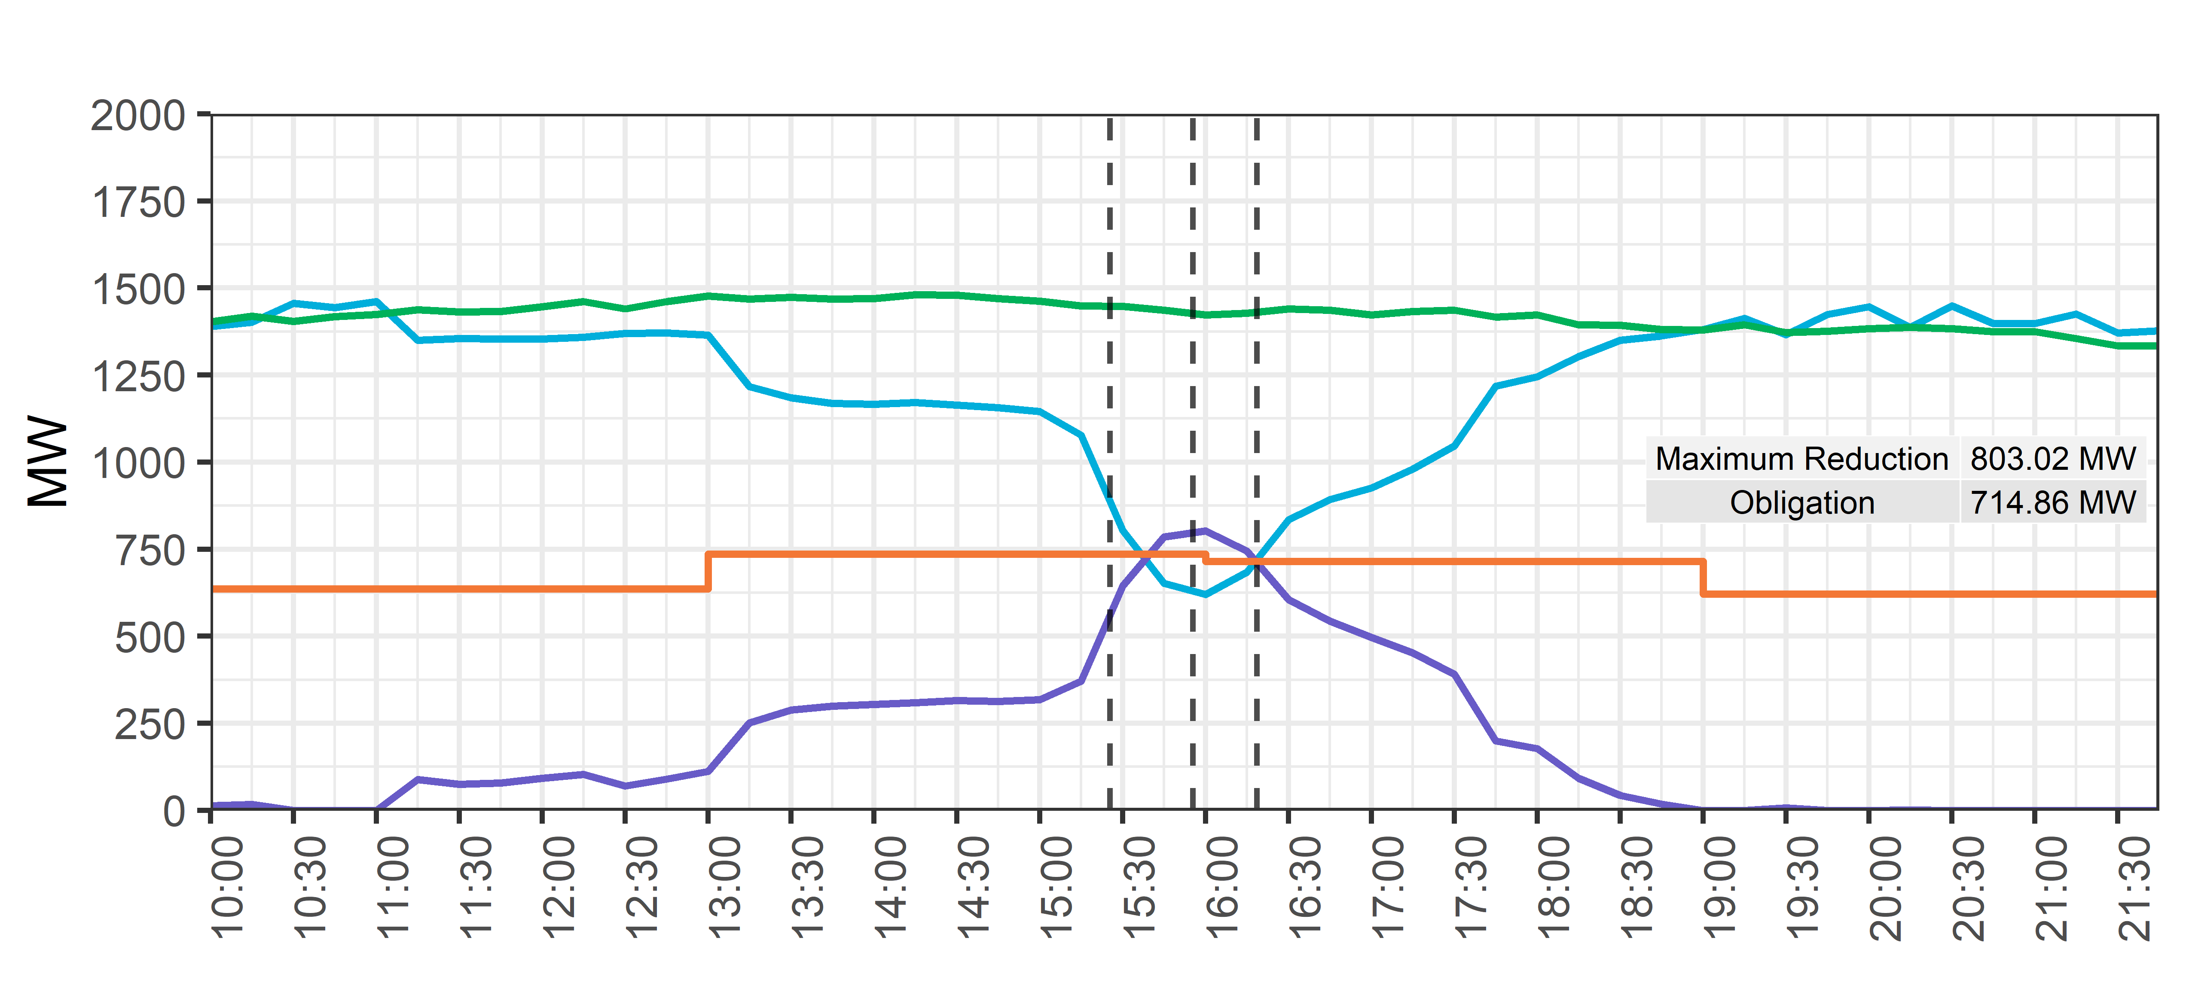
August 13th, 2019 ERS Fleet Deployment (NWS-30, WS-30)
Start Sustained
Response Period
12% peak
overprovision
Deployment Instruction
Recall Instruction
Interval Beginning 16:00 (TP4)

Slide 6
August 15th ERS Deployment
Total deployment time:
NWS ERS-30 & WS ERS-30_ TP 3 & 4 |  | 1:12:25
ERS-30_TP3 only |  | 0:16:36
ERS-30_TP 4 only |  | 0:21:56

Slide 7
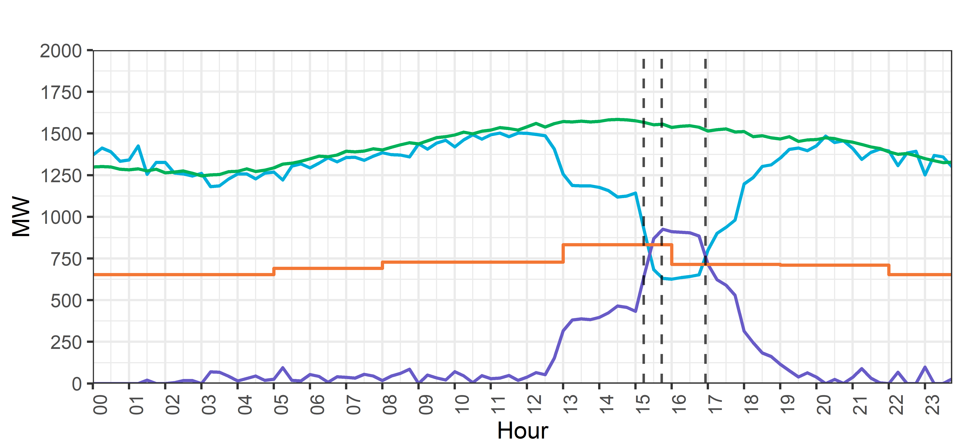
August 15th, 2019 ERS Fleet Deployment (NWS-30, WS-30)
Start Sustained
Response Period
Deployment Instruction
Recall Instruction

Slide 8
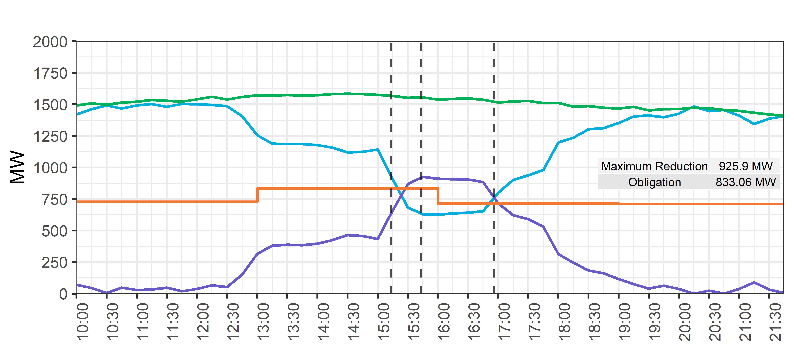
August 15th, 2019 ERS Fleet Deployment (NWS-30, WS-30)
Start Sustained
Response Period
Deployment Instruction
Recall Instruction
Interval Beginning 15:45 (TP3)
11% peak
overprovision

Slide 9
ERS Deployment on August 13, and August 15
QSE & Resource Level Events posted to MIS
1 QSE failed August 15th event
Next Steps for Jun-Sept 2019 SCT
Prior to November 14, 2019 ERCOT will provide for review
QSE Level Event Performance Standard Contract Term for review
Resource and QSE Level Availability for the SCT

Slide 10
Impacts of the August deployments on the October19January20 SCT
If a Resource passed either event, they are not subject to testing for 330 days unless they fail Availability
Test list sent out to QSEs

Slide 11
Issues that have been raised
Considerable load reduction from the ERS Resources prior to ERS deployment. Is this acceptable?
Re-evaluate the 10 hour recovery time and its impact on the Reliability Deployment Price Adder (NPRR626).
TP3 &TP4 straddle summer peak hours.

Slide 12
Appendix

Slide 13
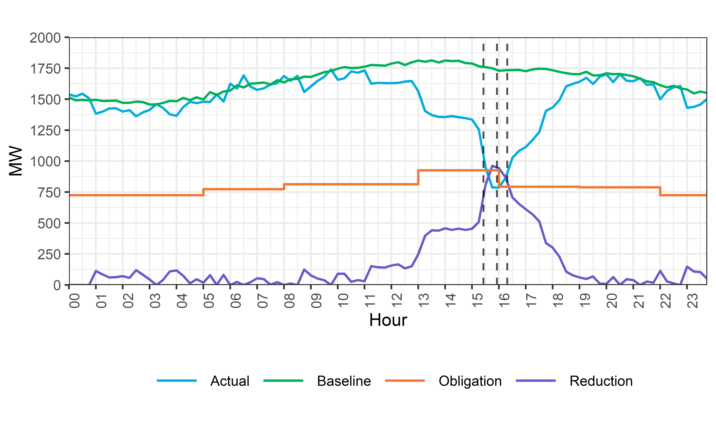
August 13th, 2019 ERS Fleet Deployment (Entire Day View)
Start Sustained
Response Period
Deployment Instruction
Recall Instruction
Includes NWS30, WS30 & NWS10 deployment

Slide 14
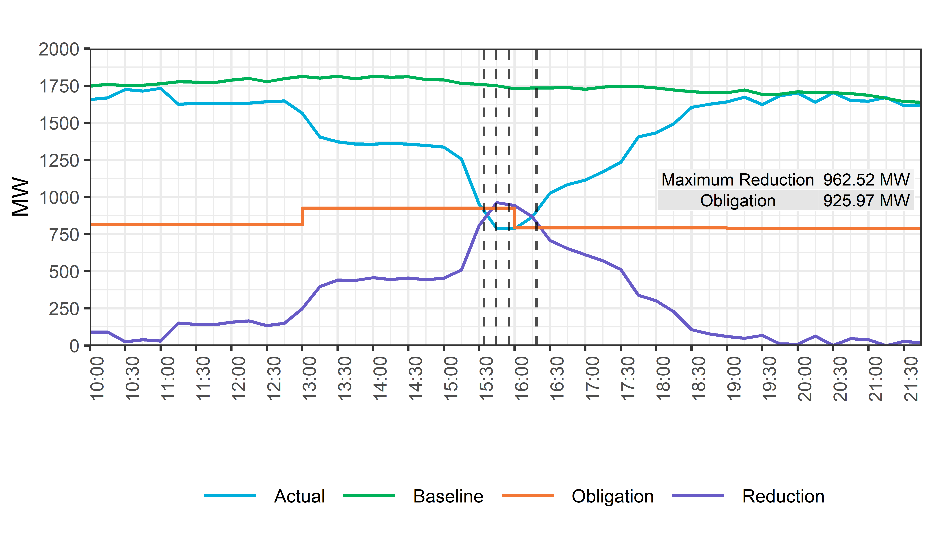
August 13th, 2019 ERS Fleet Deployment (NWS-30, WS-30, NWS- 10)
ERS-10* Start
Sustained
Response Period
ERS-30 Start
Sustained
Response Period
Recall
ERS-10
Recall
ERS-30
Note: For clarity, only start times for sustained response period are plotted
* ERS-10 was deployed improperly

Slide 15
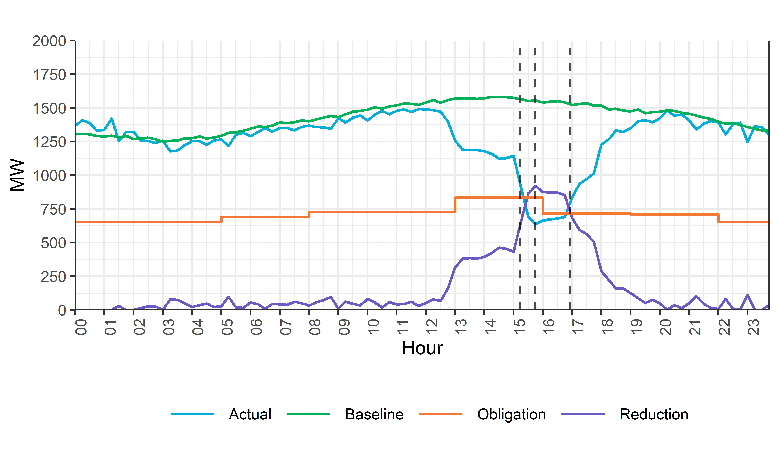
August 15th, 2019 ERS Fleet Deployment* (Entire Day View)
Start Sustained
Response Period
Deployment Instruction
Recall Instruction
Weather Sensitive and Non-Weather Sensitive ERS-30 Deployed

Slide 16
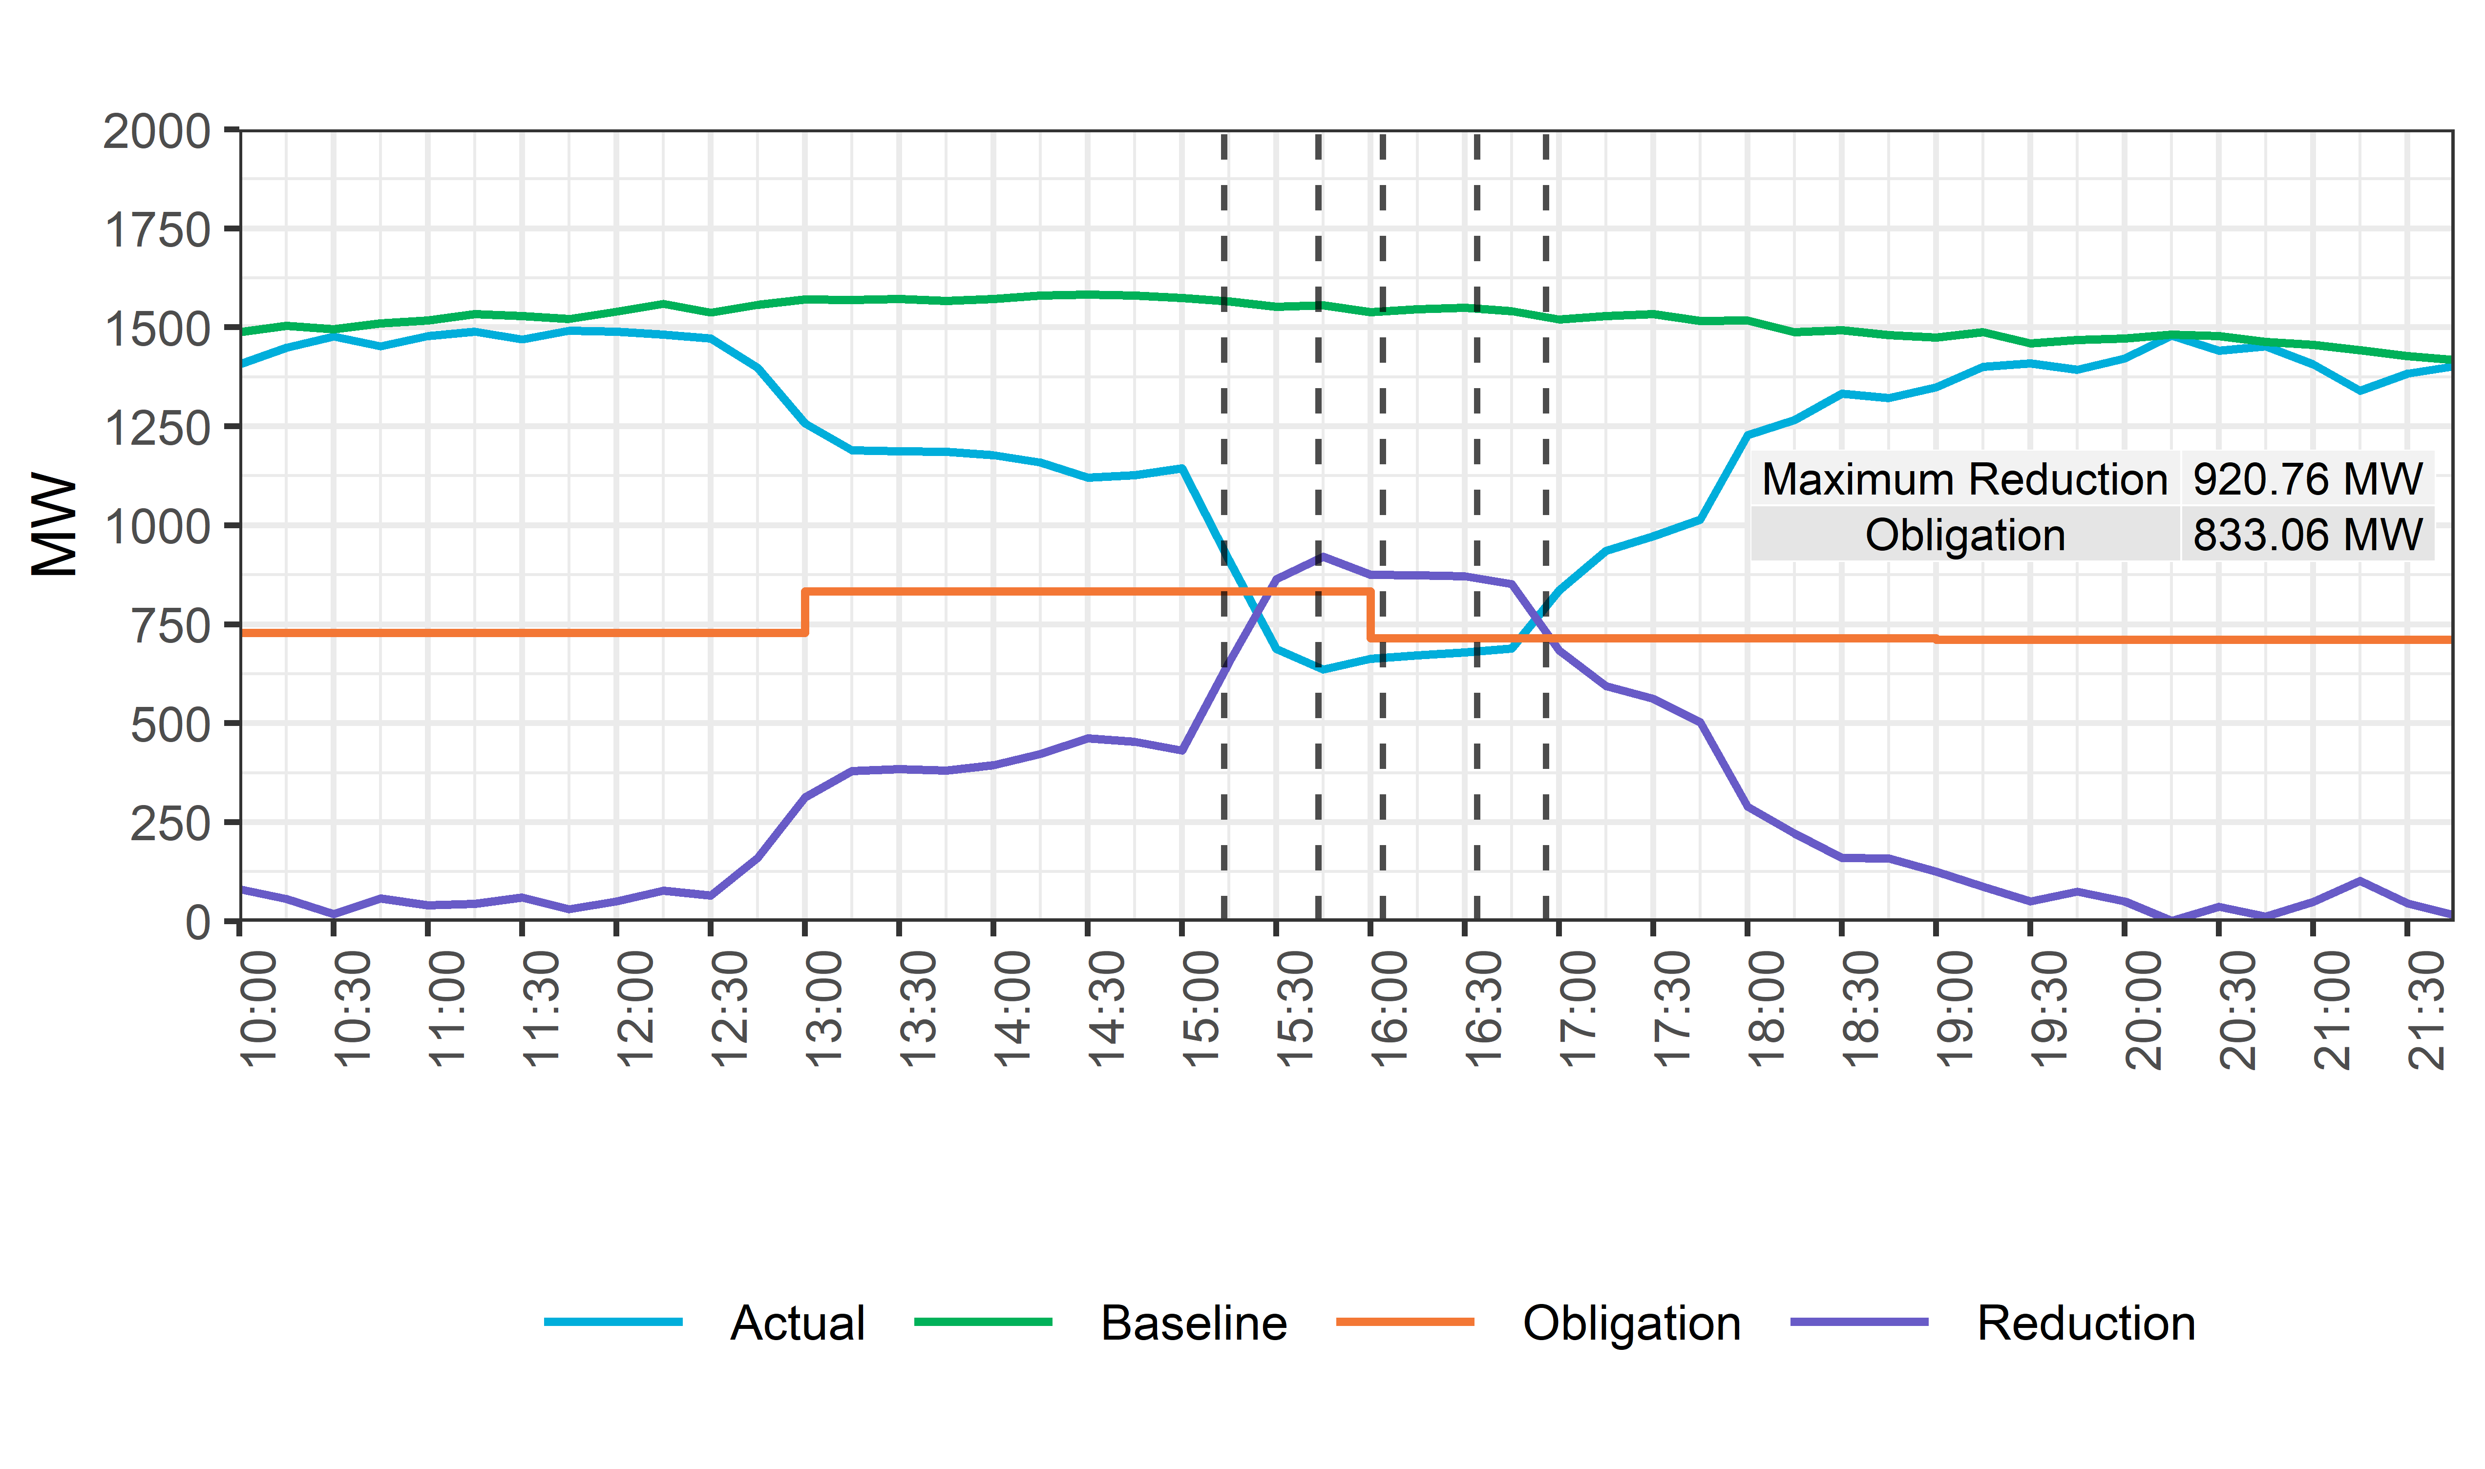
August 15th, 2019 ERS Fleet Deployment (NWS-30, WS-30)
Deployed
ERS-30 (TP3)
ERS-30 TP3
Start Sustained
Response Period
Deployed
ERS-30* (TP4)
ERS-30 TP4
Start Sustained
Response Period
Recalled ERS-30
*An additional 0.1 MW of ERS-30 deployed (Time Period 4)

