Slide 1
Credit Exposure Update
Spoorthy Papudesi
Credit Work Group
ERCOT Public
October 17, 2019

Slide 2
Monthly Highlights Aug 2019- Sep 2019
Market-wide average TPE increased from $ 1,020.1 million to $ 1,441.1 million
The increase in TPE is due to relatively high ERCOT Real Time and Day Ahead prices during August 2019
Discretionary Collateral is defined as Secured Collateral in excess of TPE,CRR Locked ACL and DAM Exposure.
Average Discretionary Collateral decreased from $ 1,730.5 million to $1,627.8 million
The decrease in Discretionary Collateral is largely due to increase in TPE
Number of active Counter-Parties increased from 241 to 242
21 collateral calls on September 5th, 2019

Slide 3
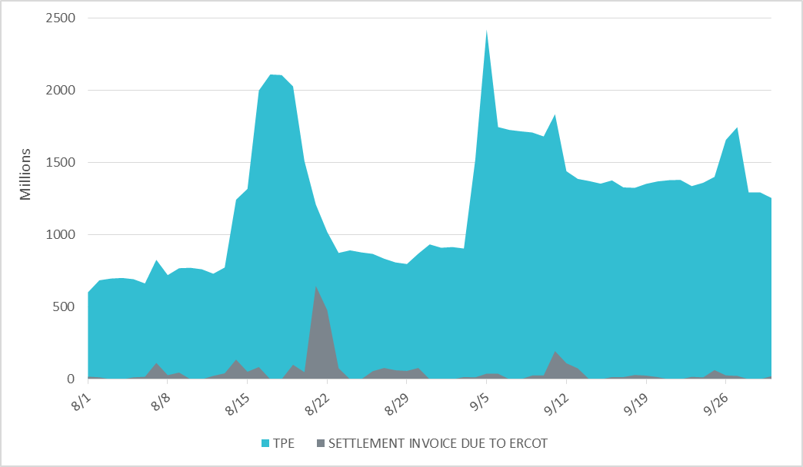
Settlement Invoice Charges/TPE Aug 2019- Sep 2019

Slide 4
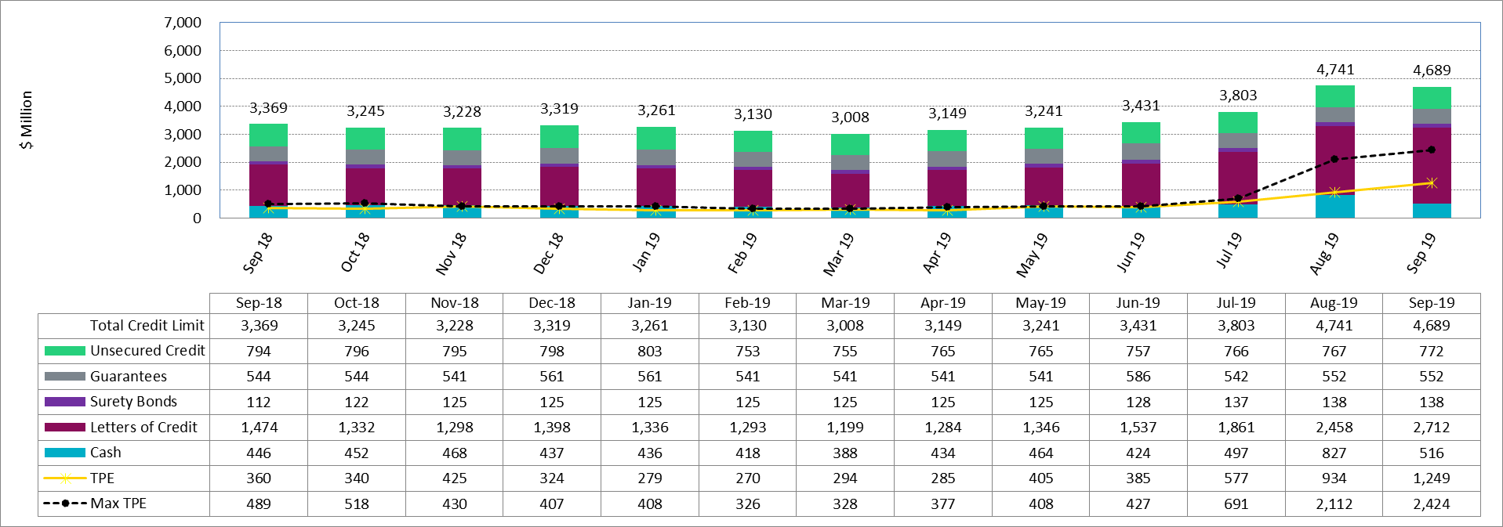
Available Credit by Type Compared to Total Potential Exposure (TPE)
*Numbers are as of month end except for Max TPE

Slide 5
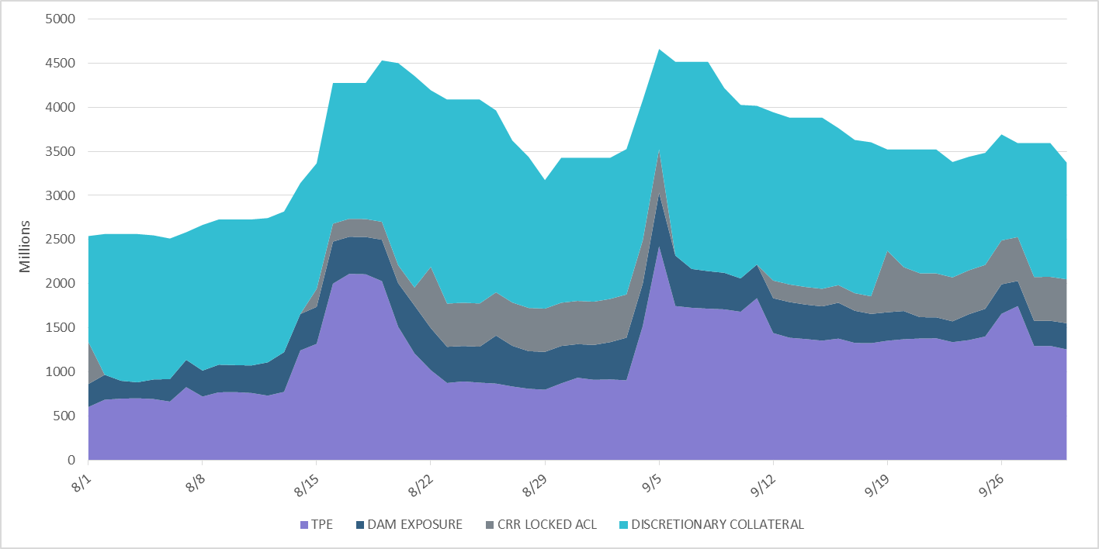
Discretionary Collateral Aug 2019- Sep 2019
At a Counter-Party level, no unusual changes were noted
Note: Discretionary collateral doesn’t include Unsecured Credit Limit or parent guarantees

Slide 6
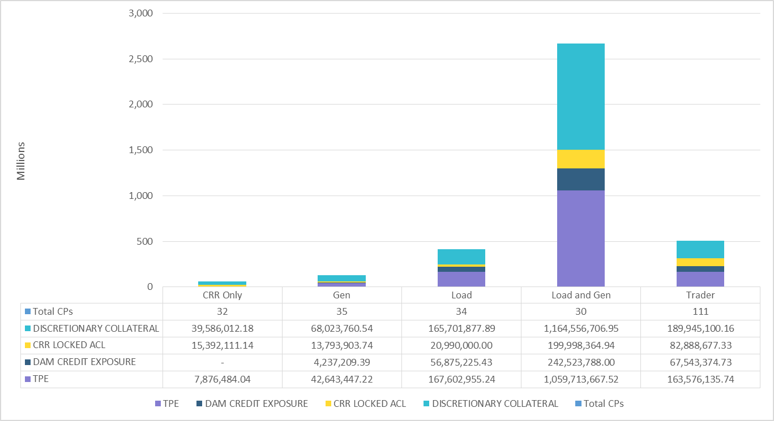
TPE and Discretionary Collateral by Market Segment- Sep 2019
Load and Generation entities accounted for the largest portion of discretionary collateral

Slide 7
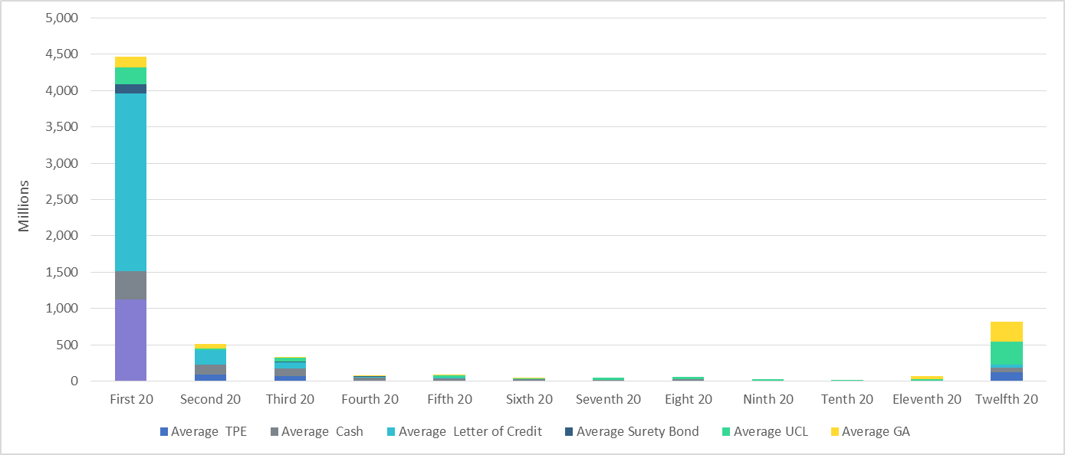
Secured Collateral and Unsecured Credit Limit (UCL) distribution/ TPE- Sep 2019
TPE in the last bucket is mostly covered by Guarantees and UCL

Slide 8
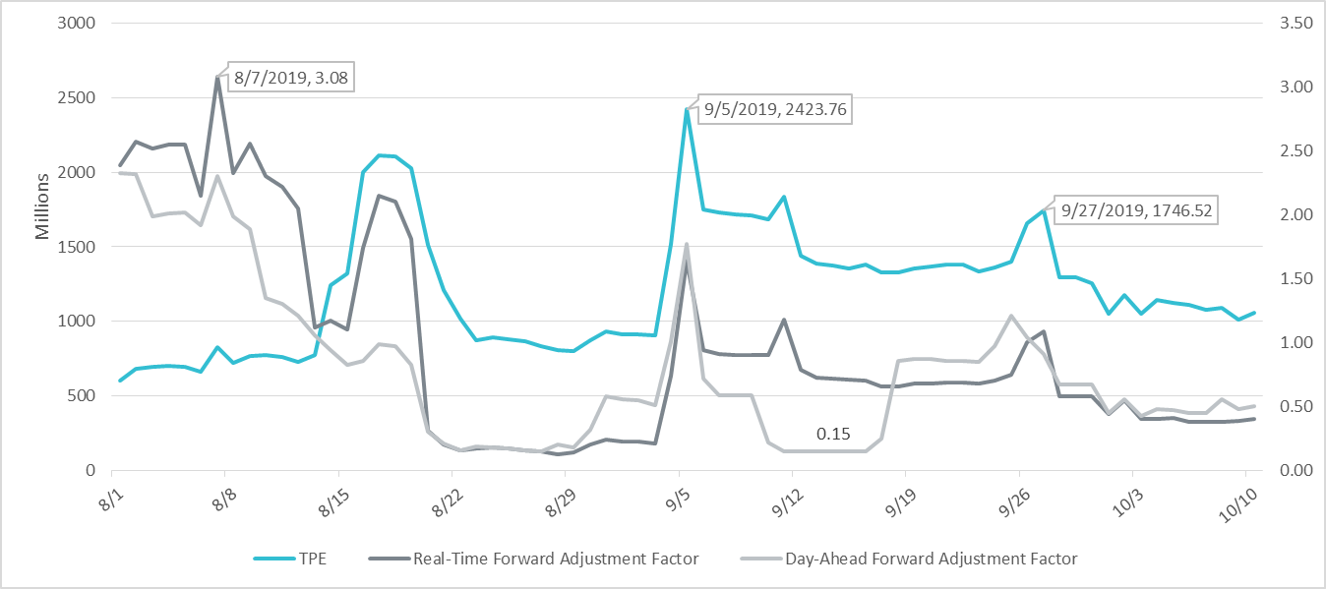
TPE and Forward Adjustment Factors Aug 2019- Oct 2019
TPE moved in conjunction with forward adjustment factors
The Real-Time (RFAF) and Day-Ahead (DFAF) forward adjustment factors capture the ratio of forward ERCOT North prices to actual prices.

Slide 9
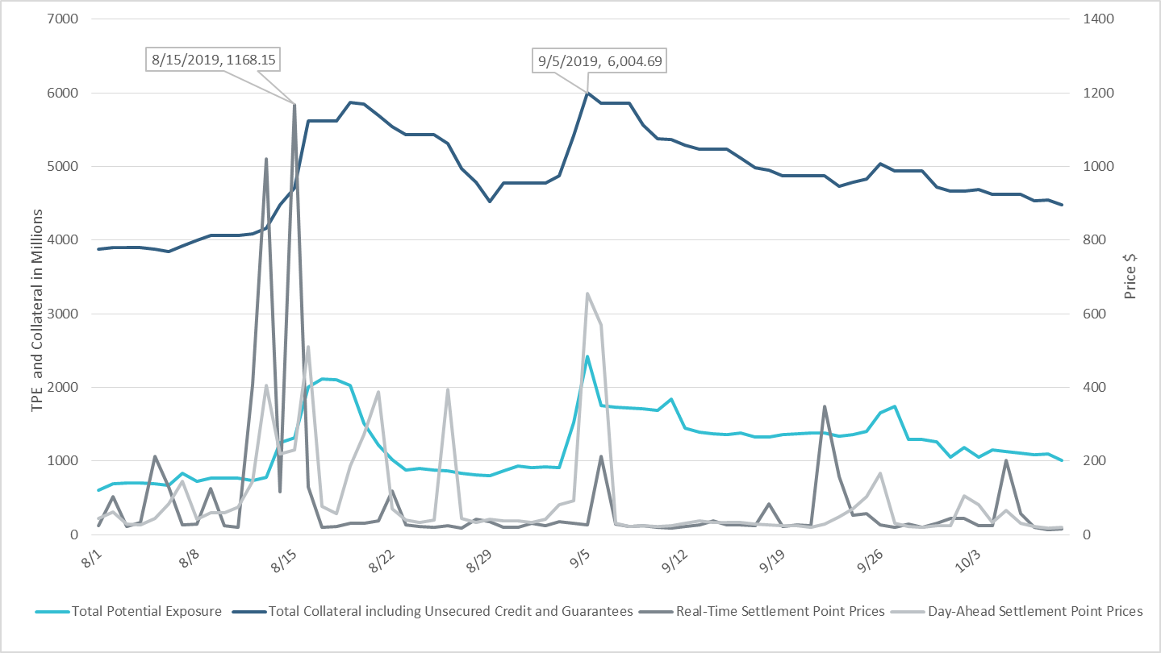
TPE/Collateral/RT & DA Settlement Point Prices for HB_NORTH Aug 2019- Oct 2019

Slide 10
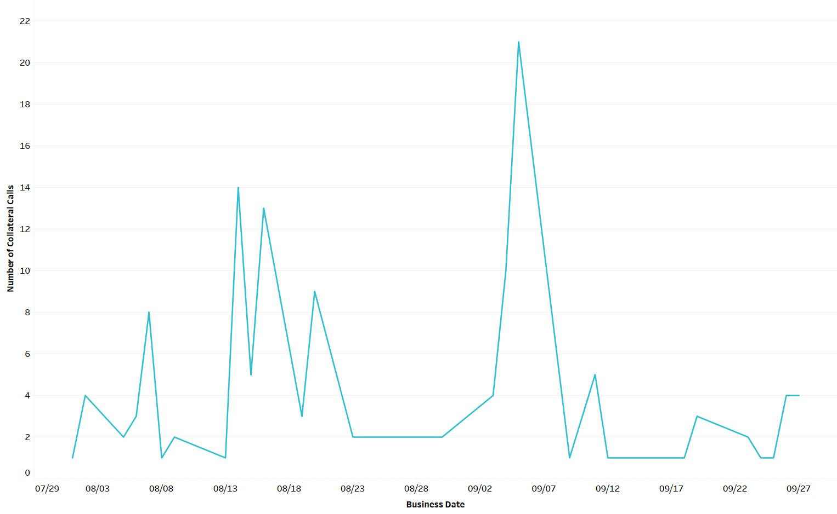
Collateral Calls Aug 2019- Sep 2019

Slide 11
Appendix

Slide 12
Summary of Distribution by Market Segment

Slide 13
Summary of Distribution by Rating Group

Slide 14
Distribution of TPE by Rating and Category

Slide 15
Distribution of Excess Collateral by Rating and Category
Note: Excess collateral doesn’t include Unsecured Credit Limit

Slide 16
Bottom Quintile Distribution of Excess Collateral by Rating and Category

Slide 17
Bottom Quintile Distribution of Average TPE by Rating and Category

Slide 18
Questions

