Slide 1
Single Energy Storage Resource Model Overview
and
Hybrid Resource - Questions/Challenges
Sai Moorty
Principal, Market Design and Analysis
October 18, 2019

Slide 2
Single Energy Storage Resource (ESR) Model : Drivers
Current “Combo” (GR+CLR) model approach for a ESR is working acceptably for the limited numbers registered with ERCOT
With the anticipated increased number of ESR (and increasing energy storage capacity- MWh), the continuation of the use of the “Combo” model eventually will prove inadequate and cumbersome
The EMS vendor has implemented a simple version of a single ESR model in the next version that ERCOT is upgrading to (EMS upgrade project)
ERCOT plans to implement in phases a single ESR model and use this model where applicable (e.g. Li-Ion Battery Storage Resources)
  Phase 1: Implemented with the EMS upgrade + RTC Project
    Single device without consideration of state of charge in applications (DAM, RUC, RTC)
    Like today, QSEs representing Storage Resources have the responsibility of maintaining state of charge and providing accurate telemetry/COP information of limits (HSL, LSL) and AS capability
  Phase 2: Implemented after EMS upgrade + RTC project
    Single device with consideration of state of charge limits in applications (DAM, RUC, RTC) [Subject to Stakeholder discussion]
    ERCOT has presented a preliminary “end-state” concept of the single ESR model that includes consideration of state of charge (MWh) limits
http://www.ercot.com/content/wcm/key_documents_lists/176495/Proposed_BESR_model_for_SCED.docx

Slide 3
Characteristics of a Single ESR Model (Phase 1)
ERCOT market systems will not consider State of Charge (SOC) related telemetry
  No State of Charge Management in DAM, RUC, Real-Time market
SOC related telemetry by QSE will be used for: :
  PRC calculation
  To increase situational awareness
Physically a single device with one electrical pathway to the modeled electrical network
  The charging and discharging electrical path is the same
Limited energy storage capability (<= 24 hours). This implies that the ESR cannot discharge continuously at its rated MW for 24 hours.
Does not have temporal constraints (StartTime, MinUpTime, MinDownTime, etc.) and does not have transition times between charging and discharging
Does not have startup, shutdown and transition costs
Can smoothly transition from charging to discharging and vice-versa and there is no dead band around 0 MW
All data inputs are measured at the Point of Interconnection (POI) or Point of Common Coupling (PCC)
Single price curve from charging (Bid-To-Buy) to discharging (Offer-To-Sell) that is monotonically non-decreasing as the MW quantity increases; i.e., the single submitted price curve covers both the charging and discharging MW range

Slide 4
Characteristics of a Single ESR Model
ESR Status will be ON, ONXX, OFF, or OUT. This statement reflects current thinking that new statuses are NOT required
With the above characteristics, MMS modeling/calculations for ESRs become a dispatch problem for Real-Time (SCED), DAM and RUC processes.
An ESR will be settled at a Nodal price for both charging and discharging.
QSE responsible for maintaining state of charge (MWh) and reflecting energy capability to ERCOT via telemetry, COP, etc.

Slide 5
ESR: Combo Model
QSE responsibility for managing State of Charge by changing ESR-GR (HSL,LSL) and ESR-CLR (MPC,LPC) telemetry
ESR Generation Resource Telemetry
Resource Status (ON,OFF,OUT,etc.)
Gross MW
Gross MVAr
Net MW
Net MVar
HSL
LSL
HEL
LEL
AS MW Responsibility
AS MW Schedule
ESR Controllable Load Resource Telemetry
Resource Status (ONCLR, OUTL)
Net MW consumption
Net MVar
MPC
LPC
AS MW Responsibility
AS MW Schedule
10MW
HSL
Breaker
GR
GR-MW=BP+AS Deployed
Meter
Resource Node
LSL=0 MW
CLR-MW=BP+AS Deployed
Pseudo
Switch
LPC=0 MW
Pseudo
Switch
CLR
MPC
ESR-GR
ESR-CLR
ESR State Of Charge (SOC) Telemetry
SOC (MWHr)
MaxLimitSOC (MWHr)
MinLimitSOC (MWHr)
MaxDisRate (MW)
MaxChgRate (MW)
10MW
Empty
Full
MWHr

Slide 6
ESR: Single Model
QSE responsibility for managing State of Charge by changing ESR (HSL,LSL) telemetry
ESR Telemetry
Resource Status (ON,OFF,OUT,etc.)
Gross MW
Gross MVAr
Net MW
Net MVar
HSL
LSL (can be negative)
10MW
HSL
Breaker
MW=BP+AS Deployed
Meter
0 MW
Resource Node
ESR
+
ESR
-
LSL (can be negative)
ESR State Of Charge (SOC) Telemetry
SOC (MWHr)
MaxLimitSOC (MWHr)
MinLimitSOC (MWHr)
MaxDisRate (MW)
MaxChgRate (MW)
-10MW
Empty
Full
MWHr

Slide 7
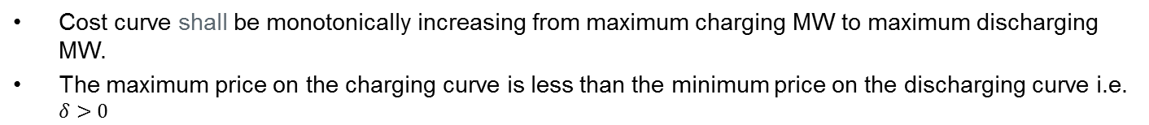

Single ESR Model: Energy Incremental Cost Curve
Cost curve shall be monotonically increasing from maximum charging MW to maximum discharging MW.
The maximum price on the charging curve is less than the minimum price on the discharging curve i.e. $δ>0$
Single ESR Model
Combo ESR Model
$/MWh
$/MWh
$100/MWh
ESR-GR EOC
$100/MWh
$$δ>0$$
$4/MWh
Discharging MW (+ve)
Charging MW (-ve)
Discharging MW (+ve)
$/MWh
ESR-CLR RTM Bid
$4/MWh
Charging MW (+ve)

Slide 8
Combo Model Enhancements Applicable to Single Device Model
Improvements to the use of the “Combo” model in current systems will be incorporated, if applicable:
  PRC Calculation considering State of Charge (RTOLCAP calc. changes does not carry over when RTC goes live)
  Mitigation changes
  Allowing updates to EOC closer to Real-Time
  Applicable changes to RUC to consider limited energy storage capacity of Storage Resources
  Nodal price settlement for both charging and discharging, regardless of whether Storage Resource has WSL treatment or not
  Reactive Capability (4 quadrant) and Voltage Support Service
  Voltage/Frequency Ride-through requirements
  Uniform Governor Deadband and Droop setting requirements from charging to discharging
  Energy Storage Resource Performance Deployment (ESRDP)

Slide 9
Hybrid Resource - Questions/Challenges

Slide 10
Overview of different flavors of “Hybrid Resources”
Battery and GT
  Enhance GTs capability to provide RRS and Regulation with and without increasing Generation site net export capability
Battery and Solar (individual components AC-coupled to grid)
Battery and Solar (DC-coupled), [One bi-directional inverter for both the battery and Solar array]
Battery, Solar and Wind

Slide 11
AC Coupled Resource (Solar + Battery)
Resource Node
BKR-1
BKR-3
BKR-5
Rest of Grid
BKR-6
Meter
BKR-2
BKR-4
BKR-7
BKR-8
=
~
~
Power Electronics
=
Power Electronics
=
QSE would like to commercially operate as one resource
+
-
+
-
Battery
Solar PV

Slide 12
DC Coupled Resource (Solar + Battery)
BKR-1
BKR-5
Rest of Grid
BKR-6
meter
BKR-2
BKR-7
Solar and battery are coupled on the DC side
~
Converter
=
Power Electronics
=
QSE would like to commercially operate as one resource
+
-
=
+
-
Battery
Solar PV

Slide 13
Questions/Challenges with “Hybrid Resources”
Desire from developers for ERCOT Market Systems to consider “Hybrid Resources” as a single Resource
ERCOT plans to present its initial proposal at the 1-17-2020 BESTF meeting.

Slide 14
Appendix
Single ESR Model @(Go-Live of EMS Upgrade + RTC)
The following slides, describe the market implementation of a single ESR model
The single ESR model provides a better platform for NPRR863 implementation than the “Combo” model under RTC

Slide 15
Single ESR Model: AS Participation Matrix
 | RegUp |  | RegDn |  | RRS |  |  | ECRS |  | NSPIN
 | Conventional | FRRSUp | Conventional | FRRSDn | PFR | UFR | FFR | Dispatchable | Blocky
Single Device Storage Resource | X | X | X | X | X |  | X | X |  | X

Slide 16
Single ESR Model Statuses
Resource Status | COP | Telemetry | Proposed use of Generation Resource Status under RTC
ON | Y | Y | Available for energy and AS awards
ONOPTOUT | Y | Y | Considered to be same as ON
ONRUC | Y | Y | Considered to be same as ON (specific rules for EOC and AS Offer)
ONOS | Y | Y | Applying current rules for output schedules, available for energy and AS awards
OFFQS | Y | Y | Considered to be same as ON for energy, ECRS and NSPIN. Cannot be awarded Regulation or Responsive Reserve
OFF | Y | Y | Not available to for energy, RegUp, RegDn, RRS, or ECRS awards Available for NSPIN if qualified
ONTEST | Y | Y | Energy participation same as today. Not eligible for AS award
ONEMR | Y | Y | Considered to be same as ON, Not eligible for AS award QSE may appropriately set LSL and HSL to reflect operating limits
OUT | Y | Y | Not available for energy or AS awards
EMR | Y | Y | Not available for energy or AS awards
EMRSWGR | Y | Y | Not available for energy or AS awards

Slide 17
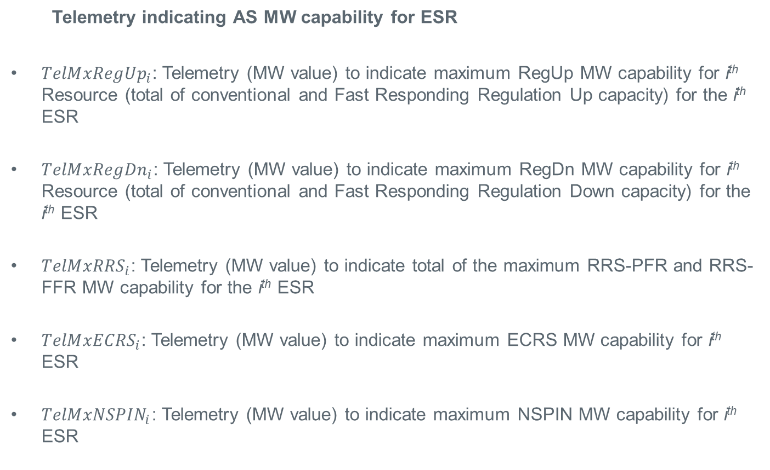
RTC: Single ESR Model
  Telemetry indicating AS MW capability for ESR
${TelMxRegUp}_{i}$: Telemetry (MW value) to indicate maximum RegUp MW capability for i^{th} Resource (total of conventional and Fast Responding Regulation Up capacity) for the i^{th} ESR
${TelMxRegDn}_{i}$: Telemetry (MW value) to indicate maximum RegDn MW capability for i^{th} Resource (total of conventional and Fast Responding Regulation Down capacity) for the i^{th} ESR
${TelMxRRS}_{i}$: Telemetry (MW value) to indicate total of the maximum RRS-PFR and RRS-FFR MW capability for the i^{th} ESR
${TelMxECRS}_{i}$: Telemetry (MW value) to indicate maximum ECRS MW capability for i^{th} ESR
${TelMxNSPIN}_{i}$: Telemetry (MW value) to indicate maximum NSPIN MW capability for i^{th} ESR

Slide 18
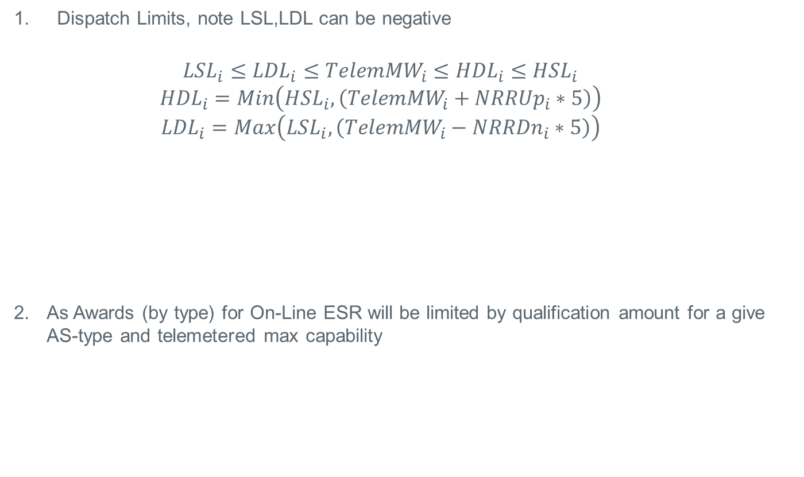
RTC: Constraints for On-Line Single ESR Model
Dispatch Limits, note LSL,LDL can be negative
  $${LSL}_{i}≤{LDL}_{i}≤{TelemMW}_{i}≤{HDL}_{i}≤{HSL}_{i}$$
  $${HDL}_{i}=Min\left({HSL}_{i},\left({TelemMW}_{i}+{NRRUp}_{i}∗5\right)\right)$$
  $${LDL}_{i}=Max\left({LSL}_{i},\left({TelemMW}_{i}−{NRRDn}_{i}∗5\right)\right)$$
As Awards (by type) for On-Line ESR will be limited by qualification amount for a give AS-type and telemetered max capability
LSL
LDL
TelemMW
HDL
HSL
Can be negative
LSL
LDL
TelemMW
HDL
HSL

Slide 19
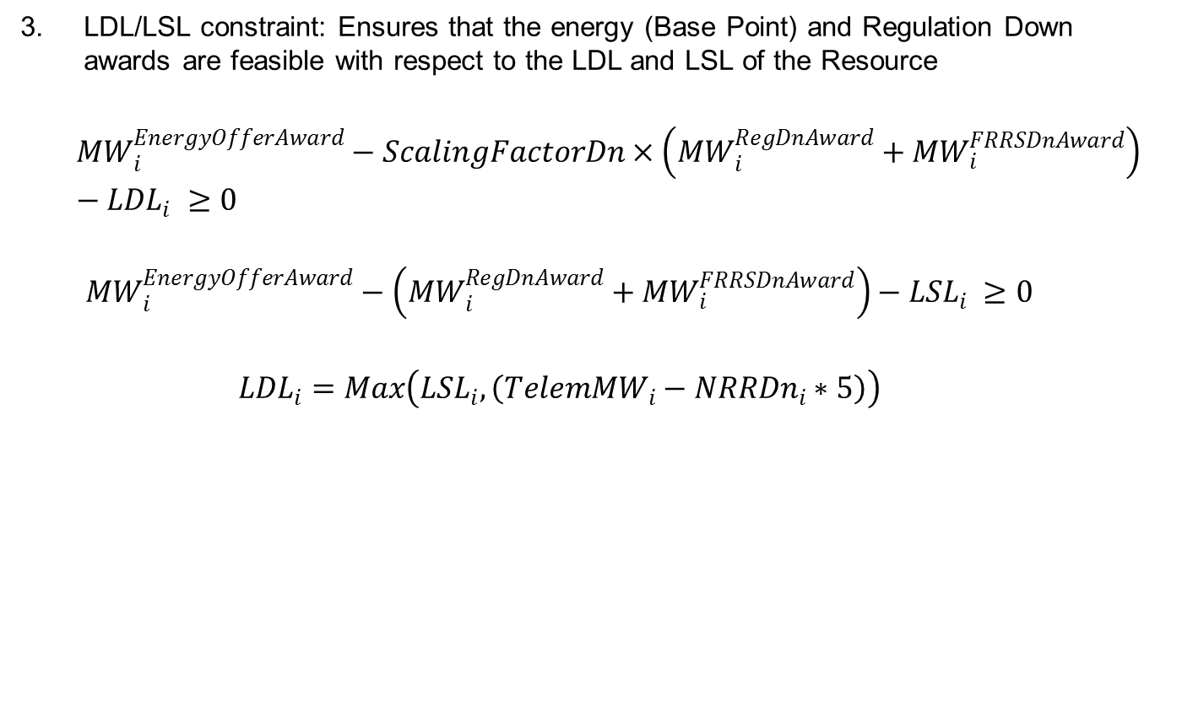


RTC: Constraints for On-Line Single ESR Model
LDL/LSL constraint: Ensures that the energy (Base Point) and Regulation Down awards are feasible with respect to the LDL and LSL of the Resource
  $${MW}_{i}^{EnergyOfferAward}−ScalingFactorDn×\left({MW}_{i}^{RegDnAward}+{MW}_{i}^{FRRSDnAward}\right)−{LDL}_{i} ≥0$$
  $${MW}_{i}^{EnergyOfferAward}−\left({MW}_{i}^{RegDnAward}+{MW}_{i}^{FRRSDnAward}\right)−{LSL}_{i} ≥0$$
  $${LDL}_{i}=Max\left({LSL}_{i},\left({TelemMW}_{i}−{NRRDn}_{i}∗5\right)\right)$$
$$\left({MW}_{i}^{RegDnAward}+{MW}_{i}^{FRRSDnAward}\right)$$
LSL
LDL
$${MW}_{i}^{EnergyOfferAward}$$
HDL
HSL
LSL
LDL
TelemMW
HDL
HSL

Slide 20


RTC: Constraints for On-Line Single ESR Model
HDL constraint: Ensures that the energy (Base Point) and Regulation Up awards are feasible with respect to the HDL of the Resource
  $${HDL}_{i}−{MW}_{i}^{EnergyOfferAward}−ScalingFactorDn×\left({MW}_{i}^{RegUpAward}+{MW}_{i}^{FRRSUpAward}\right) ≥0$$
$${MW}_{i}^{RegUpAward}+{MW}_{i}^{FRRSUpAward}$$
LSL
LDL
$${MW}_{i}^{EnergyOfferAward}$$
HDL
HSL
LSL
LDL
TelemMW
HDL
HSL

Slide 21






RTC: Constraints for On-Line Single ESR Model
HSL constraint: Ensures that the energy (Base Point), Regulation Up, Responsive Reserve (PFR, FFR), ECRS and On-line NSPIN awards are feasible with respect to the High Sustained Limit (HSL) of the Resource
  $${HSL}_{i}−{MW}_{i}^{EnergyOfferAward}−{MW}_{i}^{RegUpAward}−{MW}_{i}^{FRRSUpAward}−{MW}_{i}^{PFRAward}−{MW}_{i}^{FFRAward}−{MW}_{i}^{ECRSAward}−{MW}_{i}^{NSPINAward}≥0$$
$${MW}_{i}^{RegUpAward}+{MW}_{i}^{FRRSUpAward}$$
$${MW}_{i}^{PFRAward}+{MW}_{i}^{FFRAward}$$
LSL
LDL
$${MW}_{i}^{EnergyOfferAward}$$
HDL
HSL
$${MW}_{i}^{ECRAward}$$
$${MW}_{i}^{NSPINAward}$$
LSL
LDL
TelemMW
HDL
HSL

Slide 22
Discussion

