Slide 1
OTWG Meeting – Generator Winter Weatherization Preparedness
October 9, 2019
Alan H. Allgower
Operations Analyst, Senior
alan.allgower@ercot.com
512-248-4613 (o)

Slide 2
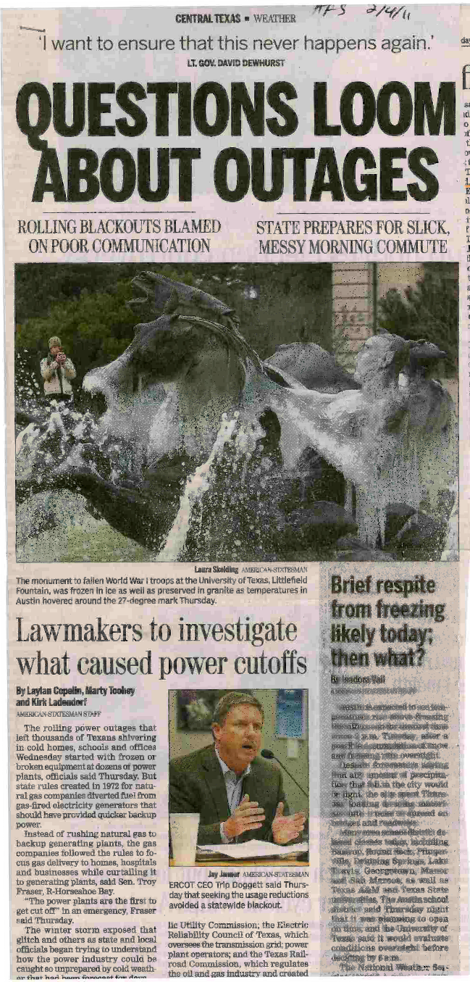
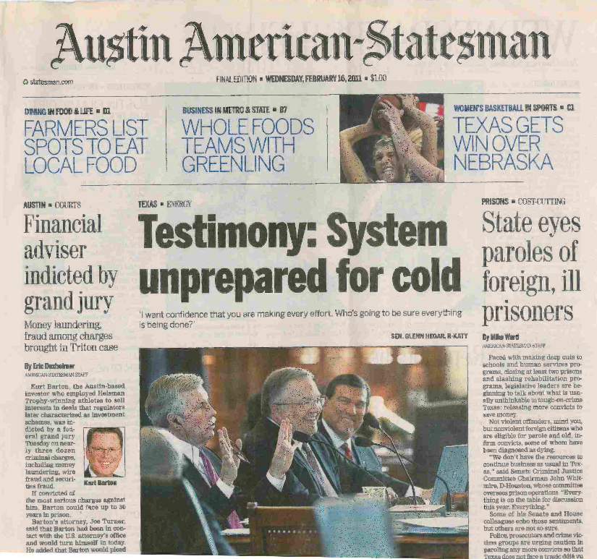
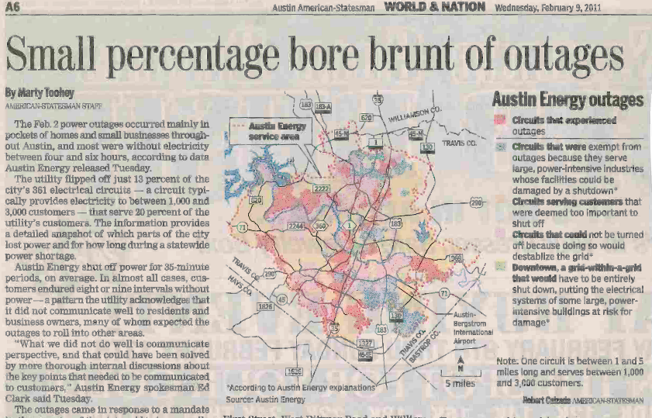
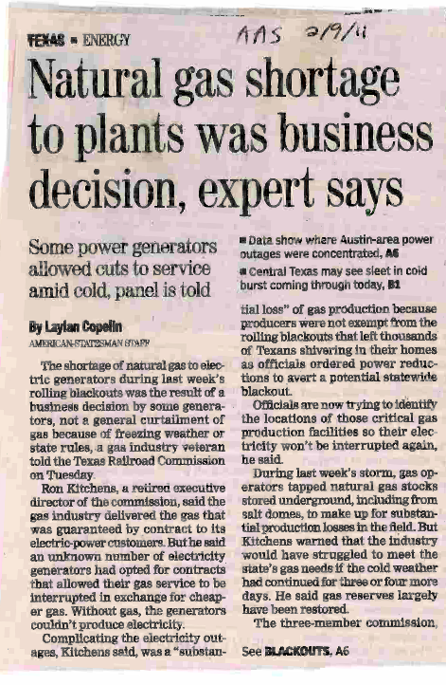
February 2011 Headlines….
Notes:
Headlines speak for themselves!

Slide 3
Remember……

Slide 4
PUCT Regulatory Requirements for Generator Preparedness
§25.53. Electric Service Emergency Operations Plans.
(c)(1)(H) A plan for the inventory of pre-arranged supplies for emergencies.
(c)(1)(I) A plan that addresses staffing during severe weather events.
(c)(2)(A) A plan that addresses severely cold and severely hot weather.
(c)(2)(B) A plan that addresses any known critical failure points, including any effects of weather design limits.
(c)(2)(G) Checklists for generating facility personnel to address emergency events.
(c)(2)(H) A summary of alternate fuel and storage capacity.
(c)(2)(I) A plan for alternative fuel testing if the facility has the ability to utilize alternative fuels.
(c)(2)(d) A Market entity shall conduct or participate in one or more drills annually to test its emergency procedures if its emergency procedures have not been implemented in response to an actual event within the last 12 months.
Notes:
So, I would like to remind everyone of the PUCT regulatory requirements.
My checklist includes the PUCT requirements related to winter operations, lessons learned and best practices.
All of these requirements are important however, the commission had the foresight to require a plan that addresses critical failure points that if frozen will trip, derate or fail to start a unit.
Some examples of critical failure points; drum level sensing lines, drum level transmitters, steam flow transmitters, BFP flow transmitters, deaerator level transmitters. Weatherization Plan should identify measures to prevent from freezing (heat trace circuit, insulation inspection and transmitter enclosure heater are all functioning).
I would like to remind everyone that ERCOT will be conducting a winter storm drill in October. See Market Notices on ERCOT.com for information.

Slide 5
EEA3
Normal
Operations
Normal
Operations
*2/2/2011 1/6/2014 1/8/2015 12/19/2016 1/7/2017 1/1/2018 *1/17/2018 3/3/2019 3/5/2019
Salmon colored reflects four coldest days in ERCOT in last eight years
* 2/2/2011 and 1/17/2108 were the two coldest days this decade
Notes:
Graph shows us were on a very good track in the ERCOT region.
Last winter was mild. We had extreme cold periods March 3 and 5, 2019.
Please note that these two dates were not part of the protocol official winter.
Chris Coleman has reminded us each year at our WS to expect some extreme weather days each winter.

Slide 6
Plant spot checks winter season 2018/2019 results
97 units spot checked
The purpose of spot checks is to verify plant personnel are following their weatherization plan.
As necessary, plant personnel are left with a recommendation(s) based on lessons learned or best practices observed.
Company senior management is emailed results.
Fuel types
4 coal units
93 gas fired units (conventional and combined cycle)
33 units agreed to improve preparations and/or records management and will be scheduled early in 2019 to verify improvements.
64 units had no observed deficiencies in their plan or records management.
Notes:
I would like to clear up a misconception. Some folks believe that because I have been to a plant, that plant is ready for winter operations. I verify that the plant personnel are following their plan with evidence in terms of completed WO’s, PM’s or other evidence. Plants personnel spend several months in preparation, I am at a plant for 3-4 hours.
The 33 units fall into the following buckets; new units or in some cases units that I have visited for the first time. However, the bulk of units are units that I have not visited in a couple of years. A unit may have looked good a couple of years ago but, because my experience level has increased, improvements are recommended.

Slide 7
Common causes of transmitter manifolds and/or sensing lines freezing
Tripped heat trace circuit breaker.
Blown fuse in heat trace panel.
Contractor error when terminating heat trace after testing.
Insulating contractor damage to heat trace.
Section of heat trace not functioning.
Incorrect heat trace for application.
Heat trace open ended and not grounded.
Transmitter cabinet heater not functioning.
Poor or lack of wind break measures.
Transmitter(s) exposed to the elements.
Gaps in insulation.
Notes:
The top seven causes were all related to heat trace not working.
Transmitter cabinet heater not functioning could be due to a heater or thermostat not functioning.

Slide 8
What have we learned since February 2011?
Identify critical components if frozen, will derate, trip or fail to start the unit and incorporate the measures to prevent from freezing into weatherization plan.
Heat trace failure rates in Texas on average are 10-15% from previous season.
Detailed testing of heat trace is necessary, identifying critical circuits. Repair at minimum, critical circuits.
Verify critical heat trace circuits are functioning prior to every extreme cold weather event.
Insulation inspections, focusing on critical components.
As an additional measure, install wind breaks and/or space heaters protecting critical components, focusing on the N and NE sides of unit. Avoid off the shelf tarps.
Notes:
How do you identify critical components? I will accept if they are identified in your heat trace audit, a separate critical component list and measures used to prevent from freezing.
Prior to an event verify critical heat trace circuits are functioning – reason for this is to catch a blown fuse or tripped breaker.
Jason Kessel from LCRA said it best at last years WS; “Heat trace is working, except for when it’s needed”!
Several plant managers continue to budget for wind breaks as insurance to heat trace.

Slide 9
What have we learned since February 2011? (continued)
Review scope of contractor work and verify acceptable completion.
Verify instrument air dryers, dew point monitoring, blow downs are all operating correctly.
Conduct a refresher training drill in the fall with operators on extreme cold weather procedures.
Ensure critical transmitters are in a heated enclosure and inspect integrity of transmitter enclosures in the fall as part of weatherization plans.
Test critical components transmitter cabinet thermostat and heater as part of heat trace testing.
Weatherization plan portion of EOP should be updated annually as lessons are learned and sent to ERCOT at EOP@ercot.com.
Notes:
Contractor work – example of LPCCS
The best training I have seen is a training drill in the fall with staff and operators will pay benefits during the winter. Cold weather checklist are given to operators and have them verify as if it were a real event.
Transmitter enclosure – Deer Park as an example.

Slide 10
Closing comments……
ERCOT assists generators in preparing for winter operations with spot checks, sharing lessons learned, best practices, recommendations and the annual fall workshop.
Recent history has shown us that for every extreme cold weather event, a small amount of generation will experience freeze related derates or trips.
Overall, ERCOT was pleased with the performance of generators during this past winter.
For winter 2019/2020, spot checks will begin November 15, 2019 and will conclude February 28, 2020.

