Slide 1
Operational Requirements for Energy Storage Resources
ERCOT Staff
10/18/2019

Slide 2
Operational Requirements for Inverter-Based Energy Storage
In this session, we will discuss
Adding one resource attribute: “Inverter-Based Resource”
Voltage Support Service (VSS)
Reactive Power Testing
Voltage Ride Through
Frequency Ride Through
Primary Frequency Response and Testing
Several clarifications

Slide 3
Inverter-Based as Resource Attribute
Introduce Inverter-Based Resource (IBR) as Resource Attribute:
To distinguish between IBR and non-IBR Energy Storage Resources
Will also be applicable for the requirements that apply to all IBRs, e.g. VRT, FRT and some of VSS requirements
Resource Attribute: specific qualities associated with various Resources
Inverter-Based Resource (IBR): a Resource that is connected to the ERCOT System either completely or partially through power electronic converter interface.
IBR Attribute definition will be included as a part of DGR/DESR-related Protocol Revision Request

Slide 4
Reactive Capability Requirements, Voltage Support Service
All Generation Resources and Energy Storage Resources (including self-serve generating units) that have a gross generating unit rating greater than 20 MVA or those units connected at the same Point of Interconnection (POI) that have gross generating unit ratings aggregating to greater than 20 MVA, that supply power to the ERCOT Transmission Grid, shall provide Voltage Support Service (VSS).

Slide 5
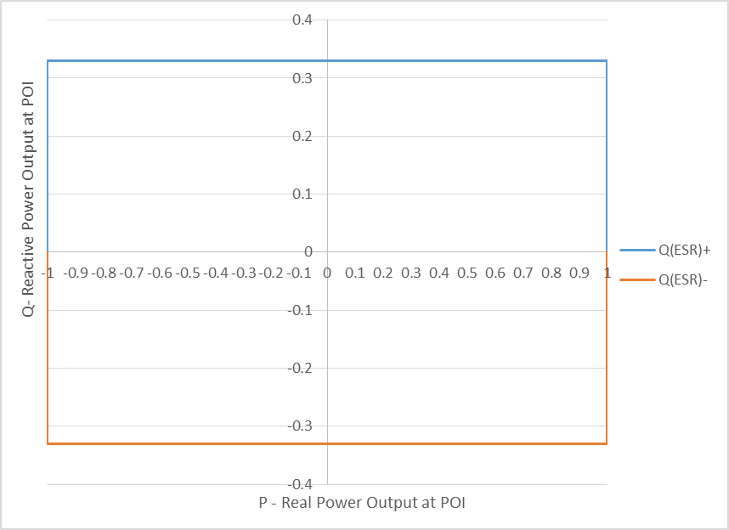
Reactive Capability Requirements, Voltage Support Service (cont.)
GR/IRR ≥ 20 MVA | IBR ESR ≥ 20 MVA
Must have sufficient reactive capability to provide 0.95 power factor leading and lagging relative to the maximum net real power deliverable to the POI
Must be provided at all real power outputs from 10% of Pmax to Pmax | Must be provided at all MW levels from Pmax (discharging) to -Pmax (charging)
May be met through a combination of the Resource’s CURL, and/or dynamic VAr capable devices. Reactive capability is evaluated via the Reactive Study and later verified through reactive and AVR testing

Slide 6
Reactive Power Testing
GR/IRR | IBR ESR
Lagging Test 1: Test at or above 95% of the unit’s High Sustained Limit (HSL) for at least 15 minutes. | Lagging Test 1a: at ≥ 95% of the unit’s maximum discharging capability for at least 15 minutes. Lagging Test 1b: at ≥ 95% of the unit’s maximum charging capability for at least 15 minutes.
Leading Test at the unit’s normally expected maximum real power output during system light load conditions for at least 15 minutes. | Leading Test 1a: at ≥ 95% of the unit’s maximum discharging capability for at least 15 minutes. Leading Test 1b: at $≥$95% of the unit’s maximum charging capability for at least 15 minutes.
Lagging Test 2: Test with all inverters on-line for at least one hour. Testing acceptance criteria is met if the unit achieved at least 50% of its CURL for 1 hour.
Testing acceptance criteria is met if the unit achieved no less than 90% of the unit’s most recent CURL.

Slide 7
Voltage Ride-Through for IRRs and IBR ESR

Slide 8
VRT Requirement (cont.)
GR | ESR
Each Resource shall not, during and following a transient voltage disturbance, cease providing real or reactive power except to the extent needed to provide frequency support or aid in voltage recovery
 | Each ESR, if is consuming active power when operating at the charging mode, shall reduce or cease power consumption to aid in voltage recovery during and following a transient voltage disturbance.

Slide 9
Frequency Ride-Through for GRs and ESRs

Slide 10
Governor / Primary Frequency Response and Testing
GR | ESR
All On-Line GRs should have Governors in service with 17-34 mHz deadband, max 5% droop and provide PFR, if they have capacity available to increase or decrease their output. | All On-Line ESRs should have Governors in service with deadband not to exceed 17 mHz, and droop setting not to exceed 5%, both while charging or discharging, and provide PFR, if they have headroom available to increase or decrease their production or consumption
Each Resource Entity shall conduct applicable Governor tests on each of its Energy Storage Resources to demonstrate their capability while both charging and discharging.
ERCOT shall analyze the performance of a Resource after every Frequency Measurable Event in accordance with Operating Guides. Resource’s PFR performance will not be evaluated for FME’s when a Resource has less than 5 MW or 2% capacity margin to provide such response

Slide 11
Additional Considerations
As a part of Inverter-Based Resource (IBR) effort:
will work on clarifying of how frequency should be measured (to avoid erroneous response) by Inverter-Based Resources.
will clarify the VRT and FRT are the minimum performance requirements, protection settings should be based physical limit of the IBR, not VRT and FRT profile.

Slide 12
Thank you! Questions?

