Slide 1
RTC Task Force General Information
Matt Mereness
October 9, 2019

Slide 2
Antitrust Admonition
Antitrust Admonition
To avoid raising concerns about antitrust liability, participants in ERCOT activities should refrain from proposing any action or measure that would exceed ERCOT’s authority under federal or state law. For additional information, stakeholders should consult the Statement of Position on Antitrust Issues for Members of ERCOT Committees, Subcommittees, and Working Groups, which is posted on the ERCOT website.1
Disclaimer
All presentations and materials submitted by Market Participants or any other Entity to ERCOT staff for this meeting are received and posted with the acknowledgement that the information will be considered public in accordance with the ERCOT Websites Content Management Operating Procedure.
1 The document is available at http://www.ercot.com/about/governance/index.html .

Slide 3
Outline of RTCTF Update
RTCTF Meeting Schedule
TAC Update
Today’s Plan for Discussion
Appendix
Stakeholder Process Summary
PUCT Direction on RTC Items

Slide 4
RTCTF Meeting Schedule
Schedule of future meetings for principles/scope of RTC:
Thursday, April 4 (Initial meeting, Charter and Approach)
Monday, April 22 (RTC Orientation Session)
Tuesday, April 30 (Begin reviewing Key Principles)
Monday, May 13
Friday, June 7
Friday, June 21
Friday, July 12
Friday, Aug. 9
Tuesday, Aug. 27
Thursday, Sept. 19
Tuesday, Sept. 24 (Special meeting for ISO Lessons Learned)
Wednesday, Oct. 9
Wednesday, Oct. 30
Tuesday, Nov. 19
Tuesday, Dec. 3
Thursday, Dec. 19
Friday, Jan. 10, 2020
Wednesday, Jan. 22, 2020 > TAC Jan 29, 2020 > Board Feb 5, 2020
Posted 2020 Schedule in coordination with BEST starting in Feb 2020

Slide 5
TAC Update
At the September 25, 2019 TAC meeting, TAC voted to endorse the following Key Principle subsections:
Unanimous Endorsement:
Key Principle 1.1 Subsections 1, 3, 4: Ancillary Service Demand Curves and Current Market Price Adders
Key Principle 1.2 Subsections 1 & 2: System-Wide Offer Cap and Power Balance Penalty Price

Slide 6
Today’s Plan for Key Principles (KP)
Note ERCOT has posted versions of each KP with Combined Comments for today’s meeting
Key Principle 1.1: AS Demand Curves and Current Market Price Adders
(2)- Pricing run for reliability deployments
(Round 1- ERCOT to present more details of RUC/reliability deployment items)
(5)- Disaggregation of ORDC Curve
(Round 3- No action needed, consensus on Crescent approach and ready for October TAC)
Key Principle 1.2 - System-Wide Offer Cap and Power Balance Penalty Price
(3)- Price caps for AS
(Round 3- Proposals from Crescent & Luminant- seek task force consensus today.)

Slide 7
Today’s Plan for Key Principles (KP)
Key Principle 1.3 Offering and Awarding Ancillary Services in Real-Time
(1)- Ability for QSE to indicate when AS unavailable in Real-Time
(Round 3 Trefny issues to be discussed)
(2)- UFR Load Resources will be able to self-provide RRS UFR and ECRS based on DAM Awards and Trades
(Round 3 No issues to date)
(3)- STEC proposal for On-Line Hydro not in ONRR mode
(Round 2 Review STEC alternative)
(4)- Combined-cycle frequency responsive AS constraint
(Round 2 ERCOT Presentation on telemetry, also Exelon comments)
(5)- RTC will not change limits on sub-categories of AS products
(Round 3 No issues to date)
(6)- Offline non-spin constraint during start-up
(Round 3 Discussion from Crescent in prior meeting, but no alternatives)
(7)- Quick-start constraint during start-up
(Round 3 No issues to date)

Slide 8
Today’s Plan for Key Principles (KP)
Key Principle 1.3 Offering and Awarding Ancillary Services in Real-Time
(8)- Re-procurement of AS during deployments
(Consensus at 9/19 meeting)
(9)- Operator ability to mitigate infeasible AS
(Round 3 Minor edits at RTCTF, Luminant comments)
(10)- RTC will leverage AS Offer structure from current structure & NPRR863
(Round 3 No issues to date)
(11)- AS Offer curve submission will be same as Energy Offer Curve
(Round 3 No issues to date, Exelon comments)
(12)- Proxy curves for RTC AS
(Round 3 comments from TCPA/LCRA, Trefny, Crescent, Luminant)
(13)- Proxy curves for AS will not be created for DAM (same as today)
(Round 3 No issues to date)
(14)- New FFR section proposed by Crescent

Slide 9
Today’s Plan for Key Principles (KP)
Key Principle 5 Day-Ahead Market
(1)- ASDCs will be used in DAM
(Round 3 No issues to date)
(2)- ASDCs in DAM will be same as Real-Time
(Round 3 No issues to date)
(3)- Current DAM Insufficiency Process will be removed
(Round 3 No issues to date)
(4)- AS Obligation quantities posted by 06:00 in Day-Ahead become advisory-only number based on the AS Plan
(Round 3 No issues to date)
(5)- Minimum AS Obligation quantity will be 0.1 MW
(Round 3 No issues to date)
(6)- After DAM is published, updated AS Obligation quantities will be calculated and published based on the actual DAM AS requirement
(Round 3 No issues to date)
(7)- Virtual AS Offers- proposed by Morgan Stanley at 9/19 meeting
(Round 2 Discuss benefits of additional functionality, Shell comments)

Slide 10
Today’s Plan for Key Principles (KP)
New Items/Presentations
KP1.1 and KP3 - RUC Items and the Reliability Deployment Pricing Run
KP1.2 - Separate SWOC in DAM
KP1.5 - Emergency Operation Settlement
KP1.5 - Removal of separate Regulation and FRRS signals

Slide 11
Appendix
Stakeholder Process Summary
PUCT Direction on RTC Items
RTCTF Posting Locations

Slide 12
RTCTF Review Process
Internal ERCOT Draft Principles and Principle Concepts (elements)
ERCOT presents concepts for meeting in presentation format
ERCOT takes feedback and posts in 2 days as initial document for MP edits
ERCOT posts all MP feedback and responds to MP redlines, concerns, alternatives
ERCOT provides responses to finalize supporting principle concept
Meeting #1 Meeting #2 Meeting #3
MPs share initial feedback, concern, request for additional information
MPs submit feedback as edits to document and any
- Concerns
Alternatives
MPs must document concerns and alternative approach prior to meeting and be prepared to discuss
Take consensus and non-consensus items to TAC for vote

Slide 13
TAC Review Process
TAC is the stakeholder body to vote on Design Principles.
RTC Key Principles are non-binding and will not go directly to the Board after TAC consideration.
Procedures set forth in Protocol Section 21 do not apply to discussions, opinions or approvals by TAC with respect to RTC Key Principles.
Section VIII of the ERCOT Board Policies and Procedures does not apply to discussions, opinions or unofficial approvals by TAC with respect to RTC Key Principles.
After TAC endorsement of all RTC Key Principles, ERCOT will compile the RTC Key Principles into a single package, and submit it to TAC for a courtesy review prior to Board review. The package will contain a full record of TAC votes.
Following TAC review of the complete RTC Key Principles package, ERCOT will submit it to the Board for discussion and consideration.
Any stakeholder opposed to an RTC Key Principle may, at this time, request Board consideration in accordance with Section VIII of the ERCOT Board Policies and Procedures.

Slide 14
PUCT Direction on RTC Design Items
Key updates PUCT Project No. 48540
June 26, 2019 Chair Memo: http://interchange.puc.texas.gov/Search/Documents?controlNumber=48540&itemNumber=60
June 27, 2019 PUCT Open Meeting: http://www.adminmonitor.com/tx/puct/open_meeting/20190627/
July 17, 2019 ERCOT Letter on RTC Timeline: http://interchange.puc.texas.gov/Search/Documents?controlNumber=48540&itemNumber=62
July 18, 2010 PUCT Open Meeting: http://www.adminmonitor.com/tx/puct/open_meeting/20190718/
Ancillary Services Demand Curves – Curves should follow current Operating Reserve Demand Curve (ORDC) parameters.
System-wide Offer Cap (SWCAP) and Power Balance Penalty Curve (PBPC) – Set SWCAP $2,000 per MWh, Max ASDC $9,000 per MWh, VOLL $9,000 per MWh. Prices capped at $9,000 per MWh exclusive of congestion costs. LCAP will apply if necessary.
Ancillary Service Offers – Creation of Proxy AS Offers if qualified and available but not offered.
Suite of Ancillary Service Products – All Ancillary Service products finalized with the approval of NPRR863.
Day-Ahead Market – The Commission did not want to add DAM enhancements to the RTC Project that would jeopardize the RTC delivery timeline.

Slide 15
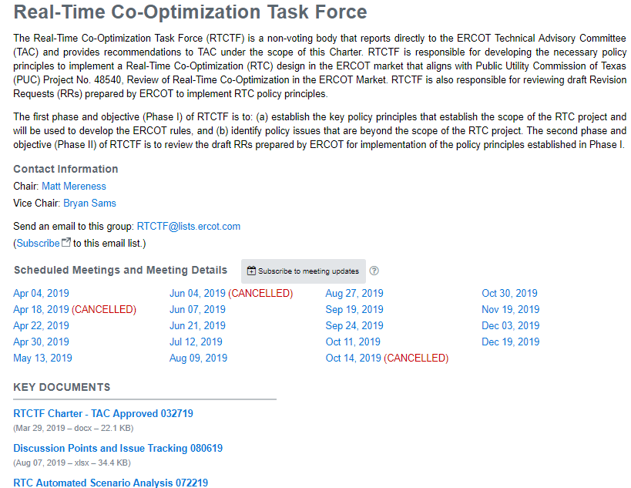
Reminder of RTCTF Posting Locations
RTCTF Home Page
RTCTF Charter
Meeting Calendar
Principle Tracking Schedule
RTC Scenario/Clearing Tool
http://www.ercot.com/committee/rtctf
RTCTF Calendar Pages
Current/new materials posted on RTCTF meeting pages
ERCOT.com/ MarketRules, PUCT Directive/RTC Page All historical materials posted
http://www.ercot.com/mktrules/puctDirectives/rtCoOptimization

