Slide 1
PDCWG Report to ROS
Chair: Chad Mulholland, NRG
Vice Chair: Jimmy Jackson, CPS
ROS
October 3rd, 2019

Slide 2
Report Overview & Notes
Report Overview
  Meeting Minutes
  BAL-001-TRE-1 FMEs & IMFR
    2 FMEs in the month of August
  Frequency Control Report

Slide 3
Meeting Minutes
PDCWG Meeting 9/11/19
  ERCOT Dynamic Model Benchmarking
    Annual RRS Study
    Governor Performance
  ERCOT Ancillary Service Analysis – Changes for 2020
  Lesson Learned Analysis
    Great Britain Lighting Strike – Load Shed Event (Aug 9, 2019)
  PDCWG Reviewed and Supports
    SCR800 – Adding DC Tie Ramp to GTBD Calculation
    Methodology to Calculate RRS Limits Procedure under NPRR 863
  Regulation & Frequency Control Reports

Slide 4
Frequency Measurable Events Performance

Slide 5
Frequency Measurable Events
There were 2 FMEs in August
  8/10/2019 06:49:30
    Loss of 1,081 MW
    Interconnection Frequency Response: 1,502 MW/0.1 Hz
    4 of 59 Evaluated Generation Resources had less than 75% of their expected Initial Primary Frequency Response.
    4 of 59 Evaluated Generation Resources had less than 75% of their expected Sustained Primary Frequency Response.
  8/11/2019 06:18:42
    Loss of 504 MW
    Interconnection Frequency Response: 1,866 MW/0.1 Hz
    10 of 58 Evaluated Generation Resources had less than 75% of their expected Initial Primary Frequency Response.
    12 of 58 Evaluated Generation Resources had less than 75% of their expected Sustained Primary Frequency Response.

Slide 6
Interconnection Minimum Frequency Response (IMFR) Performance
IMFR Performance currently 1263.43 MW/0.1Hz
Frequency Response Obligation (FRO): 381 MW/0.1 Hz

Slide 7
Frequency Control Report
August 2019

Slide 8
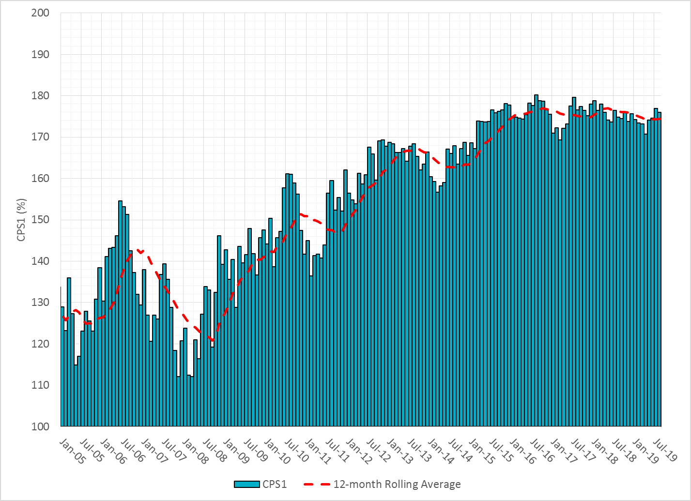

CPS1 Performance

Slide 9
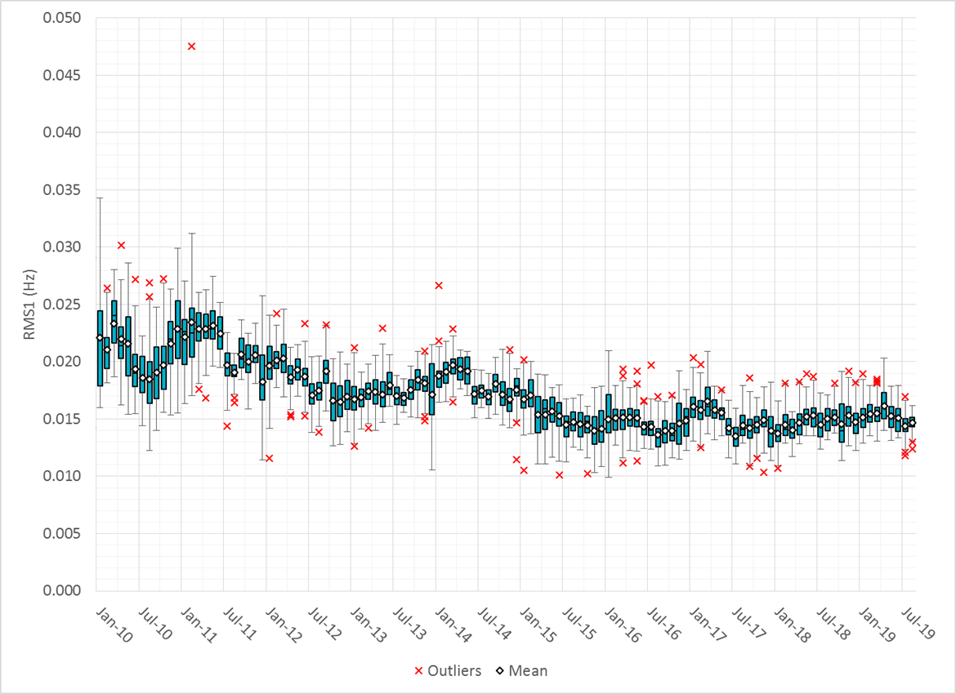
RMS1 Performance of ERCOT Frequency

Slide 10
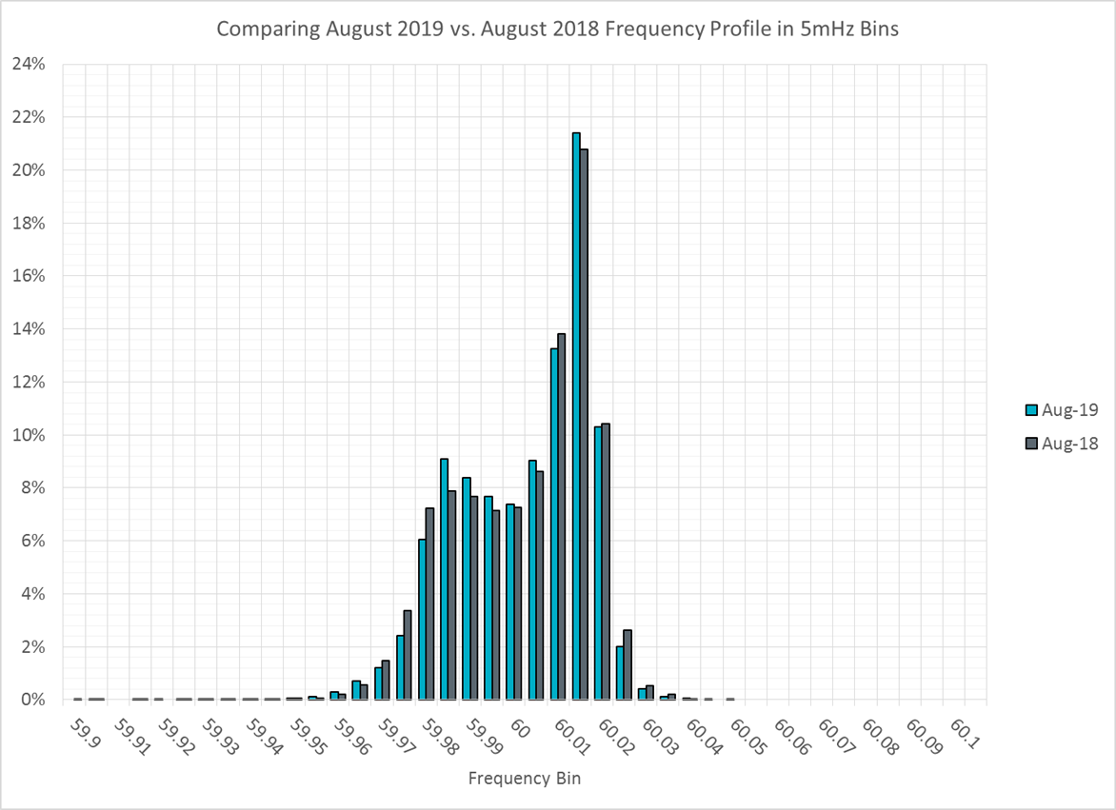
Frequency Profile Analysis

Slide 11
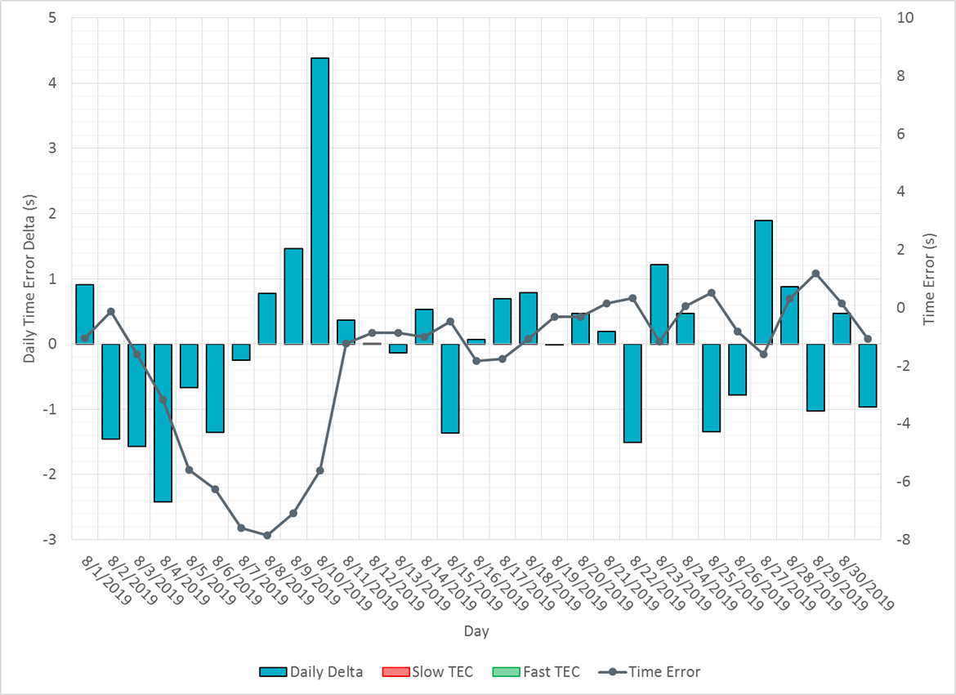
Time Error Corrections

Slide 12
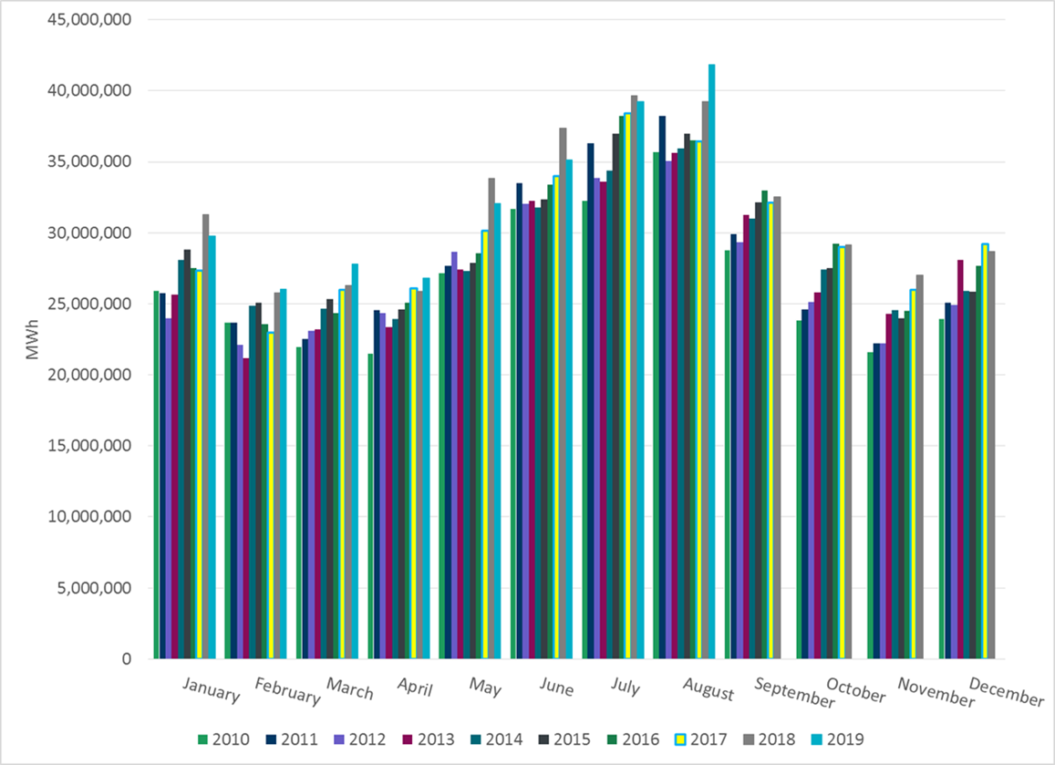
ERCOT Total Energy

Slide 13
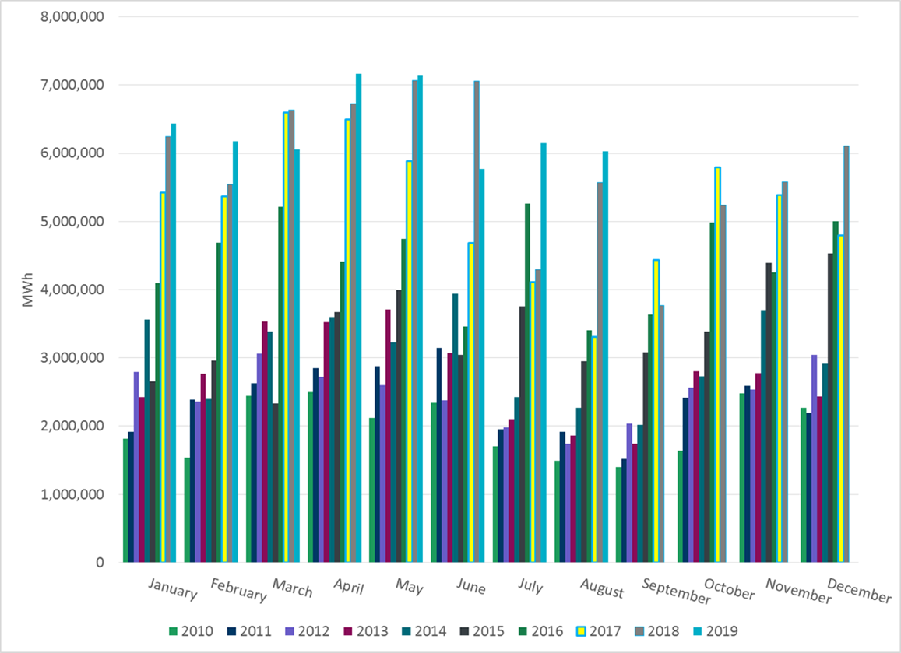
ERCOT Total Energy from Wind Generation

Slide 14
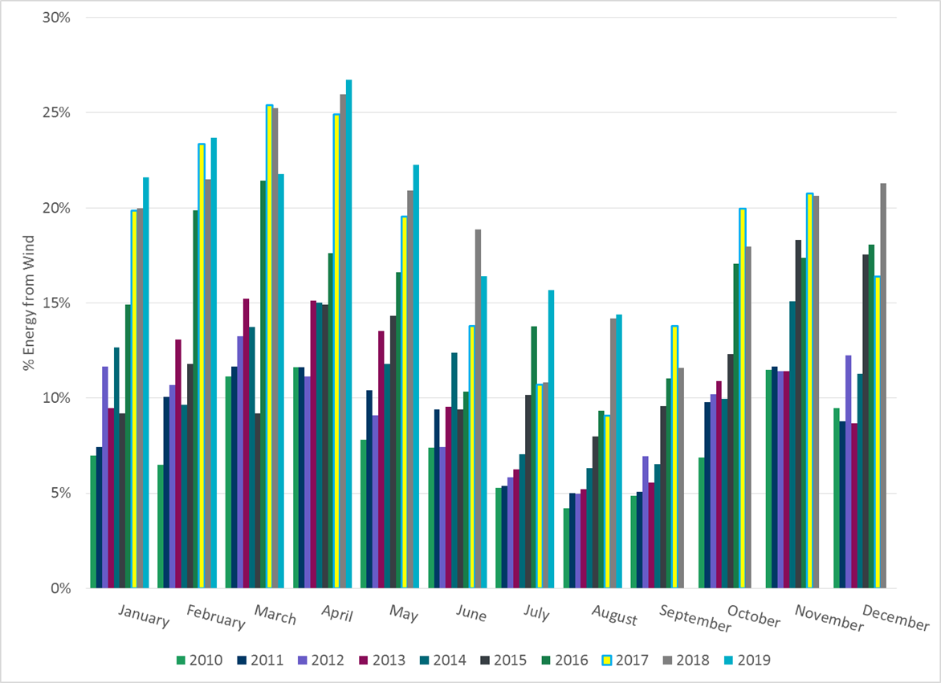
ERCOT % Energy from Wind Generation

Slide 15
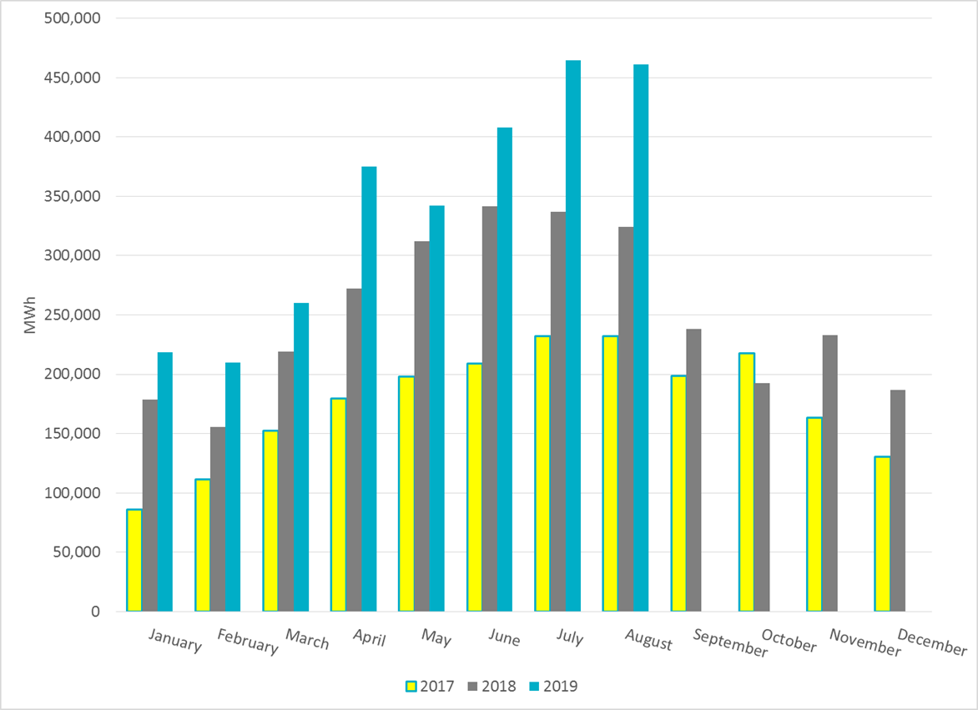
ERCOT Total Energy from Solar Generation

Slide 16
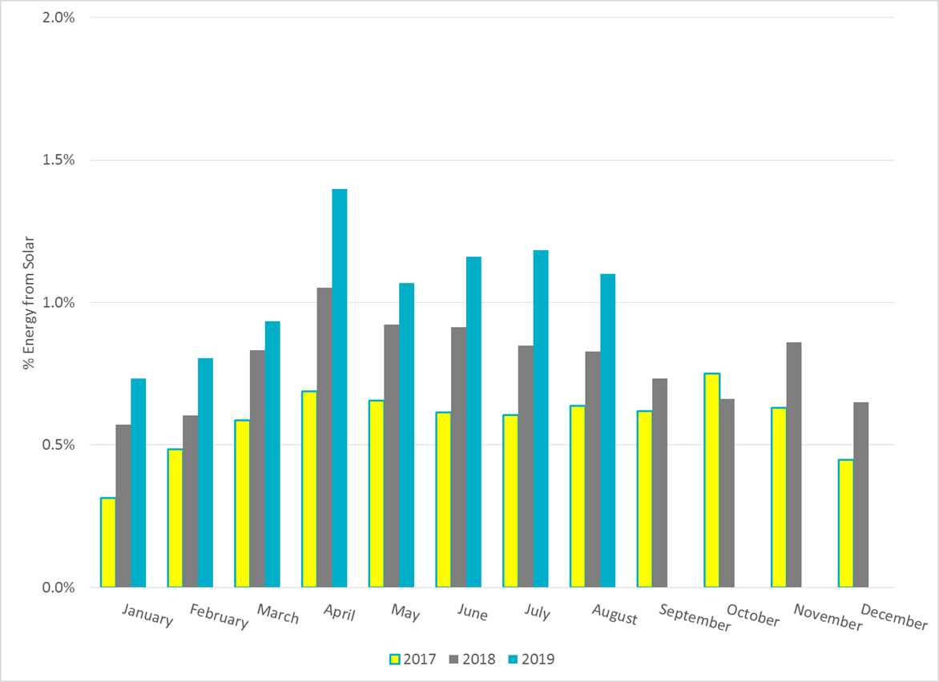
ERCOT % Energy from Solar Generation

Slide 17
Questions?

