Slide 1
RRGRR-021 Dynamic Model Requirement for TSAT
ROS Meeting
10/03/2019

Slide 2
RRGRR-021 Business Need
The recent increase in the renewable generation penetration has increased the number and the complexity of the Generic Transmission Constraints (GTCs) and it is becoming difficult to manage using the current off-line study process
The current process for Generic Transmission Limits (GTLs) calculation involves off-line studies that are based on system condition (snapshot) that represent a worst case scenario
TSAT will be used to calculate dynamic stability related GTLs in Real-Time and help the operators to maintain system reliability and also effectively manage the GTCs for changing system conditions

Slide 3
Real-time TSAT Implementation/Progress
ERCOT is in the process of implementing TSAT for Real-Time operations
Most of the ERCOT conventional generator (Coal, Nuclear, Combined Cycle etc.) dynamic models implemented in PSS®E are available in TSAT
The ERCOT conventional generator have been implemented in TSAT and validated/benchmarked against PSS®E
Current TSAT implementation allows us to evaluate certain frequency events using off-line study mode (related to conventional generator)
Next step is to implement models for inverter-based resources in TSAT

Slide 4
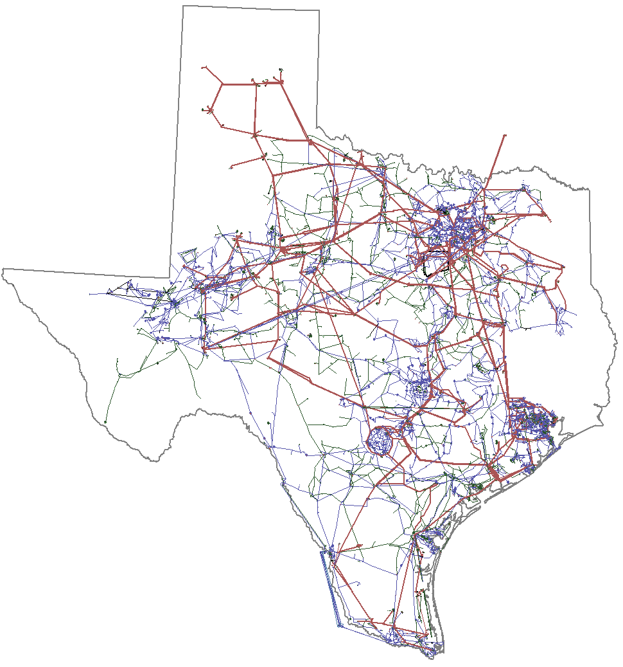
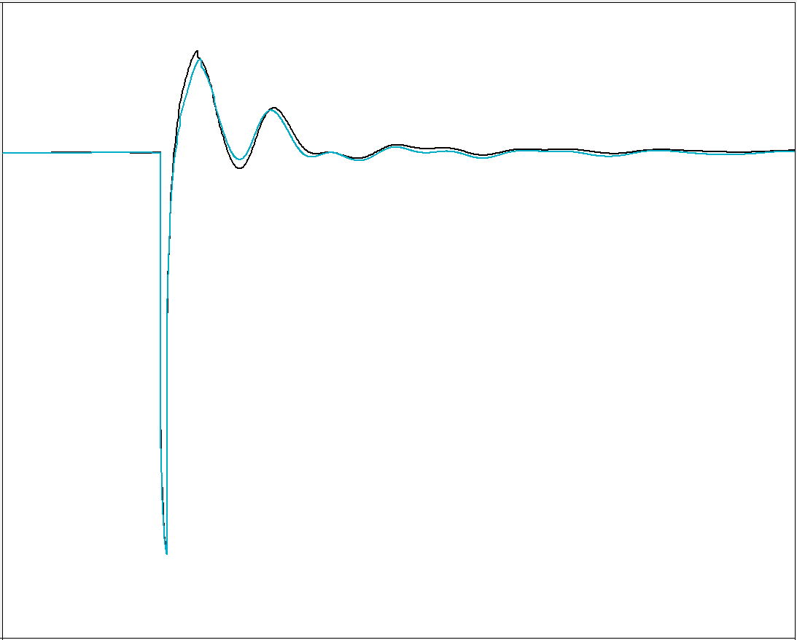
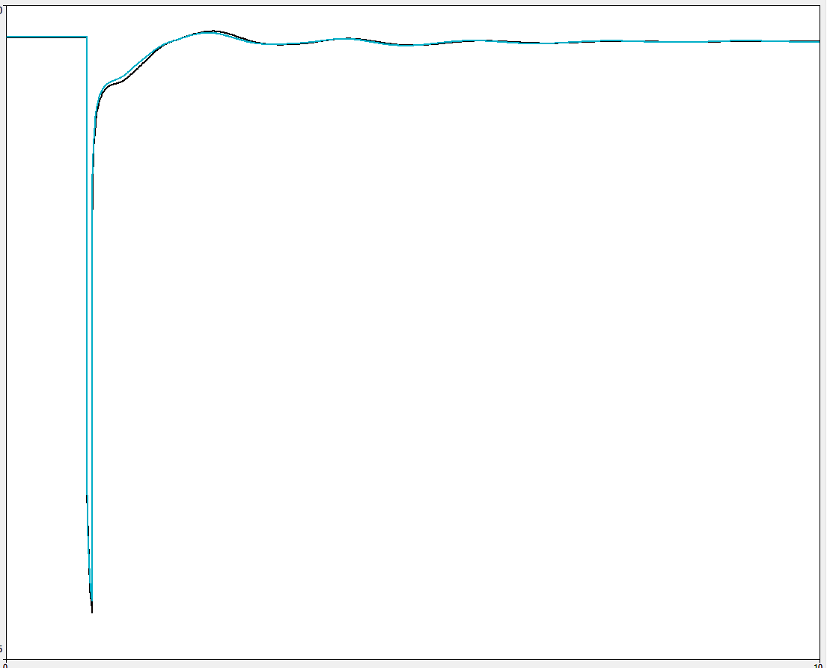
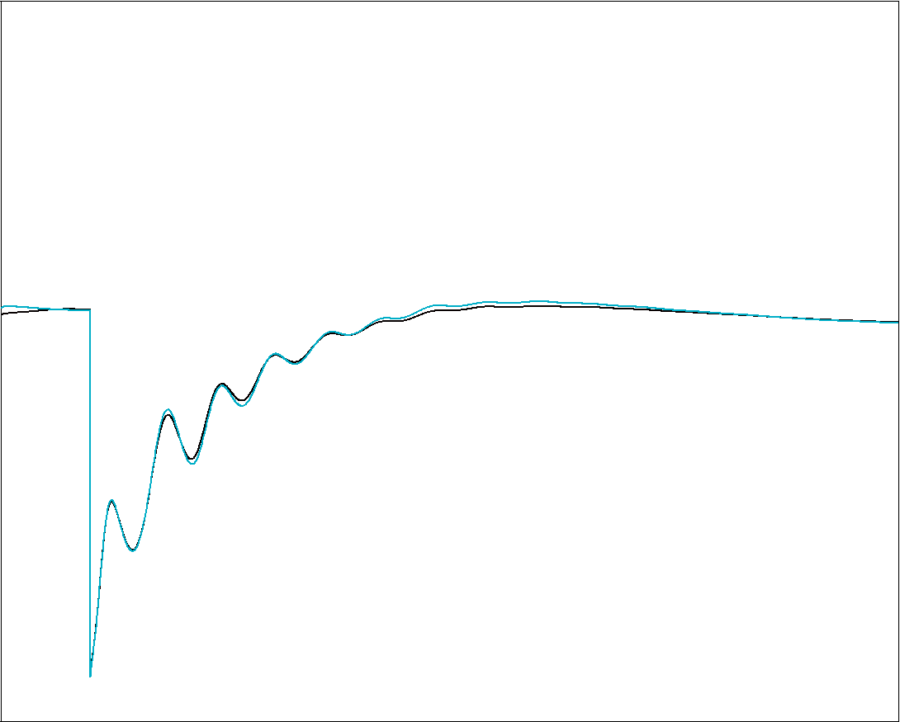
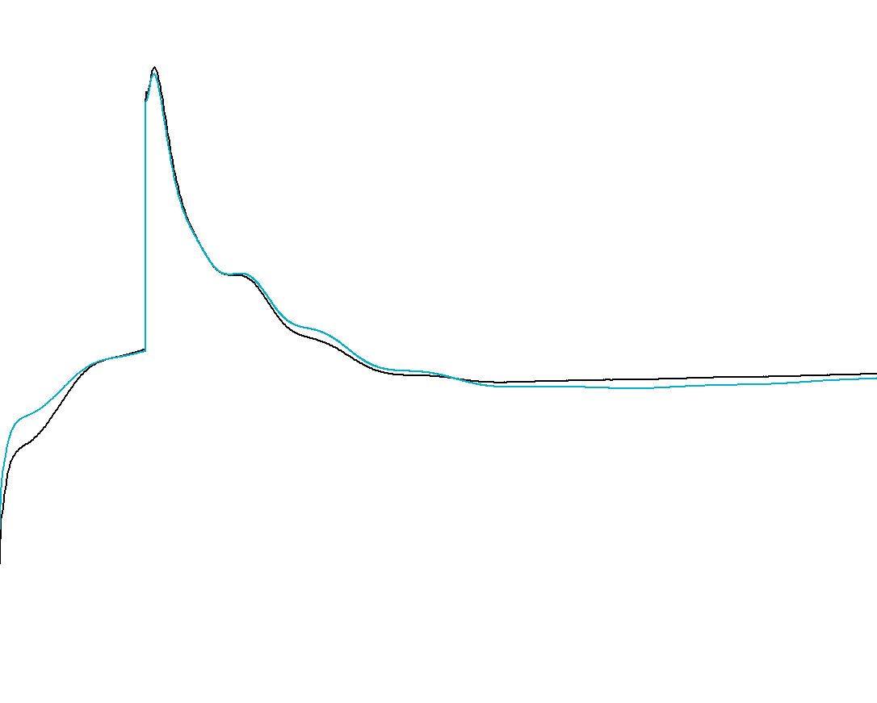
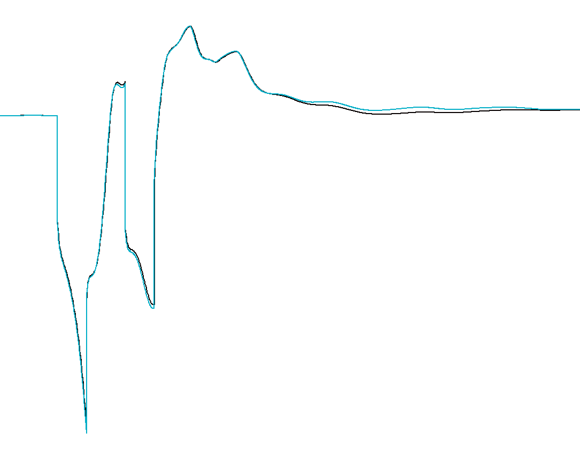
TSAT Conventional model Vs PSS®E Benchmark
1.10
0.95
1.10
0.55
Coastal Texas
South Texas
Generator Terminal Voltage (pu)
PSSE
TSAT
PSSE
TSAT
0.0 | 5.0 | 10.0
0.0 | 5.0 | 10.0
Time (s)
Time (s)
1.014
0.992
1.044
1.037
1.10
0.00
South Central Texas
Far West Texas
East Texas
Generator Terminal Voltage (pu)
PSSE
TSAT
PSSE
TSAT
PSSE
TSAT
0.0 | 5.0 | 10.0
0.0 | 5.0 | 10.0
0.0 | 5.0 | 10.0
Time (s)
Time (s)
Time (s)

Slide 5
RRGRR-021 TSAT Requirement
Adds new data requirements to the Resource Registration Glossary to account for submittal requirement fields for dynamic models required by the Transient Security Assessment Tool (TSAT)
The TSAT dynamic model/data submittal requirements are currently described in item (4)(b)(v) of Planning Guide Section 5.7.1, All-Inclusive Generation Resource Data Requirements

Slide 6
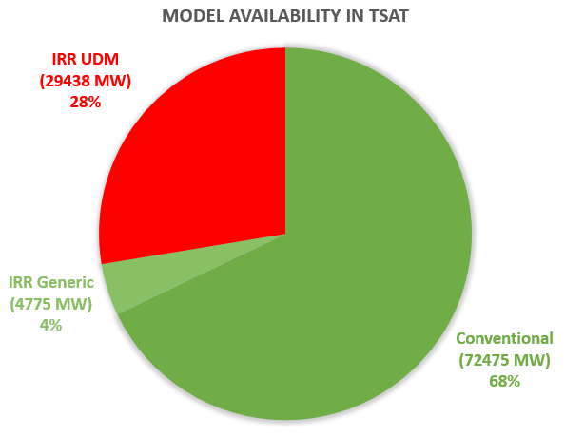
Real-time TSAT – Model Deficiencies
Models for renewable generation (wind and solar) often use user-defined code (user-defined models available in PSS®E) for implementation
No equivalent TSAT representation available in most (if not all) cases
Generic equivalent in TSAT representation are not suitable for ERCOT regions with low system strength

Slide 7
Real-time TSAT – Benefits
Assessment of transient stability limits in real-time
Calculate limits more accurate for the specific operating condition (compared to the off-line studies)
Allows utilization of full transfer capability in conjunction with other real-time tools (VSAT, WSCR)
Provide off-line study dynamic tool for shift support engineers and outage coordination
Dynamic model validation using real-time events
Using PMU data
Will improve both operations and planning models
Simulate other events (such as loss of generation) in real-time to determine system frequency response

Slide 8
Questions?

