Slide 1
Planned Analysis of Locational Reliability Deployment Price Adder Proposals
Market Analysis
9/30/2019

Slide 2
Two Concepts Have Been Proposed
Two proposals to improve locational RTORDPA price signals have previously been discussed in the stakeholder process or at the PUC
  The “but-for” concept proposed by the Hogan and Pope filing in PUC project 47199
  The “positive LMP increase” concept proposed by Shams Siddiqi
ERCOT is presenting these proposals to accept final feedback prior to performing an analysis of the impact of the proposals

Slide 3
Hogan And Pope “But-For” Proposal

Slide 4
The Hogan and Pope “But-For” Proposal
Basic concept is to “…reduc[e] the transmission capacity of the constraints relieved by the RUC by the amount of the “but‐for” counterflow created by the minimum operating level of the RUC unit.”
For any constraints where an ONRUC Resource has a helping shift factor, modify the math limit of the transmission constraint by the shift factor * LSL
This will remove the effect of the zero-to-LSL energy on the constraint and potentially send a stronger local price signal

Slide 5
“But-For” Local and System-Wide Price Impacts
Reducing the constraint limits in the dispatch run addresses local price impact but does not address any system-wide price impact
A pricing run would be used to address any system-wide price impact, as is done today
Improved locational prices would be through stronger LMP price signals in the dispatch run and the price adder would still be system-wide

Slide 6
“But-For” Proposal Variants
Variants on this proposal include using different shadow price cap values for the reduced portion of the transmission limit
Using a lower shadow price cap so that SCED violates the soft constraint and the flow is closer to the original limit may send sufficient local price signals while reducing the potential for uplift.

Slide 7
“But-For” Shadow Price Cap Options
Option A: Use existing shadow price cap
Option B: Use a linear sloped shadow price cap
Option C: Use a constant, lower shadow price cap
Max
Shadow
Price
Option A
Option B
Option C
Element Rating
Reliability Action Flow Impact (RAFI)
=RUC LSL * Shift Factor
  Intent is to allow this portion of the constraint to be violated so that a price signal is sent but dispatch is more optimal and the potential for overselling is reduced
  ERCOT is still considering options for determining the value of this lower shadow price cap

Slide 8
Locational RTRDPA Proposal

Slide 9
Proposed Locational Reliability Deployment Price Adder
Proposed by Shams Siddiqi
The Real-Time Online Reliability Deployment Price Adder (RTORDPA) is currently a system-wide price equal to the positive difference between SCED’s dispatch run System Lambda and pricing run System Lambda
The proposed Real-Time Online Locational Reliability Deployment Price Adder (RTOLRDPA) would be a locational price signal equal to the positive difference between electrical bus LMPs in the dispatch and pricing run

Slide 10
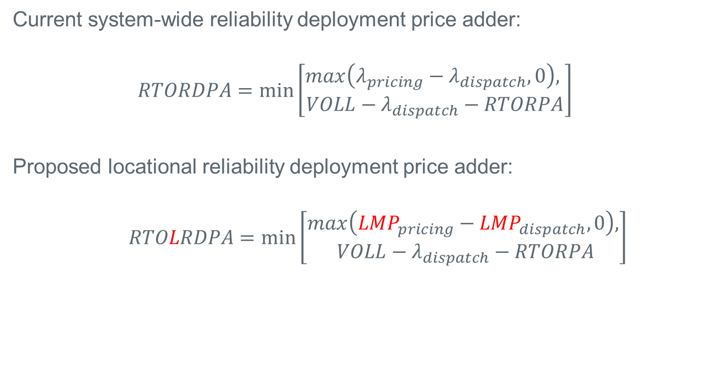
Reliability Deployment Price Adder Calculation
Current system-wide reliability deployment price adder:
$$RTORDPA=\min\left[\begin{aligned}max\left(λ_{pricing}−λ_{dispatch}, 0\right), \\ VOLL−λ_{dispatch}−RTORPA\end{aligned}\right]$$
Proposed locational reliability deployment price adder:
$$RTOLRDPA=\min\left[\begin{aligned}max\left({LMP}_{pricing}−{LMP}_{dispatch}, 0\right), \\ VOLL−λ_{dispatch}−RTORPA\end{aligned}\right]$$

Slide 11
Impact on Other Equations
Resources will continue to receive Dispatch LMP
For all other purposes, LMPs shall be (similar to ELMP markets):
ELMP = Dispatch LMP + RTOLRDPA
Settlement Point Price equations for Resource Nodes, Hubs, Load Zones, and LCCRNs, and other equations for SOGs and WSL would use ELMPs.

Slide 12
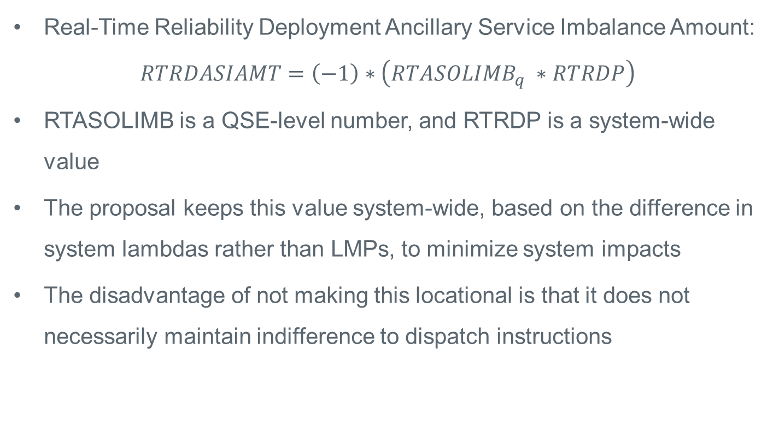
QSE Real-Time Ancillary Service Imbalance
Real-Time Reliability Deployment Ancillary Service Imbalance Amount:
$RTRDASIAMT=\left(−1\right)∗\left(RTASOLIMB_{q} ∗RTRDP\right)$
RTASOLIMB is a QSE-level number, and RTRDP is a system-wide value
The proposal keeps this value system-wide, based on the difference in system lambdas rather than LMPs, to minimize system impacts
The disadvantage of not making this locational is that it does not necessarily maintain indifference to dispatch instructions

Slide 13
Additional Treatment for Other Reliability Actions
Proposal has additional treatment of reliability actions related to DC ties via reversing the reliability action in the pricing run and adding a pseudo-Resource at the DC tie load zones with a prescribed offer
In this first round of evaluation ERCOT will only analyze RUC cases and will analyze reliability actions related to DC ties after presenting the results of the RUC cases

Slide 14
Study Approach and Plan Going Forward

Slide 15
Study Approach
Create a study SCED model able to model both proposals and base case and execute the model for a base case and the proposals using historical data
Compare the results in terms of:
  SPPs and locational price impacts
  Offer-based production costs
  Congestion revenue
  Uplift due to DAM PTP settlement, DAM energy-only transactions, RTM AS imbalance payments, and RUC make-whole

Slide 16
Base Case Assumptions
NPRR904 (approved 8/13/2019 but not yet implemented) contains changes to the pricing run. The base case will assume approval and implementation of these changes.
There is currently a proposal to include startup and minimum generation costs in MOCs for ONRUC Resources. At the last CMWG minimal feedback was received on whether the base case should include this proposal. Do CMWG members have any further recommendations?

Slide 17
Scope of Analysis
This analysis is aimed at quantifying the relative advantages and disadvantages of the two approaches in terms of local price signals and uplift.
The two approaches would also have different advantages and disadvantages in terms of implementation cost and impact on routine operations. This analysis does not consider these impacts.

Slide 18
Plan Going Forward
Discussed concepts and plan at CMWG 8/5/2019
Present final form of the proposals at CMWG 9/30/10 (today)
Run initial analysis on historical RUC cases
Bring back to a future CMWG once the initial analysis is complete to discuss initial results and expansion of analysis to DC tie curtailments

