Slide 1
RIOO-RS Update
September 26, 2019

Slide 2
Wireframe Review

Slide 3
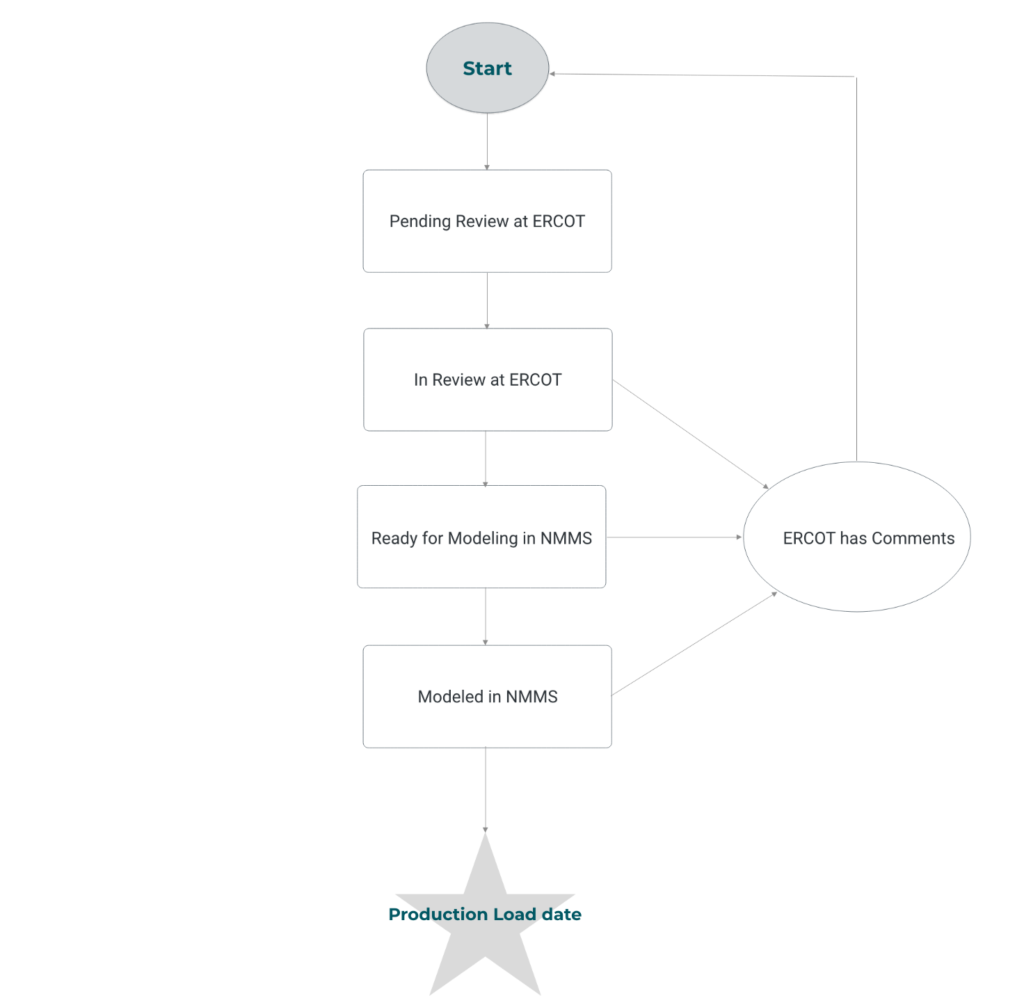
RIOO-RS Basic Flow of a Change Request

Slide 4
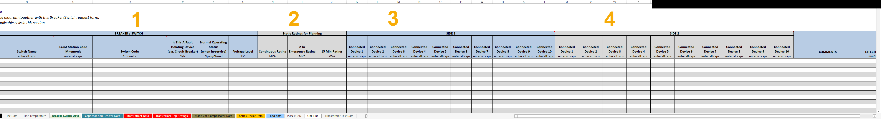
Transmission.xls Breaker Switch Data

Slide 5
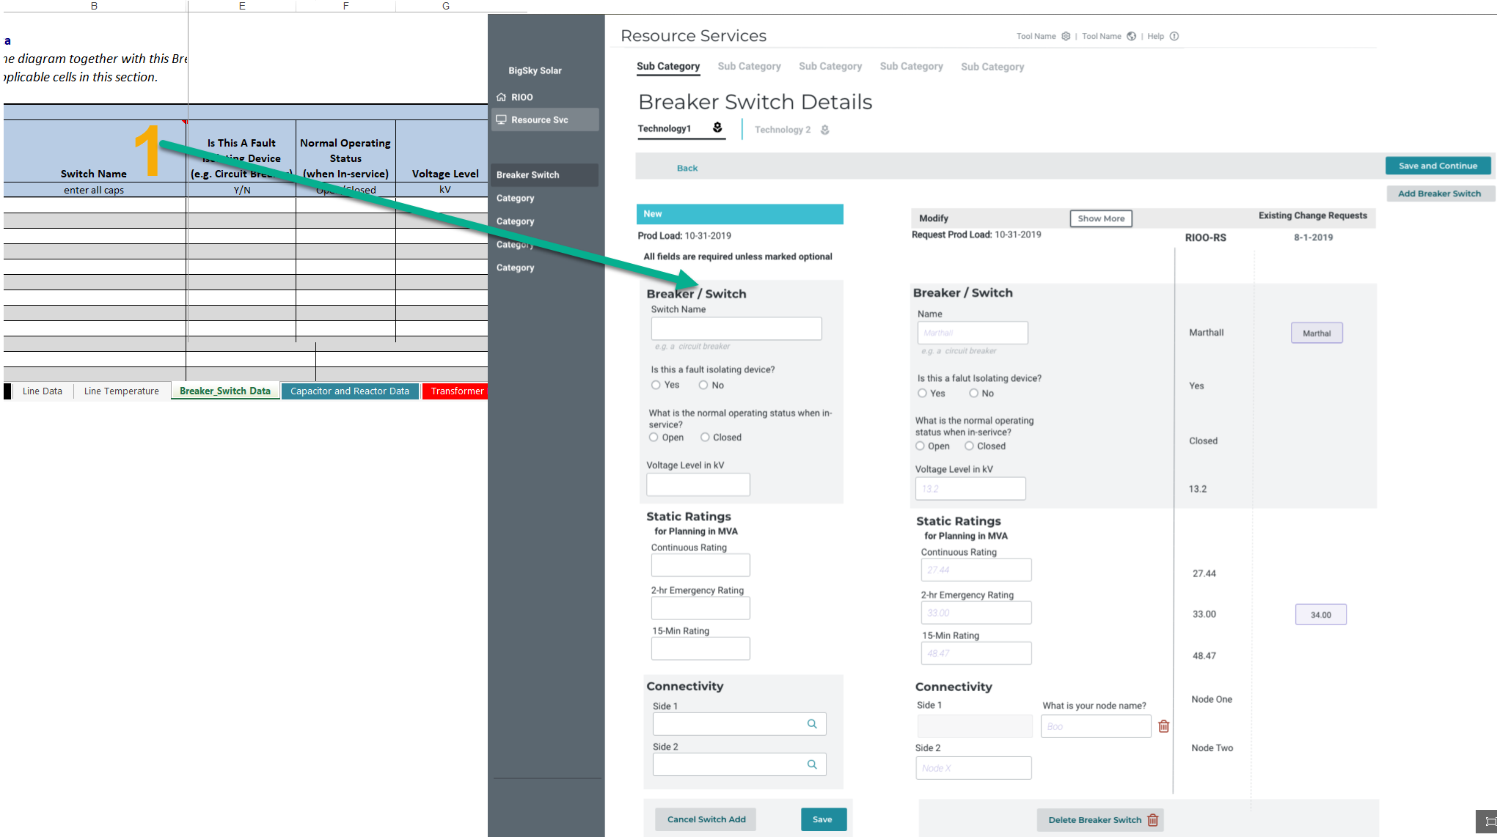
1.Breaker / Switch

Slide 6
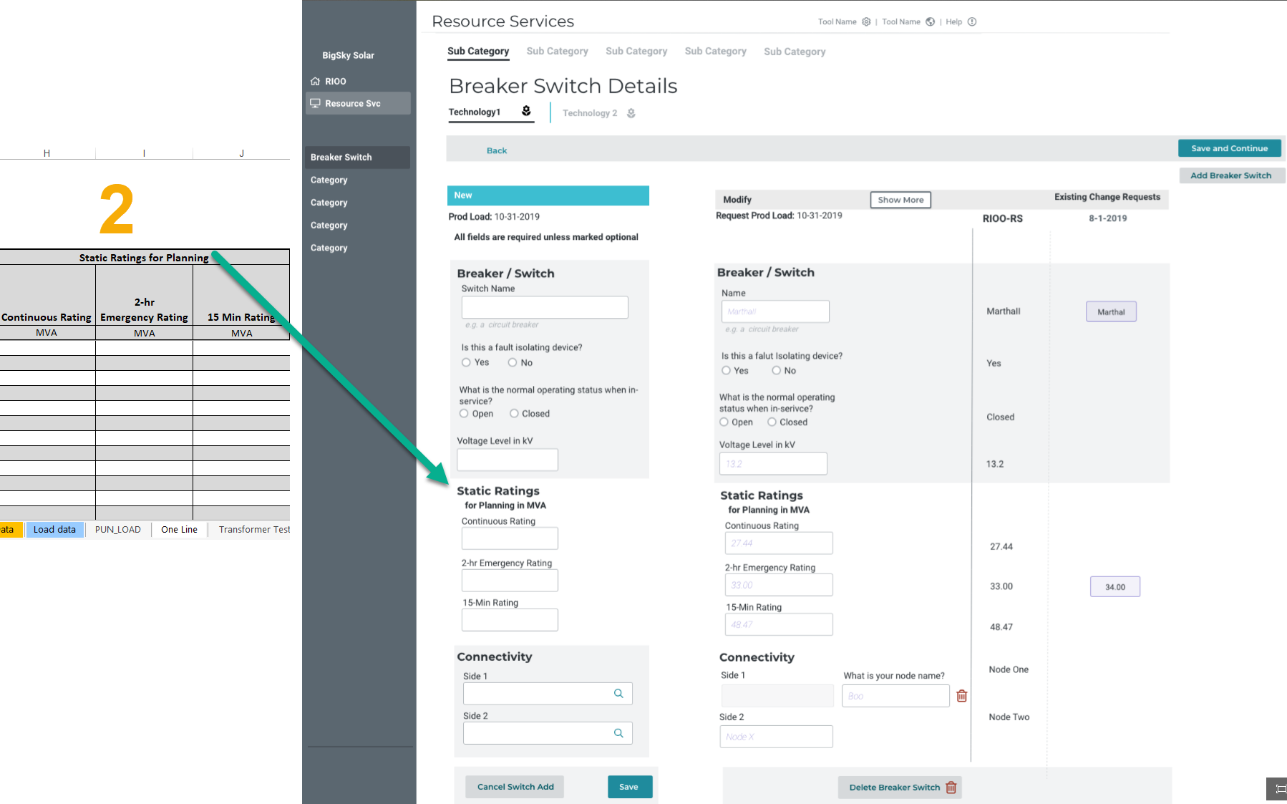
Static Ratings for Planning

Slide 7
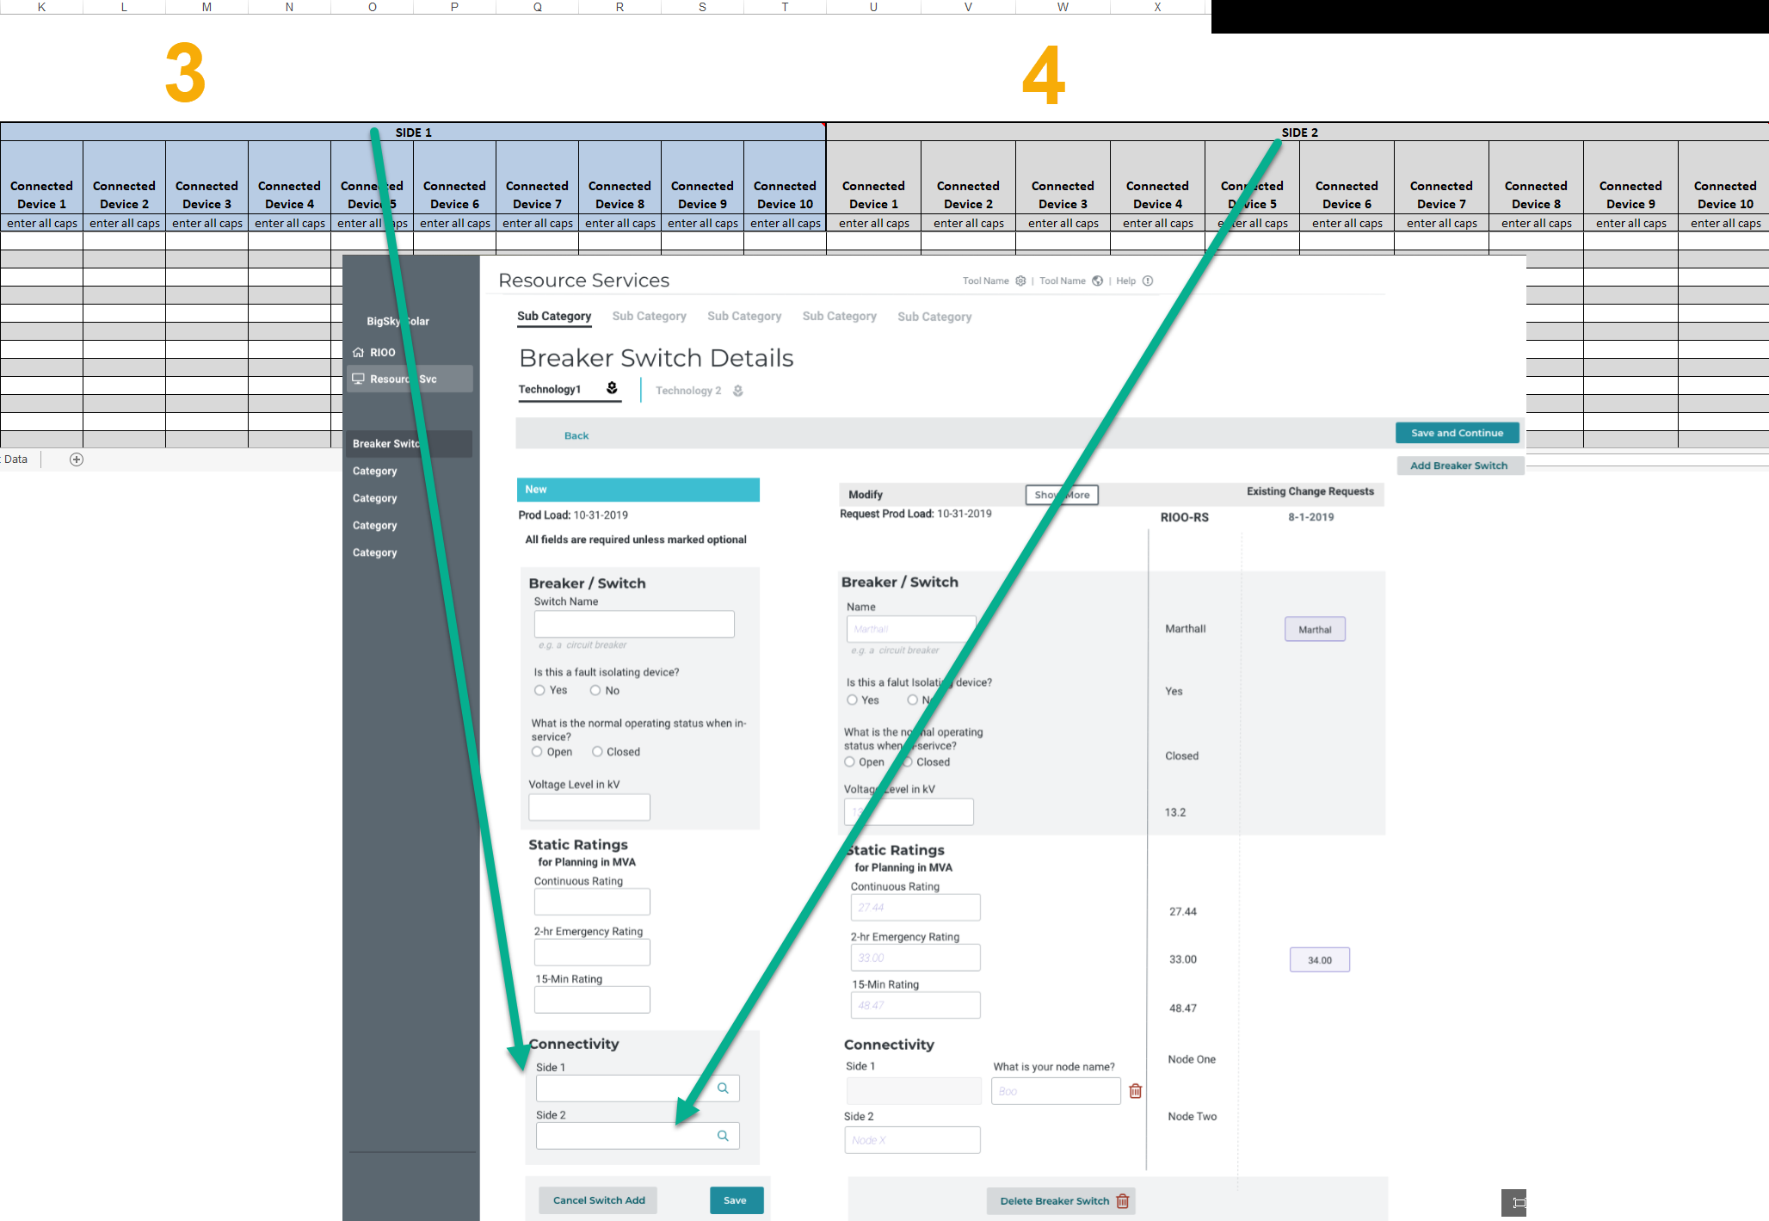
Side 1 – Side 2 Connectivity

Slide 8
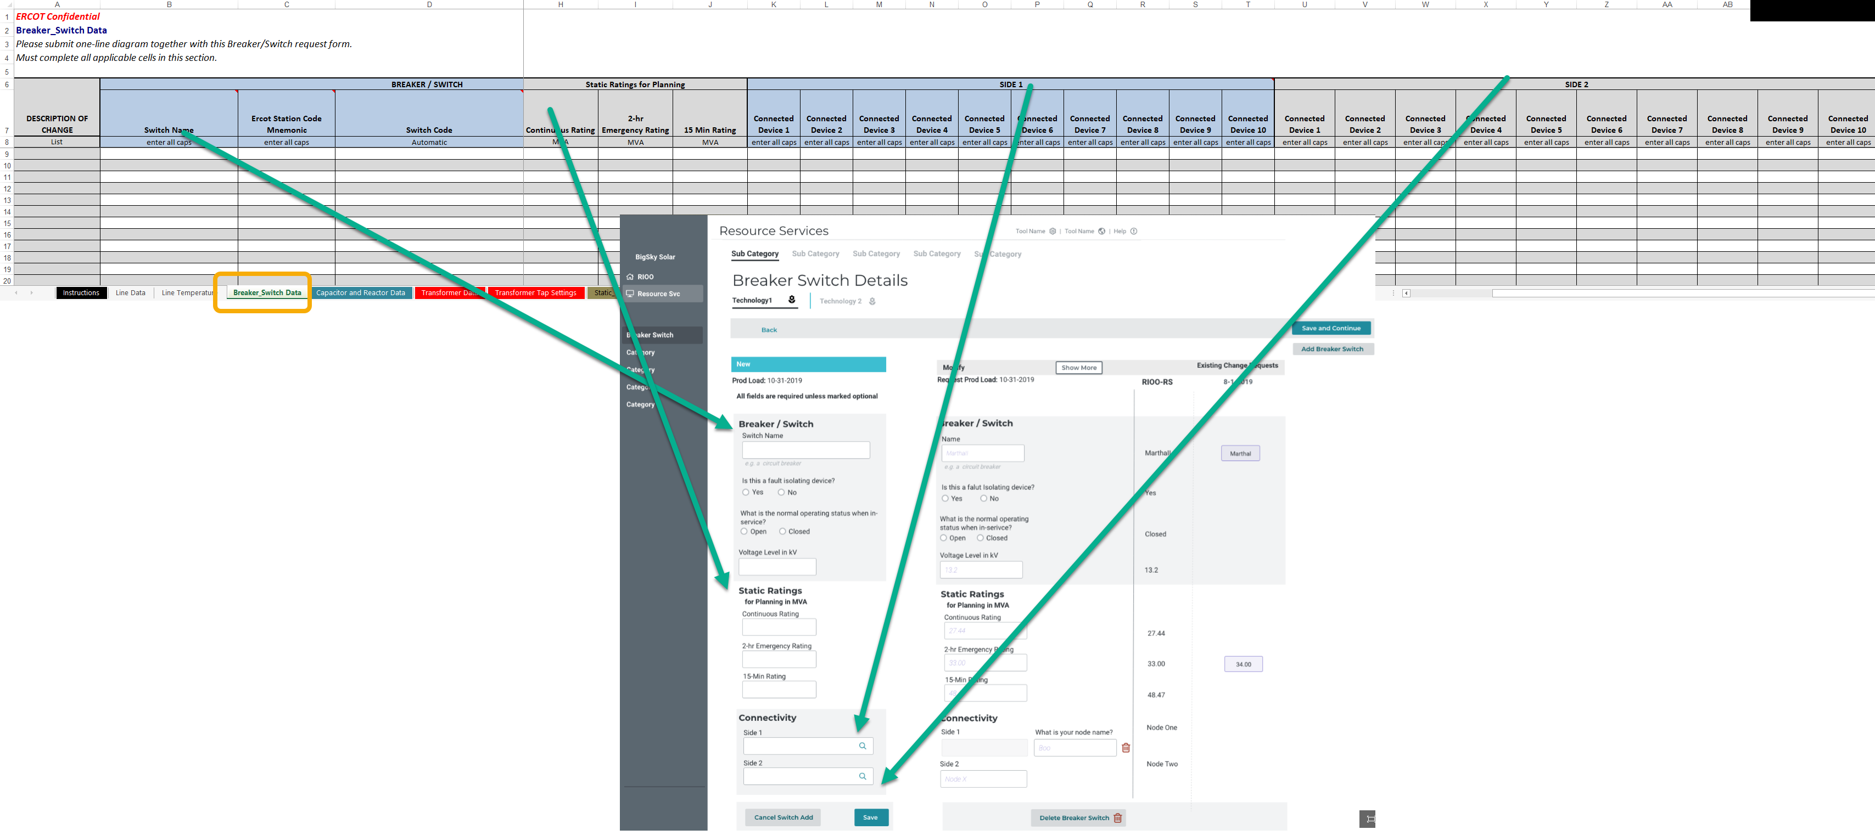
Breaker Tab Map to new RIOO-RS

Slide 9
Questions?

Slide 10
Mapping Document
What got moved where in RIOO-RS – a spreadsheet
  One time effort for ERCOT
Glossary will be updated

Slide 11
Information/Data issues
What’s been found, what may need to be updated:
  Connectivity
  Data that does not match the updated validation rules; special characters (#, $, *)
ERCOT will provide an updated RARF, Delta Report, and Audit Report to the RE.
Connectivity
  130 of 212 received and processed
  82 missing
If the RE agrees with the updated RARF, the RE should submit the RARF to ERCOT.
If the RE does not agree with the changes, the RE should schedule a call with your Client Services Account Manager.
Audit Report may show errors if GIC data has not been submitted or validation rules have been updated.
Model may show that the RE owns equipment, an “ADD” was created, please verify ownership.
Sites may need to be split
  Less than 10 of these

Slide 12
Training / Testing Schedule
In person training in Taylor (T4) (no webex)
  Schedule will be announced in October
User access will need to be coordinated with MPs USA
RIOO-RS system will be available mid-December - March for training and testing
  Verify data
  Updates available for most frequently changed items first
  Data will be updated and over written with production data on a regular interval
RIOO-RS system will continue to be used January – March with more update capability

Slide 13
Questions?

